Slide 1
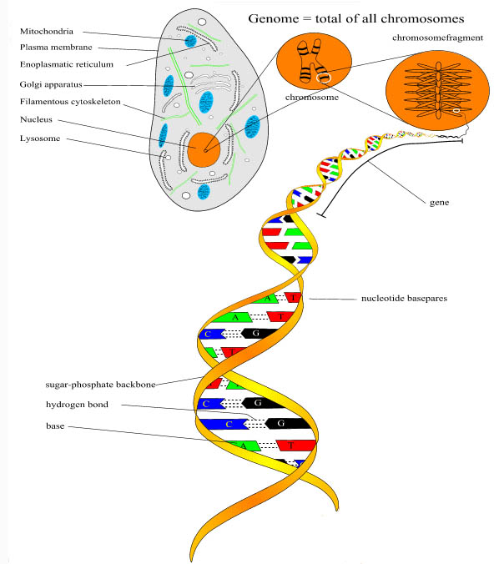
Nuclear DNA
DNA contains the complete
genetic information that
defines the structure and
function of an organism.
Nucleus contains most of the
DNA in a cell (nuclear DNA).
DNA is double helix with
nucleic acids (nucleotides)
forming cross braces.
Four types of nucleotides
in two classes:
Purines: Adenine (A),
Guanine (G)
Pyrimidines: Cytosine (C),
Thymine (T) (Uracil in RNA)

Slide 2
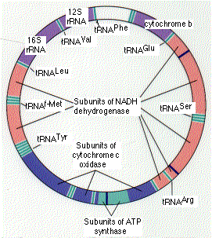
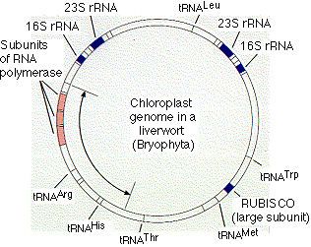
Cytoplasmic DNA
Other types of DNA found in cytoplasm.
Mitochondria, which play a role in
the oxidative degradation of nutrient
molecules, also contain DNA, called
mitochondrial DNA (mtDNA).
Eucariotic cells that are capable of
photosynthesis also contain
chloroplasts with chloroplast
DNA (cpDNA).
mtDNA and cpDNA double-stranded
and circular, like DNA of procaryotes.
http://users.rcn.com/jkimball.ma.ultranet/BiologyPages/

Slide 3
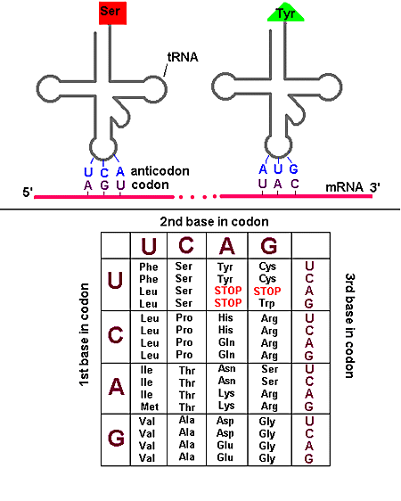
Genetic Code
Nucleotides form codons in
groups of three. Codons
code for amino acids, the
building blocks of proteins.
64 codons code for 20 amino
acids; built in redundancy
at first and third codon positions.
Changes in nucleotides at
these positions do not
change the amino acid.
Such changes are selectively
neutral or synonymous.
Substitutions that change the
amino acid are called
non-synonymous substitutions.

Slide 4
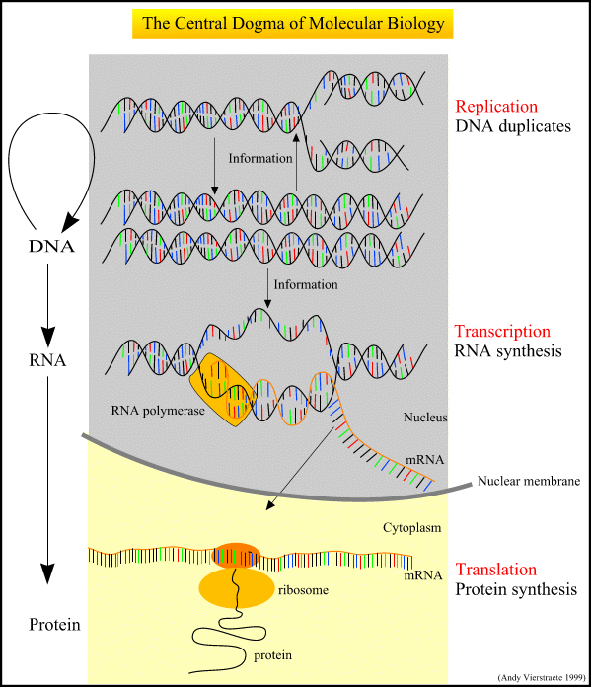
Molecular systematic
techniques use the same
basic mechanism the cell
uses to replicate DNA.

Slide 5
Polymerase Chain Reaction
Proteinase K is used to dissolve the cell and nuclear membranes, and dissociate
proteins from the DNA. After this step, phenol is added which to separate tissue
components into an aqueous phase with the DNA, which can be precipitated with
ethanol; a phenol phase with the dissolved proteins and fats; and an interface
with denatured proteins. Very small quantities of DNA needed.
Polymerase chain reaction (PCR) is a technique used to amplify a number of
copies of a specific gene for sequencing. In order to use PCR, one must already
know the exact sequences of DNA flanking either side of a given region of interest.
First step in PCR is to synthesize "primers" representing about 20 nucleotides of
known sequence flanking either side of gene of interest on both strands of DNA.
TTAACGGGGCCCTTTAAA........TTTAAACCCGGGTTT
AATTGCCCCGGGAAATTT.......................>
and:
<.....................................................TTTAAACCCGGGTTT
AATTGCCCCGGGAAATTT........AAATTTGGGCCCAAA

Slide 6
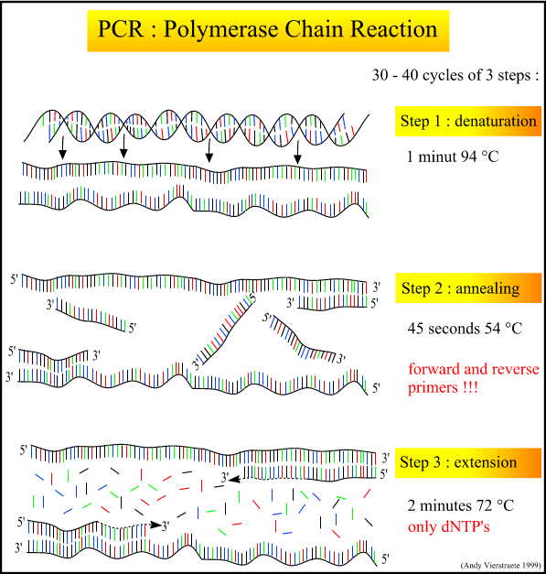
Three steps to PCR:
Denaturation
heat, separate
DNA
Annealing
Cool, add
primers
Extension
Taq polymerase
adds dNTP’s to
3’ end of primers.
Cycle 30-40 times
End result is multiple
copies of gene of
interest

Slide 7
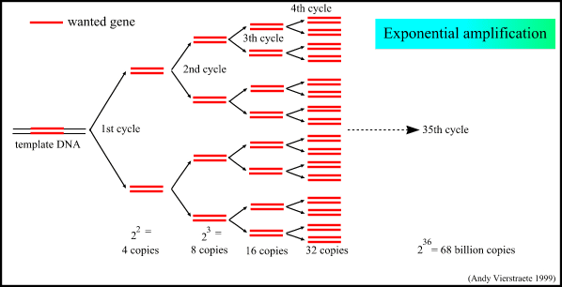
PCR Amplification
Exponential increase in number of copies of gene with each PCR cycle

Slide 8
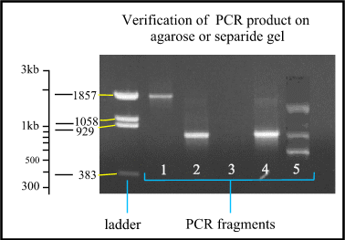
Check PCR Product
Run PCR product
out on gel to verify
that it is the right
size.

Slide 9
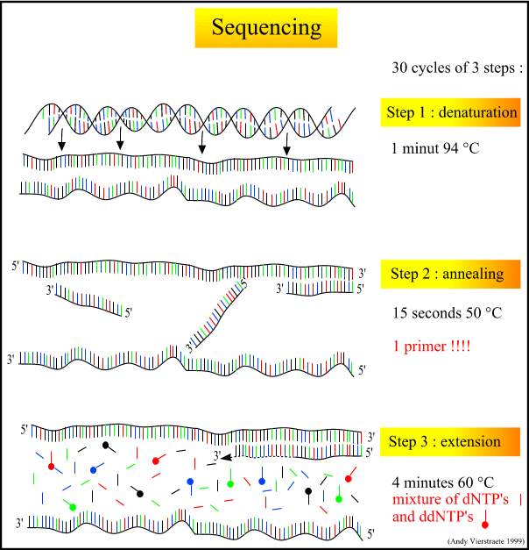
Three steps in PCR
sequencing reactions:
Denaturation
of double stranded
gene copies
Annealing
Cool, add primer for
only one strand
3. Extension
Add mixture of dNTP’s
and ddNTP’s (labeled);
sequence in only one
direction.
Cycle 30 times.

Slide 10
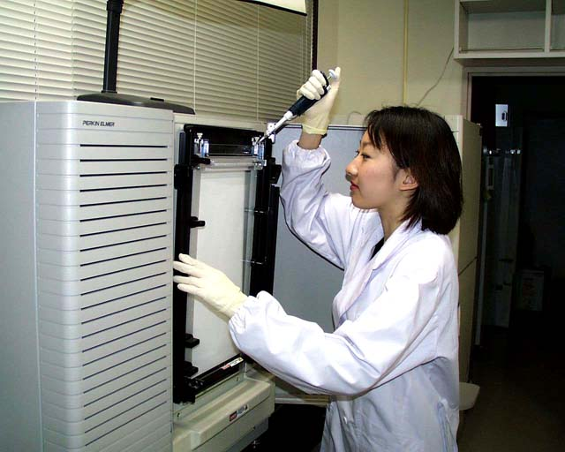
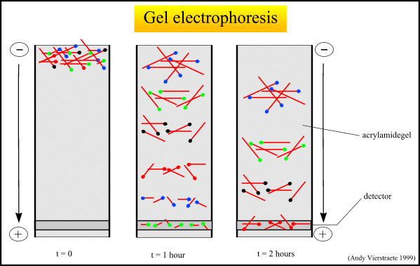
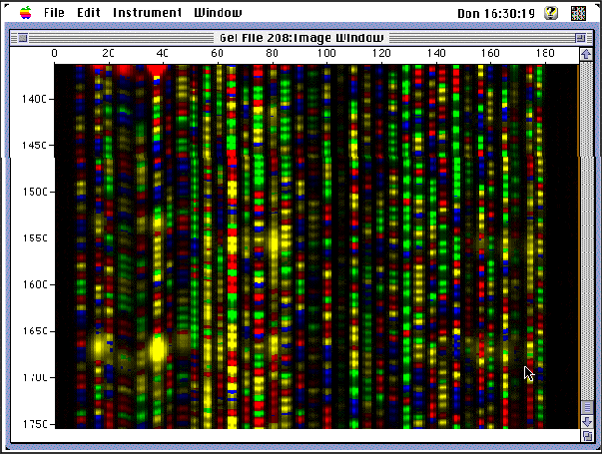
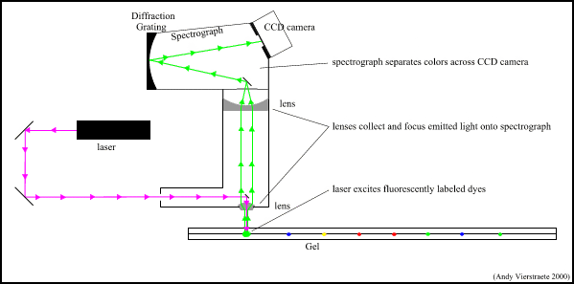
Automated Sequencing

Slide 11
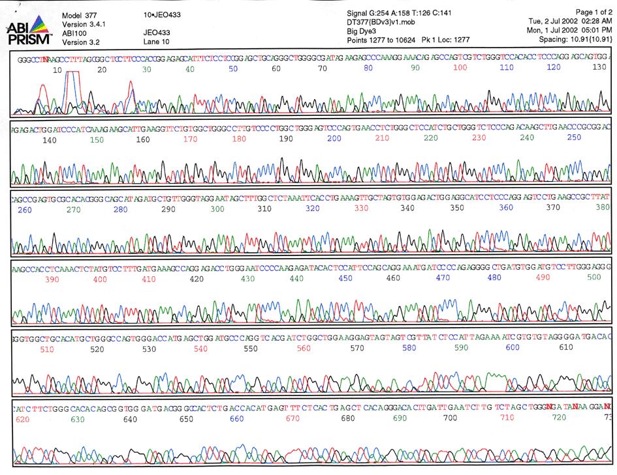

Slide 12
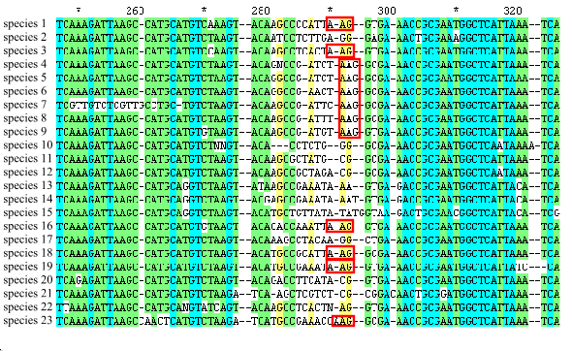
Sequence alignment
To compare two or more sequences, it is necessary to first align them and
identify locations of differences (insertions, deletions, substitutions).
Variety of computer programs available for aligning sequence (and can align by
eye). Customary to ignore poorly aligned areas.

Slide 13
Nucleotide substitutions
Substitutions are of two types: transitions (purine-purine, pyrimidine-pyrimidine)
and transversions (purine-pyrimidine). Because bases on opposite strands of
DNA typically match, transitions occur more frequently than transversions
(substitution bias).
By one theory (neutral theory), synonymous substitutions assumed to occur at
constant rate such that accumulation is clock like: the more substitutions, the
longer taxa have been diverging.
Similarities in sequence assumed to be homologous (i.e., similarity due to
common ancestry). With just four possible nucleotides, over time substitution can
change nucleotide at a particular position back to ancestral state (analogous
similarity or homoplasy).
Sequences become saturated with changes as a function of evolutionary time;
distance can be adjusted (corrected) to account for this.

Slide 14
Distance methods
Differences in sequence among taxa can be viewed simply as pairwise
divergence in a distance matrix (genetic distance).
A dendrogram can be calculated from the matrix with clustering algorithms:
UPGMA clustering (Unweighted Pair Group Method using Arithmetic averages)
Neighbor Joining : which corrects UPGMA method for its assumption that
the rate of evolution is the same in all taxa.

Slide 15
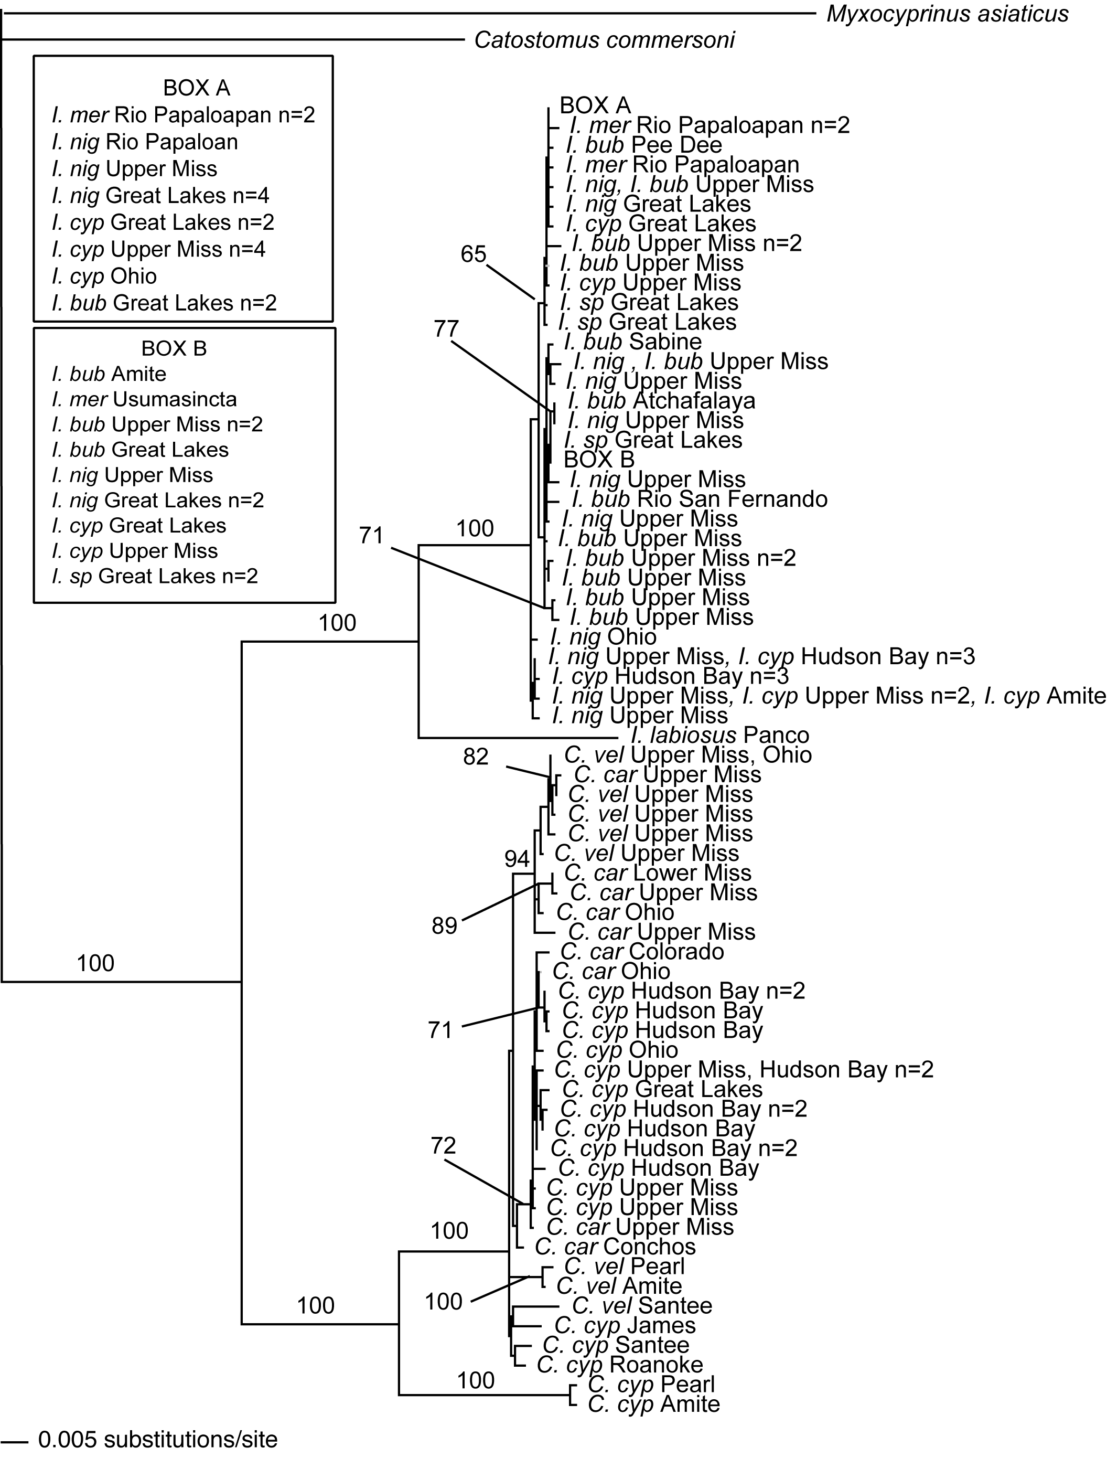
Ictiobus
Carpiodes
Tamura-Nei
Distance

Slide 16
Phylogenetic methods
Phylogenetic methods derive trees by considering the various pathways
evolution could take to produce a set of sequence data.
They are based on parsimony or likelihood methods. The resulting tree is
called a cladogram.
Parsimony method evaluated all possible trees for each position in the
alignment. Trees are given scores based on the number of evolutionary
changes needed to produce the observed sequence changes. The most
parsimonious tree is the one requiring the fewest evolutionary changes to
derive all sequences from a common ancestor.
Likeihood method also uses each position in an alignment, evaluates all
possible trees, and calculates the likelihood for each tree using an explicit
model of evolution (not necessarily the most parsimonious). The likelihoods
for each aligned position are then multiplied to provide a likelihood for each
tree. The tree with the maximum likelihood is the most probable tree.

Slide 17
Models of Molecular Evolution
Nucleic Acid Models
Jukes-Cantor
Kimura
Felsenstein
Hasegawa
Amino Acid Models
Codon
Dayhoff
Henikoff & Henikoff
Advanced Models
Combined Models
Heterogeneous Rates
Structural Biology

Slide 18
Phylogenetic Trees
One to many phylogenetic trees can result from
phylogenetic analysis of molecular data (as many trees
as characters).
Can produce a consensus tree, or have to decide which
topology has most support (branch support methods).
Also problems of congruence among different kinds of data
(molecular or otherwise)…could perform a total evidence
analysis i.e. combine all data into a single matrix.

Slide 19
Incongruence of trees based on different types of data
Morphology
Isozymes
nrDNA
cpDNA
A
A
A
A
B
B
B
B
E
C
C
E
D
D
D
D
C
E
E
C
15 chars
CI = 0.45
RI = 0.69
20 chars
CI = 0.38
RI = 0.60
79 chars
CI = 0.40
RI = 0.55
42 chars
CI = 0.69
RI = 0.78

Slide 20
Some common tree support measures
Congruence of ”independent” data sets
Bremer support
  Parsimony framework
Resampling methods (bootstrap, jackknife)
  Any method applicable to discrete data
Monte Carlo methods
  model-based methods

Slide 21
Bremer Support (decay index)
Number of steps it would take to collapse the group
Can’t be larger than the branch length (character support)
No direct connection to branch length otherwise
Quantification of support in a parsimony framework
Haliperp HPE232926
6
Arabaren AAU43231
10
13
Arabsuec ASU43227
13
Arabthal ATU43224
1
Arabsuec ASU43226
2
Arabthal ATH232900
15
Capsrube CRU232912
26
Capsrube CRU232913

Slide 22
Resampling Methods
Statistical methods for resampling data and inferring an unknown error distribution
Draw a random subset (’pseudoreplicate’) of data (characters) many times
Infer the distribution from all these random subsets
Assumes data set is large enough to accurately reflect the true error distribution
The data at hand are identically and independently distributed (i.i.d.). In other words: sampled at random.
Assumptions violated for most (if not all) data sets used in phylogenetics.

Slide 23
Jackknife
Random sampling of original data without replacement
Proportion drawn affects result

Slide 24
Bootstrap
Random samples of original data with replacement until one gets a data size as large as the original.
  sensitive to the number of characters in the matrix. When n->∞ jackknife-delete-1/e and the bootstrap coincide, but only when there are no conflicts in data

Slide 25
Resampling statistics in phylogenetics
”…provides us with a confidence interval…[of] the phylogeny that would be estimated on repeated sampling of many characters from the underlying pool of characters” (Felsenstein 1985)
True? We don’t know. The exact statistical interpretation remains unclear.

Slide 26
Computation
For large data sets (many taxa) exact solutions for any method employing an optimality criterion (parsimony, likelihood, minimum evolution) are not possible
Errors due to false solutions adds to the random error and increases uncertainty about the interpretation of resampling frequencies, but…..

Slide 27
Thoroughness of tree searches
”...no branch-swapping is required for finding well-supported groups, and jackknifing eliminates poorly supported groups” (Farris et al. 1996)...

Slide 28
Resampling statistics:
Cautionary remarks
can be employed with any tree-building method
give reasonable measures of support
jackknife and bootstrap give different, but similar results
the exact probabilistic meaning of resampling frequencies is unknown
error introduced by heuristic tree searches is largely unexplored

Slide 29
Monte Carlo methods
Simulation from a theoretical model
  Parametric bootstrapping
  Bayesian phylogenetic inference

Slide 30
Parametric bootstrapping
Repeated simulations of a phylogeny using a particular evolutionary model
  evaluation of specific, competing hyptheses: ”Is tree A significantly better than tree B?”
  examining potential sources of errors, i.e. recombination and long branch attractions
  conduct power analyses, i.e. how much data is needed to resolve a given tree?

Slide 31
Bayesian phylogenetic inference
Prior beliefs are incorporated in probability calculations
No attempts are made to find the ”best” tree
The parameter space (e.g. tree topologies) is investigated using Markov Chain Monte Carlo (MCMC) algorithms

Slide 32
Bayesian phylogenetic inference
The frequency with which a given clade is encountered in the MCMC iterations approaches its posterior probability!
Computable for large data sets
Results vary according to the prior beliefs (i.e. the evolutionary model)

Slide 33
Internet Sources
Internet sites I used to put together this
presentation (please acknowledge them if you
decide to use any of this):
http://allserv.rug.ac.be/~avierstr/index.html
http://morphbank.ebc.uu.se/systbio/Literature/
supportslides/support.ppt
http://people.ku.edu/~jbrown/pcr.html
http://www.bioinf.org/molsys/lectures.html
http://www.may.ie/academic/biology/james/

