Slide 1
Habitat Complexity and Biotic Diversity
Ti Boshart
Stuart Carlton
Cary Weiner

Slide 2
Introduction
Biodiversity
  ecosystem health
  effect of anthropogenic activities
Relationship between habitat complexity and fish and invertebrate diversity

Slide 3
Methods
Reach Measured
  70m continuous
    Talisheek
    Natalbany
    South Fork of the Caddo
    Mountain Fork
  Three 25m stretches
    Caney Creek

Slide 4
Biotic Diversity
  Collection
  Identification
Habitat Complexity
  Depth (cm)
  Current (m/s)
  Substrate

Slide 5
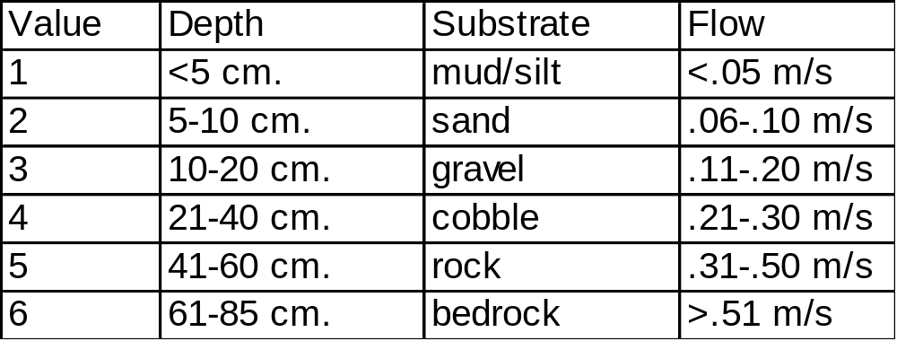
Statistical Analysis
  Richness
  Abundance
  Shannon index: H= sum(P_{i}(ln P_{i}))
    habitat
    biota

Slide 6
    Graphical Analysis
      diversity, richness, sampling design
      bar graphs, line graphs
      regression

Slide 7
Results
Biotic diversity compared to habitat complexity
Biotic richness compared to habitat richness
Effect of sampling design on diversity

Slide 8
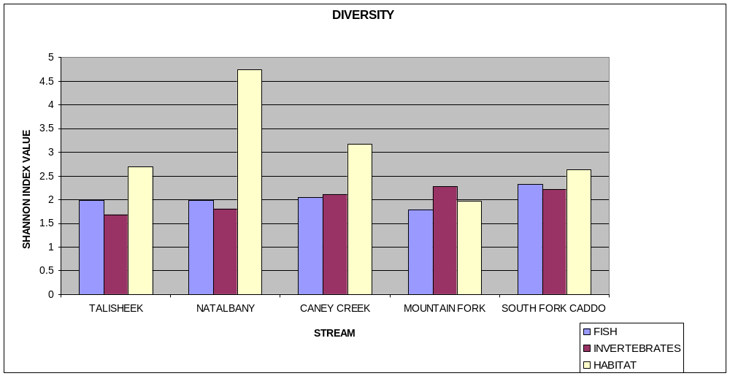
Biotic Diversity Compared to Habitat Diversity
  Biotic diversity and habitat diversity for each stream
      Fish and invertebrate diversity fairly consistent
      Habitat diversity more variable

Slide 9
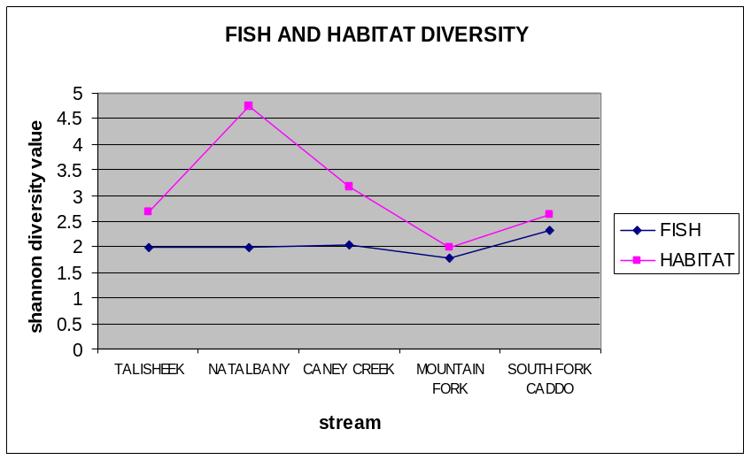
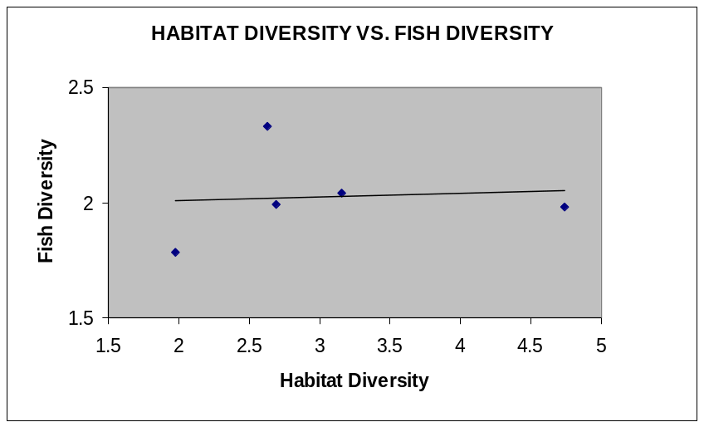
Biotic Diversity Compared to Habitat Diversity
  Fish and habitat diversity compared
No significant correlation

Slide 10
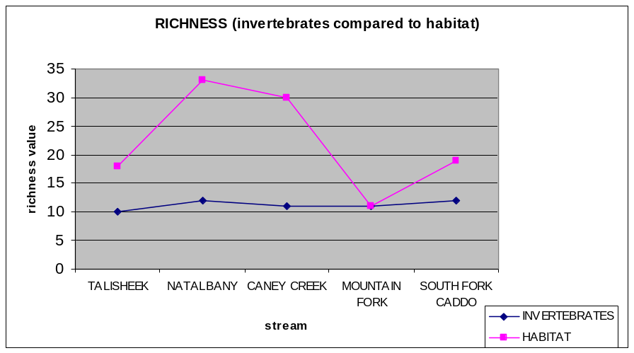
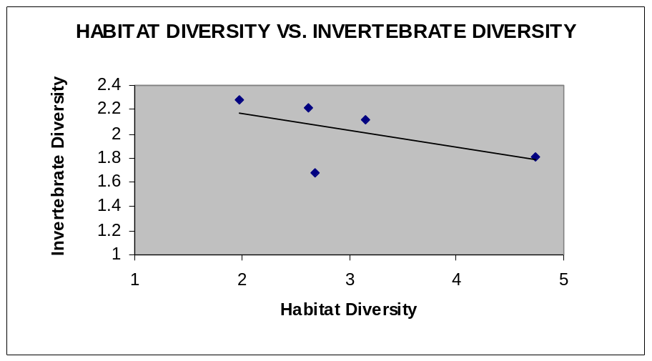
Biotic Diversity Compared to Habitat Diversity
  Invertebrate and habitat diversity compared
Significant negative correlation
Suspicious correlation

Slide 11
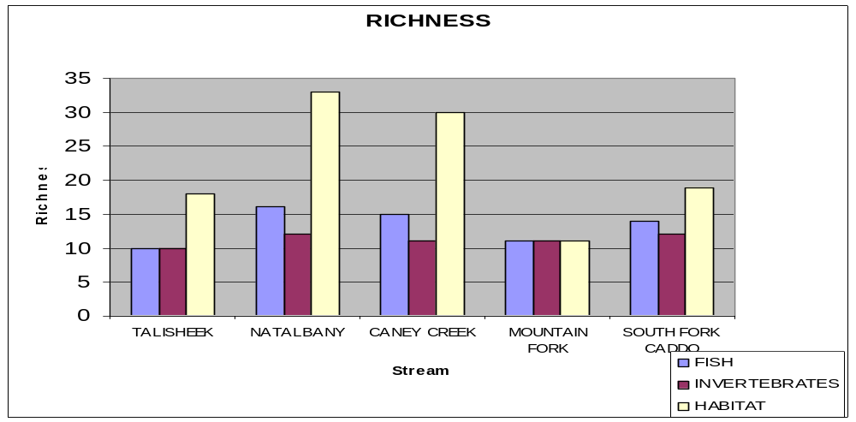
Biotic Richness Compared to Habitat Richness
Biotic richness and habitat richness for each stream
Richness versus diversity
Minor fish richness variability present
Invertebrate richness constant
Habitat richness variable

Slide 12
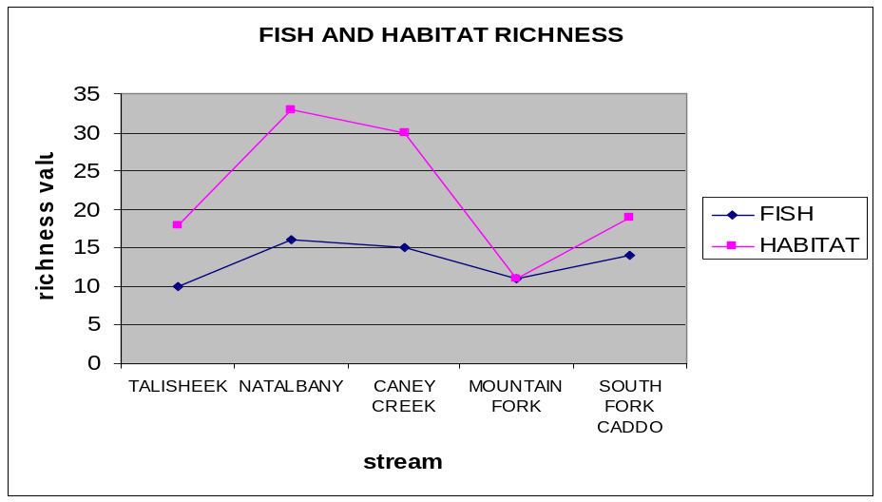
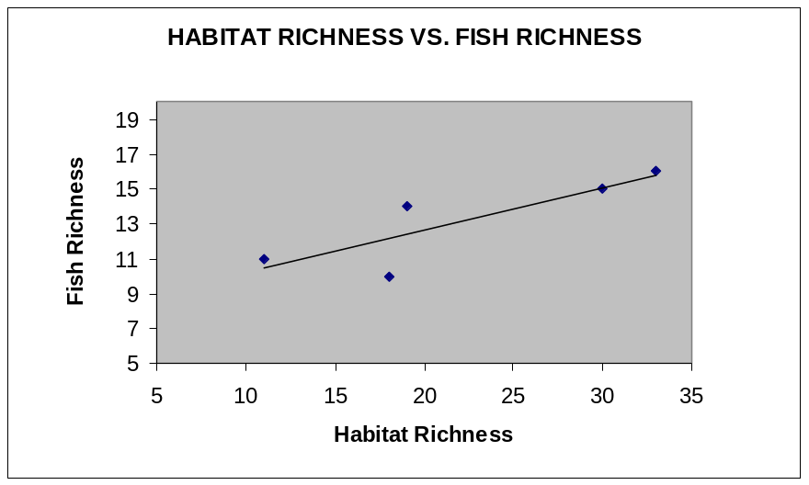
Fish and habitat richness compared
Fish richness significantly correlated with habitat richness

Slide 13

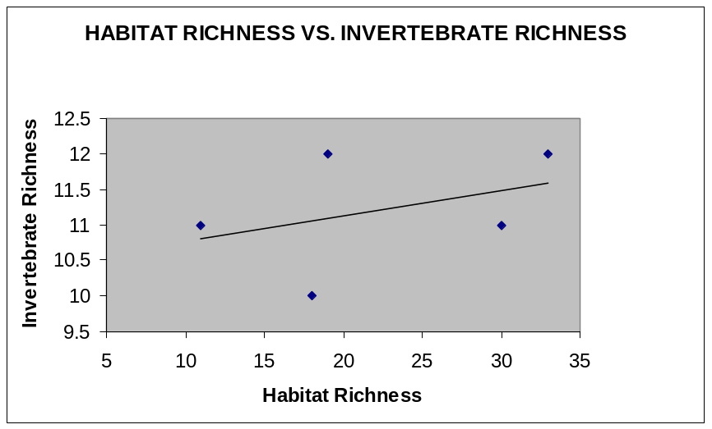
Invertebrate and habitat richness compared
No significant correlation

Slide 14
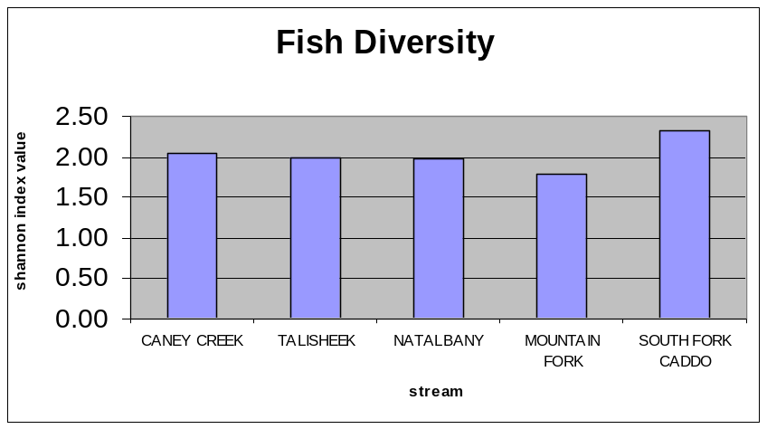
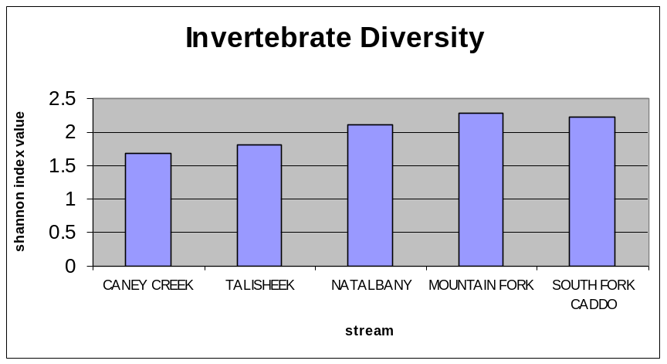
Effect of Sampling Design on Biotic Diversity
No obvious correlation between sampling design and fish diversity
Possible correlation with invertebrate diversity

Slide 15
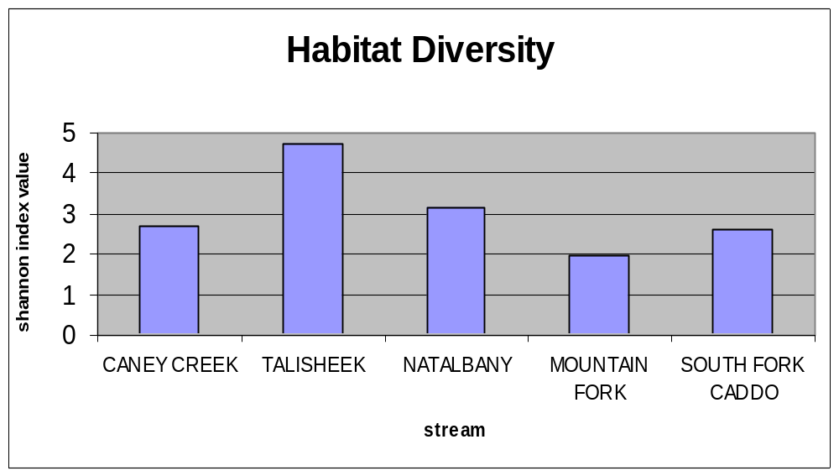
Effect of Sampling Design on Habitat Diversity
No obvious correlation between sampling design and habitat diversity

Slide 16
Conclusions
According to data, biotic diversity is not correlated with habitat complexity
  Parameters of habitat complexity measured
  Local versus regional analysis of diversity
  Evenness factor
  Sampling error
The effect of sampling design on diversity values was inconclusive
Suggestions for further study

Slide 17
