Slide 1

Indices of Biotic Integrity
By Aaron, Lauren, and Alysia

Slide 2
Introduction

Slide 3
Definitions
IBI--Assessment system used to evaluate the quality of an aquatic community structure
%EPT--Ephemeroptera, Plecoptera, and Tricoptera ratio of all sampled Macros.

Slide 4
IBI
Advantages
takes into account different aspects of the biotic community
chemical monitoring systems miss many anthropogenic disturbances, such as: flow alteration, habitat degradation, etc.
impossible to take into account all factors that influence biotic integrity
takes into account changes over time
measures short-term events that may effect biotic integrity, such as flooding or short lived events that may be seasonal or manmade
Disadvantages
limited regional use of IBI
proportions of different fish can be affected by seasonality, food supply, etc.
sampling techniques vary, samples obtained dependent upon techniques utilized
areas of streams may be more conducive to certain sampling techniques than other areas

Slide 5
% EPT
Advantages
easy to calculate
based on order, so chances of identification error is greatly reduced
utilizes three orders of insects that are universal indicators of good biotic integrity
Disadvantages
percentage of Macroinvertebrates is seasonally affected
macro numbers also affected by stream flow
macros numbers affected by sampling technique

Slide 6
Methods/Study Sites

Slide 7
Natalbany River (love bugs)
A fourth Order tributary in the Maurepas/Pontchartrain Basin.
Dominant substrate is sand with gravel and silt interspersed.
Deciduous vegetation, partially cleared. Some in stream vegetation.
Moderate Flow: samples taken during late summer low flows.

Slide 8
Talisheek Creek
A second order tributary of the Pearl River in St Tammany Parish LA.
Substrate dominated by sand and gravel. A large amount of large woody debris, and CPOM were present.
Heavily wooded area, predominantly Longleaf Pine.
Moderate flow

Slide 9
Caney Creek
Third Order stream in the Ouchita River Basin Montgomery County AK.
Substrate composed primarily of cobbles.
Vegetation dominated by scrubby bushes and grasses.
High flow due to significant rain event.

Slide 10
South Fork Caddo River
Third order in the Ouchita River Basin in Polk County AK.
Substrate dominated by sand, gravel, boulder.
Streamside vegetation predominantly deciduous forests.
High Flow due to significant rain event.

Slide 11
Mtn. Fork of the Little River
Fourth order stream in the Red River Basin in AK.
Substrate dominated by bedrock and cobbles.
Streamside vegetation dominated by thin forest and grasses.
Extremely low flows, almost lentic.

Slide 12
Sampling Techniques

Slide 13
Specimen Collection
In the case of the Arkansas streams, sampling was performed on separate sections, this was superfluous because all the samples were pooled for IBI and EPT analyses
Fish were sampled using an electroshocker and sieve nets within netted off areas along the stream
Except in the case of South Fork Caddo, fish specimens were taken from the entire stream reach (s) being analyzed
Fish samples were placed in ethanol for preservation
Macroinvertebrates were sampled using dip nets and Surber techniques
The invertebrates were also placed in ethanol for preservation purposes

Slide 14
Specimen Identification
All samples were identified by different lab groups for every site
Organisms were keyed out usually from the level of a known order for macroinvertebrates and a known family for fish
Freshwater Fishes of Louisiana by Douglas (1974) was used to ID fish by the various groups
Ecology and Classification of North American Freshwater Invertebrates by Thorp and Covich (1991) and An Introduction to the Aquatic Insects of North America by Merritt and Cummins (1996) were used to ID macroinvertebrates by the each groups

Slide 15
Calculation of IBI
All analyses done following the techniques utilized by Karr et. al. (1986) for an Illinois stream
various metrics were selected based on organism sensitivity to human disturbance
Each metric is given a point value of 1, 3, or 5 depending on the actual number or overall percentage of the indicated organisms within the sample
The higher the tabulated IBI score, the more pristine the stream
This rating system is based on the species composition found in an undisturbed stream preferably in a similar habitat to the stream being analyzed

Slide 16
Significance of Metrics
Metric
Total number of fish species
# of darter species
# of sunfish species
#of sucker species
#of intolerant species
Significance
the more fish, the better the integrity
sensitive to degradation due to their specificity for reproducing and feeding in benthic habitats (siltation and oxygen content effected by disturbance)
effected by degradation of pool habitats and instream cover
intolerant to habitat and chemical degradation
pretty obvious, but too many species in this category it reduces the usefulness of IBI

Slide 17
Significance of Metrics (continued)
Metric
proportion of green sunfish
proportion of omnivores
proportion of insectivorous cyprinids
proportion of piscivores
#of individuals in sample
proportion of hybrids
proportion with disease,tumors, anomalies
Significance
green sunfish increase in abundance in degraded streams, they are very tolerant
because of their generalized diet, omnivores tend to increase in # in degraded streams
#s decrease with degradation due to variability in insect populations
higher #s indicate a healthy, trophically diverse community
the less individuals, the more degraded the site
degradation may alter reproductive isolation of species
any of these things is NOT a good sign

Slide 18
Calculation of %EPT
Percentage calculated from proportion of individuals from the orders Ephemeroptera, Plecoptera, and Trichoptera (Hauer 1996)
The higher the percentage, the better the integrity
Advantageous because identification does not have to be very precise
Disadvantageous because it does not take into account the other macroinvertebrates sampled

Slide 19
Analysis
Data analyzed using two methods.
First put data into existing IBI parameters for mid-western streams from Karr (1986).
Could not use the Louisiana streams in this analysis.

Slide 20
IBI for three AK streams.
South Fork Caddo*
Mt. Fork
Caney Cr.
# species
(14) 5
(11) 5
(15) 5
#individuals
(120) 3
(316) 5
(372) 5
#darter spp..
(3) 5
(1) 3
(2) 3
#sunfish spp..
(2) 5
(3) 5
(2) 5
#sucker spp..
(1) 3
(0) 1
(0) 1
#intolerant spp..
(3) 5
(1) 3
(1) 3
Omnivorous
(12-10%) 5
(0) 5
(0) 5
Insectivorous Cyprinids
(35-24%) 3
(161-51%) 5
(121-33%) 3
Green sunfish
(9-7.5%) 3
(29-9.1%) 3
(13-3.5%) 5
Piscivores
(1-1%) 3
(1-.30%) 1
(0) 1
Hybrids
(0) 5
(0) 5
(0) 5
Diseased
(0) 5
(0) 5
(0) 5
Notes:
* The sampling for South Fork Caddo was incomplete. Only ½-2/3 of the sample area was sampled from.Species composition was most likely accurate, however #’s of individuals would most likely be higher. Thus the IBI value may be significantly higher.

Slide 21
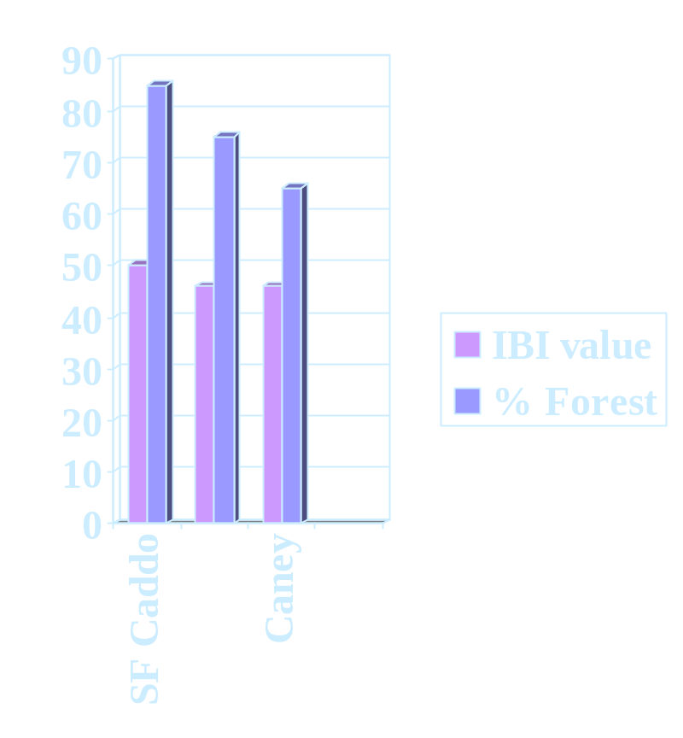
(Continued.)
Compared to estimated watershed forestation.
There seems to be a correlation between integrity and amount of human interference.
Does not take all streams into account.
Assumes that the IBI parameters for a third order Illinois Stream is applicable to there Arkansas streams.
We wanted a way to look at all of the streams.

Slide 22
Comparative Analysis
Compared the data and rated the five streams with respect to each other.
Each stream was ranked in value 1-5. Then tallied to get a final score which categorized the streams from most to least altered.
Proportion of Green Sunfish, # of diseased individuals, and # of hybrids were omitted.
Again, the results were compared to the proportion of the watershed forested, to estimate the effect of anthropogenic alterations on the watershed.

Slide 23
Comparative analysis of the five streams
Natalbany
Talisheek
SF Caddo
Mt. Fork
Caney
# species
(16) 5
(10) 1
(14) 3
(11) 2
(15) 4
#individuals
(411) 5
(173) 2
(120) 1
(316) 3
(372) 4
#darter spp.
(3) 5
(0) 1
(3) 5
(1) 2
(2) 3
#sunfish spp.
(4) 5
(4) 5
(2) 2
(3) 3
(2) 2
#sucker spp.
(0) 3
(2) 5
(1) 4
(0) 3
(0) 3
#intolerant spp.
(1) 3
(2) 4
(3) 5
(1) 3
(1) 3
%insectivorous Cyprinids
(58) 5
(13) 1
(29) 2
(51) 4
(33) 3
%omnivores
(0) 5
(0) 5
(10) 4
(0) 5
(0) 5
%Piscivores
(3) 5
(1) 4
(1) 4
(.3) 2
(0) 1
totals
41
28
30
27
28

Slide 24
Forest cover correlates to IBI value

Slide 25
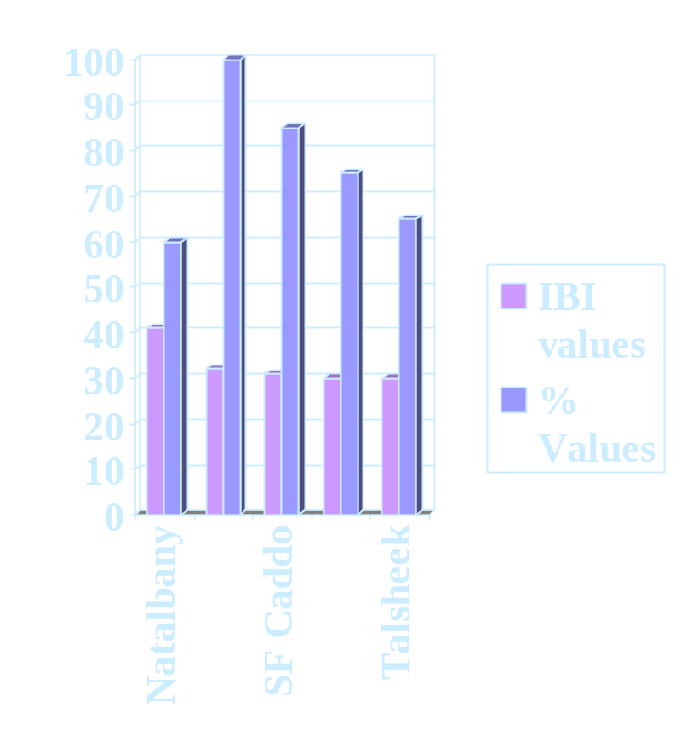
(Continued)
Excluding the Natalbany River there is a rough correlation between amount of deforestation and IBI ranking.
Whether the IBI differences are significant is unknown.
S. Fork Caddo IBI may be significantly higher due to incomplete sampling.

Slide 26
% EPT Values for All Streams

Slide 27
Discussion

Slide 28
Correlations between Forest Cover and IBI
With the exception of the Natalbany River, the % Forest Cover correlated with the IBI value calculated; the stream with the greatest amount of forest cover also had the highest IBI value.
A possible reason why the Natalbany River had the highest IBI value but the lowest forest cover is that it is a higher order stream and could have different community characteristics. Mountain Fork is also a 4th order stream, but it appeared to receive a high level of agricultural runoff. The land use for Natalbany is not known.

Slide 29
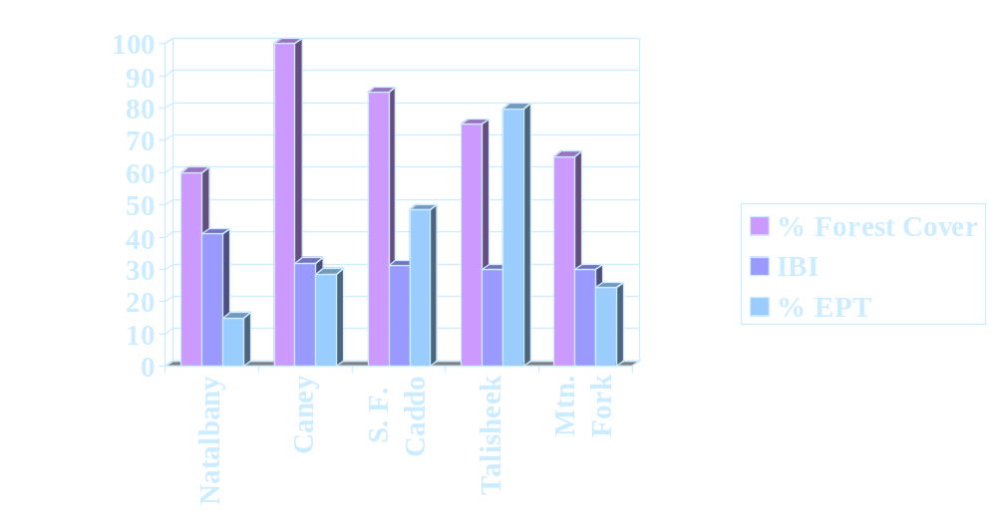
% Forest cover, IBI, and % EPT values for LA and AK streams

Slide 30
Why did IBI and %EPT give different results?
There were skewed results because it was easier to find Macroinvertebrates in LA than in AK
A large rain event took place after a long period of low flow which may have contributed to low macro populations
Some areas of streams were easier to sample from than others (e.g. depth of water, strength of current, etc.)
Different people sampling led to slight variations in methods used and what organisms were collected
Greater numbers of fish and macros collected at some streams than at others
There may not be a direct correlation between IBI and EPT

Slide 31
Problems with Forest Coverage
Land use within altered areas of the watershed is not known
Anthropogenic impacts could be different from one stream to another

Slide 32
Problems with IBI Method
Established IBI data does not include streams in Southern Louisiana.
Arkansas streams are on the regional fringe of the established IBI database used in our analysis
Cross regional comparisons may not be good because differences in late summer stress levels in AK differ from those in LA.

Slide 33
Problems with EPT Method
Sampling inconsistencies
Harder to locate in AK than in LA
Regional variations in communities
Identification error
Not really “macro season”

Slide 34
In general, streams may not be directly comparable
Distributions of fish and macroinverts can be affected by:
Higher/lower elevations
Seasonal differences
Watershed size
Severe weather events (e.g. flood, drought, etc.)

Slide 35
In Conclusion...
IBI seems to be a good way to evaluate the relative health of a stream. However, with a study of this size, we cannot draw any ultimate conclusions.
Our primary problems were sampling size and error and regional differences in communities.
More extensive study is recommended.

