Slide 1
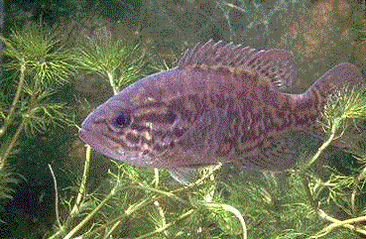
Temporal analysis of stream runoff patterns across the southern U.S. using long term stream flow records
Seth Willey & Donata Roome

Slide 2
Global Climate Change Predictions
And the impacts of increased Carbon Dioxide levels
Higher temperatures
Increased evaporation
More water in the atmosphere
More precipitation
Increased frequency of severe flood events

Slide 3
How have these predicted impacts been reflected in streams of the southeastern U.S.?
Is stream flow increasing?
Is it increasing predictably?
Are there monthly or seasonal trends?
Is there a higher frequency of extreme events (floods & droughts)?
Are floods and droughts becoming more extreme?
How might any or all of these impact stream biota?

Slide 4
Data Collection Methodology
Seven streams were selected from the southeastern U.S. Gulf Coast (between 30-32N & 91-87W) where at least 50 years of data was available.
Daily discharge was collected from United States Geologic Survey (USGS) for the years of 1988 to 1997.
Daily, monthly, and annual discharge was collected from the Hydro Climatic Data Network (HCDN) for the years of 1931 to 1987.
USGS data was broken down into monthly and annual discharge.
All data was then merged.

Slide 5
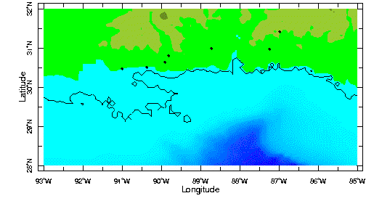
Gaging Stations of the Southeast, US
Murder
Pearl
Pascagoula
Escambia
Amite
Bogue Chitto
Tangipahoa

Slide 6
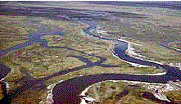
Runoff (c.f.s. / square miles)
was used to compare streams across the southeast because it takes into account relative basin sizes.

Slide 7
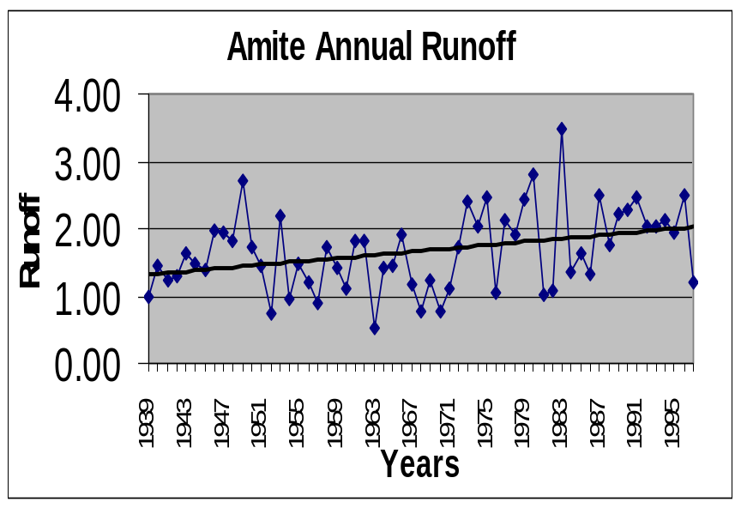
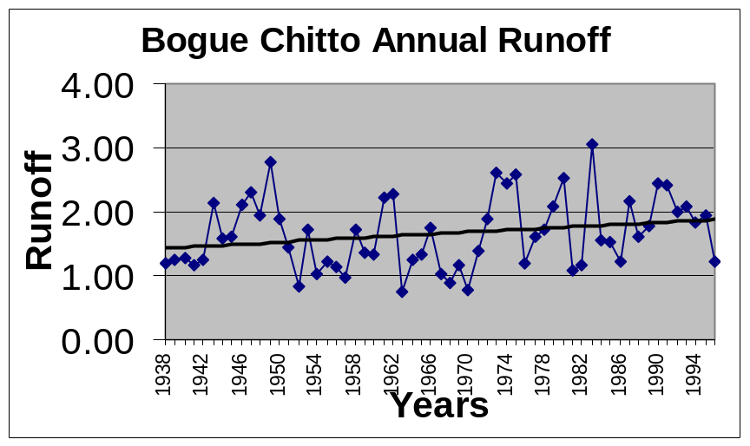
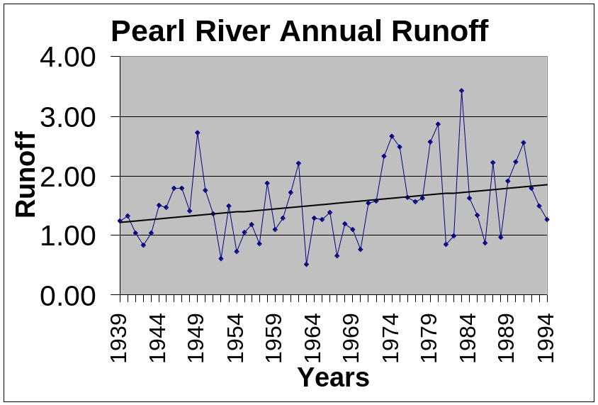
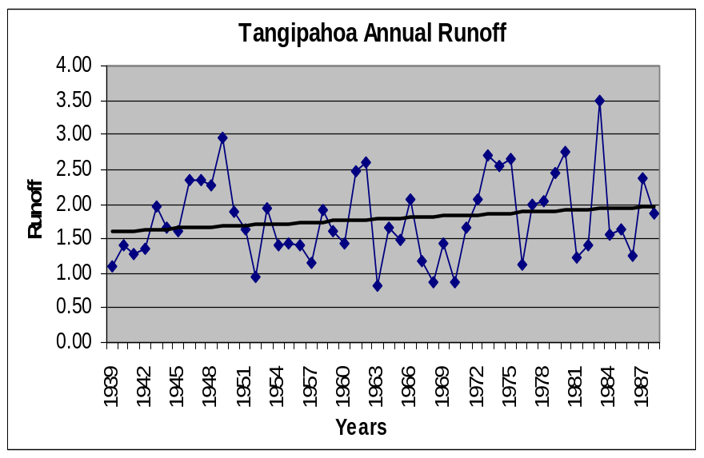

Slide 8
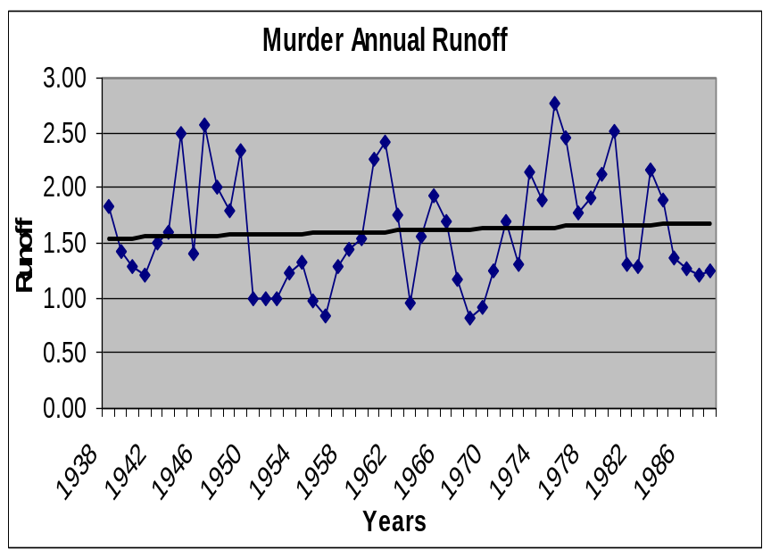
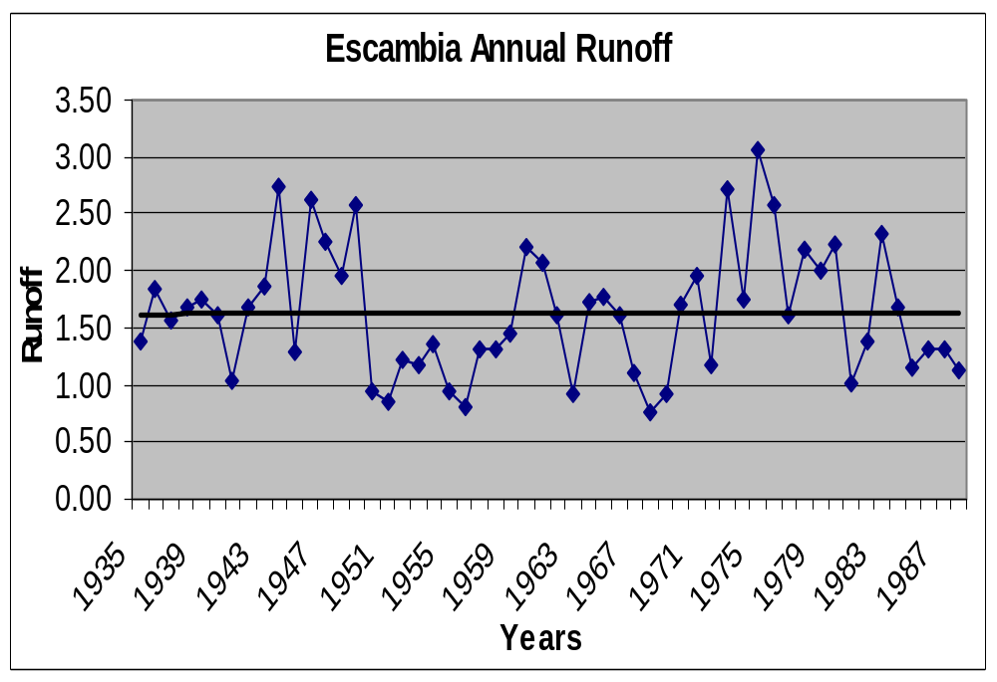
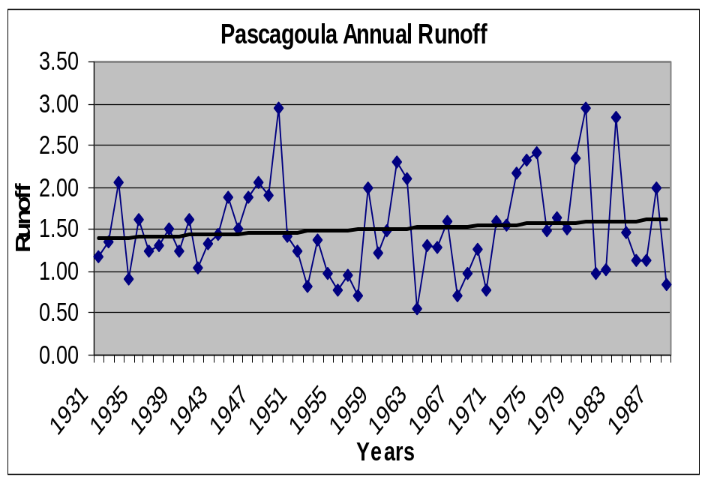

Slide 9
Effluent stream - fed by groundwater and less influenced by precipitation patterns than influent streams

Slide 10
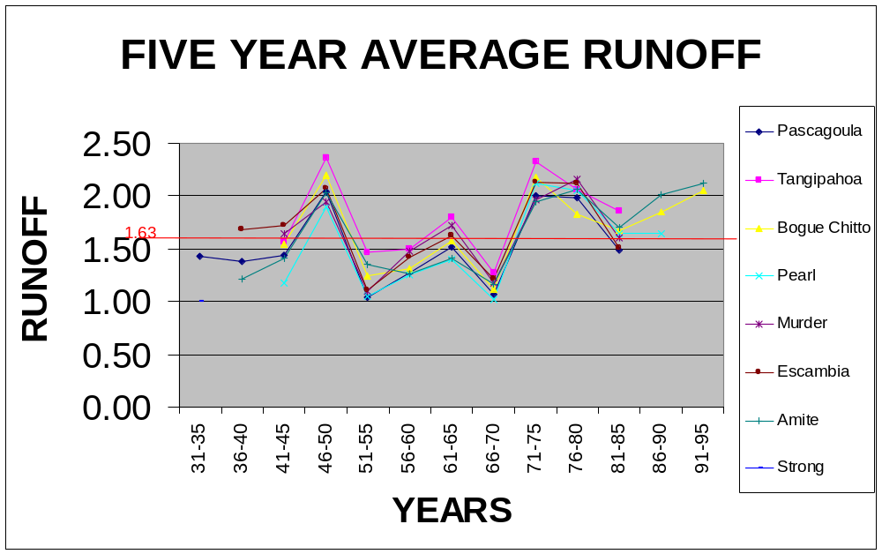

Slide 11
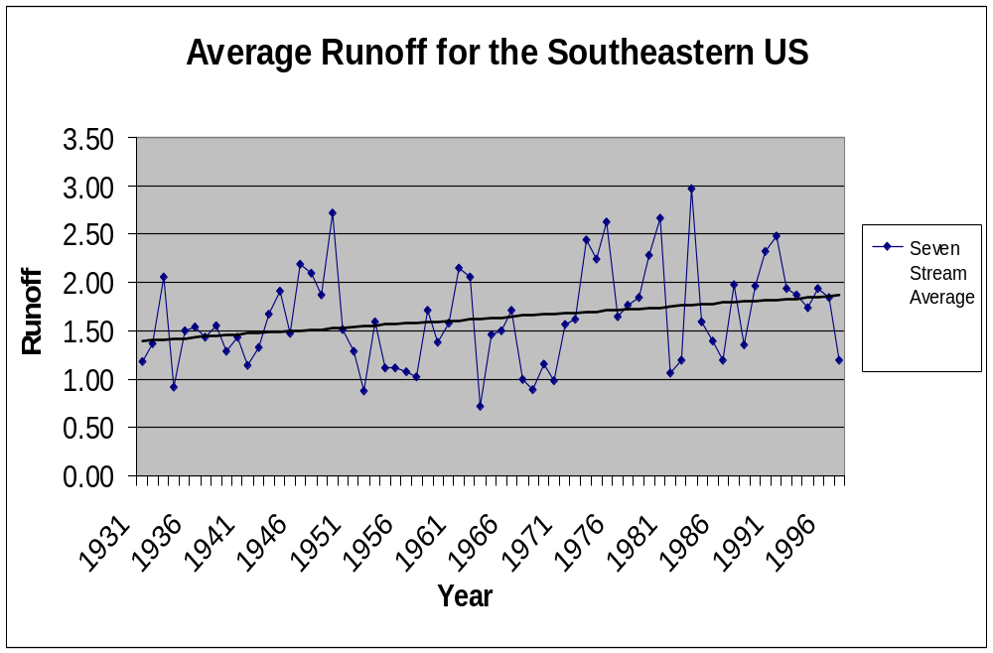

Slide 12
Physical factors and biological responses
Speed of current influences:
  size of substrate particles
  delivery and removal of nutrients
  physical force
  distance of drift
  morphological adaptations
    slow flow: lateral flattening (sunfish)
    fast flow: stream-lined, rounded (minnow)

Slide 13

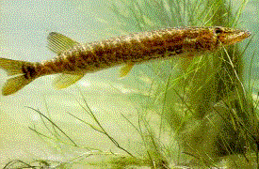
Depth:
  shallow: anterior dorsal fin acts as rudder (stone roller)
  mid-range: dorsal fin acts as rudder and stabilizer
deep: caudal dorsal fin acts as stabilizer (pickerel)

Slide 14
Case Studies
Vegetation: attached algae is most abundant in fast water with hard substrates, rooted vascular plants in slow water with soft substrates. (Allan 1995)
Caddisfly larvae: species are adapted to construct nets at specific current velocities. (Edington 1968)
Blacktail shiner: preferred spawning current speed varies across streams. Too low a flow risks eggs being covered by sediments and suffering reduced oxygen availability. Too high may prevent complete insemination, egg positioning, and adherence to substrate. (Baker, Killgore, and Foster 1994)

Slide 15
Monthly Discharge Patterns
The Amite and Bogue Chitto Rivers were selected for an analysis of monthly discharge patterns as representative of the southeast region.
Monthly stream discharge is illustrated through average runoff for the decades of 1940’s, 1950’s, 1960’s, 1970’s, 1980’s, and the 1990’s (up to 1997) for both rivers.
Monthly discharge patterns are illustrated through the following graphs...

Slide 16
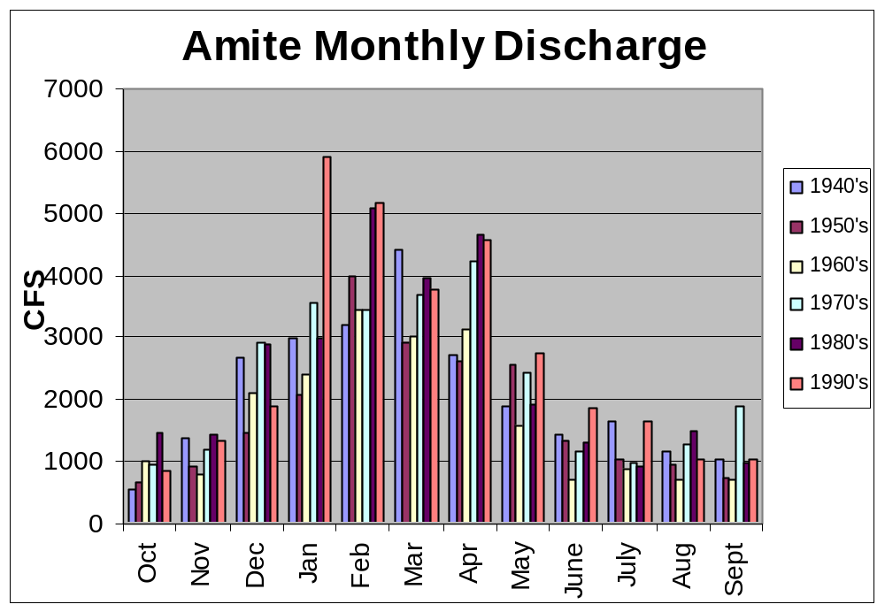

Slide 17
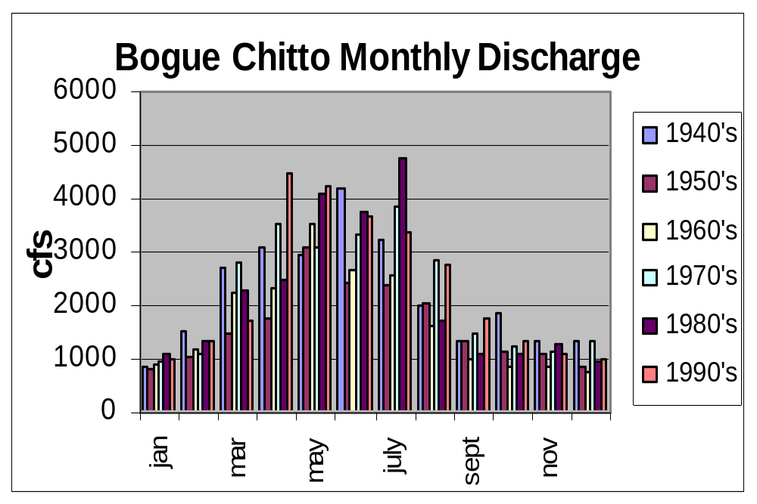

Slide 18
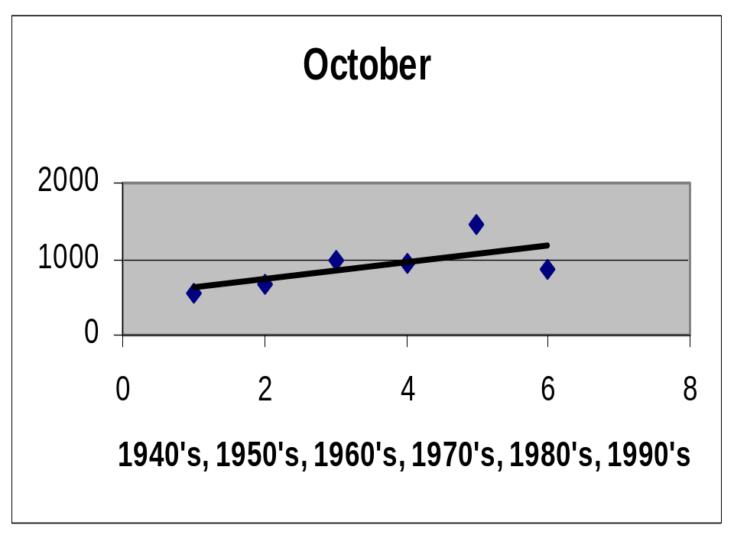
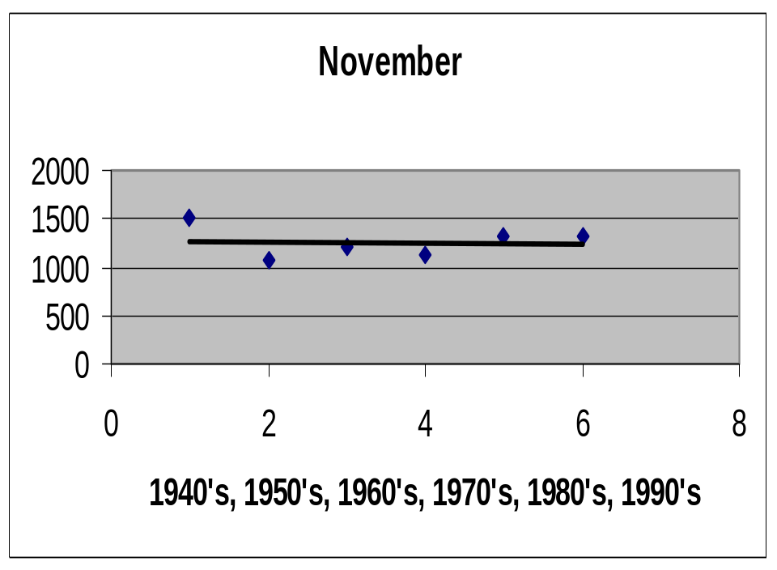
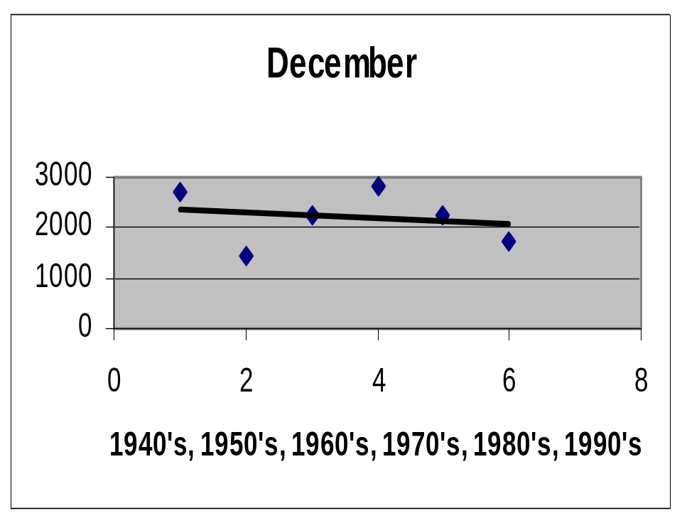
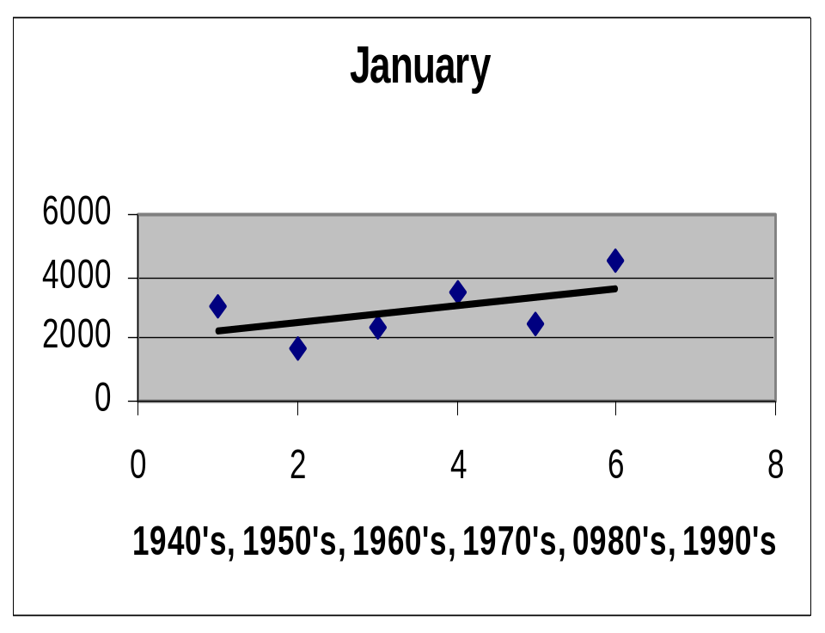

Slide 19
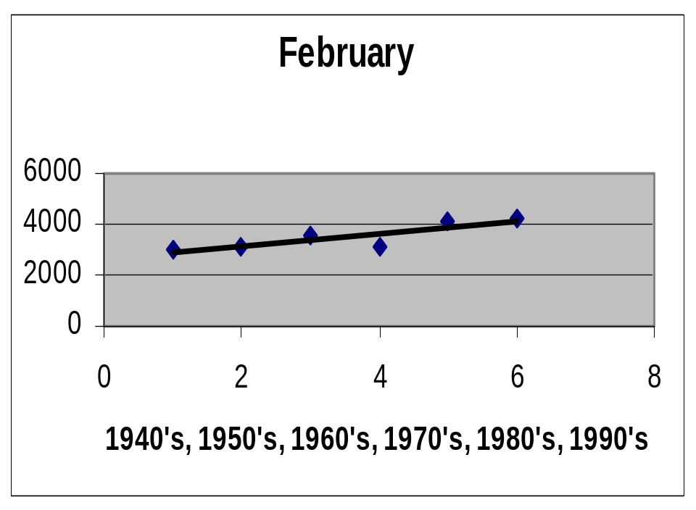
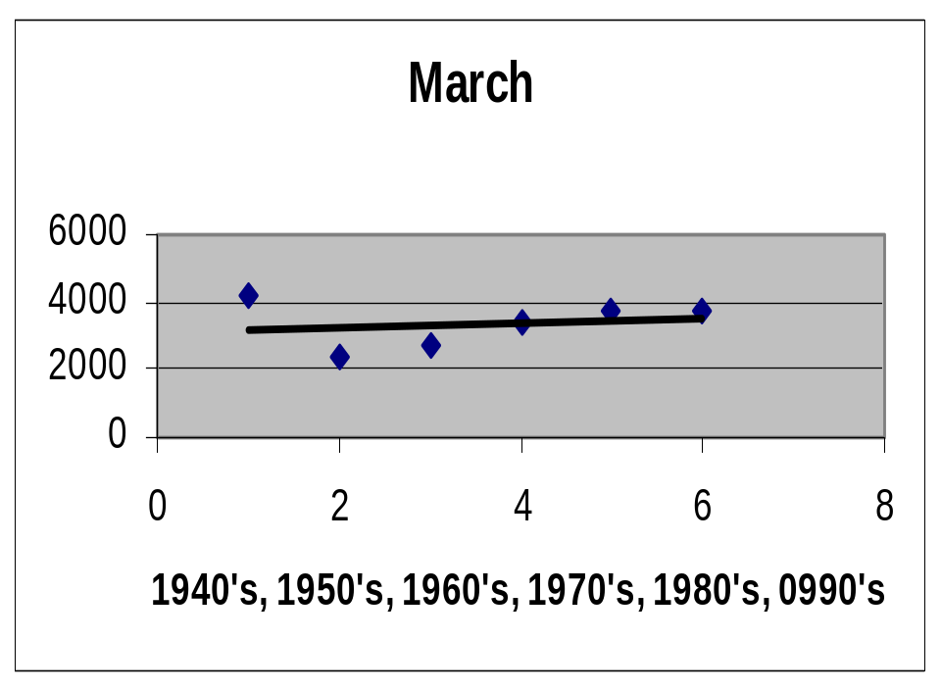
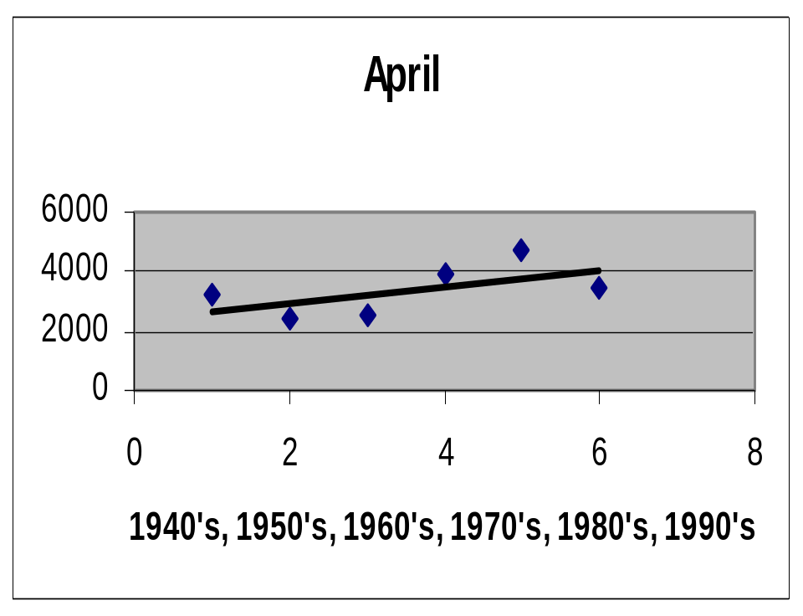
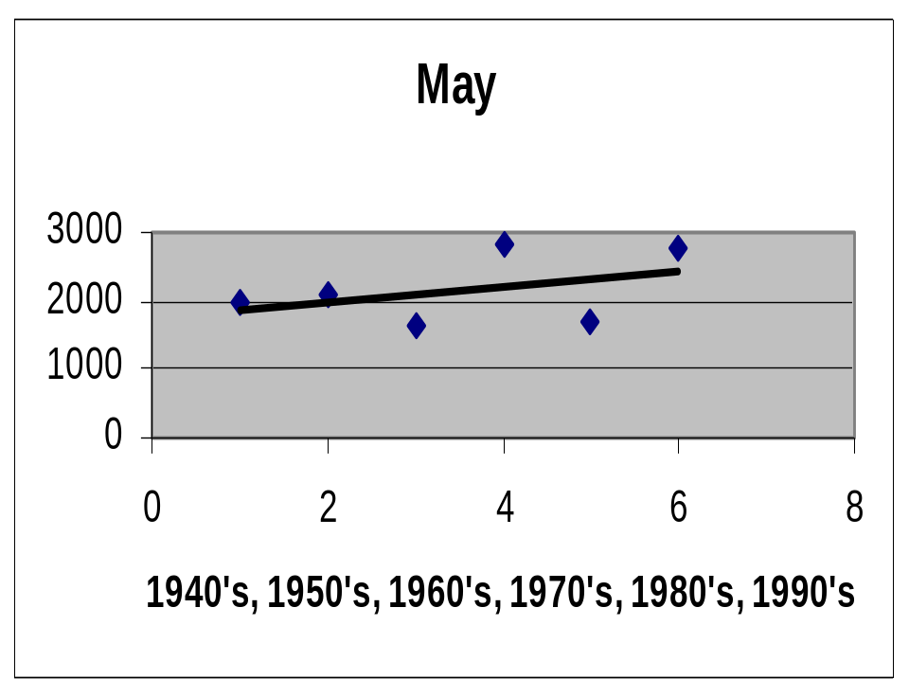

Slide 20
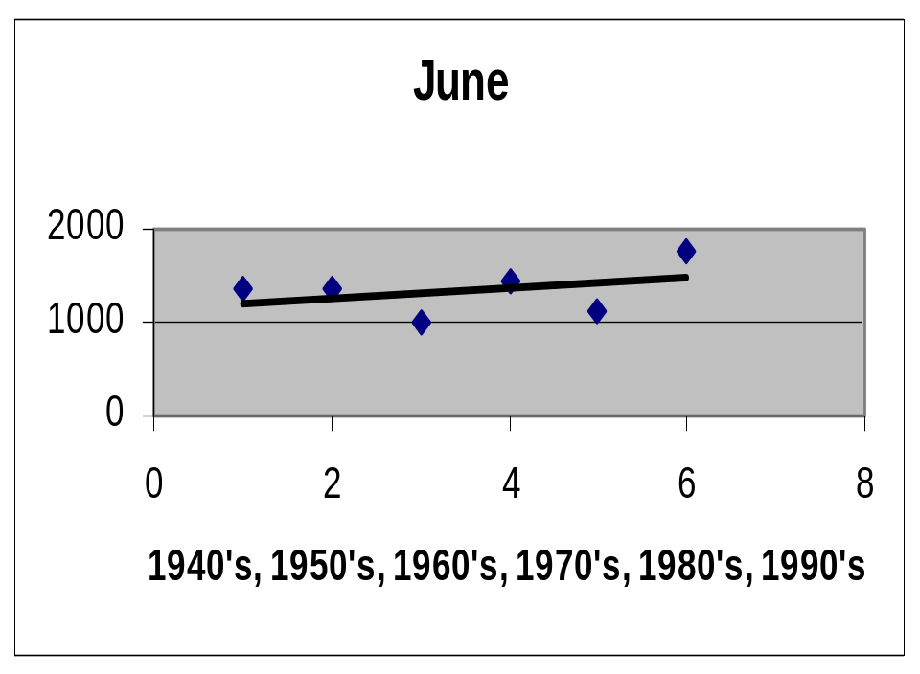
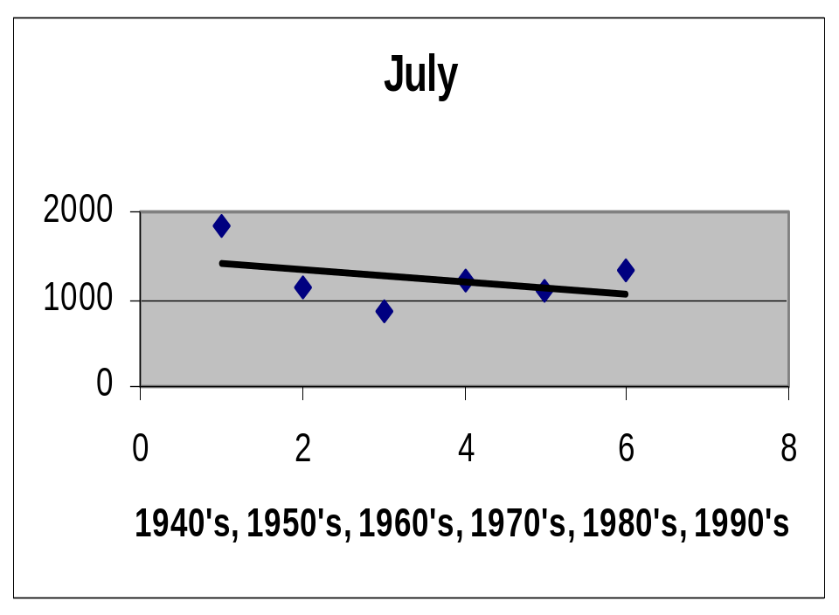
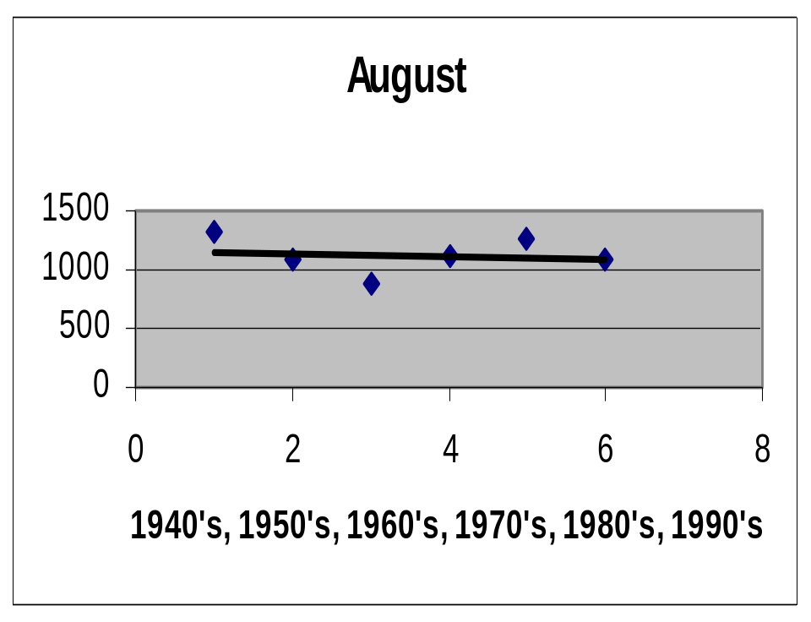


Slide 21
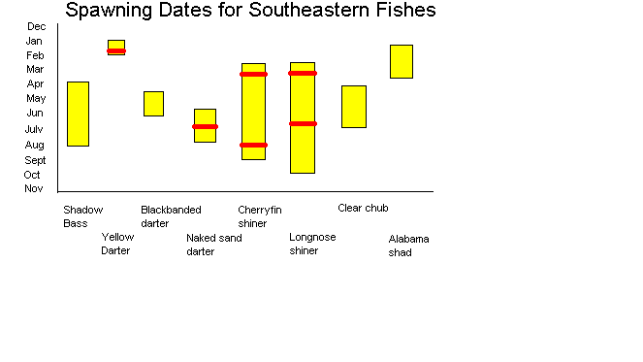

Slide 22
Standard deviation methodology
The Amite and Bogue Chitto Rivers were again selected to determine occurrence of extreme events such as floods or droughts.
Standard deviations for each month were calculated from daily discharge.
Each event outside of mean by one standard deviation was counted.
Standard deviations are graphed over time to illustrate changing flow variability.

Slide 23
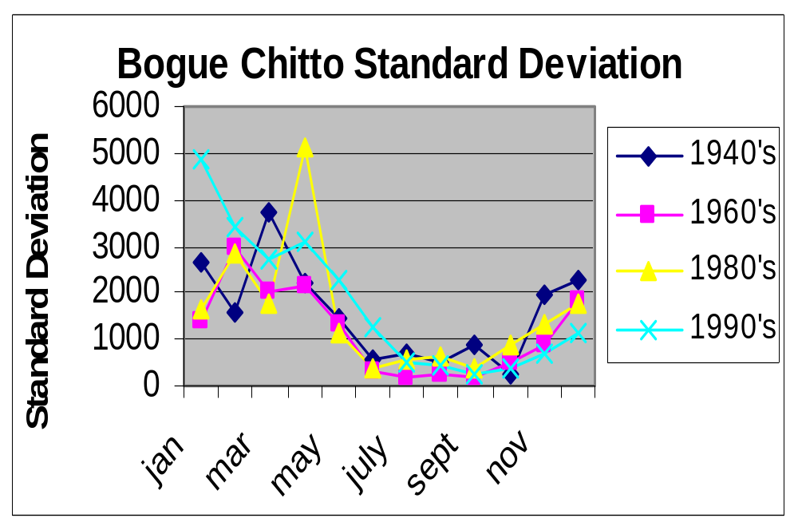

Slide 24
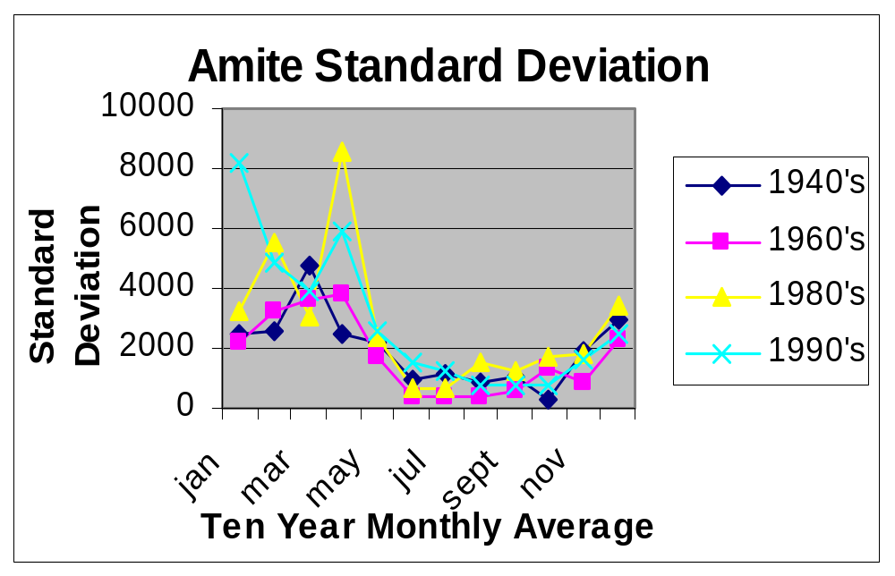

Slide 25
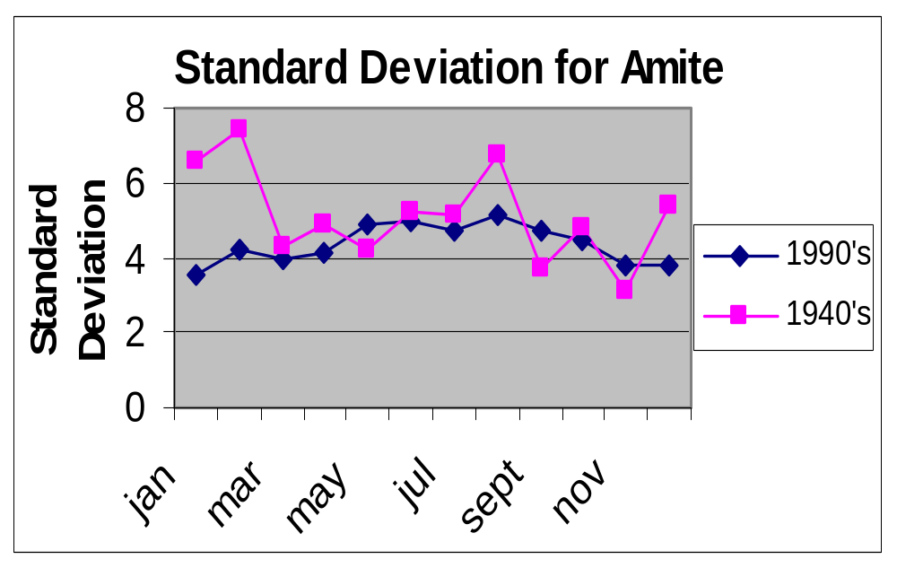

Slide 26
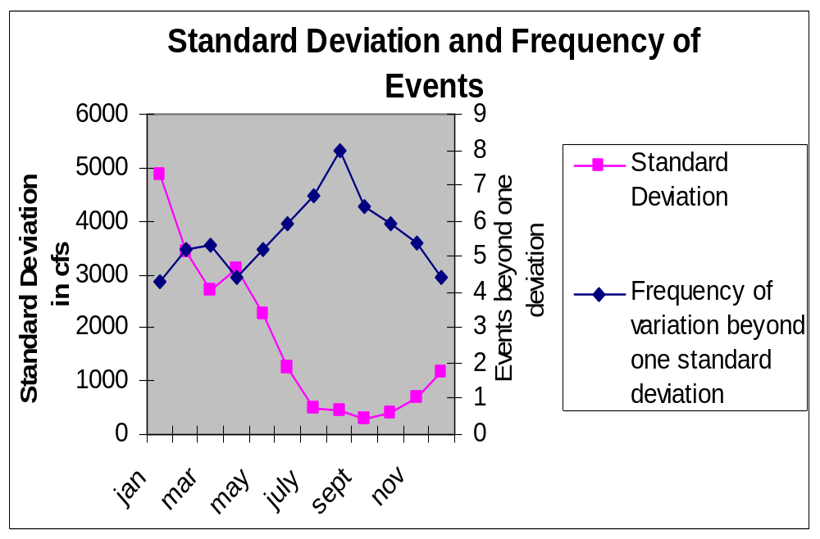

Slide 27
Number of events outside of one standard deviation did not illustrate a recognizable trend.
Increasing stream variability appears in the winter and spring months of the 1980’s and 1990’s. This variability was illustrated by the substantial growth in what characterizes a standard deviations.
This apparent contradiction is explained by the reciprocal relationship of standard deviation and the number of deviations.
The biotic impacts of this increasing variability are...

Slide 28
Biotic Response to Floods
Algae: Rhizoclonium persisted after floods due to basal attachments to substrate, however, over time recolonization was dominated by more filamentous Spirogyra (Power and Stewart 1986).
Invertebrates will seek refugia during floods, for protection from downstream export and scouring, in stream margins and rock eddies. Species adapted to floods may have increased developmental rates and subsequent reduced body size (Poff and Ward 1989)

Slide 29
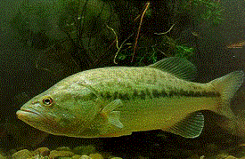
In study comparing natural (low flow flux) vs. regulated (high flow flux) streams, smaller slow current fishes (bluegill, small mouth bass, tasselated darter) could not persist in microhabitats with increased flux, as could larger, midstream species (large mouth bass, white sucker) (Bain, Finn, and Brooke 1988).

Slide 30
Regulation of stream fish assemblages may be stochastic (driven by response of species to environmental conditions) or deterministic (driven by predation and competition) (Poff and Ward 1989).
Matthews (1986) found fish fauna to be stable and persistent across years. Species richness and abundance was recovered eight months after severe flooding of Arkansas stream. However, he states:
  Floods can have more serious effects during reproductive season than any other time of year.
  Restoration after floods depends on:
  - adult survival and redispersal
    - high recruitment of young after the event

Slide 31
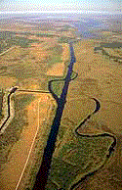
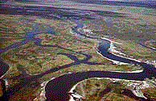
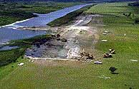
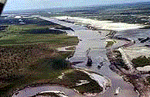
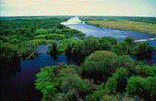
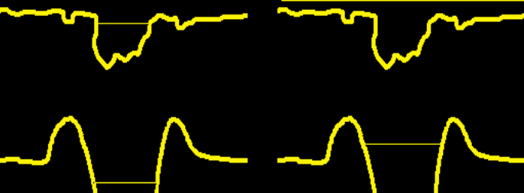

Restoration of the Kissimmee River
after
before
filling in C-38
during
enhanced floodplain
dry season
wet season

Slide 32
Conclusions
Stream flow is increasing in the southeastern U.S.
The increase appears to be fairly constant.
Seasonally, the months of January through June show substantially increased stream flow.
Relative to the 1940’s, no trend was found in recent occurrence of extreme weather events.
However, standard deviations of the mean monthly flows for January, February, and April show more variability in recent decades.
More study and better statistical analyses are highly recommended.

Slide 33
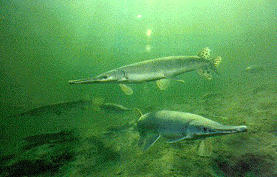
We recommend more study!
The End

