Slide 1
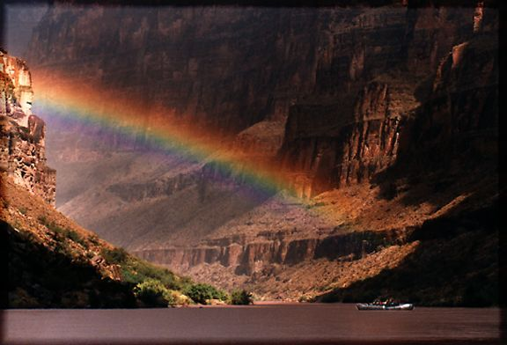
Case Study:
Colorado River

Slide 2
Yojna Singh- Water Management
Myra Kunas- Salinity Control in the Colorado River
Ethan Barr- Effects of the Loss of Colorado River Effluent on the Gulf of California
Andy Jiminez-Effects of Impoundments in the Ecology of the Colorado River: The Glen Canyon Dam

Slide 3
Water Management in the Colorado River Basin

Slide 4
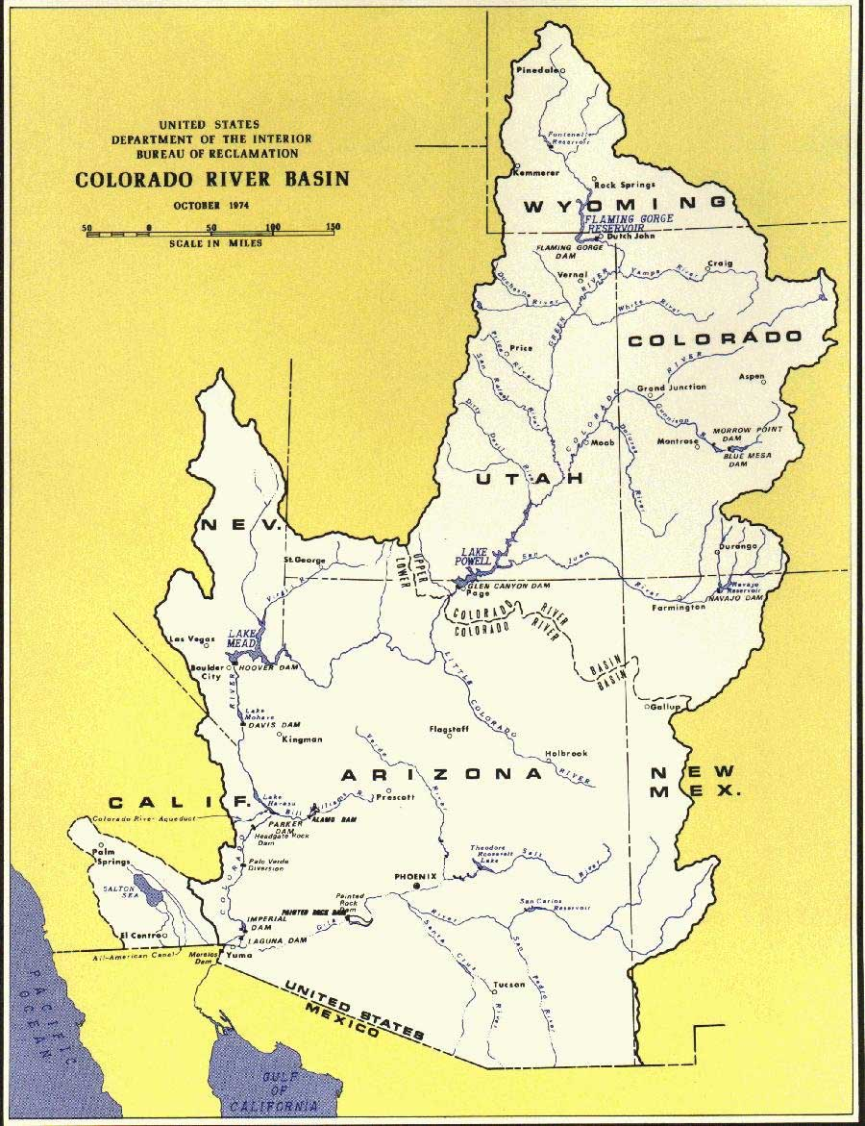

Slide 5
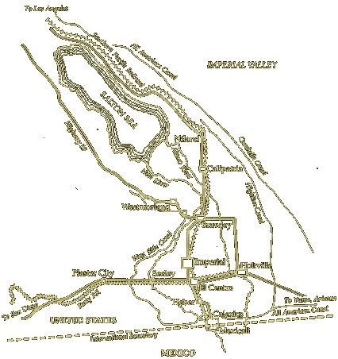
Old western water rights
  Prior Appropria-tion
Imperial Valley dilemma

Slide 6
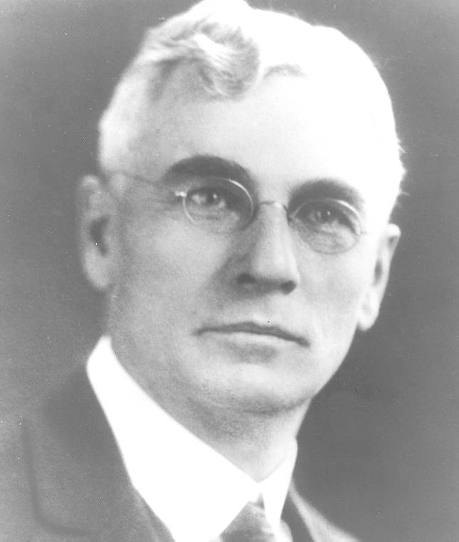
Kettner Bill
Kincaid Act

Slide 7
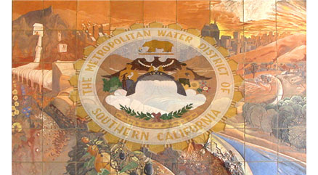
Metropolitan Water District

Slide 8
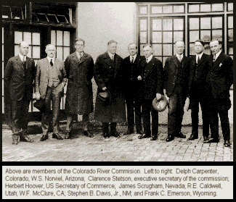
Upper Basin Alarm
  Fall-Davis Report
  Wyoming v. Colorado
Colorado River Commission

Slide 9
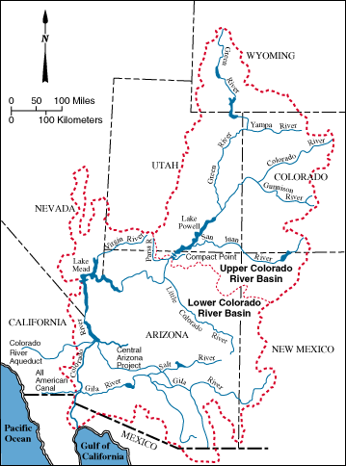
Division of the Basin:
  Upper Basin:
    Wyoming
    Colorado
    Utah
    New Mexico
  Lower Basin:
    Arizona
    California
    Nevada

Slide 10
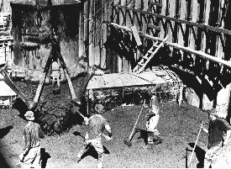
Arizona’s hesitation to join
Six-Sate Agreement
California’s deal
Boulder Canyon Act (Hoover Dam) approved 1929

Slide 11
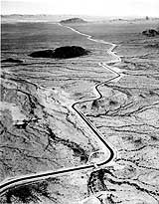
Arizona’s growing need for electricity
Mexico Water Treaty
Upper Basin Compact
Planning for the Central Arizona Project (CAP)
Arizona v. California
Upper Basin’s Deal with Arizona
CAP approved in 1968

Slide 12
Native American Water Rights
Western tribes move to reservations in 1800’s
Winters v. United States decision addresses water rights
Arizona v. California case allocates water for 5 reservations
Native Americans do not receive full amount of water
  Funding
  Pressure from Non-Native American people
Integration of Native Americans into decision making process
  7-10 Committee
  Glen Canyon EIS

Slide 13
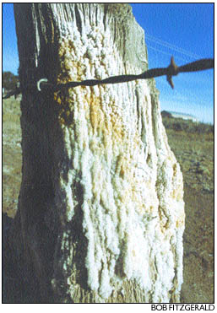
Salinity
Irrigation
Damming
Evaporation:Precipitation

Slide 14
Typical Salinity
Salinity naturally occurs in rivers
At source about 50 ppm
Early 1900s 400 ppm at Mexico-US boarder
Increase in surface area more then doubled salinity
In 1960s salinity levels in lower portion exceeded 1200 ppm
Typical oceanic salinity is 35 ppt

Slide 15
Mexican Water Treaty
February 3, 1944 agreed on delivery of 1.5 maf of water
Mexico expressed concerns about high salinity in 1961
1973 agreed not to exceed 115 +/- 30 ppm over salinity level at Imperial Dam, 27 miles upstream from boarder
To meet requirement constructed Yuma desalting plant

Slide 16
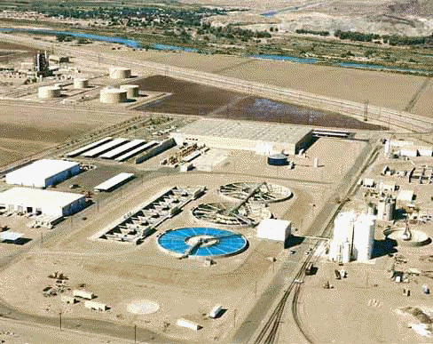
Yuma Desalting Plant
5 miles west of Yuma, AZ
2nd largest desalting plant in world
Produce 72.4 mgpd
Can expand to produce
96 mgpd

Slide 17
Goals of Desalting
Meet salinity requirements of Colorado River delivered to Mexico
U.S. saves 78,000 acre-feet of water per year

Slide 18
Problems with Desalting Plant
Construction alone resulting in loss of fish and wildlife habitat
Plant produced very high saline waste product
Filtration produces other waste such as acids, cleaning solutions, and spent membranes
Produces chemical waste similar to sludges produced by municipal water treatment plants

Slide 19

Colorado River Basin

Slide 20
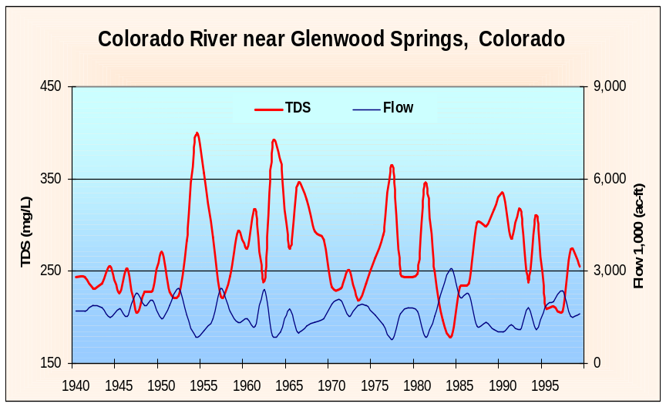
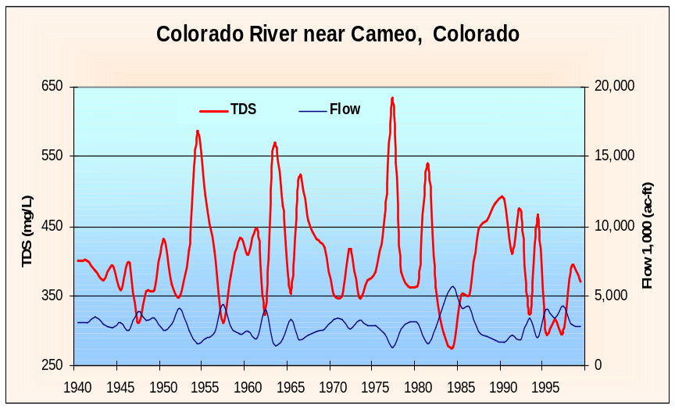
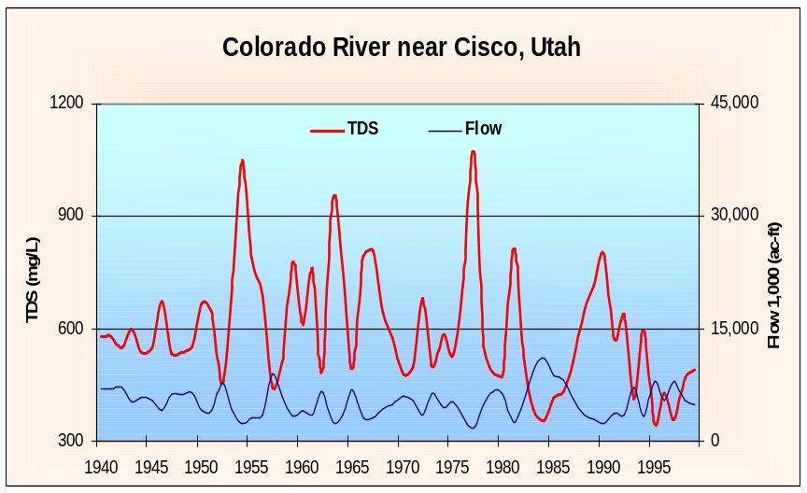
Natural Flows and Salinity

Slide 21
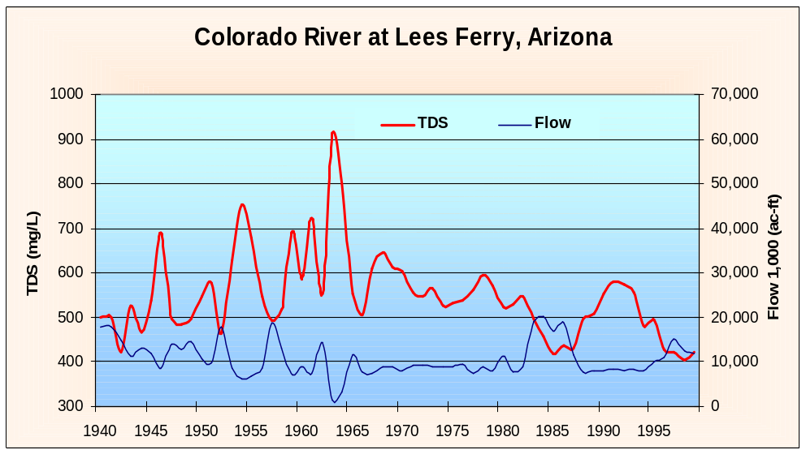
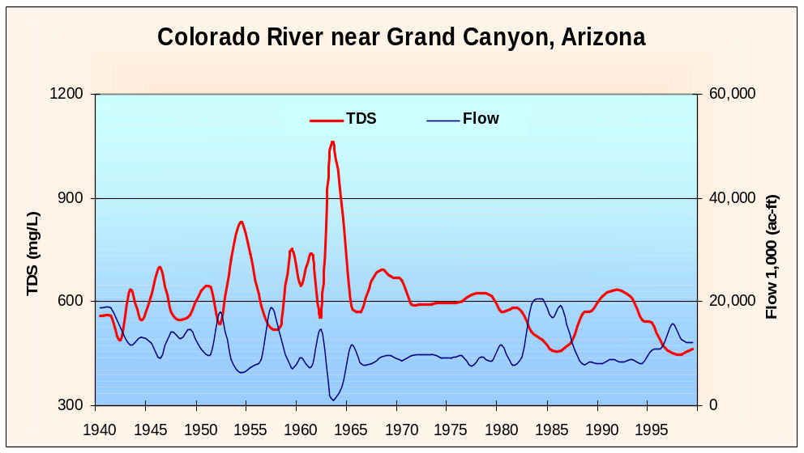
Natural and Dammed Effects

Slide 22
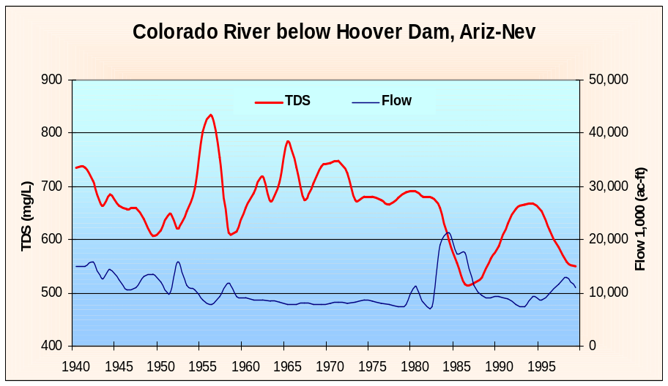
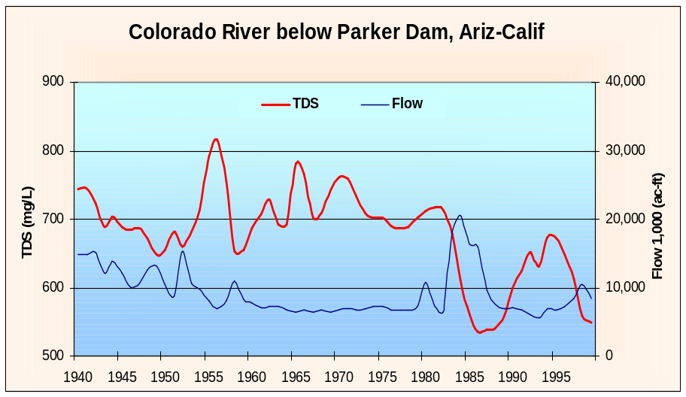
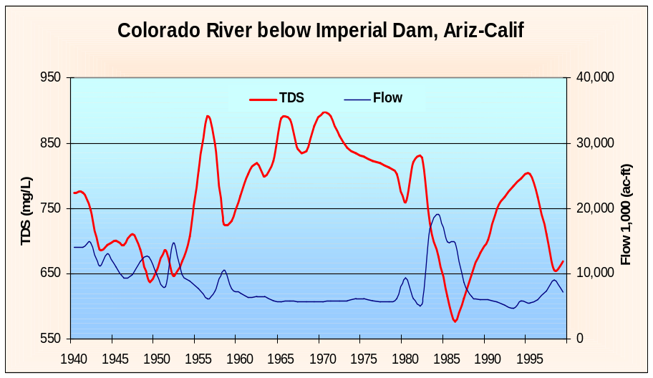
Dammed Effects

Slide 23
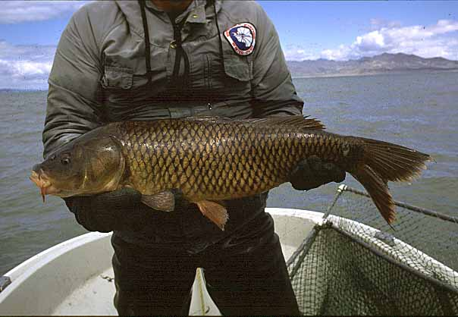
Main Ecological Effect
Proliferation of non-indigenous organisms
Common Carp (Cyprinus carpio)

Slide 24
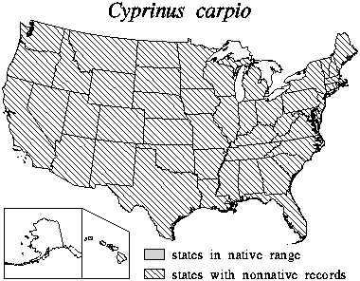
History of Common Carp
1877 U.S. Fish Commission began stocking
Imported from Germany for food fish
Now in all U.S. states except Alaska

Slide 25
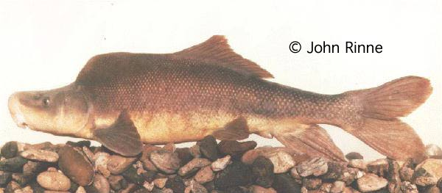
Why is common carp harmful?
Widespread abundance
Destroy vegetation and increase turbidity
Feed on eggs of other fish
Believed this is cause of the decline in razorback sucker populations

Slide 26
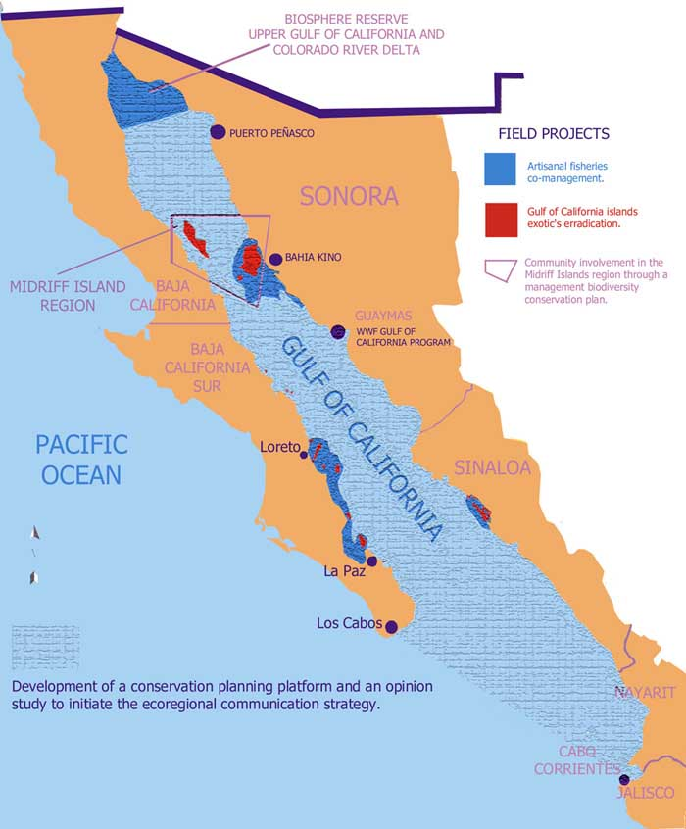
Gulf of California
Gulf of California
Effect of the Colorado River
ld.panda.org/gulf_map.html

Slide 27
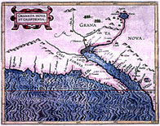
History
Colorado River used to flow out at a point called Robinson’s Landing
Ships were able to go up the river in the past
www.library.arizona.edu/branches/spc/set/pimeria/pimajpgs/page3sm

Slide 28
More History
Colorado delta region was known for its unique beauty
Called the “Green Lagoons” by Aldo Leopold
Supported jaguars, bobcats, willows and cottonwoods
The delta covered 3,000 mi²

Slide 29
Fishing industry
The Gulf of California supports a large fishing industry
Colorado supplied much of the sediment found in the Gulf of California
Endemic species like the totoaba and the vaquita

Slide 30
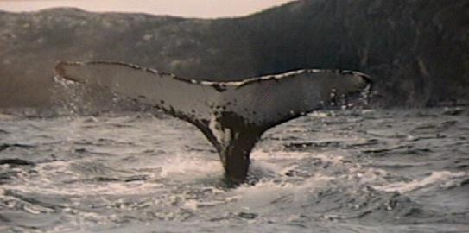
Organisms in the Gulf of California
Many types of soft corals (Oculina sp.)
Whales (Fin, Bryde, Orcas and Humpbacks)
Pacific Manta Ray
Acanthaster ellisii

Slide 31
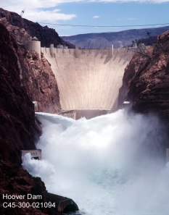
The change
Everything changed in 1936 with the completion of the Hoover Dam
28 more dams built since then
Flow of Colorado reduced to a trickle

Slide 32
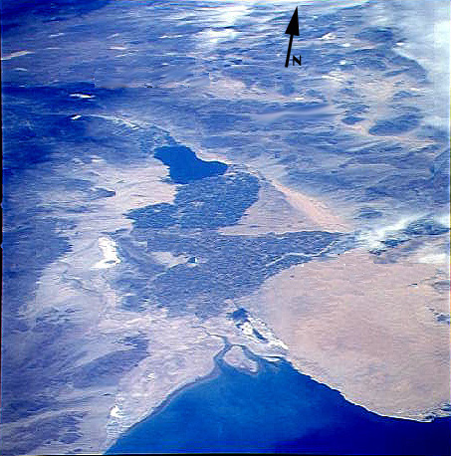
More damage
Since 1983 the river has only reached the Gulf 5 times, most recently in 1998
Colorado River delta has turned into barren sand flats
Some wetlands have survived

Slide 33
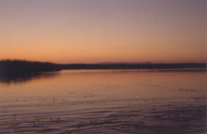
Natural flow
When the river has reached the Gulf, there has been an explosion of life
Riparian community of the delta was adapted to river flooding

Slide 34
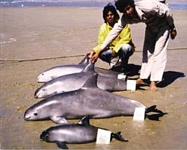
Natural flow (cont’d)
Scientists observed vaquita going into the delta to feed (never seen before)
Higher catches of shrimp in the Gulf

Slide 35
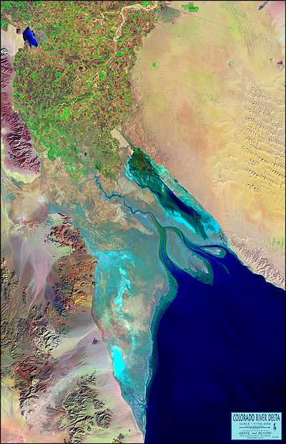
Solving the Problem
Policies need to be put in place to allow more water to reach the Gulf
One proposal is for 32,000 acre feet annually with floods of 260,000 acre feet every 4 years

Slide 36

Hope
People of Mexico want to preserve the delta and the Gulf of California and the fishing industry understands how important that is
In 1993 President Carlos Salinas de Gortari declared the river delta a biosphere reserve

Slide 37
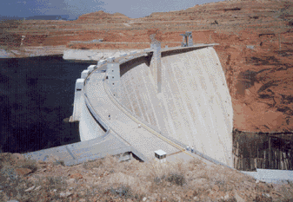
Colorado River Case Studies:
The Glen Canyon Experimental Release.

Slide 38
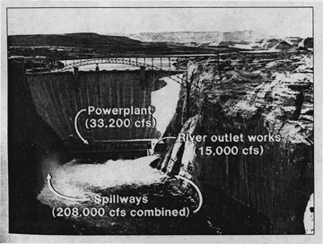
History:
-Completed 1963.
-Part of Colorado River Storage Act of 1956.
-Forms Lake Powell (2nd largest manmade lake in U.S.)
-Named after canyon location (lake after explorer)

Slide 39
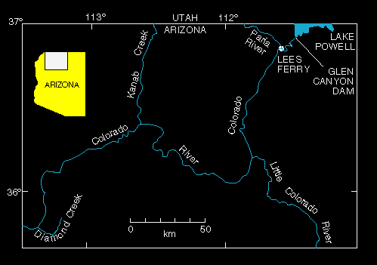
Glen Canyon Dam:
-Silt control (66 million tons → Lake Mead)
-Located 24 km upstream of Grand Canyon
-Now primarily for water storage, delineates upper and lower Colorado river basins
(CO, WY, UT, NM) (AZ, NV, CA)

Slide 40
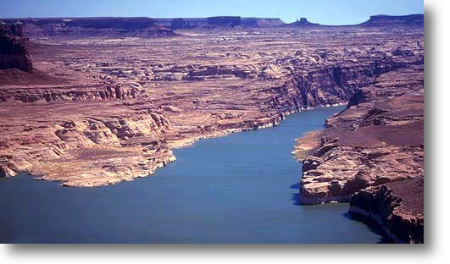
Important Uses:
7.5 million acre-feet/year to upper states, must release 7.5 million acre feet to lower states.
Agriculture, consumption.

Slide 41
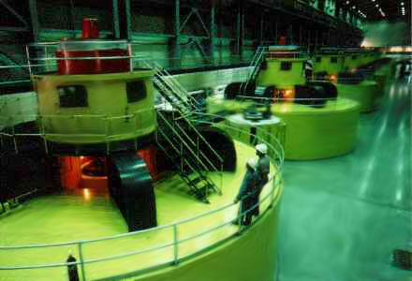
Benefits:
Recreation, Tourism, Business, Agriculture
Hydroelectric power (CREDA), cheap, clean, 110 entities.

Slide 42


Problems:
Sediment control…too good (Powell has accumulated 822,000 acre-ft)
Sediment downriver dropped from 66 million tons to 91,00 tons/yr.
No floods
No beach dynamics (scouring, mid-channel depostion, redeposition)
Less species
More invasive species
Colder temperatures (7deg—24 in summer)

Slide 43
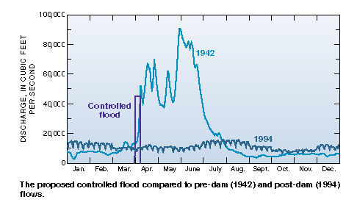
A Solution?
Release 360,000 acre-ft in two weeks.
Mimic pre-dam conditions, solve problems.

Slide 44
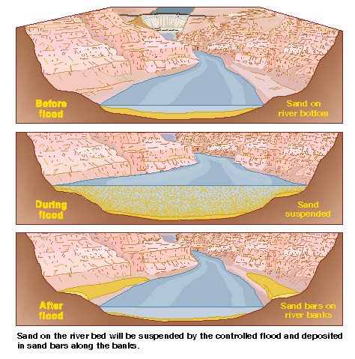

Slide 45
Interests Against Release:
Power plant (loses $2.7 million)
Upper States (lose 360,000 acre ft. of water)
Businesses (lose business)
Tourists (lose river)
Interests For Release:
Scientists (get information)
Lower States (get 360,000 acre ft. of water)
River (get new beaches)
Animals (get new habitat)

Slide 46
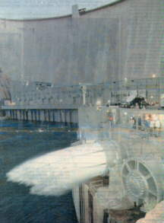
Experiment:
March 22, flow dropped to 8,000 cfs.
-researchers take “before” photos
March 26, flow increased to 45,000 cfs. For seven days.

Slide 47
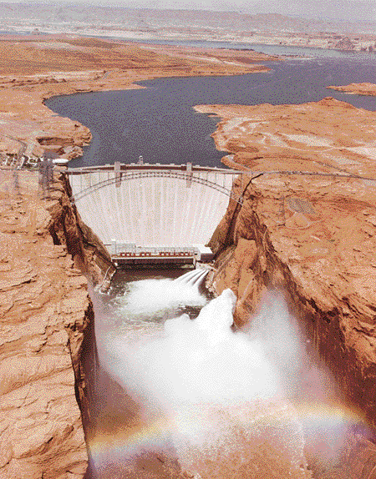

Slide 48
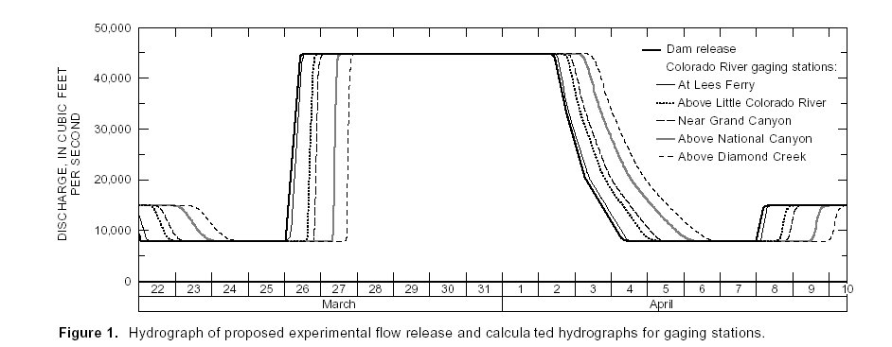
Results:
-1/3 more beaches formed
-New backwater channels for warm water species
-Beach scouring

Slide 49
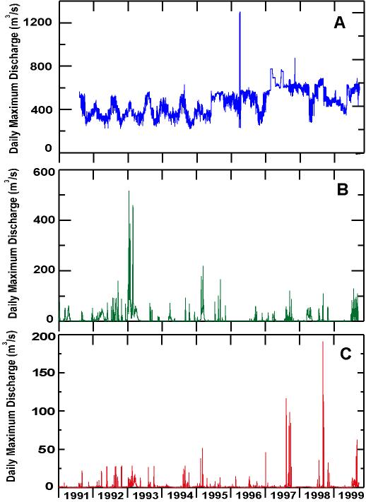

Slide 50
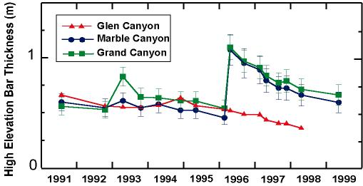
Sandbar survey:

Slide 51
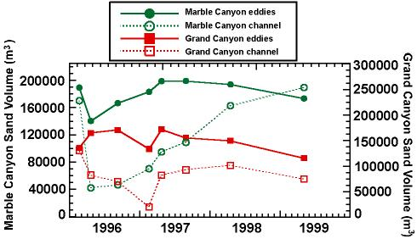
Eddies and Channels:

Slide 52
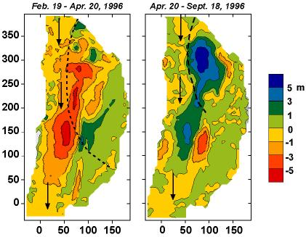
Sandbar Topography:

Slide 53
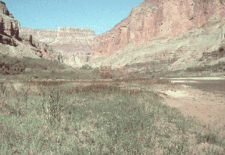
Vegetation Before:

Slide 54
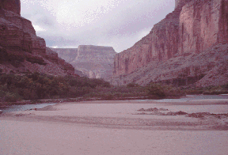
Vegetation After:

Slide 55
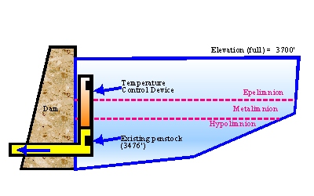
Temperature Plan:

Slide 56
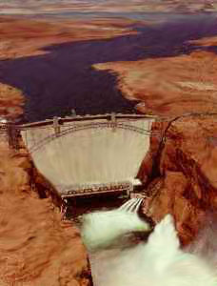
Future Plans:
Unlikely, without proper conditions.
-Erosion prominent
-Water surplus
-Inevitable spill

