Slide 1
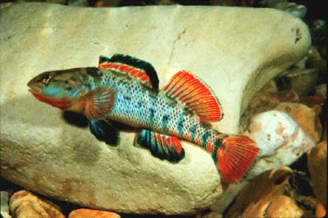
Index of Biological Integrity
Mike Doosey, Alice Moore &
Katie Smith

Slide 2
Overview
History
Theory
What do we look for?
How do we look for them?
How to analyze it?
How does it apply to what we collected and in LA?

Slide 3
History
Use of living organisms to assess water quality is a century old approach
  Used widely in Continental Europe
  US and UK relied on physical and chemical measures
    Water pollution is essentially a biological problem
IBI first done in Illinois
  Originally designed to test stream quality in an agricultural water shed
  Look at both inverts and fishes
  People that helped to create IBI
    James R. Karr
    Charles H. Hocutt
    Isaac J. Schlosser
    Philip R. Yant
    Kurt D. Fausch

Slide 4
Theory Behind IBI
Can be detailed and done over many years or a quick survey of current conditions
Based on the premise that pollution tolerance differs among various organisms
By looking at the types of organisms that live in the stream and their relative tolerances, you can determine water quality
Get into more detail a little bit later

Slide 5
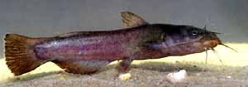
Fishes
Usually classified down to species level
  Darters, sunfishes, and suckers are especially important
Look at proportion of feeding groups
  Piscivores
  Insectivores
  Omnivores
Look at trophic guilds
  Top predator vs. primary consumer
Look at health of fishes collected
  Black spot – fecal contamination
  Ectoparasites

Slide 6
Fish Sampling
Fish are collected in a given reach of a stream
  Both ends are blocked
  Used seining and electrofishing for a depletion collection of fish
Fish less than 20mm are usually omitted
Site selection should be representative of the stream
  Length of reach depends on stream size
  Low flow times are preferred
Fish species are identified, counted, and assigned to trophic guilds
Estimates are created for expected values in order to rate metrics

Slide 7
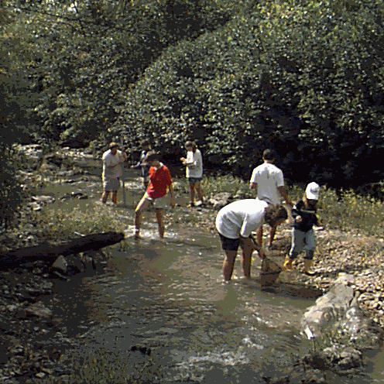
Sampling ☺

Slide 8
Quantifying Fish Data
IBI measures twelve metrics in three categories (Karr et al. 1986)
  1) Species composition
    Total number of fish species
    Number of darter species
      Sensitive to benthic degradation
    Number of sunfish species
      Sensitive to pool degradation
    Number of sucker species
      Sensitive to chemical degradation
    Number of intolerant species
      5-10% of species most sensitive to degradation
    Proportion of tolerant species

Slide 9
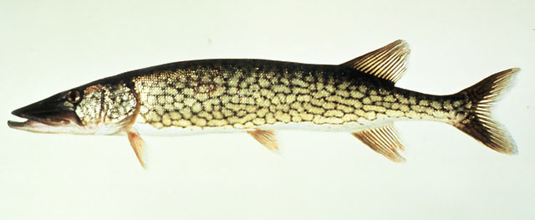
Quantifying Fish Data Cont.
  2) Trophic composition
    Proportion of omnivores
    Proportion of total insectivores
    Proportion of piscivores
  3) Fish abundance and composition
    Number of individuals in the sample
    Proportion of hybrids
      Sometimes omitted for difficulty
      An indicator of poor water quality
    Proportion with disease, tumors, fin damage and skeletal anomalies

Slide 10
Quantifying Fish Data Cont.
Metrics may have to be added, deleted or altered to effect different local conditions
  Measuring large river species
  Evenness
  Headwater species
  Reproductive and Functional Guilds
  Pioneer Species
Then ratings given relative to expected results
  1: Deviates strongly
  3: Deviates moderately
  5: Deviates slightly

Slide 11
Six Categories of Total Metrics
60-58: Excellent integrity
52-48: Good integrity
44-40: Fair integrity
34-28: Poor integrity
22-12: Very poor integrity
No fish after repeated sampling

Slide 12
Assignment of Metric Values
Expectation number assignments are based on stream size and geographic region
  Stream size is measured by Strahler stream order classification system
  Stream size effects certain metrics (1-4 suggested by Karr)
Number of fish species plotted as a function of stream order
  Should produce a linear regression
  Line of maximum species richness created and area below this line is trisected to determine scores of 1,3, & 5
  Data must be based on individual samples

Slide 13
Using Fishes As Biological Indicators
Advantages
  Present in nearly all streams
  Represent a variety of trophic levels
  Populations relatively stable
  Allow for temporal dimension in quality assessment
  Relatively easy to identify
Disadvantages
  Can only be used in local watershed area
  Representative sample must be chosen
  Sampling favors some fish
  Fish are mobile organisms

Slide 14
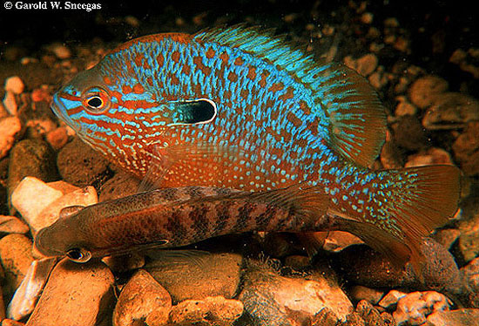
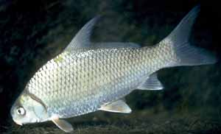
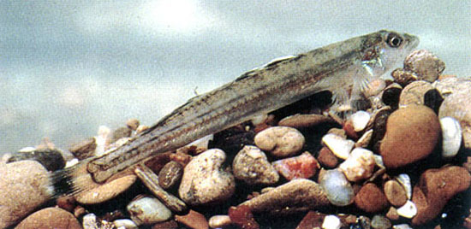
Louisiana Fishes

Slide 15
EPT & FBI Index
EPT: is an enumeration at a broad taxonomic (order) level
  Specifically looks at proportion of 3 generally intolerant orders of insects
    E= Ephemeroptera
    P= Plecoptera
    T= Trichoptera
FBI: Family Biotic Index
  More detailed at this taxonomic (family) level
  Gives biotic score according to family
FBI scores
See Appendix 31.1
  Perlidae 1
  Ephemerellidae 1
  Heptageniidae 4
  Coenagrionidae 9
  Gomphidae 1
  Corydalidae 0
  Chironomidae 6-8
  Tipulidae 3
  Asellidae 8
  Bdellidae 10

Slide 16
Inverts
Depends on how far you classify the organisms according to taxonomic levels
  Some species that are tolerant in an order or family that is mostly intolerant
Examples of intolerant orders
  Ephemeroptera (Mayflies)
  Plecoptera (Stoneflies and most intolerant)
  Trichoptera (Caddisflies)
Examples of tolerant orders
  Diptera (True Flies)
  Hirudinea (Leaches)

Slide 17
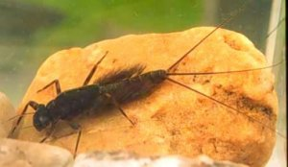
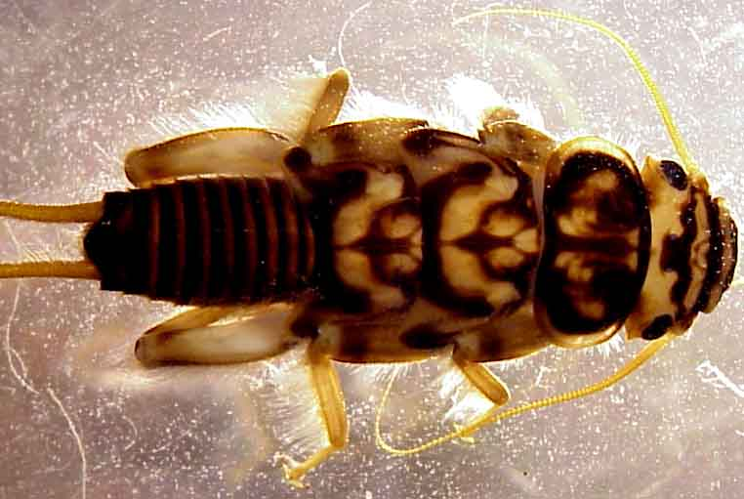
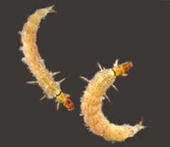
EP&T

Slide 18
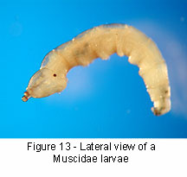
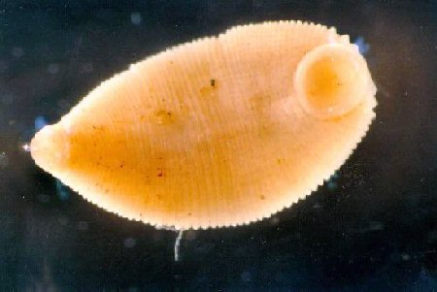
Tolerant Inverts

Slide 19
General Overview of Quantifying Invert Data
Metrics of Inverts
  Taxa richness
    E.g. How many families collected
  Enumerations
    Proportions of selected orders
  Community diversity indices
    E.g. Shannon’s index
  Community Similarity indices
    E.g. Pinkham-Pearson Index
  Functional Feeding Groups
    E.g. Percentage of the “shredder” functional group

Slide 20
Advantages For Using Inverts
Ubiquitous, affected by perturbations in all types of water and habitats
Large number of species offer a spectrum of responses to perturbations
Sedentary nature of many species allow spatial analysis or disturbance effects
Long life cycle allows effects of regular or intermittent perturbations, variable concentrations, etc. To be examined temporarily
Qualitative sampling and analysis are well developed, and can be done using simple, inexpensive equipment

Slide 21
Advantages Cont.
Taxonomy of many groups is well known and identification keys are available
Many methods for data analysis have been developed for macro invertebrate communities
Response of many common species to different types of pollution have been established
Macroinvertebrates are well suited to experimental studies of perturbation
Biochemical and physiological measures of the response of individual organisms to perturbations are being developed

Slide 22
Disadvantages
Quantitative sampling requires large numbers of samples, which can be costly
Difficult to identify because of small size and because of certain taxonomic groups not well known
Factors other than water quality can affect distribution and abundance of organisms
Seasonal variation may complicate interpretations or comparisons

Slide 23
Disadvantages Cont.
Affected by micro and macro habitat changes
Propensity of some macroinvertebrates to drift may off set the advantage gained by the sedentary nature of the species
Perhaps too many methods for analysis available
Benthic macroinvertebrates are not sensitive to some perturbations, such as human pathogens and trace amounts of pollutants

Slide 24
Alternative Stream Quality Indicators
Indicator Species
Diversity Indices
Abundance of Desirable Species
Physical Habitat Estimation
Chemical Analysis
Algal and Protozoan Analysis

Slide 25
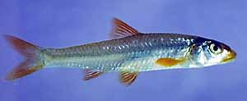
Our Own IBI
For Lake Pontchartrain drainages
Louisiana, Mississippi
Only included flowing streams
Used methodology of Karr et al. 1986
Modified for LA & MS

Slide 26
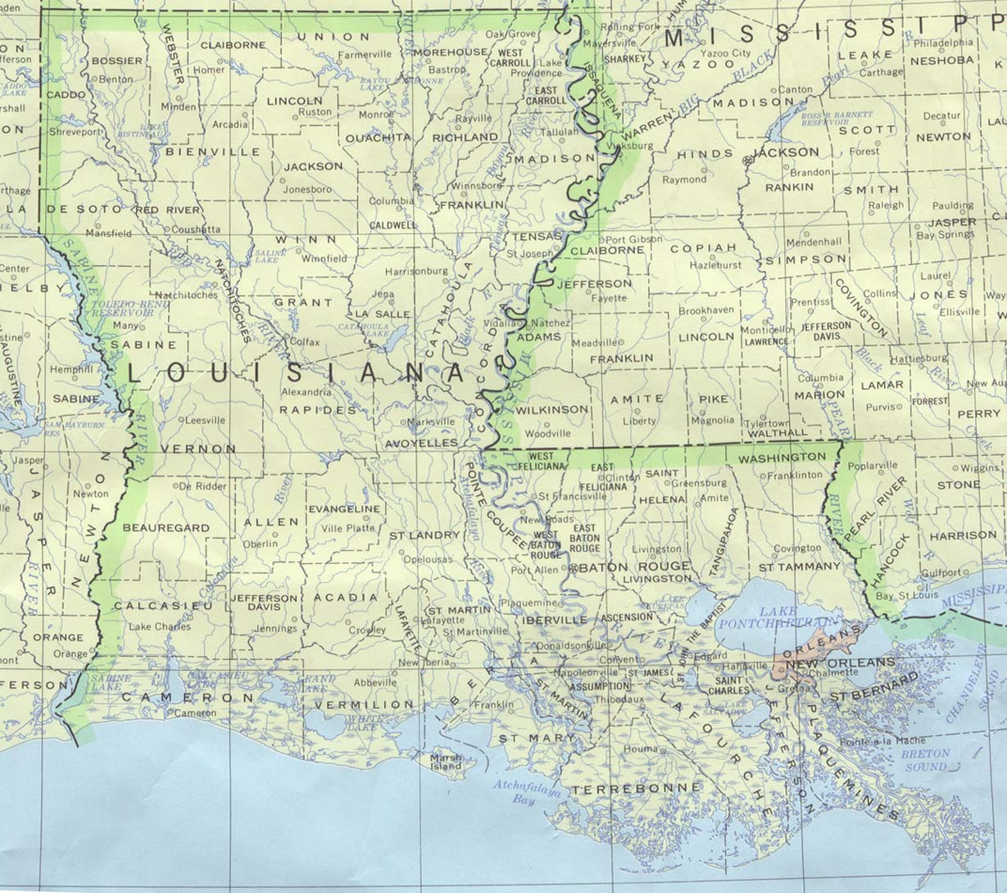
Study Area

Slide 27
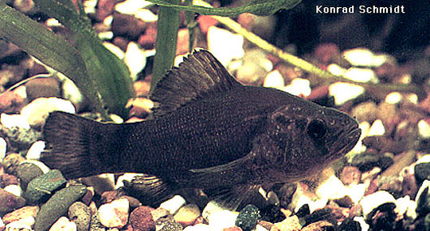
Pontchartrain Drainage IBI
10 metrics
  Species richness
  Number of individuals in a sample
  Number of darter species
  Number of sunfish species
  Proportion of omnivores
  Proportion of insectivorous cyprinids
  Proportion of piscivores
  Proportion of hybrids
  Proportion of mosquito fish
  Proportion with disease

Slide 28
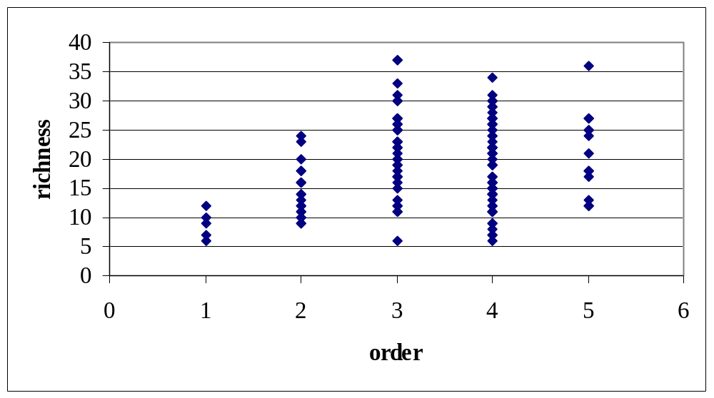
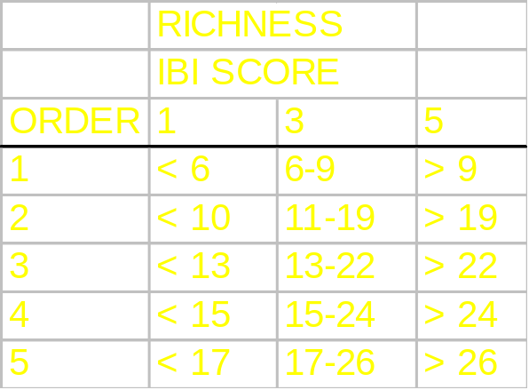
Pontchartrain Drainage IBI
Data from Tulane Museum of Natural History
  Regional biodiversity for fishes
  Calculated stream order
  Determined richness and abundance
5
3
1

Slide 29
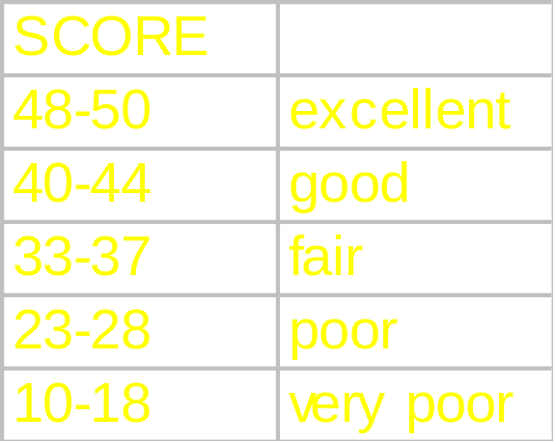
Pontchartrain Drainage IBI
Used data from lab
Classified each species taxonomically and ecologically
Assigned score for each metric
  Maximum of 50

Slide 30
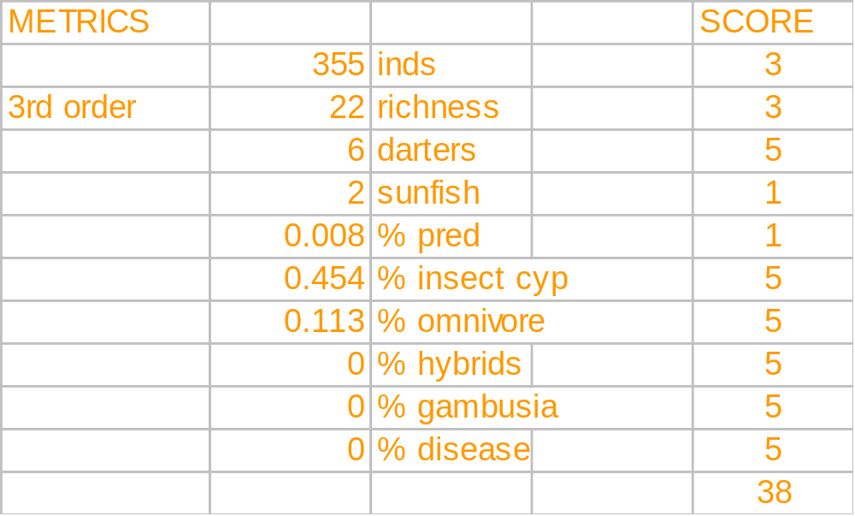
IBI Score for Natalbany River
5 September 2003

Slide 31
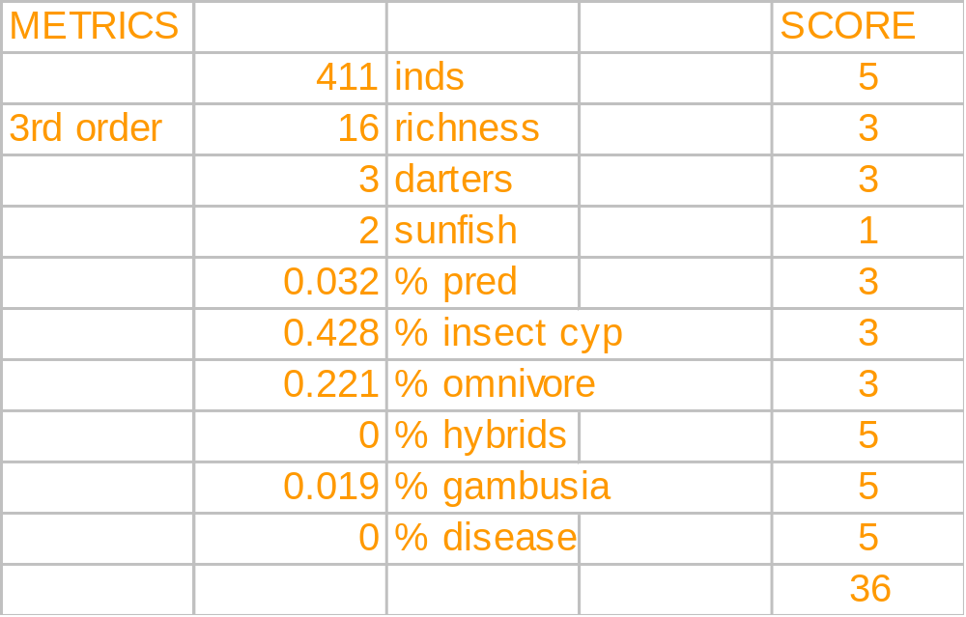
IBI Score for Natalbany River
17 September 1999

Slide 32

IBI Score for Natalbany River
20 April 1979

Slide 33
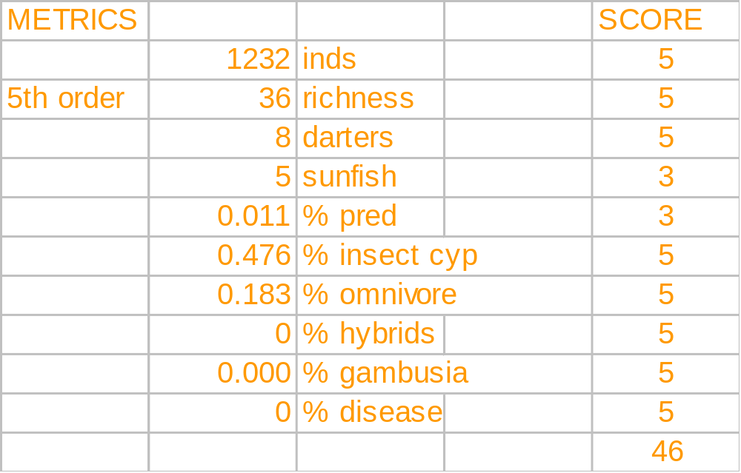
IBI Score for Amite River at LA Hwy. 10, 28 January 1972

Slide 34
Summary
Natalbany scored Fair to Good
  For class sample
Previous samples scored Fair
Is this the score you would have expected from Natalbany river?
What are some limitations of a fish IBI?
How would you expect the other streams to score?

Slide 35
References
Karr, J. R. 1981. Fisheries 6(6):21-27.
Karr, J. R., K. D. Fausch, P. L. Angermeier, P. R. Yant, and I. J Schlosser. 1986. Illinois Natural History Survey Special Pub. 5. 1-28.
Resh, V. H., M. J. Myers, and M. J. Hannaford. 1996. Pp. 647-667, Methods in Stream Ecology.

