Slide 1
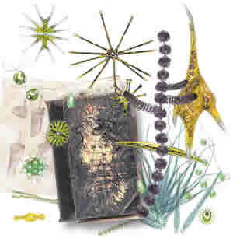
STREAM ALGAE

Slide 2
Overview
This lecture deals with an ubiquitous “group” of organisms that play an important role as primary producers in streams.
We will discuss taxonomic diversity of stream algae…,
And their ecological diversity and role in stream ecosystems.

Slide 3
Algae general
All algae are closely related on a functional level; they are autotrophs, responsible for most of the photosynthesis in streams.
Algae are diverse taxonomically; they are classified in three different kingdoms and a number of different divisions (= phyla of animal/fungal classification).
All algae have chlorophyll a and lack multicellular gametangia.
They have simple organization, existing either as single cells, colonies, or strands of cells.

Slide 4
Taxonomic Classification
Stream algae classified in as many as 10 different divisions.
Algal classification is based on:
1) pigmentation
2) chemistry and structure of internal storage products
3) cell wall composition
4) flagellation.
Groups reviewed below in order of importance.

Slide 5
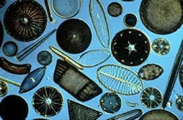
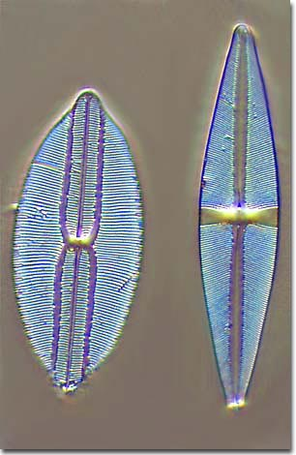
Diatoms
Classified in Division Bacillariophyta of Kingdom Protista.
Have chlorophylls a and c, with carotenoids that make them appear brown or golden in color.
They have silicious cell walls in two halves with a slit in the middle that allows them to be motile.
Likely the most widespread and abundant of all algae in streams.

Slide 6
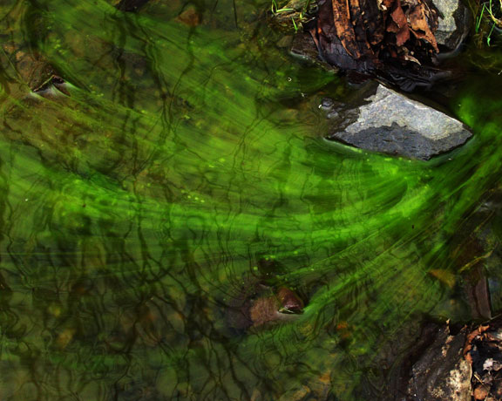
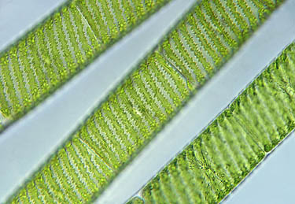
Green Algae
Green algae are classified in Division Chlorophyta (often in Kingdom Plantae, although most experts consider them to be protists).
They mainly have chlorophylls a and b.
Cell wall is made of cellulose and pectin.
They are green in color and usually filamentous.
Growths of filamentous green algae may be extensive in well-lit streams with course bottoms and few herbivores.

Slide 7
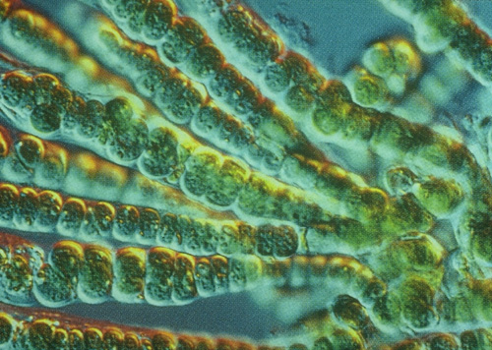
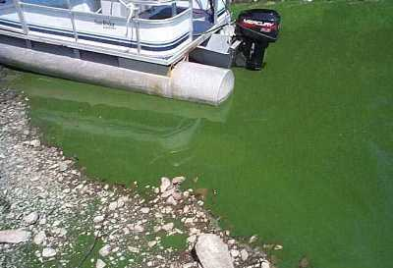
Blue-green algae
Blue-green algae are classified in Division Cyanophyta of Kingdom Monera (bacteria).
Also called cyanobacteria, and are the only procaryotic algae.
Have chlorophyll a and phycobilins and appear blue-green to olive in color.
Occur as mats or filaments.

Slide 8
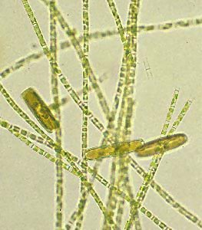
Golden Algae
Golden or yellow-green algae classified in Division Chrysophyta of Kingdom Protista.
Have chlorophylls a and c, are yellow-green in color, and have cell walls of cellulose and pectin.
Only a few genera of yellow-green algae occur in streams and all are filamentous.

Slide 9
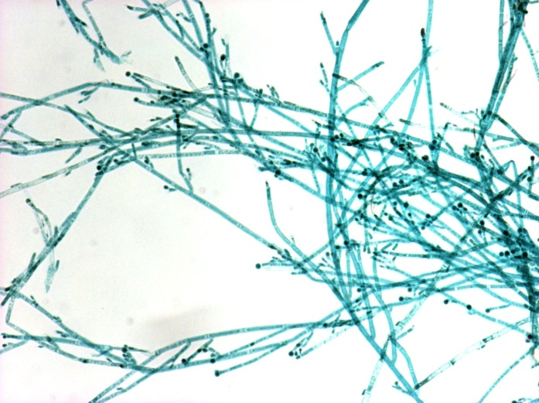
Red Algae
Red algae are classified in Division Rhodophyta of Kingdom Plantae.
Have chlorophyll a and phycoerythrin.
Are olive to maroon in color.
Most red algae are marine, but several filamentous groups occur in streams.

Slide 10
Ecological classification
Algae typically attached to something (component of periphyton)
Called epiphyton when attached to plants
Epizoon when attached to animals
Epilithon when attached to rocks
Epidendron when attached to wood
Episammon when attached to sand
Epipelon when attached to fine sediment

Slide 11
Algal associations
Epipelon communities dominated by motile diatoms that can move over and between fine sediment particles
Epilithon is dominated by non-motile (attached) diatoms and filamentous algae.
Physiognomy refers to the physical structure of a community; algae can occur in motile or nonmotile (filamentous or prostrate) physiognomies.
Non-motile forms attached by mucilagenous pads or stalks.
Filamentous forms occur as short filaments or long filaments that extend above the surface of the substrate.

Slide 12
Ecological role
All algae are primary producers that provide an important, fresh, fixed carbon source to herbivores.
Nutritionally superior to detritus (dead organic matter).
Produce oxygen for aerobic organisms
Useful indicator organisms: dominance of algal communities by blue-green algae is generally a sign of excessive nutrient enrichment.

Slide 13
Algae importance
Best way of assessing a particular taxon's importance in a community or ecosystem is to measure its biomass.
Measurement of benthic algal biomass is complicated by the fact that benthic algae are a component of periphyton communities, which include bacteria, fungi, and protozoans.

Slide 14
Algae importance cont’d
Despite the fact that allochthonous dead organic matter is the primary fixed carbon source in streams, autochthonous, autotrophic production can be substantial.
Algae superior to detritus as a food source.
Modeling and empirical studies suggest that lotic algal biomass can support 10-20 times more grazer biomass than detritus.
Algae so readily consumed that biomass measured at any particular time is not a good indication of the herbivore biomass it can support.

Slide 15
Sloughed algae
Not all algal biomass produced in an area is consumed by herbivores.
Laboratory studies suggest that a large amount of the algae grazed by snails is transported downstream.
Sloughed algal biomass can be an important detrital source for filtering heterotrophs.
Short-term changes in algal biomass can be useful index of algal productivity, but must be careful to account for grazing, upstream inputs, and downstream losses.

Slide 16
Measuring algal biomass
Three main approaches to determining algal biomass.
Ash-free dry mass calculation involves drying a collected sample to constant weight, oxidizing in a muffle furnace, and measuring the loss in weight due to oxidation.
Provides a measure of total organic matter in a sample, but can’t distinguish algal biomass from other periphyton
Also doesn't account for the physiological state of the organic matter (dead or living).

Slide 17
Pigment analysis
Pigment analysis involves extracting pigments from collected samples and measuring each pigment's absorbance of light of different wavelengths.
Because different pigments absorb maximally at different wavelengths, pigment analysis provides clues as to the types and concentrations of pigments present.
Allows differentiation of algal biomass from other organic biomass.

Slide 18
Biovolume measurement
Biovolume measurement involves measuring the dimensions of algal cells under a microscope and calculating cell volumes for each species.
When combined with algal community composition, this method provides most precise information on biomass for each algal species.
However, this is very labor intensive and it is difficult to distinguish live cells from dead cells under the microscope.

