Slide 1
BIOTIC INDICATORS OF ENVIRONMENTAL QUALITY

Slide 2
Organisms and Adaptation
Streams are complex environments, offering a variety of conditions for organisms to adapt to (temperatures, light levels, substrate types, depths, flows, suspended loads, solutes, etc.) and predictable set of relationships among various habitat parameters.
Organisms have responded to this environmental variability by adopting a variety of different life modes (niches) with varying degrees of tolerance of the range of conditions offered.
Species that favor moderate water flows perform best in these flows, but poorly in slow or fast flows. The same generalization can be made for any environmental parameter.

Slide 3
Biotic Indicators
The composition of a stream's biota reflects the environmental conditions present in the stream.
Should come as no surprise that stream biota itself can be used to assess the quality of the stream environment.
Biotic indicators of environmental quality are especially useful where human activities have upset the natural balance of stream conditions.

Slide 4
Direct vs. Indirect Approaches
If the concern is environmental quality, why not measure environmental conditions directly?
Approach has two drawbacks:
  particular set of environmental conditions that define a healthy environment are rarely known
  environmental conditions measured in the present tell only about the present; little about disturbances that produced present conditions.
Use of biotic indicators tells about past and present disturbances and provides a means of identifying the correlated environmental factors.

Slide 5
Biotic Monitoring
Many different approaches to biotic monitoring.
If concerned about the loss of species, a simple species count (richness) or diversity index may be used.
Compare loss of diversity over time or diversity in a disturbed area to that in a pristine area.

Slide 6
Taxonomic Groups
Another approach involves enumeration of organisms in broad taxonomic or ecological categories.
Common metrics used in streams are numbers or proportions of Ephemeroptera, Plecoptera and Trichoptera (EPT).
Abundance of these groups correlated with environmental quality.
Also, percentage or ratios of shredders and collectors.

Slide 7
Tolerance-Based Indicators
Biotic indicators reveal more when they are based on the tolerance of organisms to particular environmental conditions.
Use of tolerance-based indices is based on the premise that disturbance tolerance varies among organisms.
Individual species or groups of species (taxonomic or functional) are typically assigned a tolerance score for a particular type of pollutant or anthropogenic disturbance (sewage, agriculture).
The higher a taxon's score, the higher its tolerance.

Slide 8
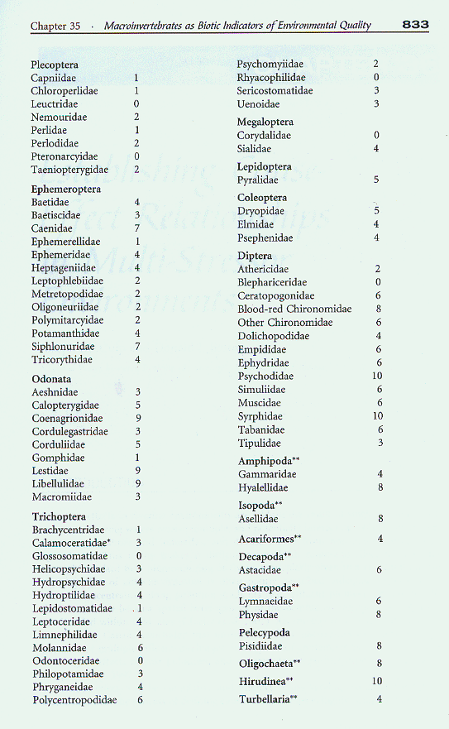
Family Biotic Index
An example of a tolerance-based indicator is the Family Biotic Index (FBI), which was developed for macroinvertebrates.
Various families of macroinvertebrates have been assigned tolerance scores based on their perceived disturbance tolerance (Appendix 35.1).

Slide 9
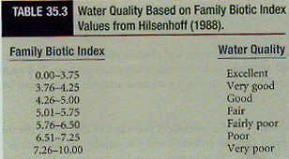
Calculating FBI
Index of stream quality obtained by tabulating the number of individuals of each family in a sample, multiplying this by the family's tolerance score, summing over all families, and dividing by the total number of organisms.
Different ranges of FBI indices have been related to different levels of stream quality in regional studies.

Slide 10
Using Reference Sites
By comparing test FBI score to score from pristine reference sites (% Similarity), can obtain relative index of biotic condition:
  >85% Unimpaired
  84-70% Slightly impaired
  69-50% Moderately impaired
  <50% Severely impaired

Slide 11
Index of Biotic Integrity
A similar index has been developed for stream fishes: Index of Biotic Integrity (IBI).
Originally developed for agriculturally disturbed streams of the upper Midwest, but has since been adapted to streams in a number of other settings.
IBI combines metrics of species richness and composition, trophic composition and fish abundance and condition (12 metrics in all).
Each metric is scored 5, 3 or 1 based on whether the particular biotic conditions in the study stream approximates, deviates somewhat, or deviates strongly from that in a relatively undisturbed reference stream in the same region.

