Slide 1
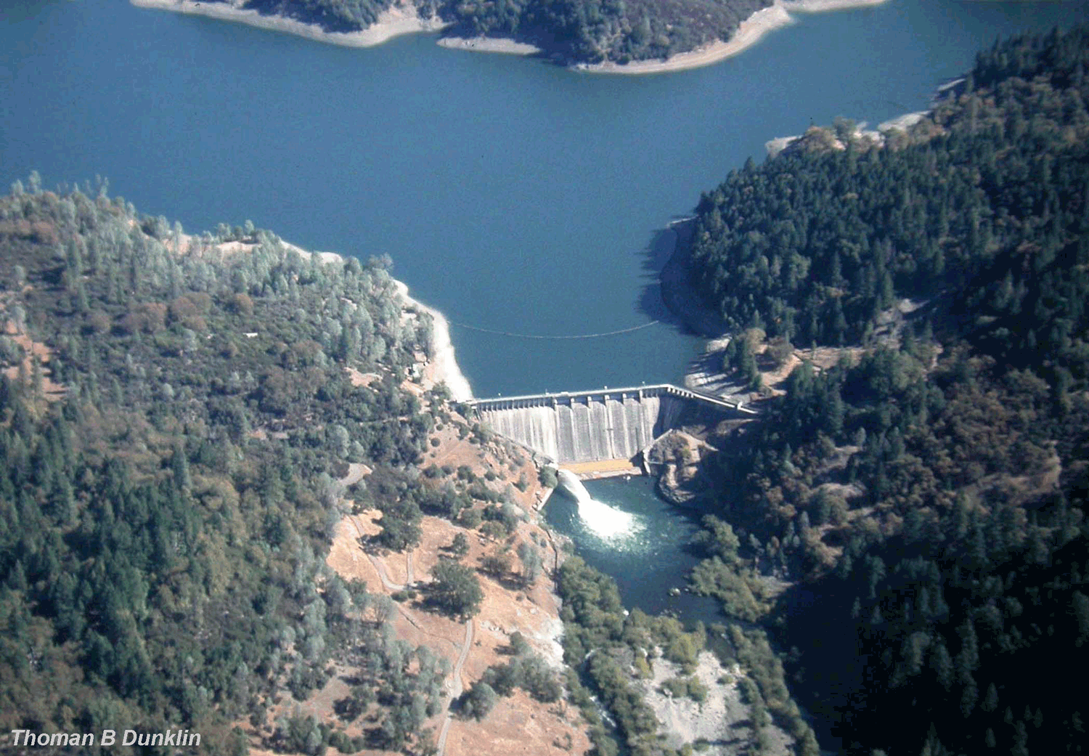
DAMS AND IMPOUNDMENTS

Slide 2
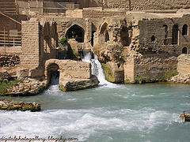
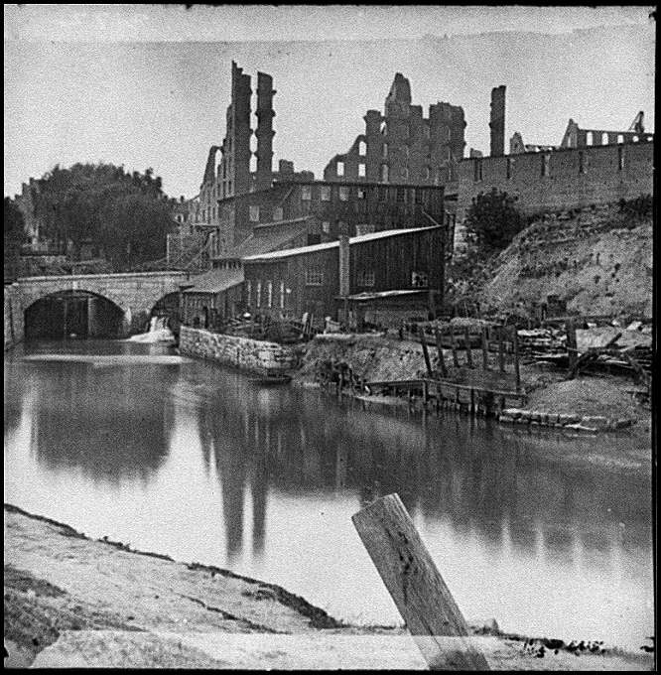
Early dams
Like all forms of stream modification, the practice of impounding (damming) rivers is ancient…

Slide 3
Accelerated Pace
Practice has been greatly accelerated over the past century.
Today, virtually every large river in North America has been impounded (many with multiple dams).
We rarely talk of flow dynamics of free flowing rivers, but rather speak of rivers as having regulated flow regimes.

Slide 4
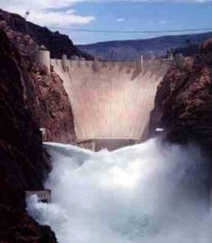
Size
Dams vary in size, purpose and operation.
The most important size dimension is height, because this determines the size of reservoir the dam will form.

Slide 5
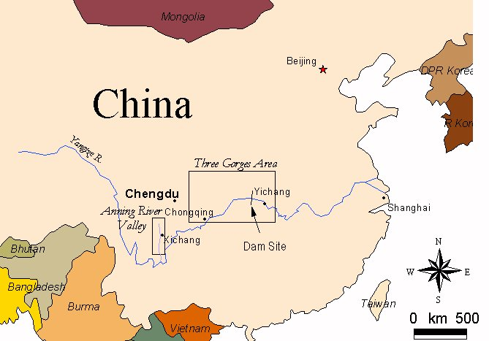
Three Gorges Dam

Slide 6
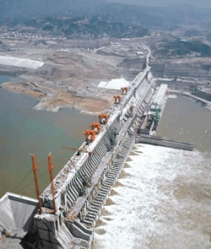
Three Gorges Dam
Dam consists of a 610-foot high wall running 1.3 miles from bank to bank.
World's Largest Hydropower Plant, producing 10% of China’s overall power needs.
Power generation capacity of Three Gorges equivalent to 15 nuclear power plants.
Project is estimated to be completed in 2009 at a cost of over $30 billion.

Slide 7
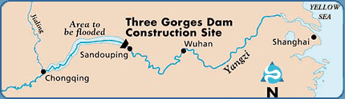
World’s Largest Reservoir
Reservoir created by the dam will form the world's largest
water storage reservoir, extending 360 miles up river to
Chongqing, a distance equal to nearly half the length of the
state of California.

Slide 8
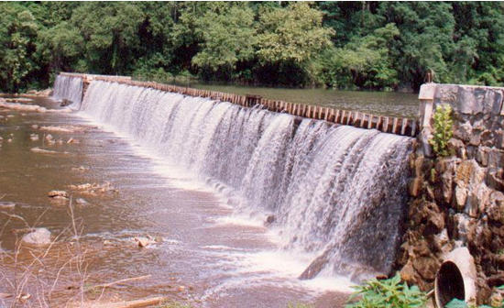
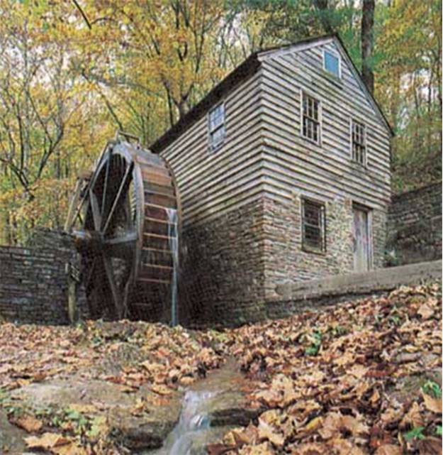
Purposes
Dams serve for water supply (reservoirs), flood control, navigation, and hydropower production.
Recreation is secondary.
Low-head dams built to create an upstream pool for irrigation diversion, milling, navigation or stabilizing larger dams

Slide 9
Operation
Dam operation refers to the extent to which dams hold back water and the ways in which water is released downstream.
An important factor influencing the impact of dams on the river ecosystems is whether water is released from the top or bottom of the dam.
Hypolimnetic (low-release) dams release water from the bottom of reservoirs, which is generally cold and low in oxygen.

Slide 10
Serial Discontinuity
Dams of all kinds transform a segment of lotic (flowing water) habitat into lentic (lake) habitat, and cause fundamental changes in community structure and ecosystem function.
Physical effects extend not only to the reservoir itself, but also to areas above and below the reservoir.
Dams disrupt the upstream-downstream continuity of rivers (serial discontinuity).

Slide 11
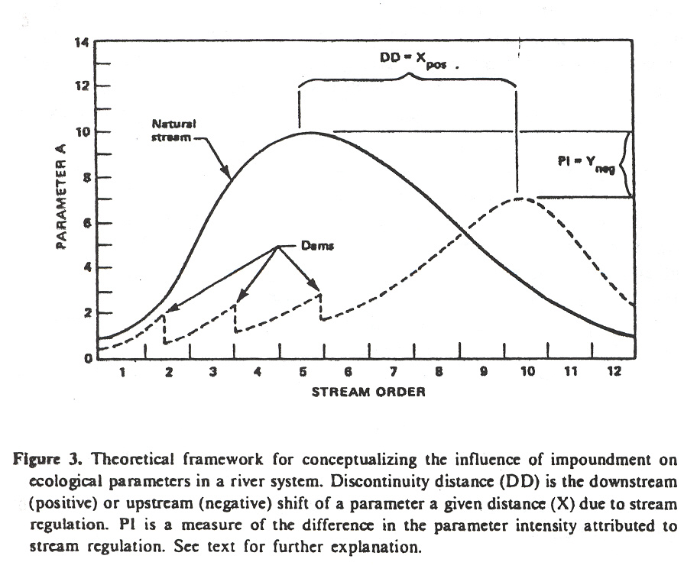
Serial discontinuity concept
Ward & Stanford 1983

Slide 12
Effects on sediment transport
When the flowing stream encounters the standing reservoir, suspended sediment settles out.
Over time, sediment can fill the reservoir, greatly reducing storage capacity.
Water released below the reservoir is sediment starved (called “hungry water”) and quickly suspends fine bed materials, resulting in armoring of the streambed.

Slide 13
Temperature Effects
Already mentioned the effect of low-release dams on downstream water temperatures.
Diel and even seasonal temperature fluctuations are reduced or eliminated in these dams.
Temperatures are cold enough in the tailwaters below dams of even southern rivers to support year-round, cold-water fisheries (salmon, trout, northern pike and muskellunge).

Slide 14
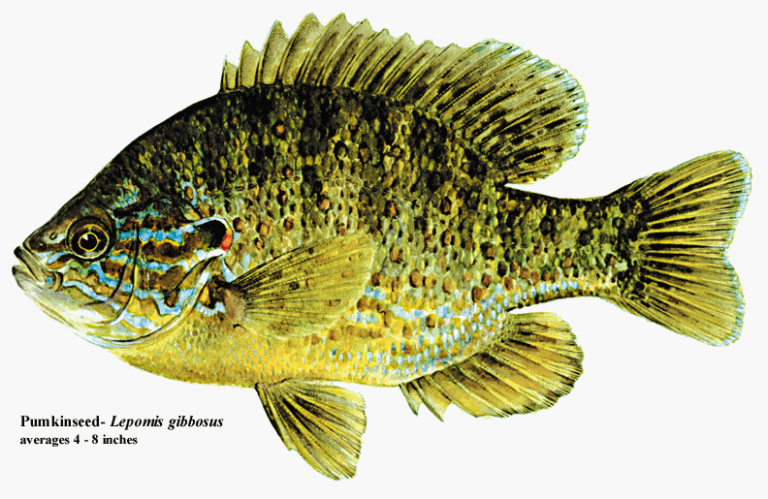
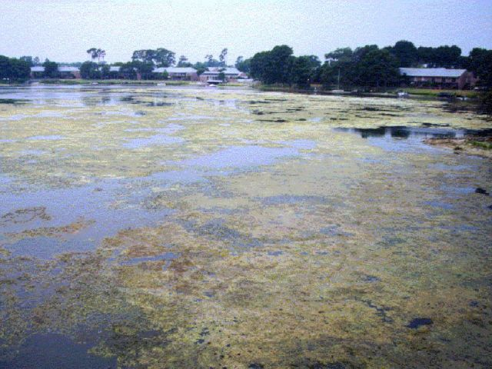
Biological Impacts
Fish community of the impounded stretch of river changes from stream-dependent species such as minnows and darters to lake or backwater dependent species such as catfish and sunfish.
Higher water clarity allows phytoplankton and rooted macrophytes to dominate primary production.

Slide 15
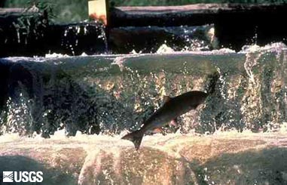
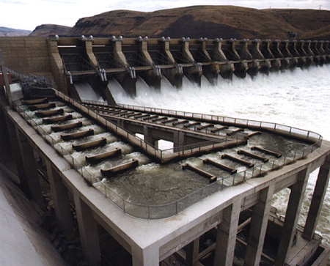
Effects on migration
Dams impede upstream migration of diadromous and other migratory fishes (e.g, salmon), causing them to disappear from upstream communities.
Fish ladders help, but species specific.
Dam construction has had a dramatic impact of freshwater mussels, by preventing upstream migration of fish that transport larval glochidia to smaller streams.

Slide 16
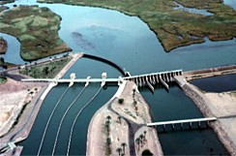
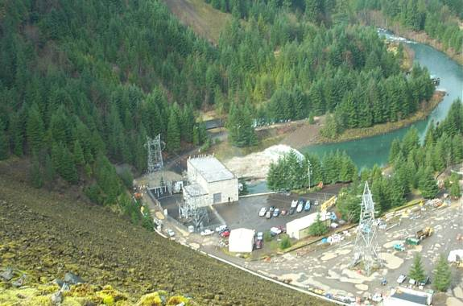
Water Diversion
A major disturbance to streams that is usually associated with impoundment is water diversion.
Most water diversion projects are for irrigation and drinking-water-supply purposes.
In a number of cases, water is diverted from reservoirs to man-made canals and tunnels designed to maximize hydropower production.
The water is usually returned to the river channel, but at a considerable distance downstream and in a highly altered state.

Slide 17
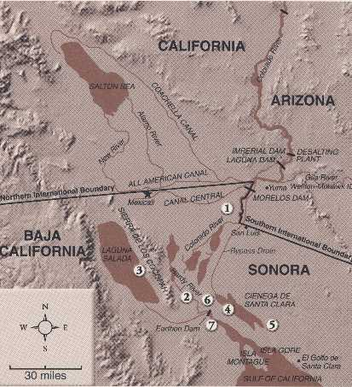
Flow restriction
In many cases, so much water is removed that the rivers often fail to reach their receiving basin (Colorado River) or they reach the basin with insufficient force to prevent extensive saltwater intrusion.

Slide 18
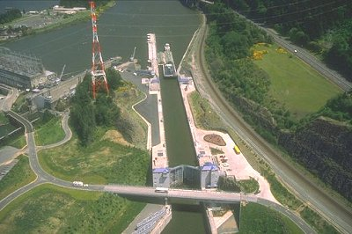
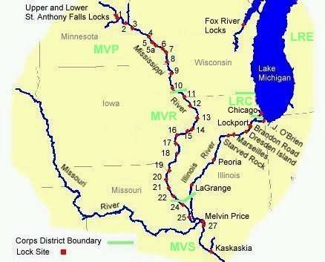
Navigation
Rivers are often impounded for navigation purposes.
Locks are constructed to allow passage of ships above dams.
“Lock and Dams” allow staged assent of rivers.

Slide 19
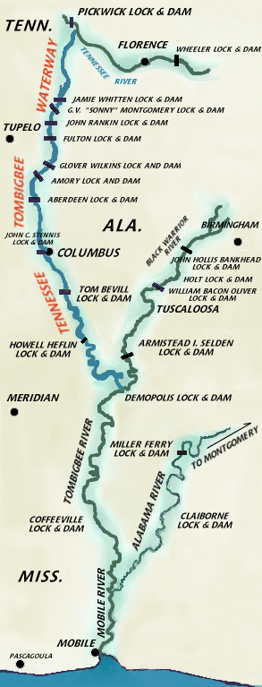
Waterway Engineering
In a few instances, historically separate rivers have been connected to short-circuit navigation.
Best known examples are Panama Canal and Tenn-Tom Waterway.

Slide 20
IFIM
Increased understanding of the biological impact of restricting or diverting the flow of rivers has spawned a new area of applied river ecology that involves determining minimum flow requirements of various species.
A popular method is the In-stream Flow Incremental Method (IFIM).
IFIM generates predictions about how flow restrictions affect the amount of usable habitat for fish by first simulating habitat preferences of fish and then determining how discharge variation influences availability of this habitat.
Establishes minimum flow criteria for dam relicensing.

Slide 21
IFIM Development and Limitations
The method was developed for small salmonid streams, but is now being applied to streams of all sizes across the US.
The approach has many limitations.
Bases fish habitat suitability simply on measure of depth, current and substrate complexity.
Nevertheless, IFIM is the only standardized method for establishing minimum flow standards.
With refinement, it should be useful for determining how much flow is required to maintain the biotic integrity of regulated stream systems.

