Slide 1
FISH TROPHIC RELATIONSHIPS

Slide 2
Do fishes conform to FFG?
Stream macroinvertebrates classify neatly into functional feeding groups because of the nature of food resources at the base of the food chain in streams.
Does the same relationship hold for stream fishes?
Apparently not…

Slide 3
Fish feeding modes
No parallels to shredders or collectors/gatherers among stream fishes.
Some fishes (e.g., Campostoma) feed by scraping periphyton from substrate, but more appropriately called herbivores.
Herbivory is not a common mode of feeding in stream fishes. However, species that exhibit this feeding strategies can account for a large amount of fish biomass.
Most "herbivorous" fishes are actually omnivores that consume invertebrates at the same time they are eating periphyton.

Slide 4
Fish feeding modes
Vast majority of fish species are macroinvertivores (analogous to predators among macroinvertebrate functional groups); feed on all of the scraping, collecting, shredding, and predatory invertebrates.
Most of the feeding specializations in fishes involve adaptations for catching invertebrate prey.

Slide 5
Active swimming
Whereas, most stream invertebrates are substrate oriented, stream fishes are more dependent on the water column (active swimmers).
Fish macroinvertivores can be subdivided into bottom feeders (benthose), midwater feeders (nekton), and surface feeders (neuston).

Slide 6
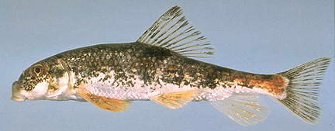
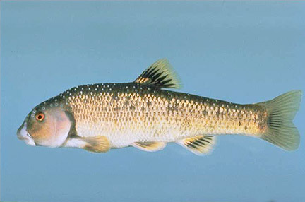
Mouth position and feeding
Mouth position is a good clue to feeding strategy in fishes.
Bottom feeders have downwardly directed (subterminal or inferior) mouths, which open below the tip of the snout.

Slide 7
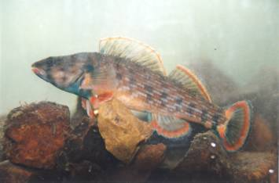
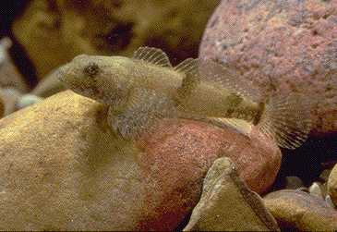
Bottom feeders
Bottom feeders can be further subdivided into epibenthic feeders and infaunal benthic feeders, which mine invertebrates from sediments.
Epibenthic feeders consume invertebrates from the top layer of substrate. The best examples are darters and sculpins.

Slide 8
Epibenthic feeders
Epibenthic invertivores pick invertebrates from the substrate surface.
They tend to have highly mobile jaws and eyes.
Some have narrow mouths for picking invertebrates from between crevices. A few actually flip stones to locate invertebrates.
In addition to darters and sculpins, catfishes, and certain bottom oriented minnows feed in this way.

Slide 9
Infaunal benthose feeders
Infaunal benthose feeders strain invertebrates from fine sediments such as sand and silt. Suckers are the dominant group.
Suckers suck up bottom sediments and water and flush them through their gills. Inner surfaces of the gill bars are modified for retaining inverterbrates, while the water and most of the suspended passes through the gills. These fishes ingest a fair amount of sediment in their diets.

Slide 10
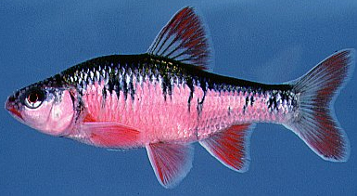
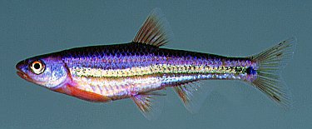
Mid-water feeders
Mid-water feeders have terminal mouths, which end at the tip of the snout.
Best examples are minnows, most of which or drift feeders.
Sunfishes and the young stages of practically all stream fishes consume zooplankton and other small macroinvertebrates picked from the water column in slack water areas.

Slide 11
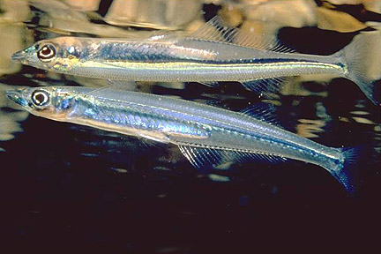
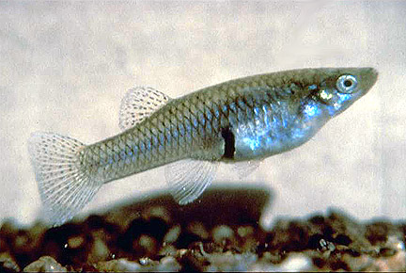
Surface feeders
Surface feeders have superior mouths, which are distinctly upturned.
Exhibit a variety of adaptations for living close to the surface, such as flattened heads and rear set dorsal fins.
Feed on spiders, waterstriders, and other insects that live in the surface tension, and terrestrial invertebrates that fall or are washed into the stream from the surrounding land.
Examples include topminnows and silversides.

Slide 12
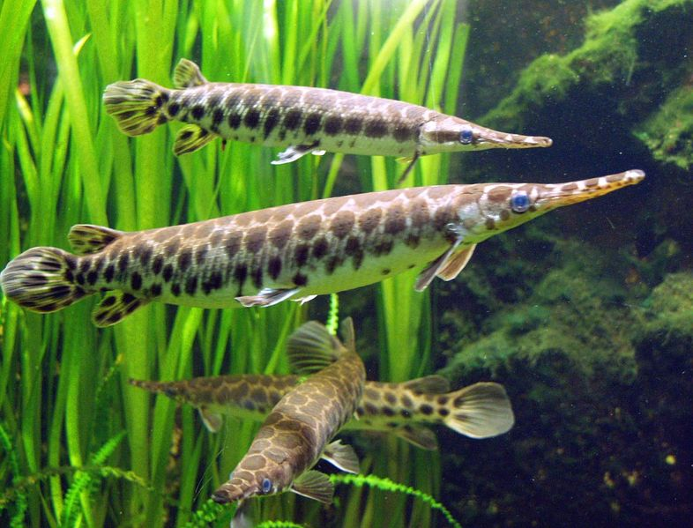
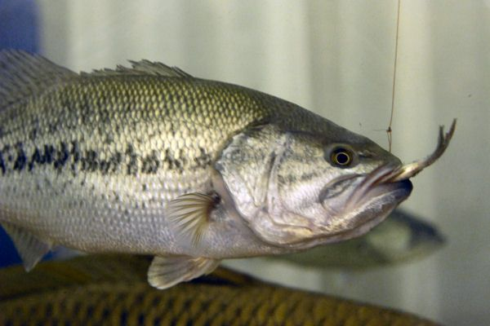
Piscivory
The other feeding mode seen in stream fishes is piscivory (fish eating).
True piscivory (year round fish eating) is exhibited by a relatively small number of fishes (bass, gar, pickerel).
Tend to have large mouths and long piercing teeth for holding prey.

Slide 13
Piscivory cont’d
Young stages of true piscivores feed on plankton and invertebrates.
A number of stream fishes feed on the larval stages of other fishes.
Fish larvae are easy prey because they are small and tend to be poor swimmers.
But available only at certain times of year.

