Slide 1
FLOW DYNAMICS

Slide 2
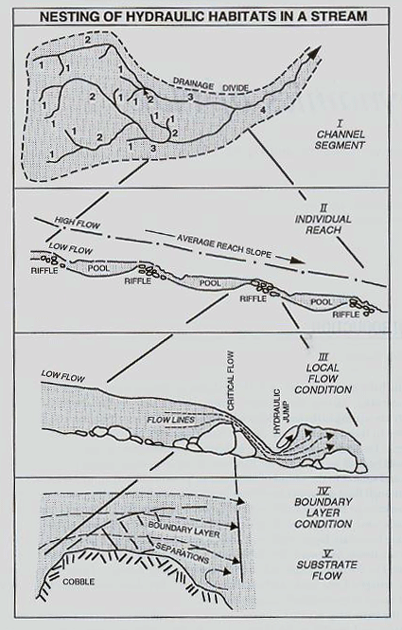
In-stream Flow Variability
Stream flow varies at different points and scales
within the stream itself.
Can talk about flow dynamics at segment, reach, habitat and microhabitat scales.
Because of the frictional forces applied by the
streambed, in-stream flow patterns are
typically non-uniform.
At stream-reach scale in alluvial valley segments, regularly recurring floods redistribute bed materials, producing riffles, pools and meanders with amazing predictability.

Slide 3
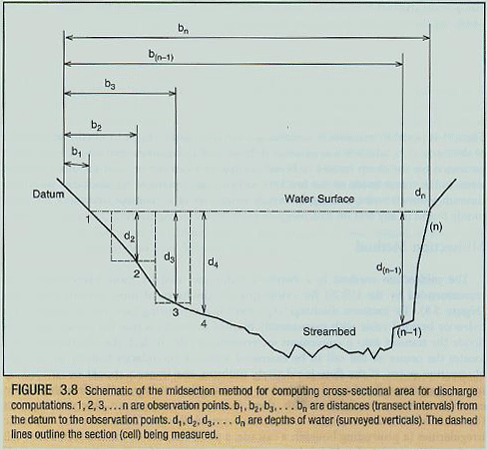
In-stream Flow Variability
Stream flow differs at different
points along the stream cross
section.
Velocities are highest just above the
thalweg (deepest point along the
channel cross section.
Thalweg is where least amount of
frictional drag (resistance to flow)
occurs.
Resistance to flow is greatest along
streambed and is a function of bed
roughness.
Stream flow at any given point in stream depends on factors like wetted perimeter
(distance along bottom of stream at particular cross section), hydraulic radius (ratio
of cross-sectional area to wetted perimeter) and hydraulic depth (ratio of cross-
sectional area to surface width).

Slide 4
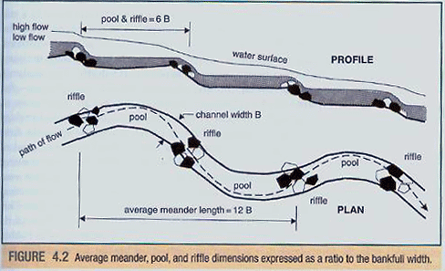
Flood flows and habitat spacing
The natural wavelength of flood flows tends to be 6 times channel width,
which roughly corresponds to the spacing of pools and riffles.
The stream channel meanders with an average wavelength of 12 bank-full
widths and each full meander tends to have two riffles and two pools.

Slide 5
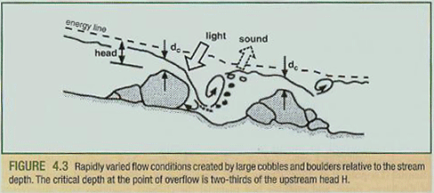
Critical Flow
At the habitat scale, flow
dynamics are dictated more
by flow momentum and
gravitational force, than by
boundary friction.
In riffles and rapids, flow can
be divided into non-uniform
components that change from
smoothly accelerating (as over or around boulders or other obstacles) to decelerating
and turbulent (as in hydraulic jumps and eddy swirls).
As flow drops over an obstacle or through a narrow gap it reaches critical (maximal)
velocity for the head of water above the obstruction.
Critical depth of flow occurs as the water passes over the obstruction and is 2/3
upstream head. The relationship between critical velocity (Vc) and critical depth (dc)
is given by: V_{c} = (gd_{c})^{½} where g is gravitational acceleration (9.81 m/s).

Slide 6
Froude Number
As water continues to accelerate
past an obstruction, it attains
supercritical flow.
This brings water into the air and
causes the whitewater plume seen
in a hydraulic jump where the flow
rapidly rotates vertically, decelerates,
and then climbs to a higher depth downstream. The splashing water and breaking
bubbles are the source of noise in a babbling brook and a roaring rapid (uniform flow
makes no noise).
The state of flow relative to critical velocity is called the Froude number and is
represented by the equation: F_{r} = V_{m}/(gd)^{½}
where V_{m} is mean velocity (m/s) and d is depth of flow (m).
Froude number has a value of 1 at critical flow; is less than one at subcritical flow
and greater than one at supercritical flow.

Slide 7
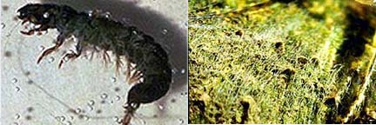
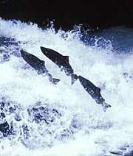
Flow and habitat
Critical and near-critical flows are efficient habitats for net-spinning caddisflies
and black flies, which use the flows to trap particulates from the water
column. Typically found along the tops of boulders or logs near the critical
flows.
Fish also take advantage of different zones of flow, moving into calmer eddies
below boulders and other obstructions to maintain position less energetically.
Salmon are able to jump over obstacles by swimming to the top of hydraulic
jumps and propelling against the tumbling water.

Slide 8
Microhabitat scale
Techniques are limited for measuring flow conditions
at the microhabitat scale. This is the scale at which
near-boundary, laminar flow conditions occur.
In the laminar boundary layer, water moves in
parallel lines without mixing.
Can think of flowing water producing shear
stresses on the streambed as it releases energy as
frictional force.
The stress is called tractive force and depends on
the density of water, the height of the water surface
(a measure of kinetic energy) and the stream
hydraulic radius. The amount of tractive force
applied determines substratum stability, size of
material transported, and density and composition
of benthic community.

