Slide 1
Section 2:
Material Transport and Storage
FLUVIAL GEOMORPHIC PROCESSES

Slide 2
Overview
This section of the course, and today’s lecture in particular, deals with the transport and storage of bed material in streams.
The study of the morphology of stream channels and flood plains is called fluvial geomorphology, a subfield of geology.

Slide 3
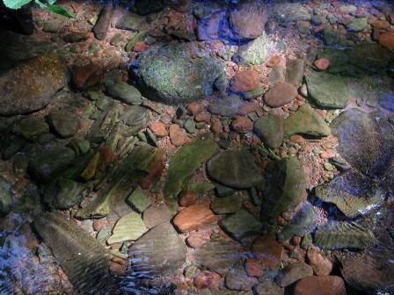
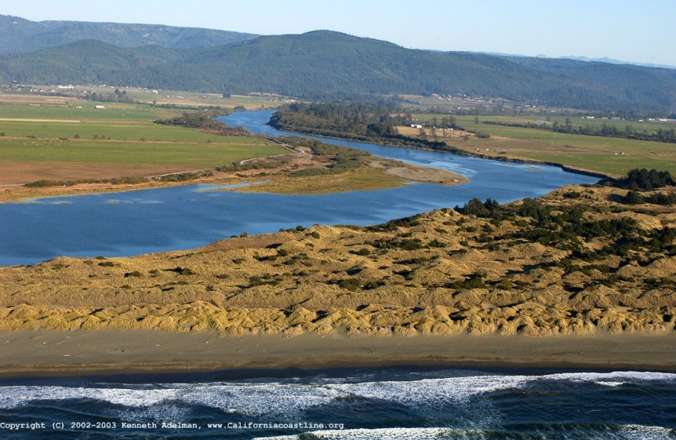
Basic Stream Morphology
All streams have the same basic morphology.
All streams have a bed composed of different types of material (e.g., bedrock, rock, cobble, gravel, sand, silt, mud, clay) washed in from the surrounding land or from subsurface rock layer.
Larger bed materials are gradually eroded, but can reside in stream beds for long periods of time.
Finer particles eventually end up on the sea floor, in coastal marshes, estuaries, or as new coastal land.

Slide 4
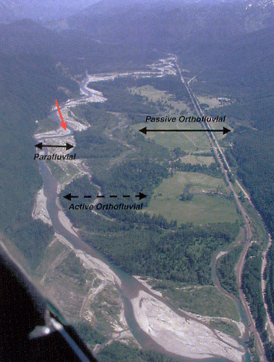
Floodplain morphology
Stream flows within floodplains bounded by high bluffs.
Zone of floodplain that contains the stream is called parafluvial zone.
Zone between parafluvial and bluffs is called orthofluvial zone.

Slide 5
Floodplain zones
Parafluvial zone is lowest in elevation and contains most of the aquatic habitat.
Orthofluvial zone is higher and has more mature vegetation, including riparian zone with extensive growths of trees (gallery forests).
Only aquatic habitats in orthofluvial zone are abandoned channels (avulsion)

Slide 6
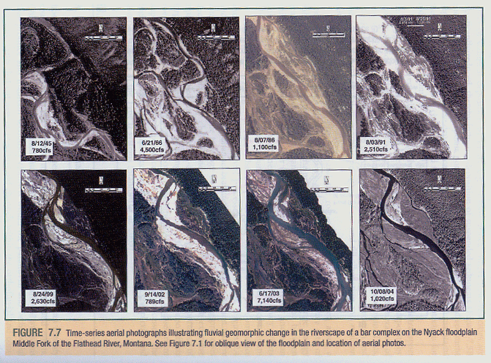
Flood flows
It is flood flows that cause the greatest amount of change in channel morphology over time.
Changes caused by repositioning bed material within floodplain.
Channel changes over time in Nyak Floodplain of Middle
Fork of Flathead River.

Slide 7
Material Transport
Inorganic material is transported to streams by two different processes: surface erosion and mass wasting.
Surface erosion is the gradual erosion of inorganic material from the surface of the land. It is more extensive where the land surface is unprotected (deserts, agricultural lands, forest clear cuts).
Mass wasting is transport of material en masse, as with a landslide or failure of a hillslope.

Slide 8
Material Transport cont’d
A number of factors influence amount of material transported to and within streams (precipitation, topography, vegetation, geology, disturbance).
Movement of inorganic material into and within streams is referred to as sedimentation or alluviation.
Stream channels increase in elevation when adding bed material (aggradation) and decrease in elevation when losing bed material (degradation).

Slide 9
Suspended sediment
There are two modes of sediment transport in streams: suspended sediment and bedload.
Suspended sediment is mass of sediment carried in water per unit of water volume.
Typically involves small silt and clay sized particles (less than 0.1mm diameter).
Sediment remains suspended in water as long as the water is moving; amount and size of sediment depends on how fast the water moves (positive relationship).
Particles between 0.1 mm and 1.0 mm diameter can be transported either as suspended sediment or bedload, depending on flow conditions (suspended at higher flows; bedload at lower flows).

Slide 10
Bedload
Bedload sediment consists of relatively large sediment (>1 mm diameter).
Measured as a mass of bed material transported past a given point per unit of time (kg/s or mt/day).
Because particles are relatively large, can't be sustained in water column very long; tend to roll, slide or saltate (bounce up and down) near the streambed.
Because of particle mass and proximity to the stream, movement tends to be slowed by frictional resistance.

