Slide 1
STREAM FOOD WEBS

Slide 2
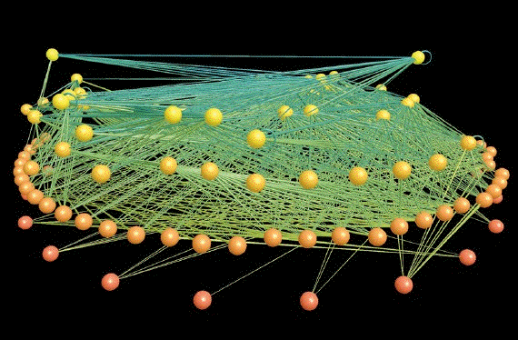
Food Webs general
A food web is a network of trophic (feeding) relationships.
Trophic interactions occur across a number of different levels (trophic levels), resulting in energy being transferred from lower to higher levels in the food web.

Slide 3
Stream Food Webs
Stream food webs typically have three or four levels.
Lowest level is occupied by living autotrophs (algae, bryophytes, vascular plants) and detritus from these organisms (most of it allochthonous).
Nature of riparian vegetation, amount of canopy cover, and watershed characteristics are the major determinants of the energy base for stream food webs, because they determine light levels, nutrients, and organic matter source.

Slide 4
Stream Food Web Complications
The task of classifying the higher trophic levels is complicated by the fact that organisms feeding at the next level (grazers, detritivores) consume microbes as well as primary producers.
Since the microbes themselves function mainly as primary consumers, the macroconsumers function as both primary and secondary consumers (somewhere between levels 2 and 3).
Secondary consumers (primary predators) can have mixed diets of detritus, diatoms and animal prey, putting them between levels 2 and 4.
Tertiary consumers (secondary predators) frequently eat algivores and detritivores (primary consumers), in addition to primary predators (between levels 3 and 4).

Slide 5
Food Web Study Approaches
There are three approaches to determining food web structure:
  1) gut analysis
  2) carbon or energy budgets
  3) stable isotope tracer studies
Will only discuss 1 and 3.

Slide 6
Gut Analysis
First step in any food web study is to identify trophic levels and linkages.
Most direct way to establish this is through gut analysis.
Gut analysis simply involves identifying and quantifying the contents of an organism's gut, using either a portion of the gut (e.g., stomach) or the whole gut.
The results are typically reported as percentage of guts an item is found in and the mean number of a particular prey item over all guts examined.

Slide 7
Gut Analysis cont’d
Gut can also be weighed to estimate the biomass of food eaten or oxidized (burned) to determine the organic matter content.
Must keep in mind that material found in the gut (especially the hindgut) is not an accurate measure of what was eaten.
Some of the food will have been digested (particularly soft parts), some food items will not be identifiable.
Also, diets change diurnally, seasonally and with age. It is important to be comprehensive in sampling to represent these changes.

Slide 8
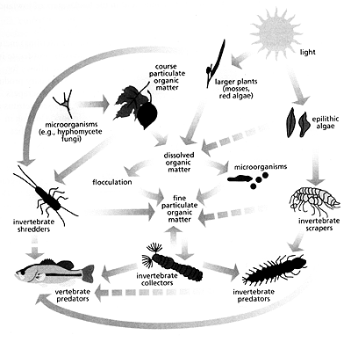
Food Web Diagram
The gut analysis results are used to construct a food web diagram.
The diagrams show the linkages among the different prey items and predators identified.
The food web can then be used to develop and test hypotheses about linkages and effects of different environmental conditions on food web structure or community stability

Slide 9
Stable Isotope Analysis
Second major approach to trophic analysis is stable isotope analysis.
Allows an investigator to look at transfers of organic carbon and nitrogen among trophic levels.
Because the ratios of carbon (¹³C:¹²C) and nitrogen (¹⁵N: ¹⁴N) isotopes differ in different types of organic matter, one can identify the source of the carbon or nitrogen by determining these isotopic ratios.

Slide 10
Stable Isotope Analysis cont’d
Organisms consuming different organic matter types will reflect the isotopic ratio of their food.
For example, if diatoms have one value (e.g., ¹³C = -30 relative percent), and streamside vegetation has another (¹³C = -14), instream grazers are likely to have ¹³C levels closer to the diatoms, whereas detritivores are likely to have levels closer to that of the streamside vegetation.

Slide 11
Isotopic Enrichment Ratios
Animal tissues tend to be significantly enriched in ¹⁵N relative to their food (2 to 4 relative percent).
This can be used as an indicator of trophic level: higher the ¹⁵N enrichment; higher the trophic level (e.g., organism with a ¹⁵N value of 6 would be considered to be at a higher trophic level than one with value of 3.5).
Conversely, ¹³C exhibits only slight enrichment in animals (1 relative percent or less) relative to their food.
Because the trophic transfer shift is small in carbon isotopes, but large in nitrogen isotopes, the combination of these isotopes can be used to assess organic matter transfer pathways in ecosystems.

Slide 12
Isotopic Enrichment Assays
If the isotopic ratios of different carbon and nitrogen sources don't vary, then it is not possible to distinguish sources by this method.
However, one can deliberately introduce a carbon and nitrogen source with a distinctive isotopic signal (e.g., corn leaf detritus or heavy isotope enriched ammonium), then look for this signal in organisms at higher trophic levels.
Detritus entering from the riparian zone, and organisms dependent on this detritus, will not have these ratios.

Slide 13
Food Web Studies
Two studies illustrate the ways is which stream organisms form food webs and the importance of these food webs to community structure:
  Power and Matthews (1983) Algae-grazing minnows (Campostoma anomalum), piscivorous bass (Micropterus spp.) and the distribution of attached algae in a small prairie-margin stream. Oecologia 60: 328-332.
  Power, M.E. 1990. Effects of fish in river food webs. Science 250: 411-415.

Slide 14
Power and Matthews 1983
Examined the relationship between an algal grazing minnow (Campostoma anomalum), its main predators (largemouth and spotted basses), and the distribution of stream algae in a small prairie margin stream in Oklahoma.
Pools with Campostoma were observed to be barren, whereas pools in which Campostoma were apparently excluded by bass supported large standing crops of filamentous algae.
Campostoma grazed actively on algae-covered stones transferred into their pools.
After a day of exposure algal biomass on the stones was reduced from 22 to 6 mg AFDM.
When a largemouth bass was tethered in the pool with Campostoma, the minnows did not feed within 30-50 cm of the bass.
The results suggested that interactions between Campostoma and their predators are important for determining pool to pool variation in the distribution of attached algae.

Slide 15
Power 1990
Examined the role of fish in the food web of a California stream.
The fish (California roach and juvenile steelhead) consumed predatory insects and fish fry, which fed on algivorous chironomid (midge) larvae.
In the presence of fish, filamentous algae were reduced to low prostrate webs that were infested with chironimids.
When fish were prevented from preying on the predatory insects and fish fry that normally suppress the chironomids, algal biomass was higher and covered by diatoms and cyanobacteria.
The results of the manipulations suggested that an important theory of trophic control - the Hairston, Smith, Slobodkin, Fretwell theory - applies to river communities.
The theory states that plants will be alternately limited by resources or herbivores in food webs with odd and even numbers of trophic levels.

