Slide 1
HETEROTROPHIC MICROBES AND FUNGI

Slide 2
Overview
The organisms we address in this section are microscopic decomposers and consumers that are part of a community associated with submerged surfaces such as rocks, leaves, wood, interstitial waters, and waters overlying the sediment surface.
Included are microscopic bacteria, protists, and fungi.
They play an important role processing DOM and FBOM in streams.
They are in turn consumed by other stream organisms (meiofauna).

Slide 3
Benthic Microbes
Benthic microbes remove DOM from the surface water and assimilate it, thereby transferring it to biomass on/in the stream bottom.
Presence and action of these organisms is documented by measuring the disappearance of DOM.
Such studies have revealed that some sources of DOM are removed more readily than others, suggesting differences in DOM quality.

Slide 4
DOM Quality
When we speak of the quality of organic matter, we are actually interested in the ability of organisms to use it as a food source.
For heterotrophic microbes, DOM quality is measured as the metabolic response of microbes to different forms of DOM, i.e., leachate from different types of leaves (not well studied).
Heterotrophic microbial production changes seasonally due to changes in temperature and the availability and quality of DOM.

Slide 5
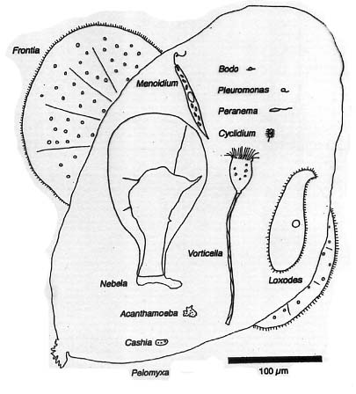
Phagotrophic Protists
In addition to bacteria, heterotrophic microbial community includes particle consuming (phagotrophic) protists.
These single-celled eukaryotes - including some single celled algae (mixotrophs) - are also important consumers of bacteria (bacterivores).

Slide 6
Protists cont’d
Phagotrophic protists are more commonly associated with sediments than with the water column.
Quantifying protistan component of the benthic microbial community not only establishes the role protists play in total microbial heterotrophy, but also in bacterial production dynamics.

Slide 7
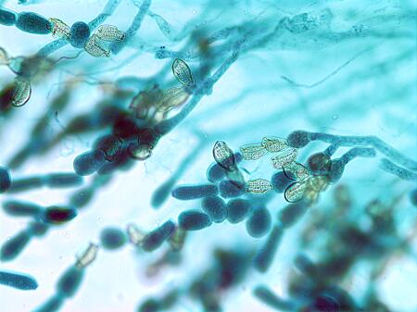
Fungi
From their appearance, we might be
tempted to think of fungi as more
plant-like than animal like, but they
are evolutionarily more closely
related to animals.
Fungi share with animals the ability to export hydrolytic enzymes that break down biopolymers, which fungi then absorb for nutrition.
Rather than requiring a stomach to accomplish digestion, fungi live in their own food supply and simply grow into new food as the local environment becomes nutrient depleted.

Slide 8
Aquatic Hyphomycetes
All phyla of true fungi can be found in streams (Chytridiomycota, Zygomycota, Ascomycota, and Basidiomycota).
Kinds of fungi most often encountered in streams, and the most important ecologically, are actually the asexual stages (hyphomycetes) of ascomycetes and basidiomycetes.
Hyphomycetes complete entire life cycle under water, starting with colonization of a suitable substrate (non-living organic matter), mycelial growth and abundant sporulation.

Slide 9
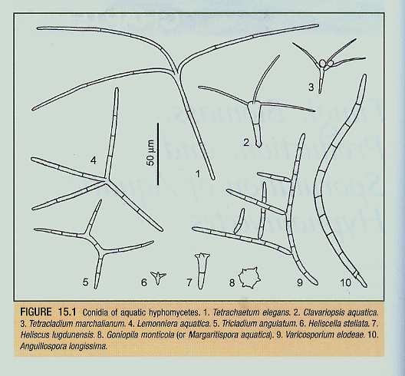
Conidia
Up to 80% of fungal production in streams is invested in conidia (asexual spores).
A component of FPOM.

Slide 10
Fungal Role
Fungi are primary decomposers of CPOM (account for 95-99% of microbial biomass associated with decaying plant matter.
“Condition” plant matter; increase palatability, nutritious value to aquatic invertebrates.
Mineralize organic carbon of plant litter.
Release FPOM (including conidia) and DOM from plants and other organisms.

Slide 11
Measuring heterotrophy
Heterotrophic activity consumes oxygen, so the most common method of measuring microbial community metabolism is to look at changes in oxygen concentration (respiration).
Other approaches include use of redox dyes to estimate numbers of respiring organisms, radioisotopic techniques for estimating bacterial productivity ([3H] leucine), and use of settling chambers and fluorescence microscopy to enumerate preserved bacteria, protists and fungal spores.

