Slide 1
LANDSCAPES AND CATCHMENT BASINS

Slide 2
STREAMS
Streams are flowing bodies of fresh water.
They vary in size from small brooks to the large rivers.
They are formed by water falling on the land as precipitation and gradually making its way to the sea (ultimate receiving basin).

Slide 3
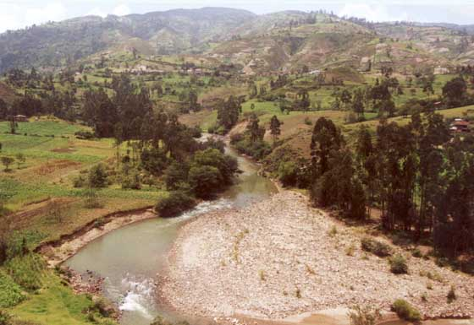
Hill Slope
Streams flow because the land has topographic relief in the
form of mountains, hills, terraces or (stream-cut) canyons.

Slide 4
Runoff vs. subsurface flow
Water enters streams in two forms: runoff (water running over the surface of the land) and subsurface or hyporheic flow (groundwater).
Proportions of each depend on permeability or porosity of the land.
Streams that receive most flow as runoff are ephemeral or intermittent (dry up after rainfall events).
More water that enters the groundwater, the longer water is stored in watershed and longer it charges the streams.

Slide 5
Bed Material
When water flows over rocks and soil on land it picks up material (erosion).
Faster water flows; the more and bigger the material it can carry (suspended sediment and bedload).
As the water slows, the material falls out of suspension (sediment deposition; sedimentation; alluviation) forming the stream bed.
Bed material is coarse where stream flows fast (erosional areas) and fine where stream flows slowly (depositional areas).

Slide 6
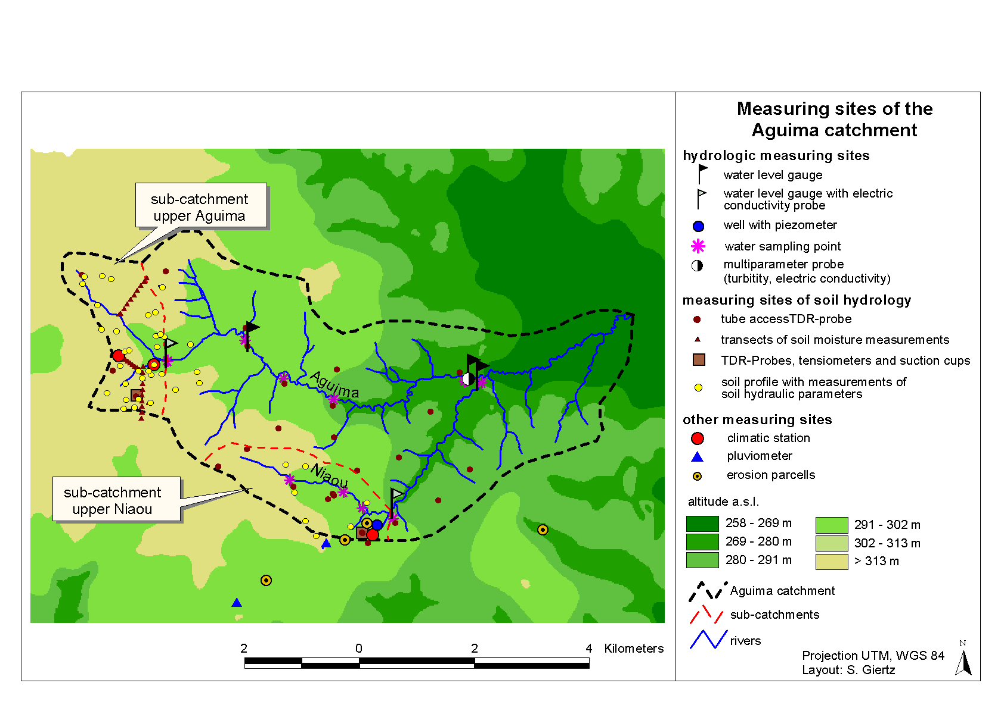
Catchment / Watershed
From a broader landscape perspective streams encompass not only its water
column and bed, but all of the land area the stream is collected from (catchment,
drainage area or watershed).

Slide 7
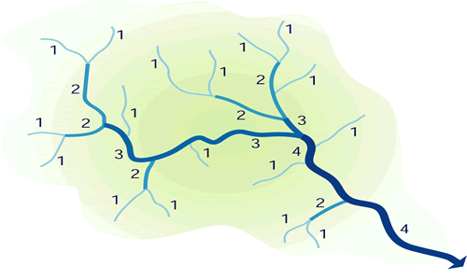
Strahler Method of Stream-Size Classification
A popular method of classifying
stream size uses a geometric
progression of orders (stream order
classification).
Smallest streams (typically those
originating at the highest elevations
within the catchment) are called 1st
order streams. These don't receive other
streams and are often intermittent.
Stream order increases only where streams of like order meet: increases to
second order only where two 1st order streams meet; 3rd order streams form
only where two 2nd order streams meet; and so on.
1st to 3rd order streams are typically referred to as headwater streams. Streams
are no longer wadable when they exceed 5th order. The lower Mississippi River is
an 11th order stream.

Slide 8
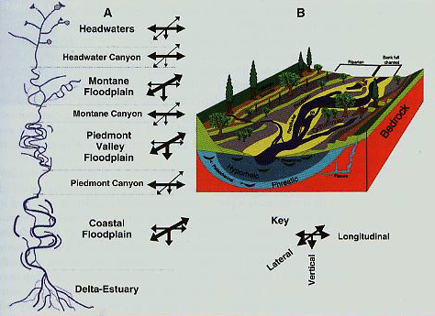
Stream dimensions
Streams have four dimensions:
Longitudinal (upstream
to downstream)
Lateral (mid-channel to
adjacent shore)
Veritical (water surface
to substratum)
Time (seasonal or
longer-term changes
in conditions)

Slide 9
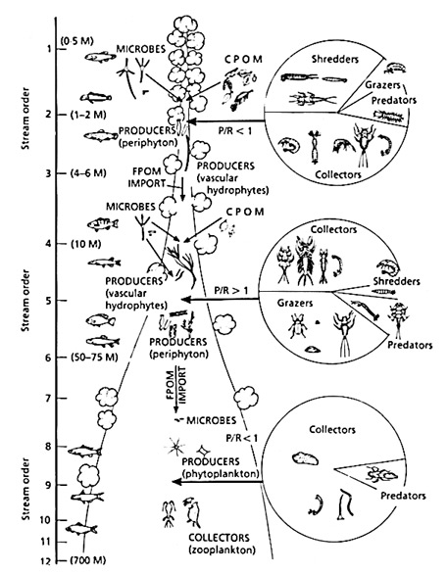
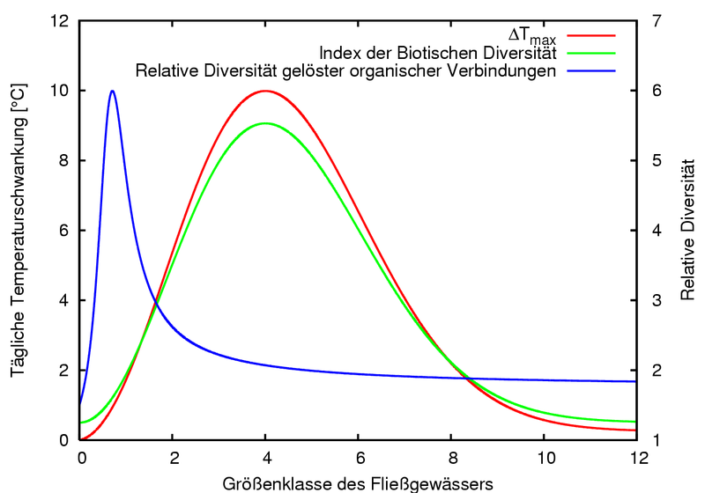
River Continuum Concept
As a stream increases, incident light,
nature of organic inputs, photosynthesis
and respiration, temperature variability,
turbidity, and structure and function of
biotic communities all change in a
predictable fashion.

