Slide 1
LEAF BREAKDOWN

Slide 2
CPOM
The primary source of energy for streams (especially small streams in forested regions) is leaves and other CPOM from the surrounding riparian vegetation.
In temperate regions, most of the leaf fall occurs in autumn when deciduous trees lose all of their leaves.
A small amount of leaf fall or leaf wash-in occurs throughout the year.

Slide 3
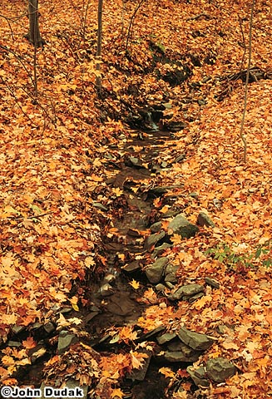
Leaf Fall
Dead leaves entering streams in fall have low nutritional value (lack most of the nutrients present in green leaves).
From the time they enter streams, leaves undergo a predictable cycle of breakdown that allows them to be utilized by animals.

Slide 4
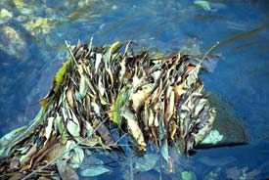
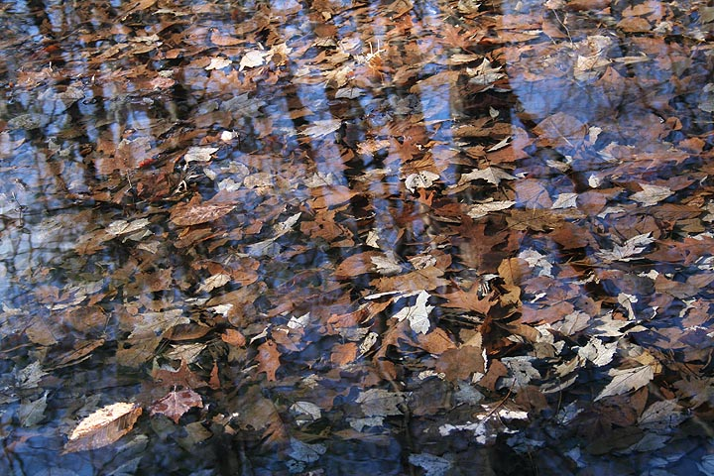
Leaf Fall
In upland streams with course substrates, leaves get caught among rocks and form packs (leaf packs).
In lowland streams, leaves form large deposits in pools (leaf beds).

Slide 5
Leaf Breakdown
Within 1 or 2 days of entering the stream, the remaining nutrients are leached out.
The material left (cellulose and lignin) is difficult for animals to digest.
The leaves are first colonized by bacteria and fungi, which secrete enzymes that begin to digest the leaf (microbial conditioning).
Two weeks of microbial conditioning would be sufficient to cause the leaves to fragment. However, shredders colonize before this time and tear the leaves into pieces (orts) in the process of eating the bacteria and fungi.
The orts then serves as food for collectors.

Slide 6
Breakdown Rates
All leaves do not break down at the same rate.
Rates vary among tree species based mainly on physical and chemical properties of leaves.
These properties may increase conditioning time or the ability of microbes and shredders to colonize leaves.
The different breakdown rates help to ensure that leaf matter will be available for a longer portion of the annual cycle than would be the case if all breakdown rates were the same.

Slide 7
Leaf Storage
All leaves that fall in autumn don’t enter the stream at the same time.
They may be stored in the riparian zone for some time as part of the humus layer in the forest floor, entering after rainfall events or blown in by the wind.
A similar process of leaf breakdown occurs on land, aided by terrestrial invertebrates.
Leachate from terrestrial leaves enters streams with groundwater as humic acid.
Orts enters with runoff.

