Slide 1
LIGHT, TEMPERATURE, OXYGEN / HYPORHEIC FLOW

Slide 2
Overview
Sun is the ultimate source of light and heat in most aquatic and terrestrial ecosystems.
Opportunities for direct lighting in streams limited mainly by shading of riparian vegetation (small streams) and turbidity (large rivers).
Degree of shading influences solar heating, which in turn influences stream temperature.
Stream temperature also influenced by the amount of hyporheic flow a stream receives.
Oxygen is important to heterotrophic organisms and in many chemical reactions key to how streams function.

Slide 3
Light
Important for photosynthesis by aquatic plants and visual behavioral activities of animals.
Light penetration to streams is reduced by overhanging vegetation, steep canyon walls, and suspended material in the water (turbidity).

Slide 4
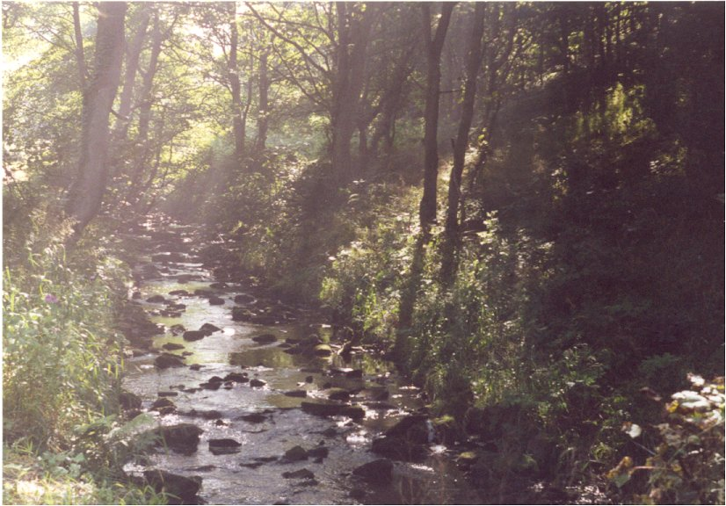
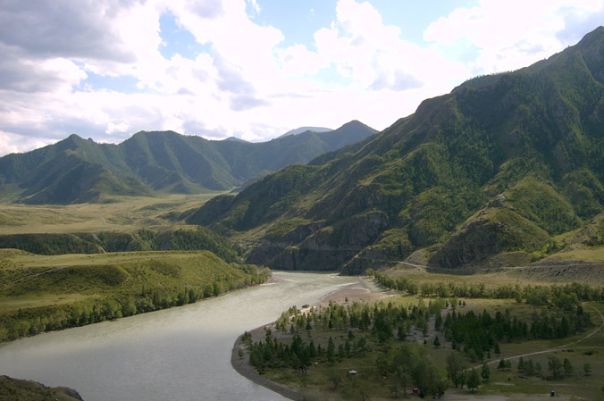
Light cont’d
Canopy shading restricts lighting in small streams. Canopy is open in large
rivers, but light penetration often restricted by high turbidity.

Slide 5
Light cont’d
Bands of solar radiation in the 400 - 700 nm range are visual bands utilized by autotrophs (photosynthetically active radiation or PAR).
As a result of ozone depletion, bands of radiation in the ultraviolet range (e.g, UV-B radiation), which are harmful to plants and animals, are becoming more prevalent.

Slide 6
Photon Flux Density
Light is measured in photons.
Number of photons in the 400-700 nm range falling on a specific area per unit time called photon flux density (PFD).
In a typical, unshaded stream, PFD can reach 2000 umol/m2 s at midday.
PFD influenced by seasonal changes in sun angle, day length, and phenological changes in stream-side vegetation (latter can cause incident light to differ by two orders of magnitude in deciduous forests).

Slide 7
Photon Flux Density cont’d
PFD also varies spatially depending on stream width, depth, proximity of a particular habitat to shore, canopy gaps.
As stream size (width) increases, riparian vegetation shades progressively less of the stream channel.
One of the biggest impacts of human disturbance in streams is removal of stream-side vegetation, so that even small streams receive large amounts of light.

Slide 8
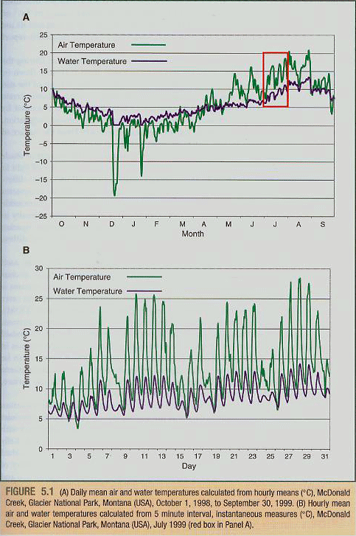
Temperature
Streams exhibit same pattern of diurnal temperature variation as terrestrial habitats (warmer by day, cooler at night).
Flux is not as great as in air because of the nature of streams and the high latent heat of water (resists temperature changes).

Slide 9
Temperature
Temperature varies in different stream habitats, depending mainly on depth, shading/incidence of light and influence of ground water flow.
Groundwater makes stream cooler in summer, warmer in winter.

Slide 10
Oxygen
Oxygen carried in water as a dissolved gas (dissolved oxygen or DO).
Amount of oxygen that dissolves depends on water temperature (inverse relationship) and amount of contact the water has with air (positive relationship with atmospheric pressure).
Because streams flow (agitation of water causes lots of contact with air) streams are typically well saturated with DO (80% or more).
Upwellings of interstitial waters of the hyporheic zone can cause considerable spatial variability in DO between habitats.

Slide 11
Oxygen cont’d
Biological activity can also cause spatial variability in DO.
Microbial activity in leaf packs or debris dams lowers DO
Dense living vegetation increases DO by day.
Organic enrichment is biggest factor affecting DO in polluted streams because of increased biological oxygen demand (BOD).

