Slide 1
MACROINVERTEBRATE TROPHIC RELATIONSHIPS

Slide 2
Trophic-level classification
Organisms in a food chain are typically assigned to different trophic levels (producers, primary, secondary, tertiary consumers, decomposers).
Stream macroinvertebrates do not fit nicely into this type of classification system.
Tend to consume across trophic levels (variety of plant, animal and microbial foods) in the course of a typical feeding.
Snail that feeds by scraping periphyton from rocks, consume algae, microbes, meiofauna, and early instars of certain insects.

Slide 3
Constrained Feeding Strategies
However, because of the prevalence of periphyton in streams, "scraping" is a popular functional mode of feeding, exhibited by a variety of macroinvertebrates.
Because of nature of food energy inputs to streams, and food production deriving from those inputs, macroinvertebrates have evolved a limited number of morphological and behavorial adaptations for utilizing these resources (convergent evolution).
Periphyton scraping mouth parts are seen in a variety of caddisfly, mayfly and beetle larvae (not to mention the stoneroller).

Slide 4
Functional Feeding Groups
More appropriate to classify trophic relationships of macroinvertebrates on the mechanism of food acquisition, than on the type of food eaten.
The functional feeding group classification of Cummins and Merritt is based on feeding mode.
Recognizes four basic categories of food in stream ecosystems (CPOM, FPOM, periphyton, and prey) and four basic macroinvertebrate feeding modes designed to utilize each of these food types (shredders, collectors, scapers, and predators).

Slide 5
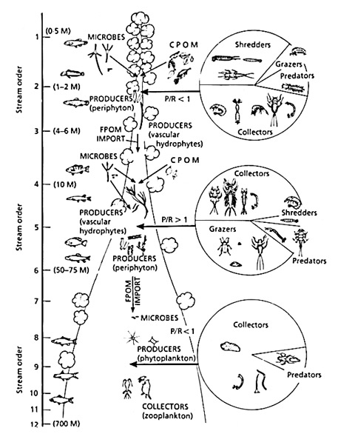
Invertebrate Functional Groups
Shredders
Collectors/Gatherers
Grazers
Predators

Slide 6
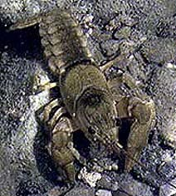
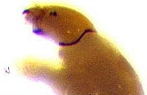
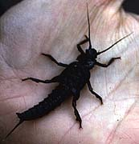
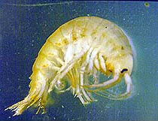
Shredders
Shredders: food particle sizes > 10³ microns; all are chewers or miners on living plants or decomposing leaf and woody debris (CPOM).

Slide 7
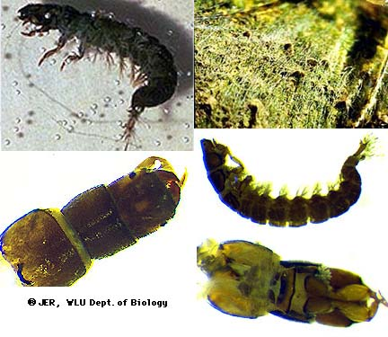
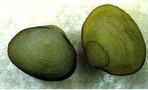
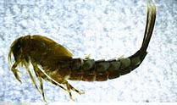
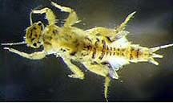
Collectors/Gatherers
Collector/Gatherers: particle sizes < 10³ microns; includes filter or suspension feeders that feed on living algae and detritus, plus deposit feeders that feed on fine particles deposited in sediment.

Slide 8
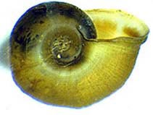
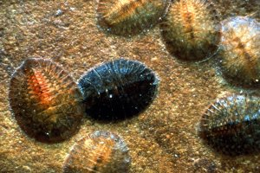
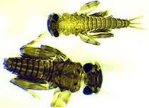
Scrapers
Scrapers: particle sizes < 10³ microns; includes mineral scrapers (herbivores that feed on periphyton associated with rocks) and organic scrapers (herbivores that feed on periphyton associated with wood).

Slide 9
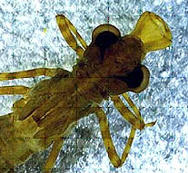
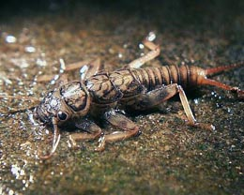
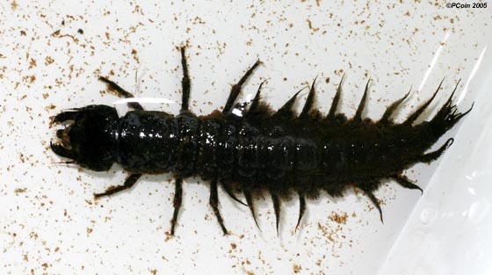
Predators
Predators: particle sizes > 10³ microns; includes engulfers or swallowers (carnivores that eat animals whole or in large parts), and piercers (carnivores that feeding on cells or tissue fluids).

Slide 10
Advantages of FFGC approach
FFGC approach allows assessment (numerical or by standing biomass) of the degree to which macroinvertebrates depend on a particular food resource.
Makes apparent the relationship between food resources and the adaptations of organisms that utilize those resources.
Relative importance of different food resources changes from headwaters to mouth in streams (RCC). FFGC sensitive to these changes. Allows stream ecologists to understand relationships under both natural and disturbed conditions.

Slide 11
FFG Ratios
Ratios of various functional feeding groups are useful indicators of:
  the relative importance of autotrophy vs. heterotrophy,
  ratios and sizes of CPOM/FPOM,
  whether FPOM is predominantly in transport or in storage,
  and stream channel stability.

Slide 12
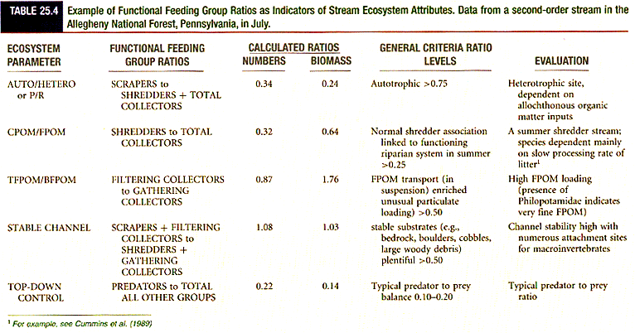
FFG Ratio example
Shaded nature of the stream is reflected in the low numbers and biomass of scrapers.
Stream is distinctly heterotrophic and dependent on allochthonous organic matter
from the riparian zone (dominance of shredders and collectors).
Large numbers of shredders indicate that the system is a "summer shredder stream",
dependent on litter with a long conditioning time (time it takes litter to be sufficiently
colonized by stream microbes, which render it useable by shredders).
Abundance of filtering collectors relative to gathering collectors indicates that a
significant amount of FPOM is in transport.
The high ratio of scrapers + filtering collectors to shredders + gathering collectors
indicates that the channel is stable (plenty of stable attachment surface available).
Predator abundance is in balance with prey. A higher ratio would signal high predation
and likelihood of dominance of prey with short life cycles and high turn over rates
(decreased prey diversity).

