Slide 1
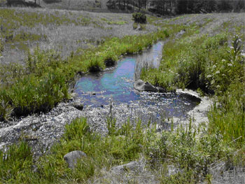
Macrophytes and Bryophytes

Slide 2
Stream Macrophytes
Macrophytes literally translates “large plants”
Includes Bryophytes (liverworts, hornworts, mosses) and Vascular plants
Classified based on life form as obligate submerged and emergent or amphibious
Primarily seen in mid-size streams.

Slide 3
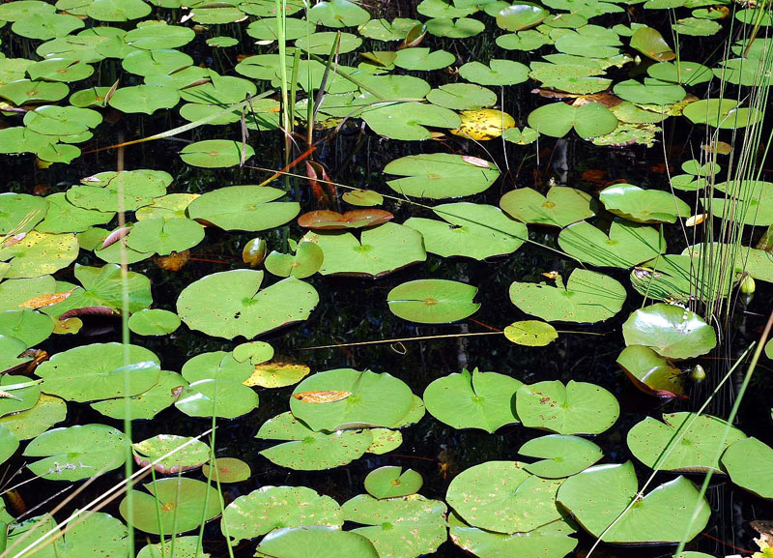
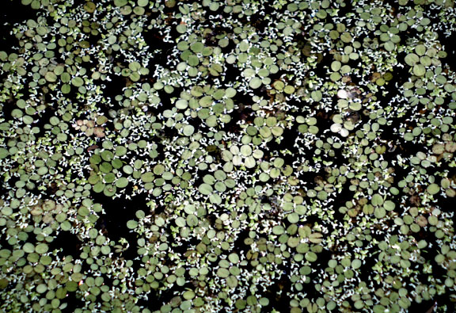
Backwaters and Large Rivers
Floating leaves (e.g., pond lilly) and free floating (e.g., duckweed) macrophyles are found in backwaters of large rivers.
Turbidity prevents establishment of most macrophytes in river mainstem.

Slide 4
Bryophytes
Includes Liverworts (Marchantiophyta), Hornworts (Anthocerotophyta) and mosses (Bryophyta).
Adult plants have only one set of chromosomes (haploid), and lack lignin, tracheids and true roots (rhizoids).
Alternation of Generations
Reproduce sexually and asexually

Slide 5
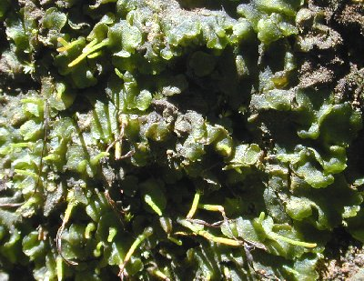
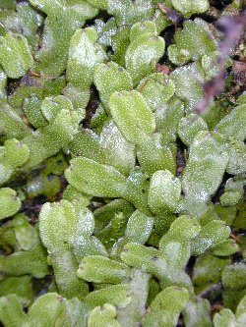
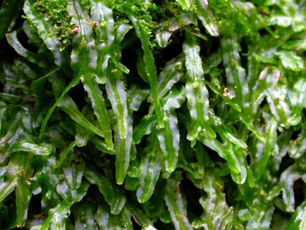
Liverworts and Hornworts
Thalloid (no stems or leaves) and leafy forms (distinct stems and leaves present).
Both forms have a flattened aspect and most (especially thalloid forms) exhibit prostrate growth.

Slide 6
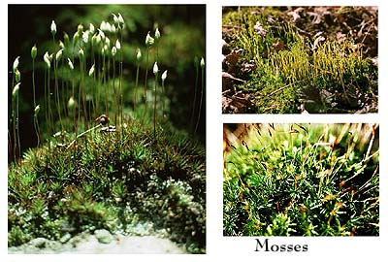
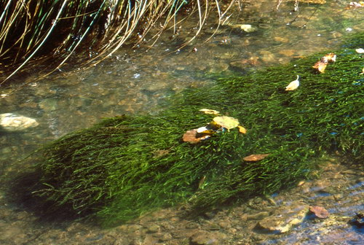
Mosses
Not as flattened or prostrate as liverworts and hornworts; more distinct leaves and stems
Cover surfaces on shore or stream bottom in shallows
Species differentiated based mainly on shape and color

Slide 7
Bryophyte habitat
Unlike other aquatic autotrophs, bryophytes can’t use carbonate as a direct carbon source in photosynthesis; restricted to acid streams where dissolve CO₂ is abundant.
Tend to occur in faster water than vascular plants.
Tolerate less light than vascular plants.

Slide 8
Bryophyte ecology
Little known about role in stream ecosystems.
Perennial and resistant to decay.
High secondary compound content discourages herbivory and microbial decay.
Able to sequester toxic chemicals and remove from ecosystem.
Useful for bioremediation.

Slide 9
Vascular Plants
Distribution and abundance in streams strongly influenced by flow and light levels.
Tend to occur in sandy or gravelly areas where seed and root set occurs more readily.
Limited or absent where flood flows frequent and mean flow exceeds 1 m/sec
Tend to occur in open canopy (well-lit), mid order streams, not small or large rivers.

Slide 10
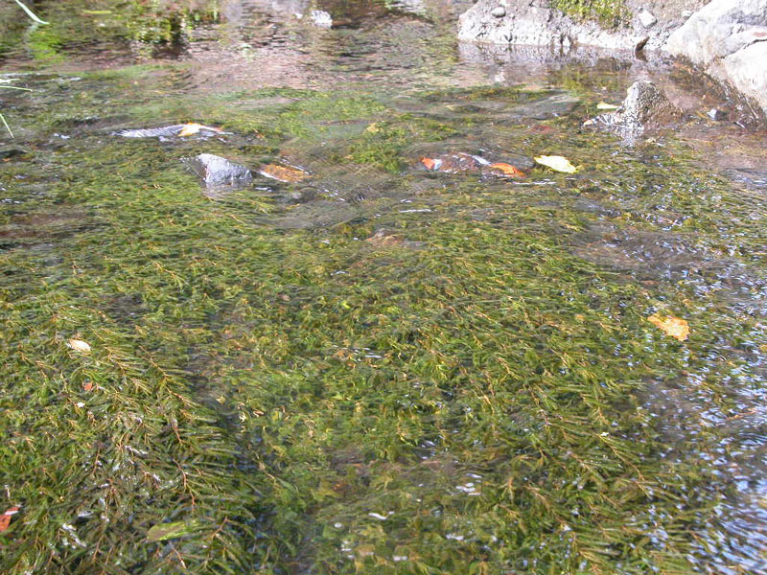
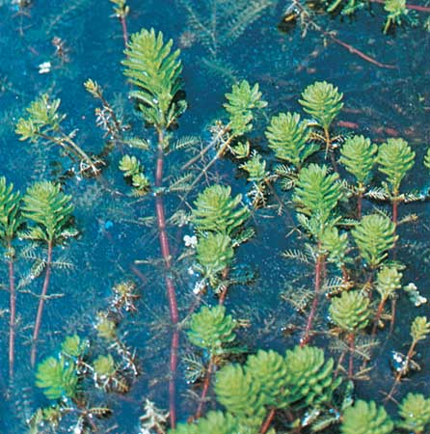
Obligate Submerged
Lives permanently submerged in water; only rarely exposed.
Common examples include Potamogeton sp. and Myriophyllum sp.

Slide 11
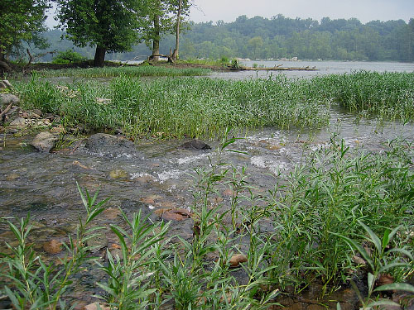
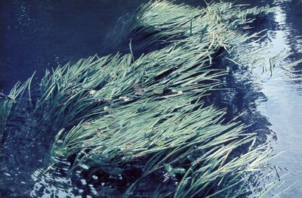
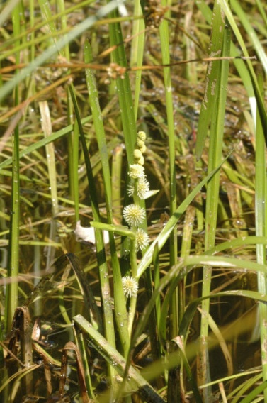
Emergent or Amphibious Plants
Found mainly along the stream margin.
Tops often exposed, but
can tolerate even prolonged inundation.
Some have different water and land forms (e.g., Sparangium emersum).

Slide 12
Ecological Role
Dense growths of macrophytes can reduce flow and affect substrate composition.
Trap CPOM and attract invertebrates, which accelerate CPOM processing.
Provide substrate for periphyton.
Attract fish and other aquatic macrofauna.

