Slide 1






MEIOFAUNA

Slide 2
Meifauna
Meiofauna is a community of small benthic animals that live in and among substrates in streams and other aquatic habitats.
Most are so small that one has to strain to see them.
Yet in terms of abundance they typically constitute more than 95% of the benthose in streams.

Slide 3
Definition
The technical definition of meiofauna is that portion of the animal fauna that passes through a 500 m sieve, but is retained on a 40 m sieve (excludes Protozoans = microfauna).
Stream meiofauna communities are dominated by rotifers, harpacticoid and cyclopoid copepods, young chironomids, naidid and enchytraeid oligochaetes, and nematodes.
Other components include flatworms, gastrotrichs, tardigrades, cladocerans, ostracods, mites, and the larvae of various insects. There can be 100 or more species in a local community.

Slide 4
Meiofauna classification
Meiofauna feed on plants, microbes and microfauna, and are themselves food for macrofauna.
Most meiofauna are permanent. Some (insects) grow into macrofauna (temporary meiofauna).
Stream ecologists divide meiofauna into epibenthic, interstitial, and burrowing groups.

Slide 5
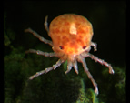
Epibenthic meiofauna
Epibenthic meiofauna live on or above the streambed, wood, leaves, or plants.
Tend to be the largest and best swimming meiofauna.
Examples include harpacticoid and cyclopoid copepods, cladocerans, ostracods, mites and certain insects.

Slide 6
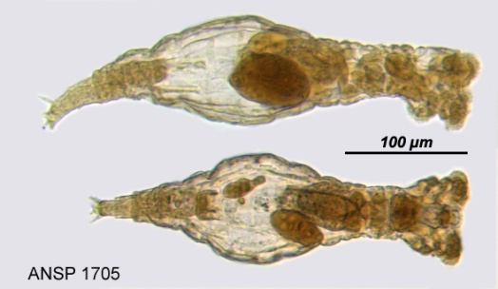
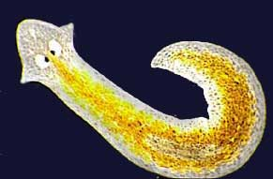
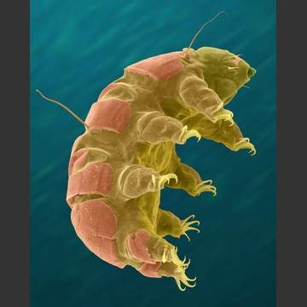
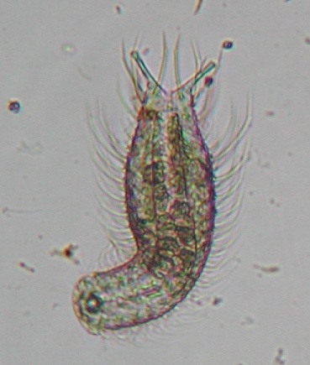
Interstitial meiofauna
Interstitial meiofauna live among sand and larger-sized substrate particles; they tend to have adhesive organs for holding position.
Examples include rotifers, copepods, chironomids, gastrotrichs, flatworms and tardigrades.

Slide 7
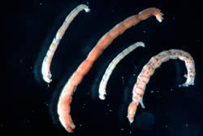

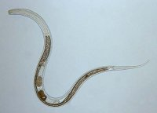
Burrowing meiofauna
Burrowing meiofauna live in fine sediments (muds); they are adapted for burrowing.
Examples include chironomids, naidid and enchytraeid oligochaetes, and nematodes.

Slide 8
Limiting factors
The two physical factors that most limit meiofauna populations are DO and water flow.
Most meiofauna are obligate aerobes, so DO is obviously an important factor limiting meiofauna distribution.
Tend to be limited to top few centimeters of sediment and are more abundant where surface water DO is high.
Sediment grain size is a good predictor of meiofauna abundance (influences interstitial water flow and DO).
Meiofauna tend to be more abundant, diverse, and penetrating in gravelly substrates than in sand.

Slide 9
Flow
Flow is another important factor governing the distribution of meiofauna, because of how it influences substrate composition and suspension of organisms in water.
Moderate flows and downdrafts (riffles) benefit interstitial and burrowing meiofauna.
High, scouring flows, redistribute sediment and displace meiofauna.

Slide 10
Meiofauna abundance
In temperate streams, meiofauna abundances peak from late spring to early fall (reaching density of up to 6,000,000 organisms/m².
Meiofauna production rivals that of some macrofauna and accounts for a large fraction of benthic respiration in streams.

