Slide 1
MACROINVERTEBRATE MOVEMENTS

Slide 2
Movement/Dispersal
Movement (a.k.a. dispersal) is the process of being actively or passively transported from one place to another.
Active (self propelled) movement is called migration.
Colonization is the process of inhabiting a new area, or reinhabiting an area that was formerly inhabitated (recolonization).

Slide 3
Types of Movement
Four routes of movement:
Downstream
Upstream
Vertical
Aerial

Slide 4
Downstream Movement
The most common direction of movement of organisms in streams is downstream movement, either by active crawling or (most commonly) by passive drift.
Drift is the downstream movement of organisms by stream flow. The term is usually applied only to benthic macroinvertebrates.
Drift occurs all the time, but is more common at night and has distinct diel peaks just after dusk and before dawn.
Changes in light levels trigger behaviors that result in organisms releasing themselves to the water column

Slide 5
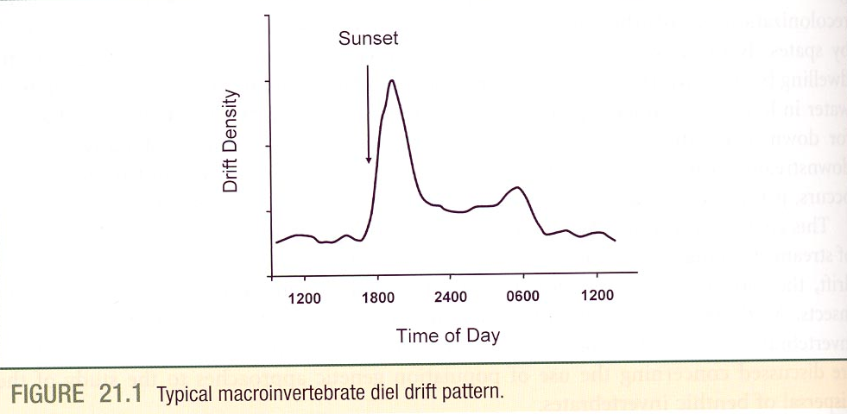
Drift

Slide 6
Drifters
A wide variety of macroinvertebrates drift (insects, crustaceans, mollusks, annelids), but insects make up the largest portion.
The fact that drift is constantly occurring means that downstream areas can be quickly recolonized following disturbances.

Slide 7
Why drift?
A variety of explanations have been offered for why invertebrates drift (escape from predators or competitors, avoidance of unfavorable water).
Most logical explanation is dispersal.
Drifting invertebrates are subject to predation by sight-feeding fish; this explains why it is more common at night.

Slide 8
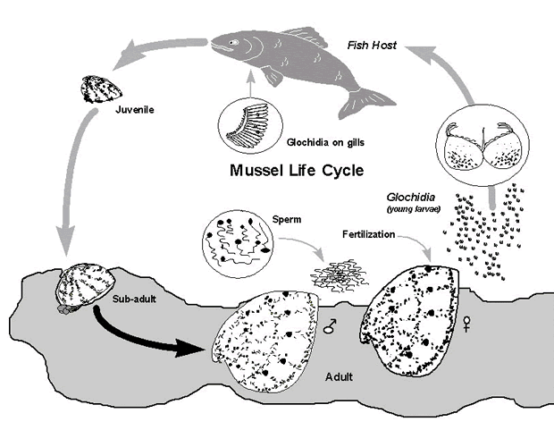
Upstream movements
Upstream movements are relatively unimportant because they are difficult to mount for most invertebrates.
Freshwater mussels and leaches may be transported considerable distances upstream by fish and other vertebrates.

Slide 9
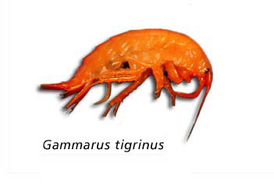
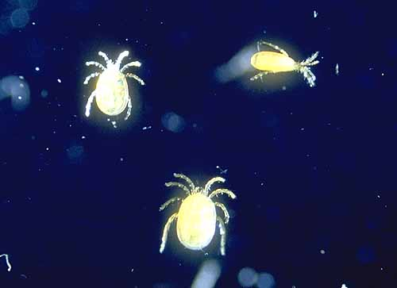
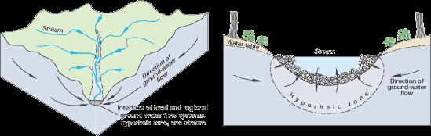
Vertical Movement
Vertical movements are movements in and out of
the hyporheic zone or up and down the water
column.
Movements of invertebrates upstream from the
hyporheic refugia can be a very important means of
recolonization following scouring floods.

Slide 10
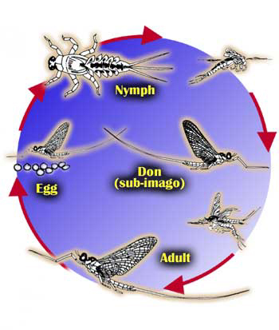
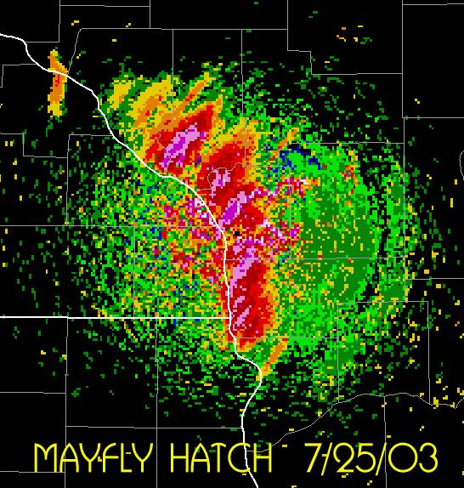
Aerial Movement
Aerial movements carried out only by the winged adult stages of aquatic insects.
Adult emergence is an important mechanism of dispersal, not only to other areas within watersheds, but to other watersheds.

Slide 11
Aerial Movement
Hypothesized (established for some insects) that females routinely fly upstream for egg deposition to counter the predominant downstream displacement of larval stages due to drift.
If generally true, this pattern of ovipositioning would establish a need for downstream drift of larval stages to relieve overcrowding.

Slide 12
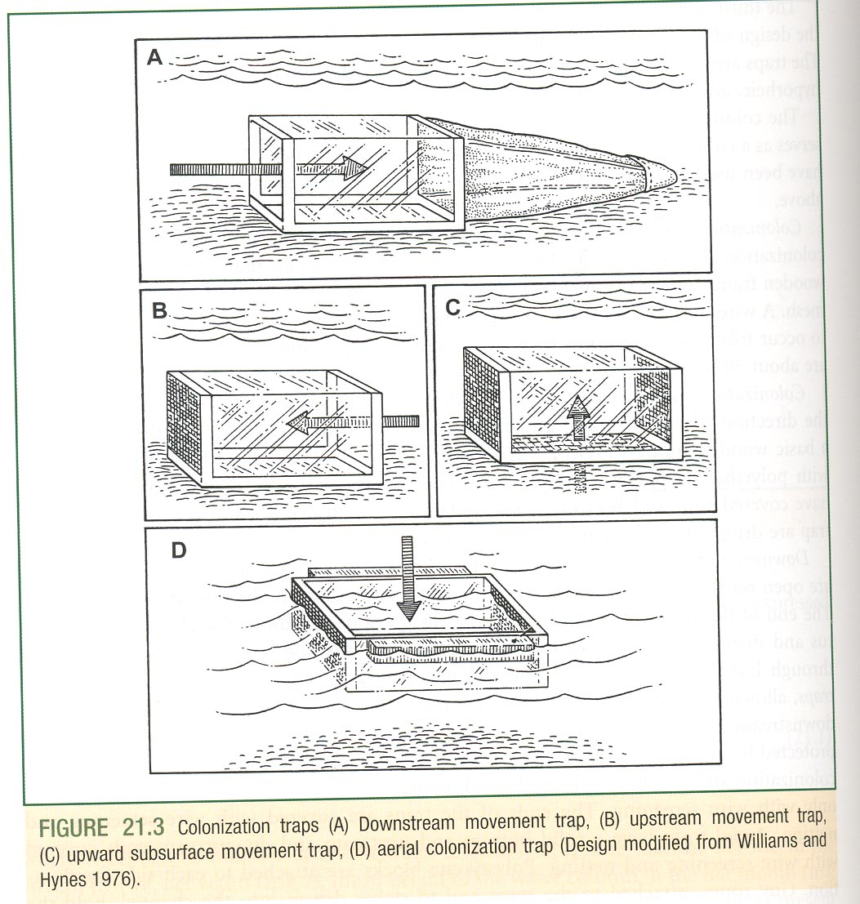
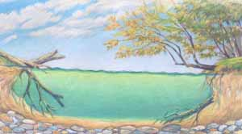
Methods of collecting migrating animals

