Slide 1
NUTRIENT ENRICHMENT
AND PERIPHYTON GROWTH

Slide 2
Nutrient Limitation
Most ecosystems respond to nutrient addition with increased production, suggesting that they are nutrient limited.
In standing-water (lentic) aquatic habitats, excessive nutrient loading causes the system to become eutrophic: biological production becomes excessive and this ultimately deprives the system of needed oxygen.

Slide 3
Streams
Most streams are not oxygen limited…
Streams typically are not thought of as nutrient-limited systems either.
Dissolved nutrient concentrations are typically very low in pristine streams.
However, the levels are probably sufficient for stream autotrophs because the flowing water means constant nutrient replenishment.

Slide 4
Nutrient Enrichment
How do stream ecologists assess effects of nutrient enrichment on stream ecosystems?
The focus of this lecture will be on approaches to studying effects of nutrient enrichment on periphyton production (autotrophs and heterotrophs).
This is the component of the stream biota that is most sensitive to nutrient dynamics.

Slide 5
Nutrient Enrichment Bioassays
Stream ecologists study nutrient effects through nutrient-addition bioassays.
Examine what happens when nutrients are added to streams in excess of ambient levels.

Slide 6
Approaches
A number of different approaches are used to assess nutrient regulation on periphyton production in streams.
We will consider four approaches:
  1) in situ nutrient manipulation;
  2) enrichment of flow through enclosures;
  3) whole-stream manipulations;
  4) integrated bioassays.
The different approaches represent different spatial scales, and different degrees of controlled experimentation versus natural system response.

Slide 7
In Situ Nutrient Manipulation
In situ nutrient manipulation involves deploying nutrient-rich substrata and measuring periphyton growth response in stream.
Substrata are dishes filled with sterile sand and/or agar enriched with nitrate, phosphate, both, or nothing (control).
The substrata simulate nutrient-diffusing action of certain natural stream substrates (e.g., chironomid-dwelling tubes in sand).

Slide 8
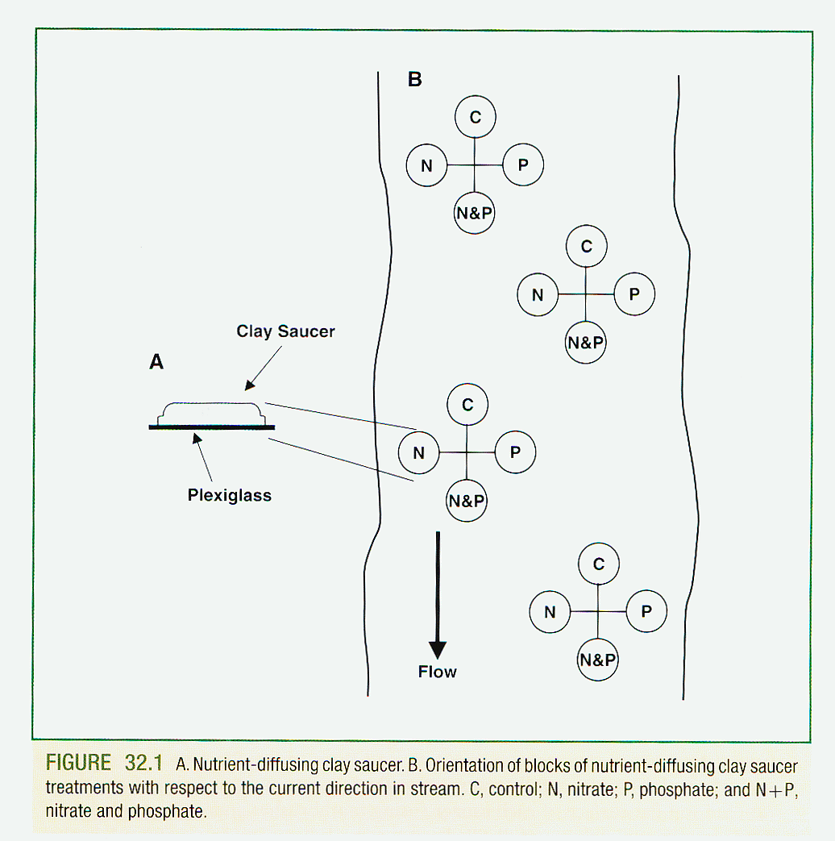

Slide 9
In Situ Nutrient Manipulation
Effective for evaluating nutrient recycling.
Validating theoretical models.
Detecting limiting factors.
Supplementing other bioassay techniques.

Slide 10
In Situ Nutrient Manipulation
Major limitation with using nutrient-diffusing substrates is inconsistency in rate of nutrient release.
Passive nutrient-diffusion substrates have proven more effective.
Nutrients held in reservoir capped by biofilter and a fiberglass substrate.
Biofilter prevents periphyton from invading reservoir; periphyton grows on fiberglass and can be collected and quantified more efficiently.

Slide 11
Flow-Through Enclosures
Another approach involves use of flow-through enclosures (flumes).
The enclosures are pipes with natural or artificial substrates and open or closed bottoms that are placed either in the streambed parallel to the flow, or beside the stream with pumped stream flow.
Nutrients are dripped in as water flows through.
The substrates are collected and periphyton growth in nutrient treatments is compared to that in controls.

Slide 12
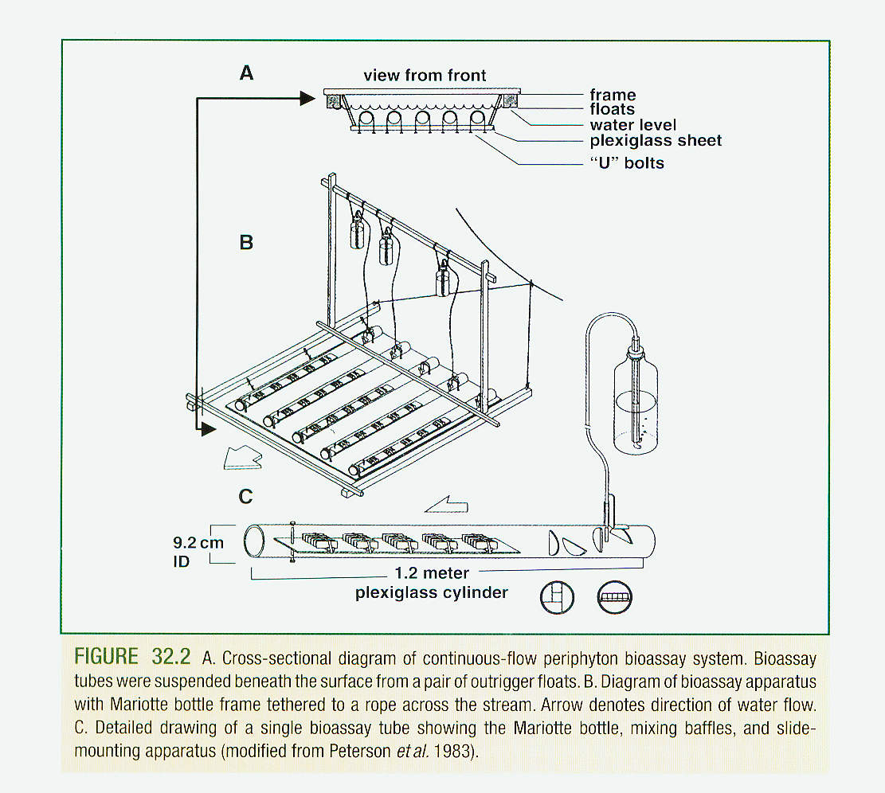

Slide 13
Flow-Through Enclosure Studies
Study in a temperate coastal stream found that a three-fold increase in ambient [NO₃] and [PO₄] resulted in higher algal growth then PO₄ addition alone.

Slide 14
Whole-Stream Manipulations
Whole-stream manipulations involve adding nutrients to the whole stream.
Use in-situ hydrologic and channel conditions to disperse nutrients (less control).
Most quantitative to follow uptake of isotopically labeled nutrients (³²P and ¹⁵N).

Slide 15
Whole-Stream Manipulations
Measure upstream-downstream changes in nutrient mass and periphyton response.
Some studies introduce clay tiles or artificial substrates to more accurately quantify periphyton.
Approach has the advantage of being the most natural, but the disadvantage of being the most difficult to control.

Slide 16
Integrated Bioassays
The integrated approach simply involves combining different approaches.
Allows differentiation of response of periphyton to nutrients derived from substrate (nutrient-diffusing substrates) versus water column (flow-through bioassays).
Also allows comparison of nutrient effects across different spatial scales.

