Slide 1
PRIMARY PRODUCTIVITY AND COMMUNITY RESPIRATION

Slide 2
Primary Production
Primary production is the rate of production of organic matter (fixed carbon) from inorganic carbon by photosynthesizing organisms (units = mass/(area [or volume] x time)).
Represents the transformation of solar energy to reduced chemical energy.
Total amount of energy produced is gross primary productivity (GPP).
Plant uses some of the energy in its own respiration (R_{a}). The balance is stored as plant biomass and is called net primary productivity or NPP.
Thus, GPP = NPP + R_{a}

Slide 3
Measuring Primary Production
In streams, the source of carbon for plant biomass production is CO₂ dissolved in water (bicarbonate).
Oxygen is produced in the process.
Possible to measure the rate of primary production by measuring changes in CO₂ and O₂ concentrations in water.
Alternatively measure rate of uptake of added [¹⁴C] bicarbonate as tracer of carbon.

Slide 4
In Situ Method
A number of stream ecologists use an in situ method of determining gas (O₂) exchange rate based on the equation:
Q _{(dissolved O2)} = P - R +/- E,
where P = change in [O₂] due to photosynthesis, R = change due to respiration, and E = change due to exchange with the atmosphere (assumes negligible accrual from surface and groundwater inputs).
The change due to respiration includes both autotroph and heterotroph (R_{h}) respiration.
Two of these respiration rates combined is called community respiration (CR). CR can be measured only at night (measurement confounded in daytime by plant O₂ production).
Daily CR (CR₂₄) is estimated by extrapolating average nighttime CR through the daylight hours.

Slide 5
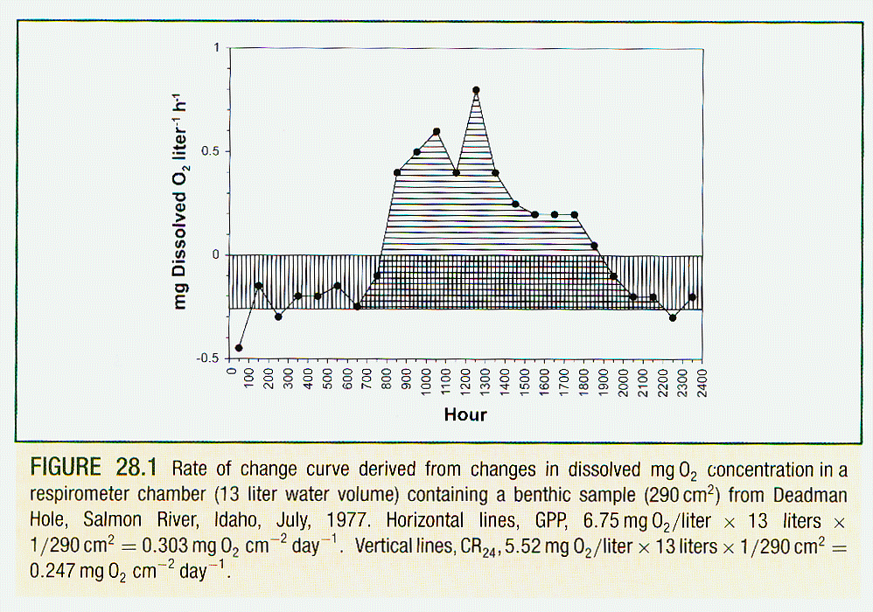

Slide 6
In Situ Method limitations
Estimates of GPP derived in this way will be subject to error from
  (1) differences in light and dark respiration, including the inability to account for photorespiration by plants (light-dependent O₂ uptake and CO₂ evolution, and excretion of photosynthate);
  (2) inability to measure autotrophic respiration separately;
  (3) any asynchrony between photosynthesis and associated metabolic costs.

Slide 7
Net Daily Metabolism
Net daily metabolism (NDM) can be estimated from the difference between GPP and CR₂₄:
NDM = GPP - CR₂₄
NDM is free of errors associated with estimation of daytime respiration.
If GPP exceeds CR₂₄, then there is net energy gain to the system; if CR₂₄ exceeds GPP then there is net energy loss. It is for this reason the NDM is also referred to as net ecosystem productivity.

Slide 8
¹⁴C uptake method
Another method is to measure the rate of uptake of radioactively labeled [¹⁴C] bicarbonate.
¹⁴C uptake method provides productivity measures between GPP and NPP.
More sensitive than the gas exchange method and thus provides better estimates when primary productivity is low.

Slide 9
¹⁴C uptake method limitations
¹⁴C uptake method has been little used in streams.
Corrections must be made for adsorption of isotope onto surfaces and for proportions of photosynthate (fixed carbon) excreted by the producer as labeled organic matter.
Method is best applied in closed systems.

Slide 10
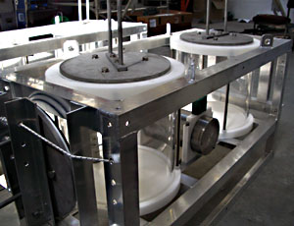
Respirometers
Respirometer chambers, equipped for water recirculation, may be used to measure metabolism (introduced for use with benthose).
Although free of the need to correct for gas exchange, there are concerns about how chamber design influences nutrients, water flow, and the ratio of sample surface to water volume, relative to the in situ method.

Slide 11
Stream size and primary productivity variation
In small to medium-sized streams, the greatest portion of biomass, and therefore the greatest metabolism, is in the benthose.
In some mid-sized systems, macrophyte (large vascular plant) productivity can be significant.
In large rivers, water column biomass (plankton) dominates productivity.

Slide 12
Measuring Primary Production
Primary productivity is typically measured at two stations at either end of a study reach which allows estimation of metabolism as water flows downstream (open system).
Select a stream reach for study for which geomorphic and hydraulic conditions are known (allows estimation of reaeration).
Third-fourth order streams typically used because of open canopy.
Measurements are typically taken hourly throughout day in warm weather.

Slide 13
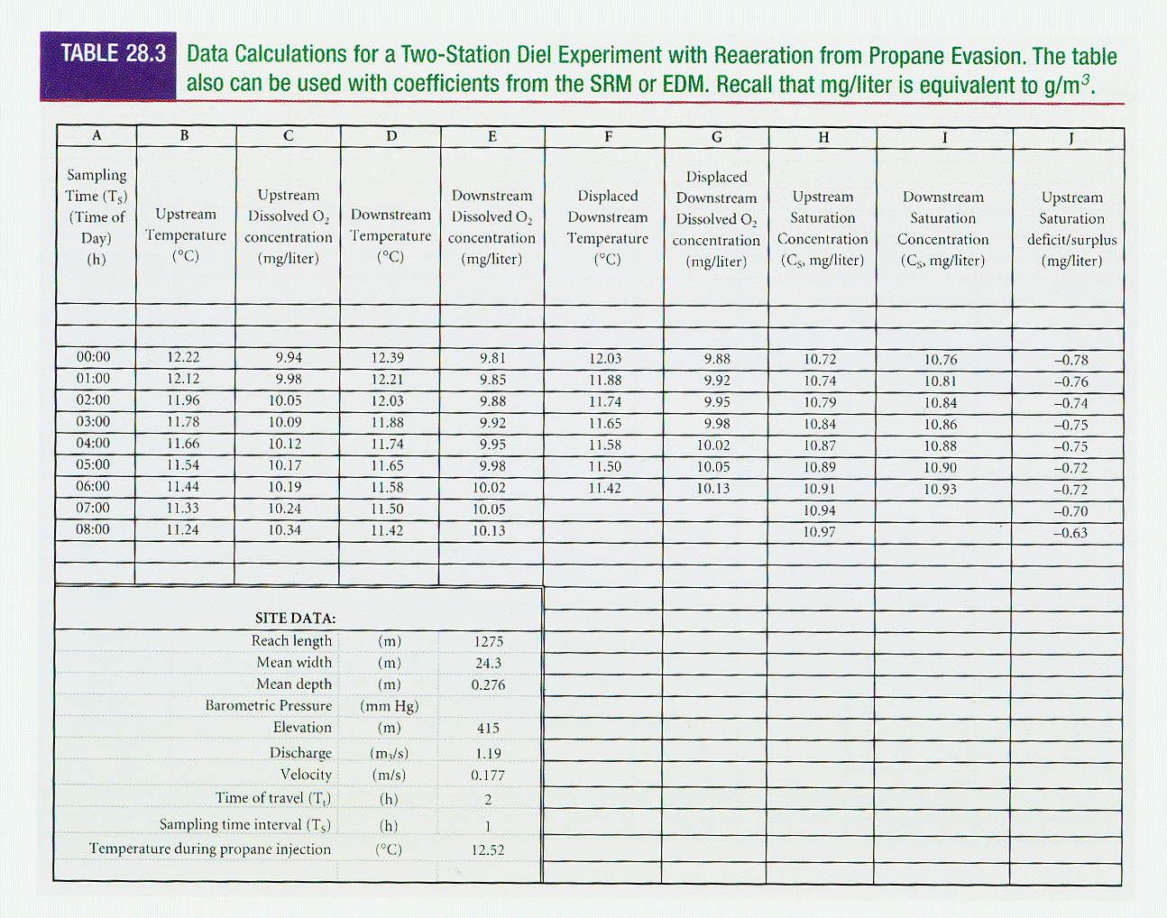

Slide 14
