Slide 1
Predator-Prey Interactions

Slide 2
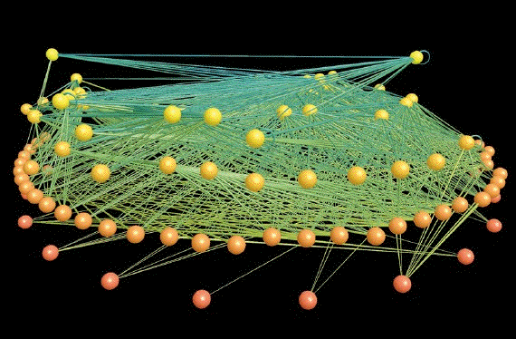
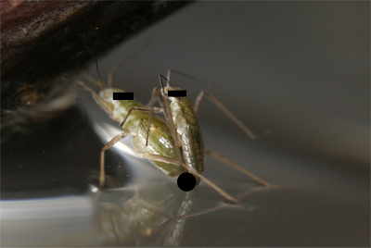
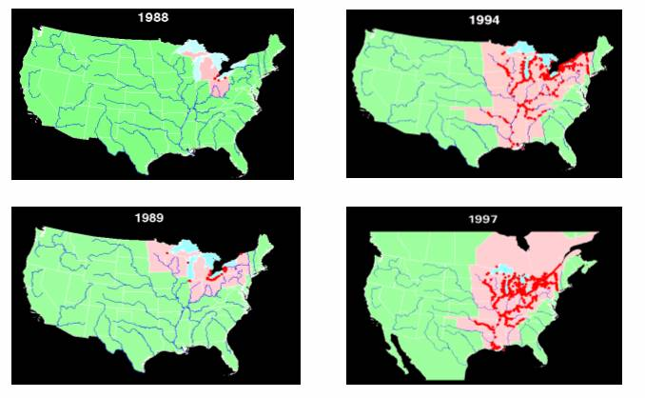
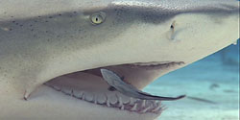
Community Interactions

Slide 3
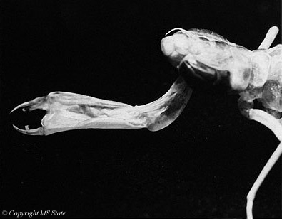
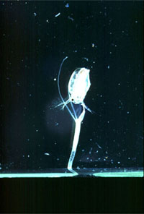
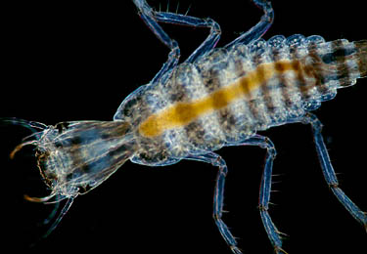
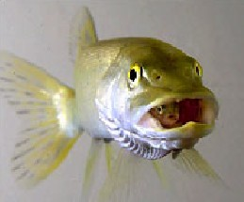
Predator–Prey Interactions
Secondary consumption, consumers eating other consumers.

Slide 4
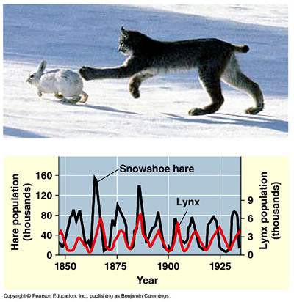
Predator-Prey Theory
Predator-prey theory seeks
to determine the impact of
predators on:
prey populations
community composition
KEY QUESTION:
TOP-DOWN CONTROL?
Can predators structure
prey populations and by
extension communities?

Slide 5
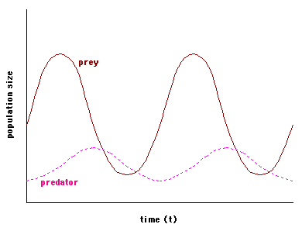
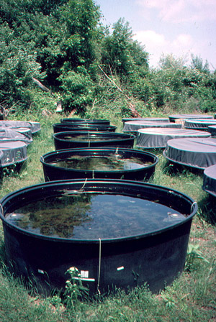
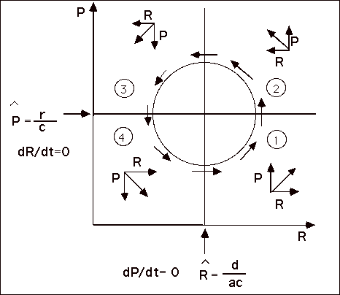
Equilibrium Theory
The theory was initially developed for:
closed, equilibrium systems
2 sp interactions (abundance)

Slide 6
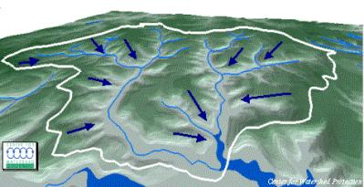
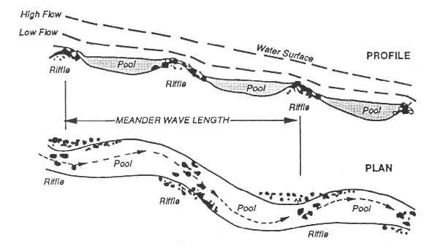
Non-equilibrium systems
Streams of course are not closed equilibrium situations.
Open to migration
100’s of species interactions
Have to look at dynamics within habitat ‘patches’ in these systems.

Slide 7
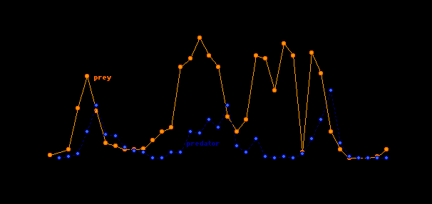
Patch Dynamics
At the patch (habitat) scale predators not thought to be capable of structuring prey populations/communities
Modeling by Caswell (1978) suggest that pred-prey can co-persist for long periods and that predators can have a large influence on prey community structure.

Slide 8
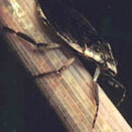
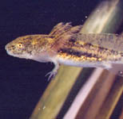
Effects of Predators on Prey
Predator effects on prey populations depend on:
Predation rate: how efficient the predator is
Prey exchange rate: movements by prey into and out of a habitat patch (drift)
Low drift rates + efficient predation = strong predator effects
High drift rates = predation swamped by immigration

Slide 9
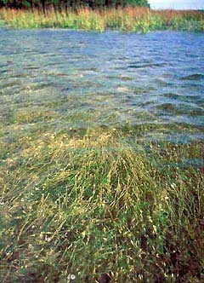
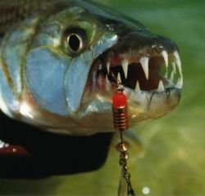
EFFECTIVE PREDATION – ability to structure a community
Many many factors can be involved (prey, pred, habitat etc)
Predator selectivity – eats prey regardless of density (specialist – prey or habitat)
Differences in prey vulnerability
Microhabitat differences – refugia

Slide 10
Selective Predation
Predator concentrates search in a preferred prey habitat and active rejects certain types of prey.
Differential prey vulnerability.
Predator rejection is a function of predator choice (active behavioral selection).
Differential vulnerability is a function of stereotypical predator behavior (fixed behavioral selection), prey defenses (passive selection), or microhabitat differences among prey that affect vulnerability.

Slide 11
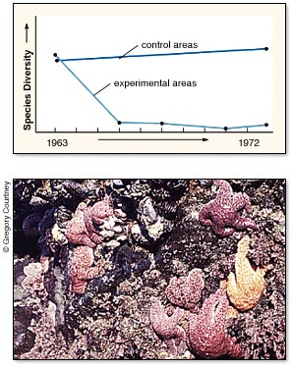
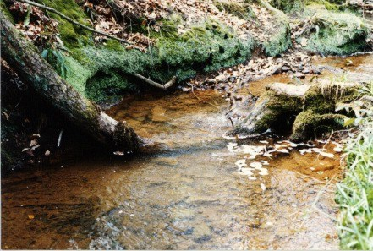
Effects of Predators:
Direct effects:
Mortality
Non-lethal mortality
behavior modifier
fitness effects (poor habitat)

Slide 12
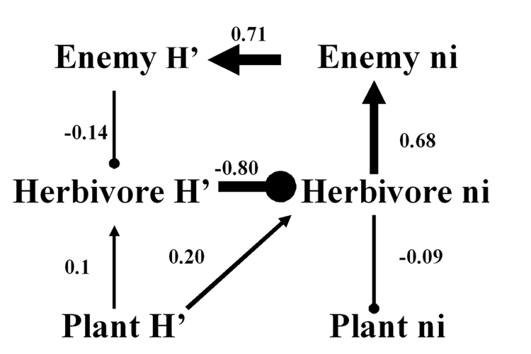
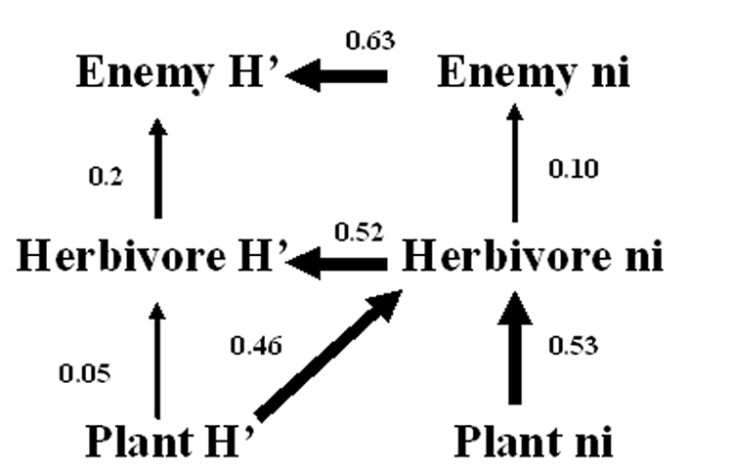
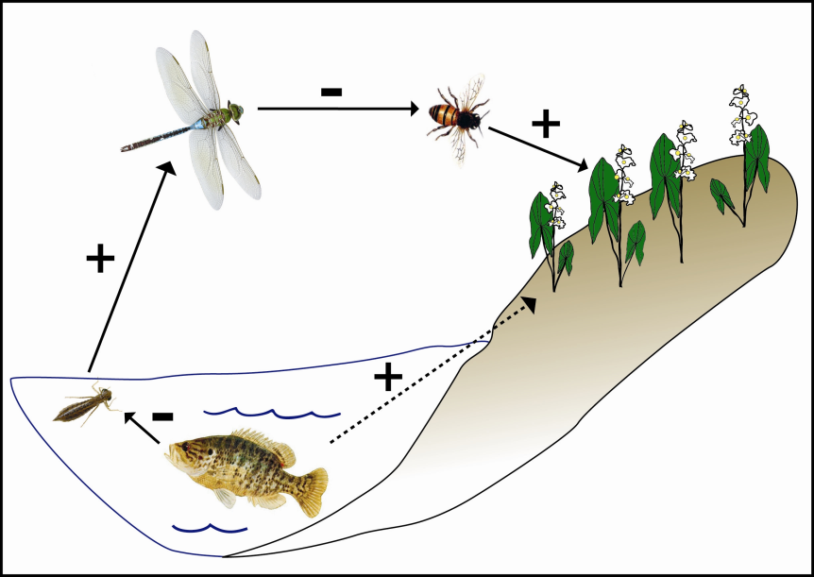
Effects of Predators:
Indirect effects:
Trophic cascades

Slide 13
Sih and Wooster study (1994)
Examined relationship of prey behavior and prey dispersal on predator impacts in streams.
Previous model suggested that prey exchange (movement of prey among habitat patches) reduces predator impact on prey density.
However, the model included two assumptions that influenced its qualitative predictions: 1) it assumed that the surrounding environment had no predators and constant prey density; 2) it assumed that prey do not alter their per capita emigration rates in response to the presence of predators.
Sih and Wooster sought to refine model by considering the impacts of these assumptions (relaxing them and examining the effects).

Slide 14
Sih and Wooster, cont’d
Found that prey emigration behavior had a profound effect on the relationship between prey exchange and predator impact.
If prey do not change their emigration rates in response to predators, then high prey exchange rates result in low predator impact (as predicted by the previous model).
However, if prey disperse out of patches in response to predators, then even very high prey exchange rates cannot swamp predator impact (in fact, prey emigration adds to predator impact).
If predators force prey to hide (thereby suppressing prey emigration), then high prey exchange can result in "negative predator impacts" (higher prey density in patches with predators).

Slide 15
Sih and Wooster, cont’d
Invertebrate predators (stoneflies) tended to have stronger effects on prey (always reducing prey density) than vertebrate predators (effects mixed).
Invertebrate predators decrease prey density mostly by increasing invertebrate drift rates; whereas, vertebrates (fish) tend to decrease prey activity (hide more) thereby limiting prey response.
Drift makes prey less vulnerable to invertebrate predators (benthic, tactile feeders), but more vulnerable to fish (sight feeders).
Caused what Sih and Wooster called a "paradox of danger", wherein more dangerous predators (fish) have weaker impacts on prey populations than less dangerous predators (invertebrates).

Slide 16
Crowl and Covich study (1990)
Predator-prey interactions often lead to evolution of a complex array of prey defenses.
Study by Crowl and Covich showed that the widely distributed pulmonate snail Physella virgata changed its life history in response to the presense of a crayfish predator, Orconectes virilis.
Changes were apparently initiated by a water-borne cue released when crayfish fed on the snails.

Slide 17
Crowl and Covich study (1990)
In the presense of the cue, snails exhibited rapid growth and delayed reproduction 8 months until they reached a size of about 10 mm.
In the absence of the cue, snails reproduced after only 3.5 months at a size of 4 mm.
The chemically induced shift indicates that life history of the snail is phenotypically plastic.
Snails were apparently able to reduce predation pressure by increasing age and size at maturity.

