Slide 1
River Continuum Concept (RCC)
Predictable pattern of change in the physical, chemical
and biological characteristics from small headwater
streams to mouths of large rivers.

Slide 2
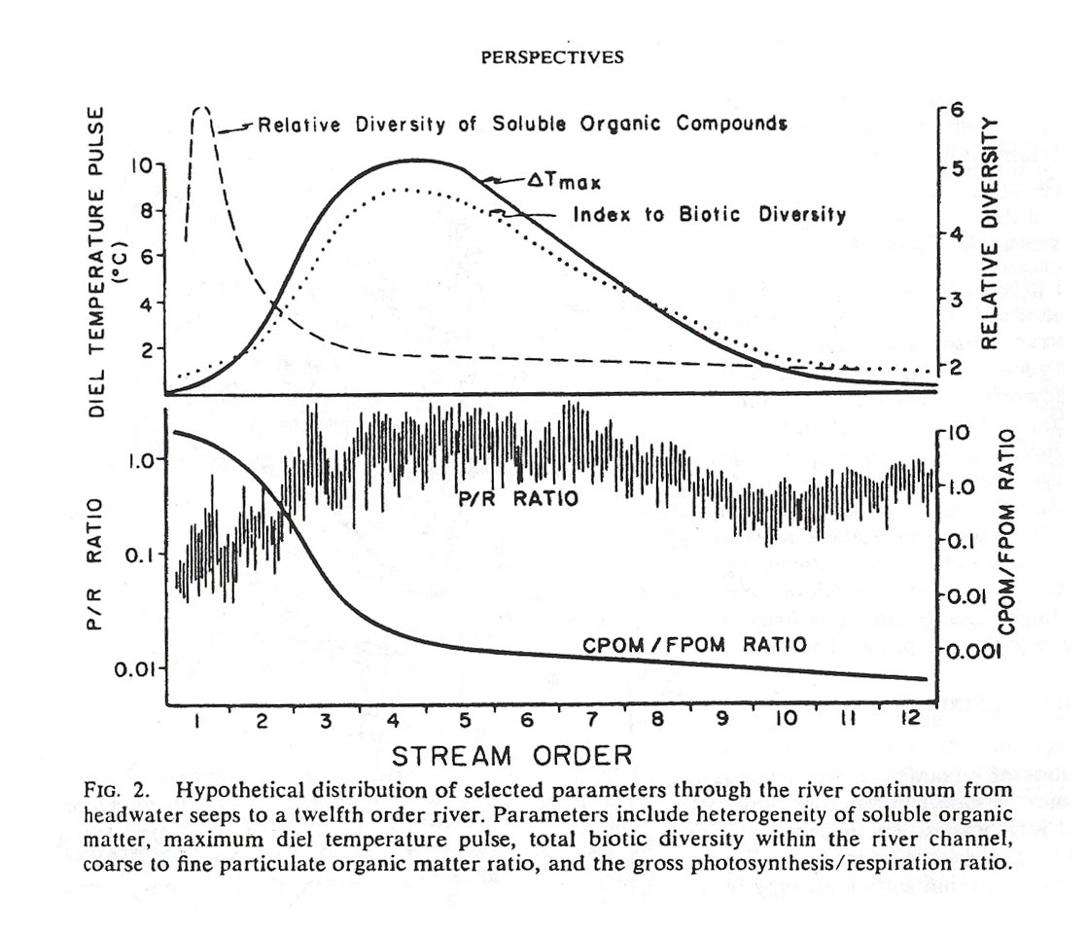

Slide 3
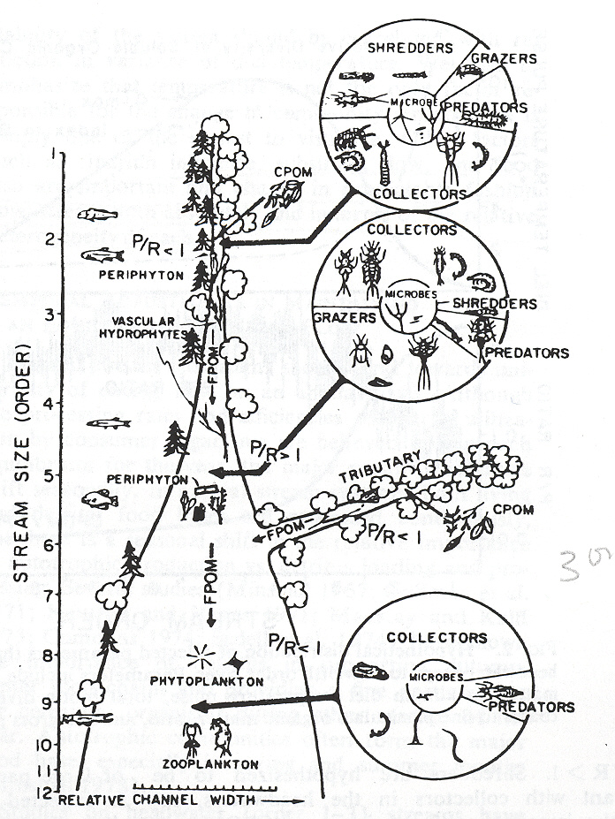

Slide 4
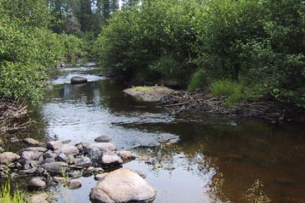
Headwater Streams (1-3 Order)

Slide 5
Headwater streams
Charged by subsurface flow (low temperature variability)
High canopy shading – low light, heavy inputs of allochthonous (leaf) material
High CPOM/FPOM ratio
Low primary productivity; high heterotrophy; P/R < 1
High inputs of soluble organic matter

Slide 6
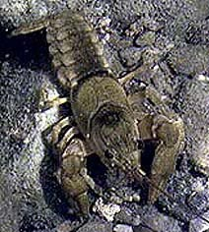
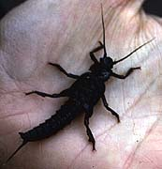
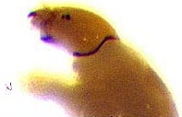
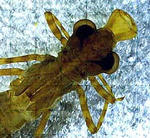
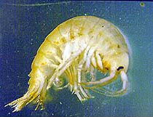
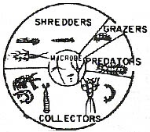
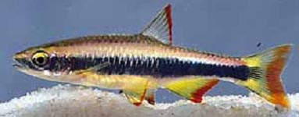
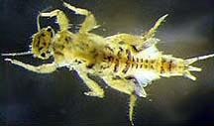
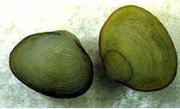
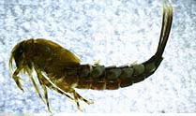
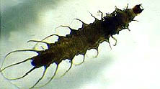
Predators
Shredders
Collectors

Slide 7
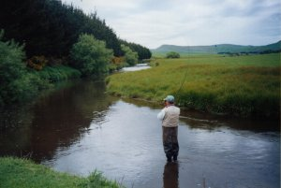
Medium Streams (4-6 Order)

Slide 8
Mid-size streams
Open canopy; high light
High daily temperature variability
High primary productivity
Low CPOM/FPOM ratio
P/R > 1 autotrophic community
High proportions of collectors, grazers
Few predators

Slide 9
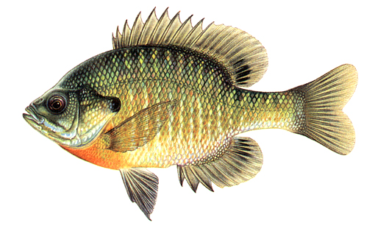
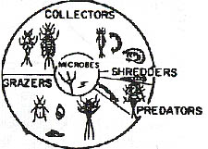
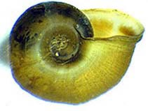
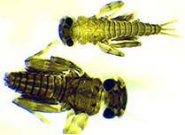
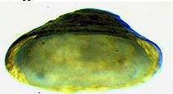
Collector/gatherers
Scrapers/grazers
Predators

Slide 10
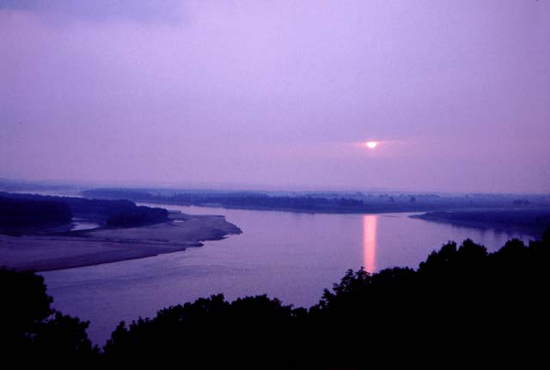
Big Rivers (> 6 Order)

Slide 11
Large rivers
Open canopy, high light, but turbid water
Low primary productivity
Low temperature variability (summing of flow from smaller streams)
Low CPOM/FPOM ratio
P/R ratio < 1; heterotrophic community
Communities dominated by predators
Filter feeders

Slide 12
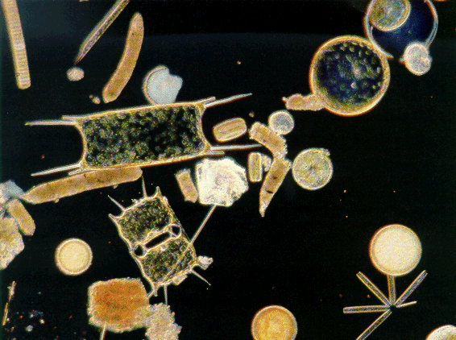
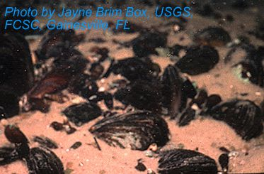
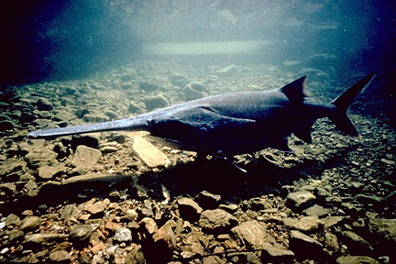
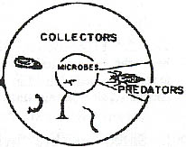
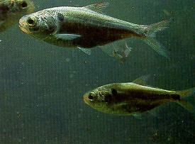
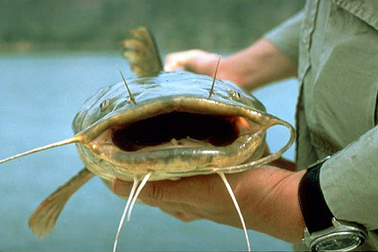
Predators
Collector/Gatherers---Filter Feeders

Slide 13
What happens when we impound rivers?

Slide 14
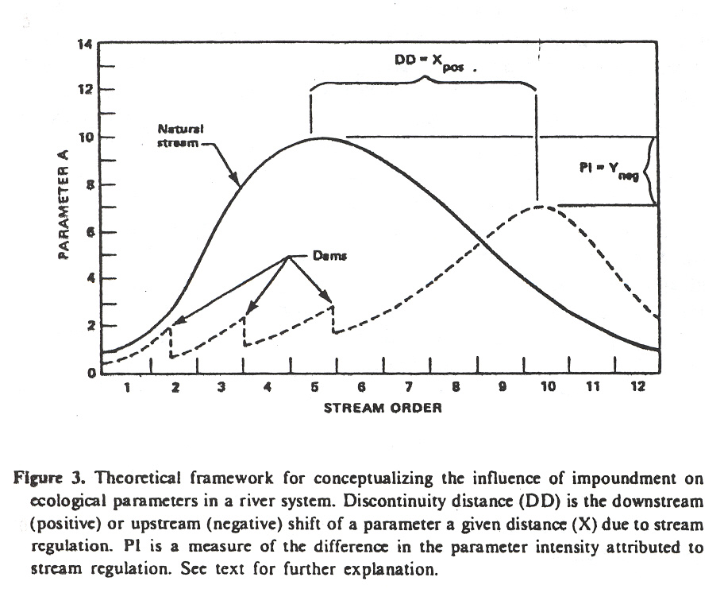
Serial discontinuity concept
Ward & Stanford 1983

Slide 15
RCC describes longitudinal change in streams/rivers
Lateral dimension is most important to large rivers
Defines extent of floodplain, nature of floodplain habitats
Floodplain habitats contribute to large river productivity
Large rivers like Mississippi channelized; entrenched; cut off from floodplain by levees

