Slide 1
SECONDARY PRODUCTION

Slide 2
Secondary Production
Biomass production through time by consumers.
Shows how energy flows through consumer portion of food webs.
Focus of this discussion is on stream macroinvertebrates, but very similar methods would be used to estimate production by fishes.
Macroinvert secondary production studies use a population approach, rather than a community approach as in studies of autotrophs and heterotrophic microbes, because inverts are generally larger, better known taxonomically and easier to quantify.

Slide 3
Secondary Production Equations
Secondary consumers ingest food (I), assimilate some of the food energy (A) and egest the rest (E). Thus,
I = A + E
A portion of assimilated food energy goes toward production (P), a portion is used in respiration (R) and a portion is lost to excretion (U). Thus,
A = P + R + U

Slide 4
Production Efficiency
Parameters in equations are fluxes (flows) of energy or carbon with units of energy/area•time.
For an individual organism P represents growth; for a population it represents collective growth across all individuals.
How much an individual grows or a population increases in mass (production efficiency, P/A) depends on how efficiently it assimilates food energy it ingests (A/I).
Assimilation efficiency varies greatly for stream invertebrates: 5% for detritivores; 90% for carnivores.
Net production efficiency shows less variation among trophic levels (~50% for both detritivores and carnivores).
Suggests detritivores convert only 2% (0.05 x 0.5) of its food to production, whereas carnivores convert 45% (0.9 x 0.5) of their food to production.

Slide 5
Biomass turnover
Production is not exactly the same as biomass.
Biomass (B) is the amount of mass of animal tissue present at any one time or averaged over several periods of time.
Units of biomass are mass per area (g/m²).
Production (P) is the rate of production of mass. Its units are mass per area•time (gm⁻² •year⁻¹).
Ratio of production to biomass (P/B) gives a biomass turnover rate with units of inverse time.

Slide 6
Annual P/B Ratios
Annual P/B ratios on benthic macroinverts vary as a function of development time.
Univoltine populations with a one-year lifespan have annual P/B values of ~5.
Bivoltine populations with same life span would have a value of 10.
Annual P/B estimate for entire communities vary from 1 to 100.

Slide 7
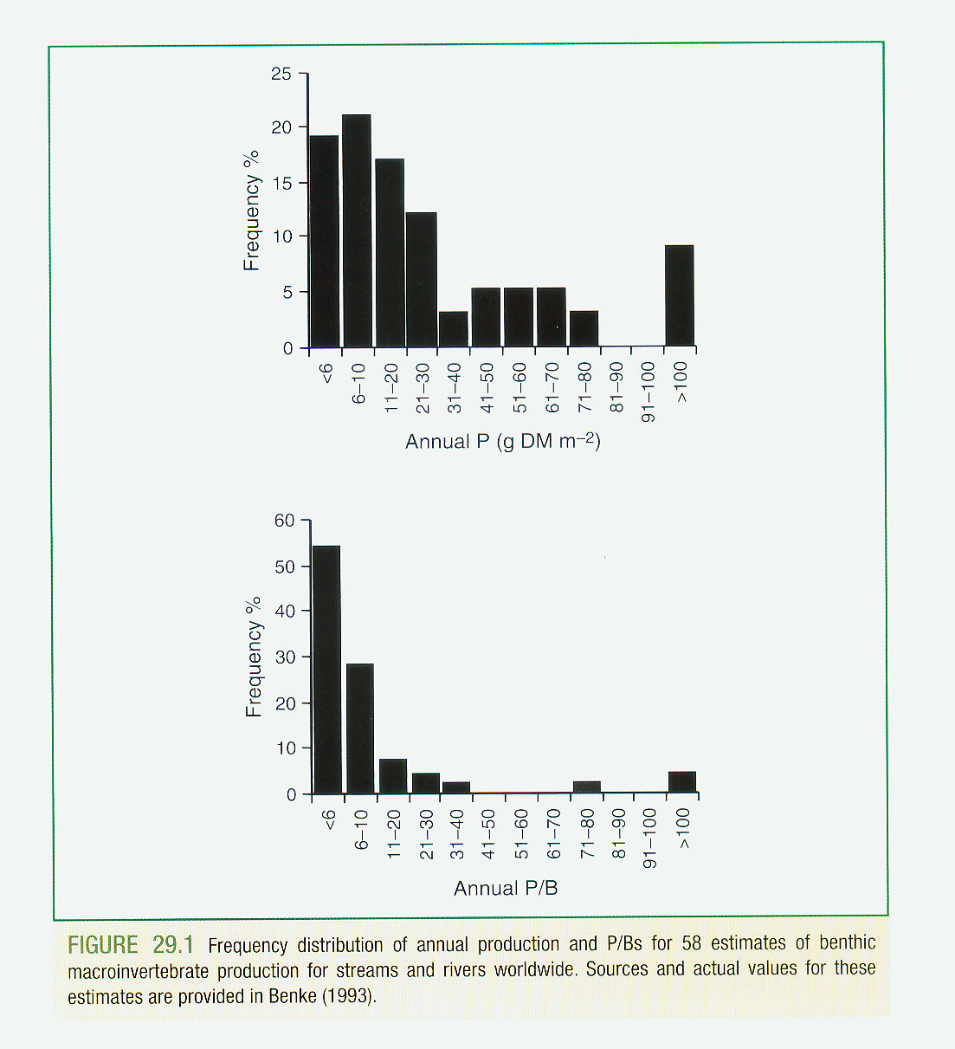

Slide 8
Increment-Summation Method
To measure production, one need only gather quantitative data on a population at different points in time.
One method involves following a particular cohort (all individuals born in a given reproductive season) through time (increment-summation method).

Slide 9
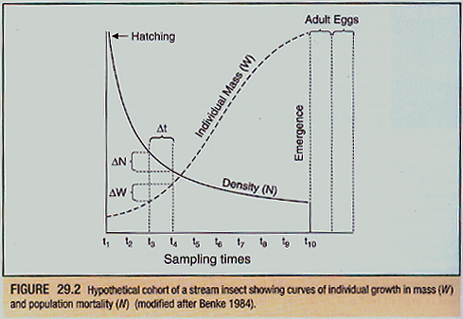
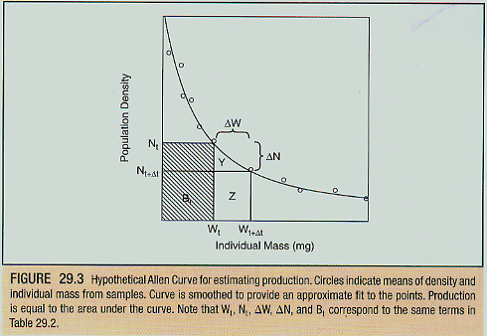
Increment-Summation Method
Cohort will likely be seen to decrease in numbers (N) over time due to mortality, and increase in individual mass (W) due to growth.
Production over the interval can thus be estimated as the sum of all interval estimates:
P = N_{(mean)}W

Slide 10
Size-Frequency Method
Alternatively, if one cannot follow a population over time, non-cohort techniques can be used.
One method (size-frequency method) assumes that the average size-frequency distribution determined from samples taken throughout the year approximates a mortality curve for an average cohort.
One then measures the decrease in density (N) from one size class to the next and multiplies this by the difference in mean mass between size categories.
Before summing, products must be multiplied by the number of size classes.

Slide 11
