Slide 1
STREAM MODIFICATION: CHANNELIZATION

Slide 2
Stream modification
Humans have been modifying streams to suit their needs since the beginning of human existence.
Stream modification is a general term for any physical modification of streams by humans.
Three main forms of stream modification: channelization; dams or impoundments; water removal or diversion.
This lecture deals with channelization.

Slide 3
Channelization
Channelization is modification designed to make the stream channel more uniform.
Involves a number of different activities: channel straightening, meander cutoffs, ditching or dredging, snagging, and diking.
Shortens and decreases the lateral extent of the stream and increases flow.
Reduces flooding tendency (short term).
Most pervasive anthropogenic disturbance to streams; reaches of virtually all streams in eastern North America - smallest creeks to largest rivers - have been channelized in some way.

Slide 4
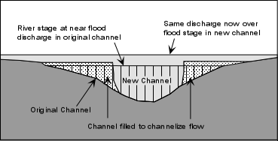
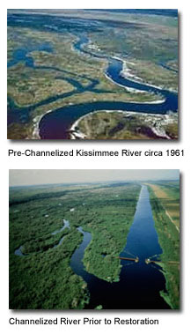
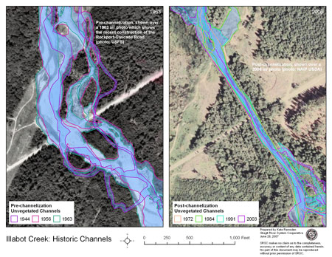
Channelization

Slide 5
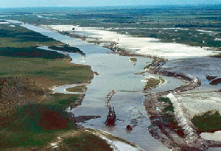
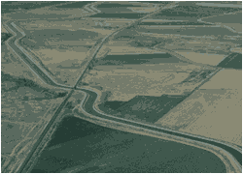
Channelization cont’d
Channelization simplifies the structure of the channel by straightening the mainstem, reducing meandering, shortening the stream and increasing its slope.
Results in higher flow velocities, higher erosional energy, and downcutting of the channel.
Many negative impacts

Slide 6
Channelization impacts
Downcutting causes the stream to become entrenched (more confined to its established channel), preventing channel switching.
Length of the stream is generally reduced. Shorter stream length over the same upstream to downstream elevation difference as before channelization means increased stream gradient and flow velocity.
The shorter length and increased velocity impacts organic-matter processing, nutrient spiraling and other important processes.
Short, channelized reaches also offer less habitat for biota than longer, sinuous stream reaches.

Slide 7
Channelization impacts cont’d
The unnatural channel configuration also does not dissipate energy as efficiently.
During high-flow conditions, channelized reaches usually experience increased erosion and scouring of the bank.
Increased erosion and bank instability often result in increased suspended sediment and bed load carried to downstream areas.
Increased sediment transport results in increased sedimentation downstream (aggradation), which disturbs habitat and increases flooding potential.
Turbidity is often higher in channelized reaches than natural stream reaches. This can have negative impacts on primary production, water quality, and food supply to stream organisms.

Slide 8
Channelization impacts cont’d
Altered stream velocities affect sediment particle size distribution along the stream bed.
Also results in loss of POM, either from direct physical removal during channel dredging, or from increased water velocities following channelization.
Since channel configuration is more uniform - lacking pools, riffles, and other diverse morphological characteristics - substrate also tends to become more uniform.
More uniform substrate means reduced habitat complexity.

Slide 9
Channelization impacts cont’d
Increased stream velocity and downcutting of the channel associated with channelization lowers the water table in the adjacent floodplain, depriving lateral habitats of their source of cool groundwater.
As groundwater drains out of the soil, the soil is compacted, further reducing its porosity to runoff flowing over its surface.
Thus, groundwater recharge capacity decreases and flash flooding potential increases.

Slide 10
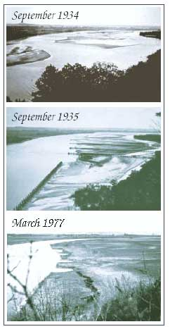
River Diking
Diking involves building rock or wood-pile berms (dikes) on point bars perpendicular to channel.
Block the flow of water across point bars and trap sediment, building up the bar and forcing all flow through the remaining channel.

Slide 11
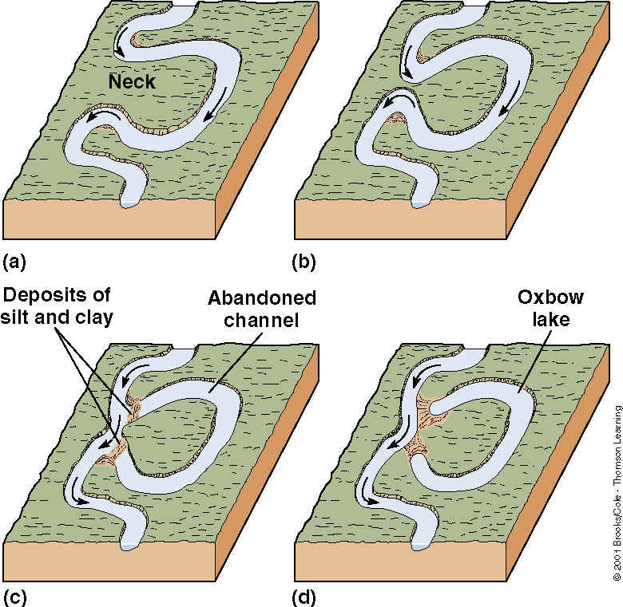
Meander Cutoff

Slide 12
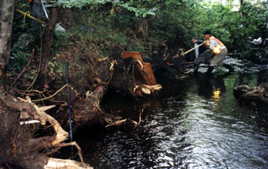
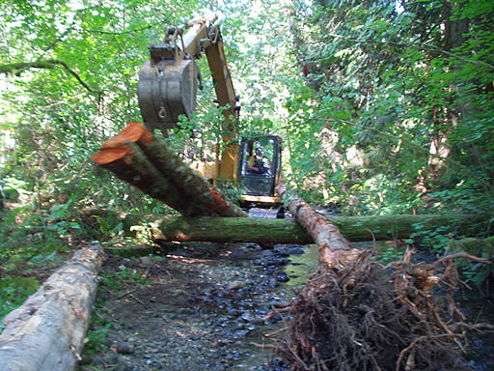
Snagging
A common feature of channelization is snagging - the removal of fallen trees, stumps and other Large Woody Debris (LWD) from the stream and its banks.

Slide 13
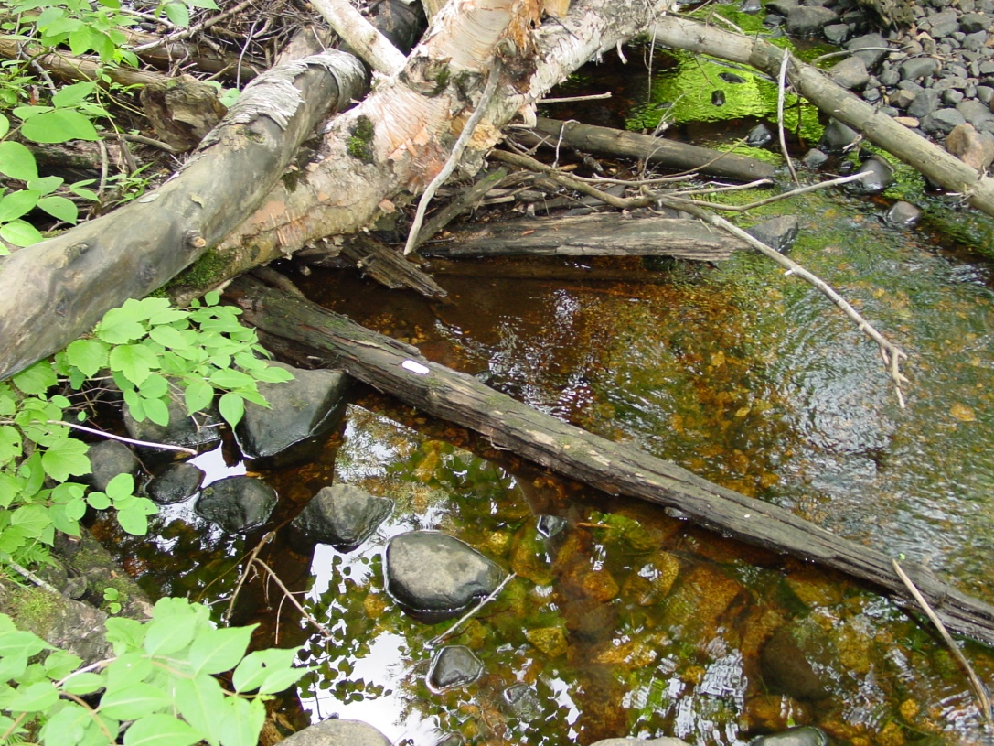
Benefits of LWD
Mentioned earlier the importance of LWD as carbon source in stream food web.
Studies indicate that the presence of LWD is one of the most important factors regulating stream habitat diversity as well.

Slide 14
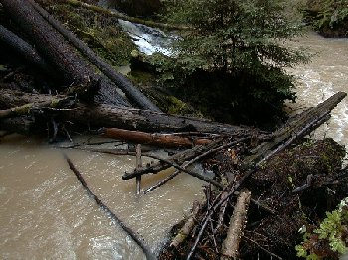
Benefits of LWD
Large tree falls obstruct streamflow and allow for the trapping of coarse substrate above the obstruction (e.g., gravels important to fish spawning) and scouring of the streambed downstream of the obstruction (plunge pool development).

Slide 15
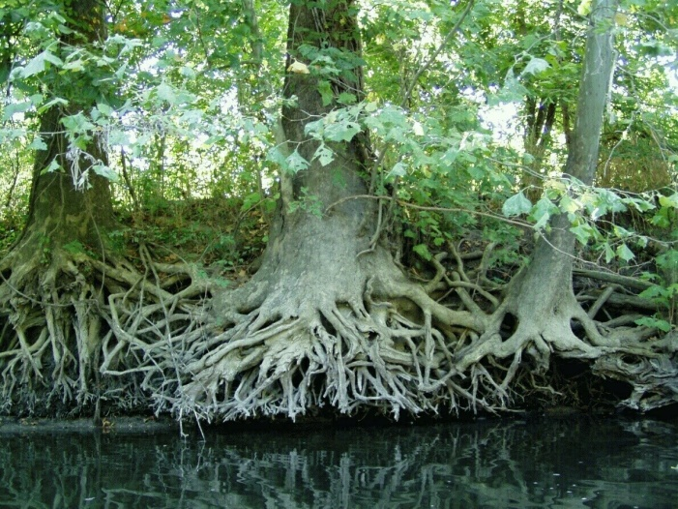
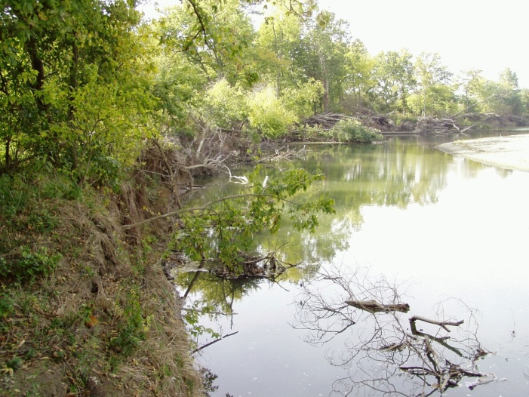
Benefits of LWD
Stumps and roots stabilize stream bank and provide cover for fish and aquatic invertebrates.
Removal of this and other in-stream LWD reduces habitat for fish and invertebrates.

Slide 16
Impacts of Snagging
Riparian vegetation - the source of instream woody debris - is typically removed when streams are channelized.
Removal of canopy vegetation reduces shading, resulting in increased stream temperatures.
Leaf supply is also be disrupted.
Increased light stimulates primary productivity (beneficial, but unnatural).
Removal of trees and their root systems destabilizes the stream bank, making it more susceptible to erosion.
Removal of riparian vegetation also reduces the ability of the floodplain to attenuate flood waters.

Slide 17
Increased sedimentation
The combination of increased flow velocities and bank erosion causes more fine sediment to be carried into the stream than the stream can handle.
Substrate in the stream also becomes more unstable (loose, unconsolidated).
Loose and shifting substrate prevents benthic invertebrate communities from becoming established and reduces coarse spawning substrates for fishes.
Increased sediment loads have an abrasive effect on the gills of fish and macroinvertebrates.
Interstitial spaces in the substratum become clogged, removing an important retreat for macroinvertebrates from high current velocities, as well as further reducing stability of the stream bed.

