Slide 1
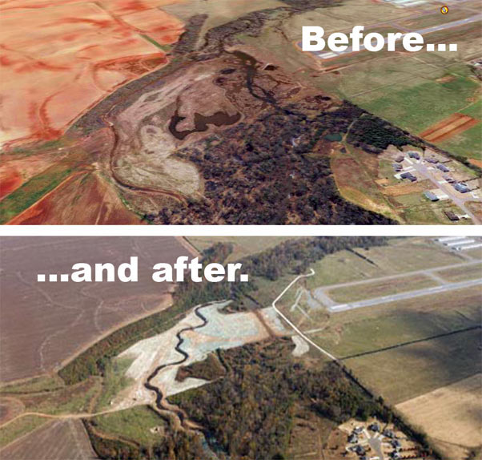
STREAM RESTORATION

Slide 2
Environmental Protection
Streams receive surprisingly little protection from conservation laws.
The Clean water Act has had some success reducing pollution in the largest rivers.
The Endangered Species Act has had limited success protecting streams that harbor rare fishes.
The Wild and Scenic Rivers Act and a number of similar state laws protect segments of rivers, but rarely entire river systems.
Scenic rivers are often damaged by excessive recreational use!

Slide 3
Secondary Protection
The stream systems that receive the highest degree of protection are those that are contained within forest reserves or state or federal wilderness areas.
However, these are terrestrial reserves designed to protect forests and terrestrial animals.
A system of stream reserves is needed to ensure that a sufficient number of streams and the biota they support are protected.

Slide 4
Risk Assessment
The Nature Conservancy recently completed a national assessment of the degree of imperilment of freshwater biodiversity in the United States.
After mapping at-risk populations of fish and mussels in more than 2000 small watersheds in the United States (most in the southeast), the Nature Conservancy concluded that 327 watersheds - 15% of the total - would need to be protected in order to protect all of the imperiled fish and mussel species.
Fewer than 15% of the watersheds in the U.S. are pristine and under protection, the issue of conserving stream biodiversity boils down to restoring some of the streams and watersheds that are currently impacted by anthropogenic activity.

Slide 5
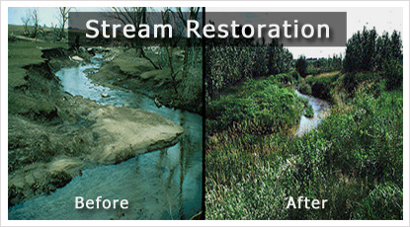
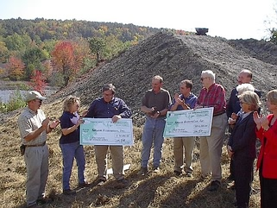
Hope for recovery
Fortunately stream ecosystems have great powers of recuperation.
Recovery times vary, depending on the type and extent of disturbance.
Humans can accelerate the recovery process if they have the will, and the proper understanding of the natural dynamics of streams and the forces causing the disturbance.

Slide 6
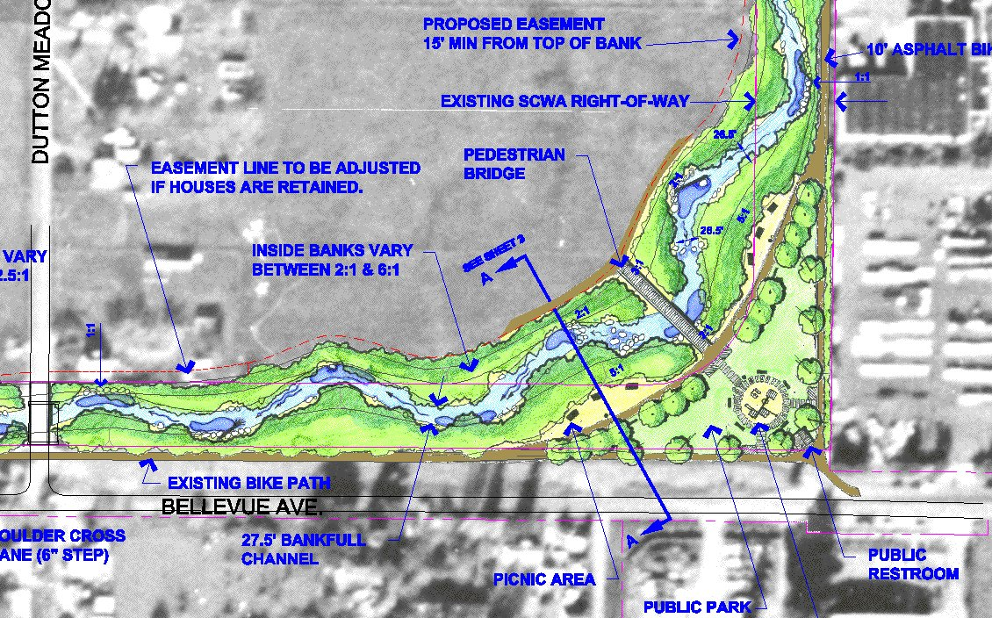
Balancing stream and human needs
Goal of stream restoration is rarely to halt human activities affecting streams.
If stream is isolated from impacts and harmful activities minimized, most will return to a more natural state on their own.

Slide 7
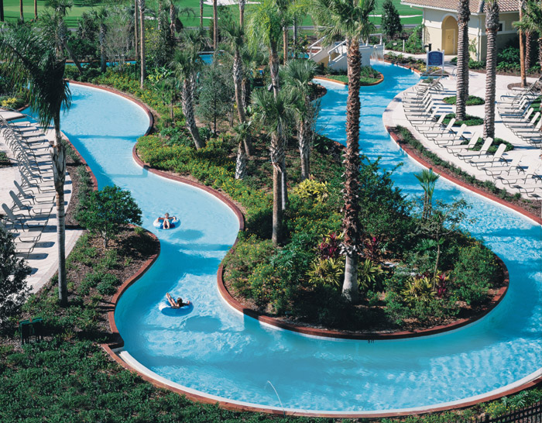
Stream Re-engineering
Humans have the knowledge and ingenuity to build streams.
Extensive channel re-engineering is expensive and rarely has the desired effect.

Slide 8
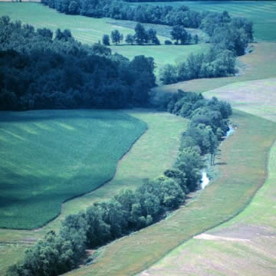
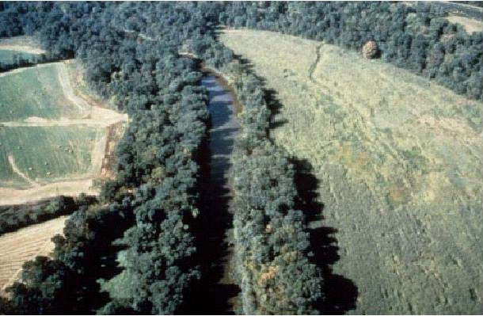
Forest Buffers
A key feature governing interactions between streams and the surrounding land in forested watersheds is the degree of forestation of the riparian zone.
Maintaining a strip of forest buffer of at least 100 meters on both sides of the stream is generally effective for trapping sediment eroding from cropland and forest clearcuts.
Wider forest buffers are generally needed to ensure that sufficient water enters the stream has hyporheic flow.
Important aspect of stream restoration in agricultural and silvicultural lands is restoring a forest buffer zone.

Slide 9
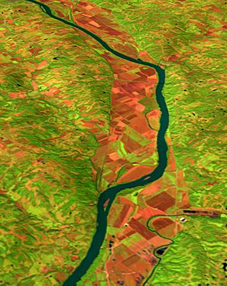
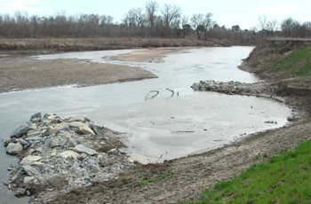
Channel repositioning
Streams that have been channelized by activities such as dredging, channel straightening, snagging, cut offs, diking, etc, generally become entrenched in a particular portion of the flood plain.
Rock weirs can sometimes be used to restrict flow to entrenched channels and force streams to return to abandoned secondary channels on the floodplain.

Slide 10
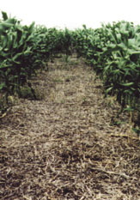
Best Management Practices
Another important aspect of restoring streams is encouraging Best Management Practices (BMP's).
In agricultural lands, BMPs include no-till farming, no planting on marginal lands, establishing ponds or marshes to trap fertilizers and animal wastes.

Slide 11
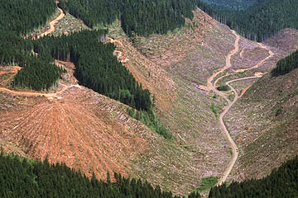
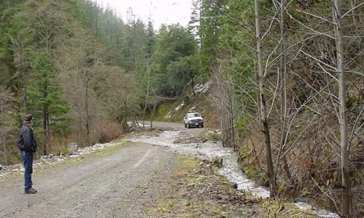
BMP’s cont’d
In silvicultural lands, BMP's include selective cutting or cutting on a rotation that allows forest regeneration, and care in the construction and use of forest roads.

Slide 12
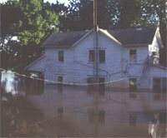
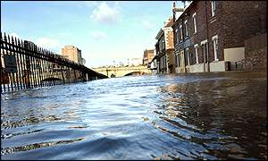
Flood Plain Management
A key aspect of restoring larger rivers is moving people out of floodplains and allowing the rivers to once again flood and meander across their valleys.

Slide 13
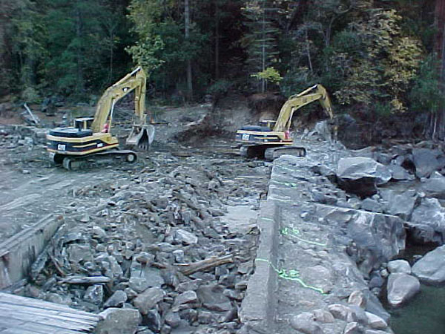
Dam Removal
Dam removal is being advocated on many small streams and rivers.
Dams are not likely to be removed on the largest rivers, especially where hydropower production is involved.
However, water can be released in ways that are more in line with the natural flow dynamics of the river.

Slide 14
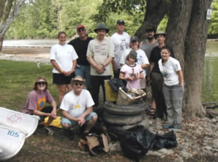
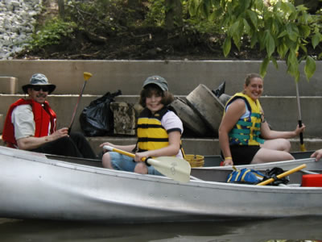
Grassroots Action
Ordinary citizens are becoming increasingly conscience of environmental quality in general and stream quality in particular.
Streams that have the most vocal protectors and that have consequently received the most attention are trout streams (high-gradient, cold-water).
Warm-water streams that are the most impacted by anthropogenic activity and need the most protection.

Slide 15
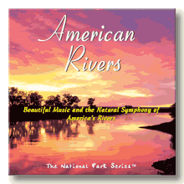


Non-governmental Organizations
A number of non-governmental organizations are devoted to protection of streams.
Some of the most important national organizations are American Rivers, River Revival, the Nature Conservancy, Sierra Club, and Trout Unlimited.

