Slide 1
SURFACE-SUBSURFACE INTERACTIONS

Slide 2
Overview
Stream ecosystems are an amalgamation of a variety of subsystems all connected by flowing water.
The subsystems may be arrayed longitudinally (e.g., riffles and pools in surface habitats), laterally (e.g., main channel, shoreline and backwater habitats) and vertically (surface-subsurface habitats).
This discussion is about interactions that occur between surface water and the hyporheic zone, and how conditions in streams influence these interactions.

Slide 3
Hyporheic Flow
Recall that the hyporheic zone is the wetted region beneath the stream bottom.
Water flows through this zone; however it flows more slowly than in the surface stream because it must flow through bed materials.
The hyporheic zone exchanges material with the surface stream via water movement.

Slide 4
Hydraulic Head and Conductivity
Exchange between surface and hyporheic zones is dictated by the character of the streambed.
Two features of streambeds are important: hydraulic head and hydraulic conductivity.
Hydraulic head is a measure of the stream's flow force and determines how far into the substrate water can penetrate.
Hydraulic conductivity is a measure of bed porosity. It determines how easily water can travel through bed materials.

Slide 5
Effects of Bed Composition
Surface-subsurface exchange is very limited in situations where the streambed is composed of unfractured bedrock, or when bedrock is close to the streambed.
Water penetration and flow-through (and thus exchange) are greater when the bed is composed of coarse material (cobble, gravel) than when the bed is composed of fine material (sand, silt).

Slide 6
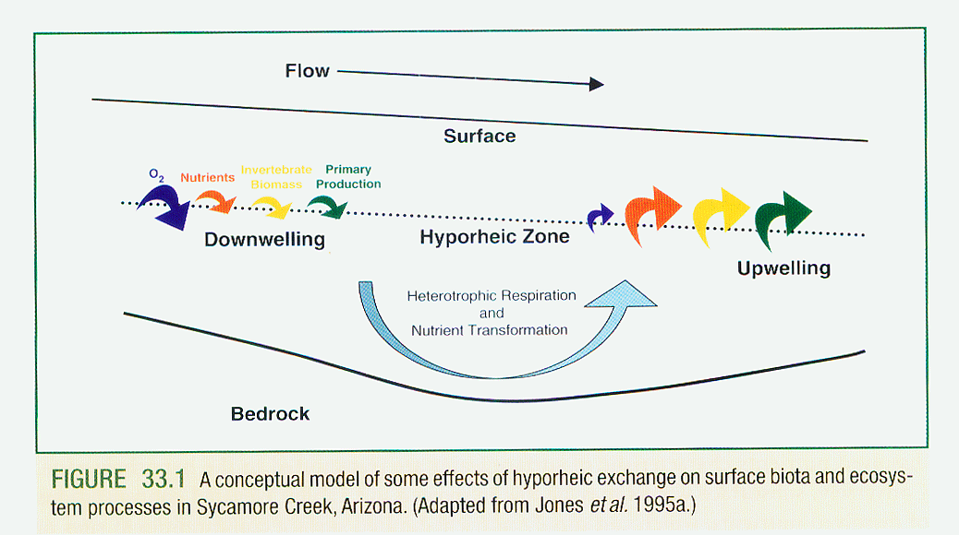

Slide 7
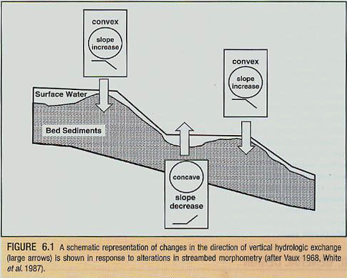
Effects of Flow Force

Slide 8
Downwells
Hydraulic head and hydraulic conductivity tend to be greatest at riffles (convex bed areas), where water is shallow, gradient is high and bed material tends to be coarsest.
Surface water penetrates the bed to the highest degree in these habitats (downwells).
Oxygen and dissolved materials are typically carried far down into the streambed.
Because of this, microbial communities tend to show the highest respiration rates in these areas.
Depending of substrate coarseness, suspended sedminent and organic matter may be filtered out.

Slide 9
Upwells
In pools (concave bed areas), where water slows and substrates become finer, the movement of water tends to be from subsurface to surface (upwells).
Oxygen concentrations tend to be low in upwells, relative to surface water.
Dissolved nutrient concentrations tend to be high.
Nutrients entering at upwells can be from groundwater sources or due to the action of nitrogen-fixing bacteria and algae.
Algal biomass tends to be higher at upwells than at downwells, due to the higher availability of nutrients.

Slide 10
Surface-Subsurface Exchange Measurement
To determine surface-subsurface exchange potential, vertical hydraulic gradient (VHG) must be measured.
VHG = ∆h/L
Where ∆h = surface/subsurface height difference; L = meter insertion depth.
Pressure difference between surface and subsurface waters.
Positive at upwells; negative at downwells.

Slide 11
