Slide 1
HYPORHEIC ZONE

Slide 2
Hyporheic zone
Zone where water flows through substrata (interstitial environment) below the streambed.
Surface-water/ground-water transition zone or ecotone.
Physically different from the surface water (in terms of temperature, light, DO).
Important, yet poorly understood, habitat (fewer than 60 papers used the term prior to 1995); interest in the hyporheic zone has increased greatly since this time (six times the pre-1995 number of paper published from 1995-2005).

Slide 3
Diversity and Productivity
Important habitat for a wide variety of subterranean organisms.
In many streams, hyporheic invertebrate production exceeds that of the surface benthose.
No primary producers and few top predators.
More susceptible to human land-use effects than surface benthose.

Slide 4
Nutrients and Metabolism
Upwellings from the hyporheic zone deliver limiting nutrients to surface waters, increasing algal primary productivity and algal diversity.
Plays a strong role in phosphorus and nitrogen cycling and ecosystem metabolism.
Metabolic rates in the hyporheic zone depend strongly on DOC and POC dynamics.

Slide 5
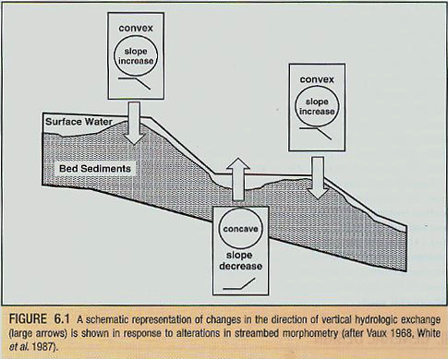
Exchange with surface water
Direction of exchange with surface water varies in different stream habitats.
Water enters hyporheic zone where stream bed is convex (e.g., riffles)
Water rejoins surface water where bed is concave (pools)

