Slide 1
PLANT-HERBIVORE INTERACTIONS

Slide 2
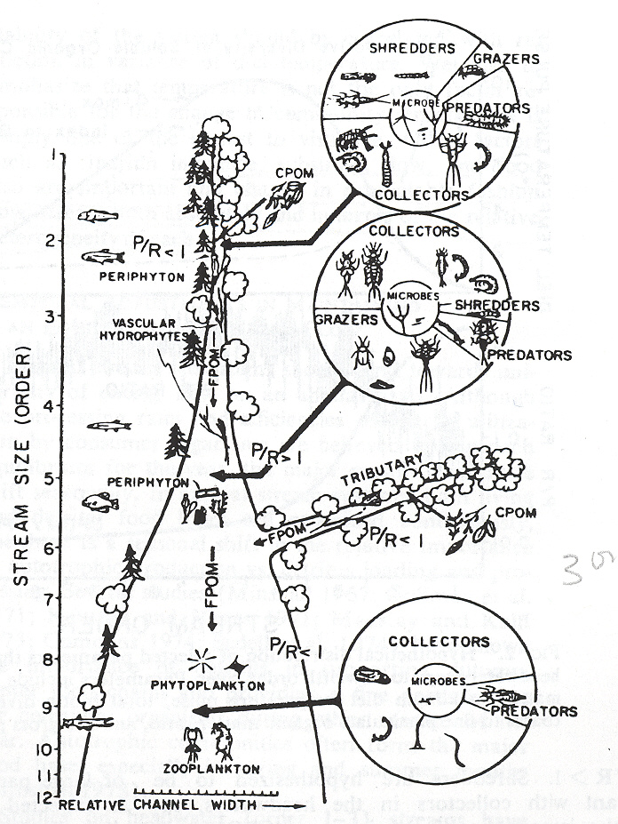
Primary Production
Autochthonous primary production can dominate annual energy budget in streams (primarily in arid landscapes).
Typically highest in mid-order streams and dominated by benthic algae
In higher order streams shifts to phytoplankton (in water column)

Slide 3
Stream Primary Producers
Stream algae and aquatic macrophytes (excluding bryophytes).
Benthic algae dominate; major component of periphyton (a.k.a. aufwuchs and biofilm).

Slide 4
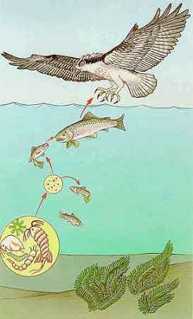
Herbivory
Herbivory (a.k.a. grazing) is the consumption of living plant matter by animals (primary consumption).
Represents the most basic and important interaction in most ecosystems.
The major link between primary production and production at higher trophic levels.

Slide 5
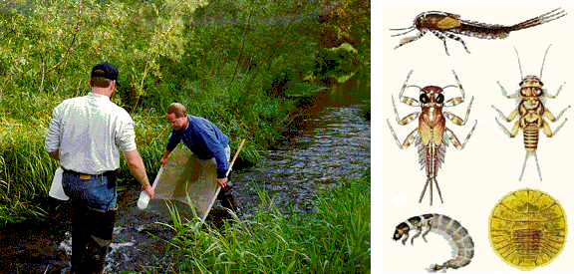
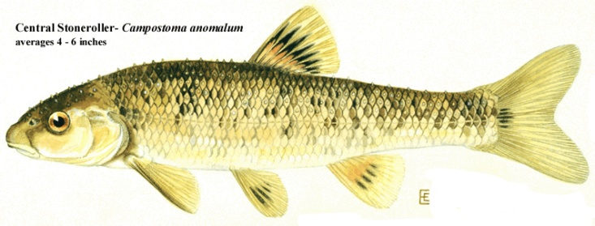
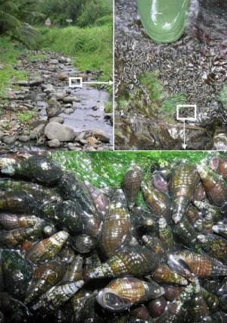
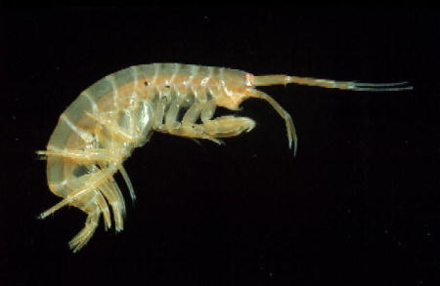
Stream Grazers
Herbivory also called grazing because herbs are constantly being grazed by grazing animals.
Low diversity of grazing fishes, but most obvious.
Also insects, crustaceans, mollusks, amphibians

Slide 6
Grazer production
Living vegetation more nutritious than detritus.
Modeling and empirical studies suggest that lotic algal biomass can support 10-20 times more grazer biomass than detritus

Slide 7
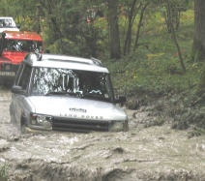
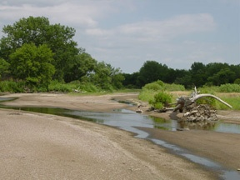
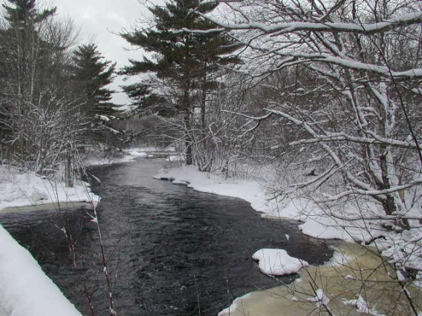
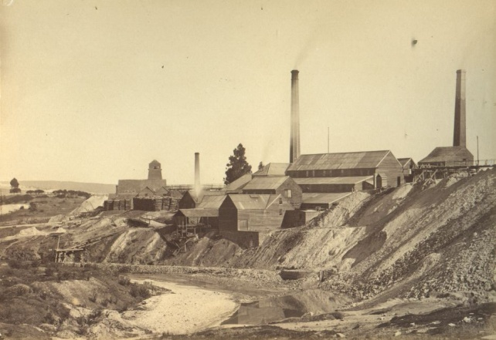
Other impacts
Grazers – effective consumers of algal standing crop
BUT…. Low levels of algae does not necessarily indicate high herbivory levels (low light, low nutrients, season, poor substrates, disturbance, etc.)

Slide 8
Controlled Experiments
Best way to determine how herbivores are influencing algal biomass is to do controlled experiments.
Quantify differences in algal biomass production under different grazing regimes.
Simple herbivore exclusion and enclosure experiments permit quantification of algal response in the absence and presence of herbivores or with varying herbivore densities.

Slide 9
Case studies
Power et al. (1988) used short-term exclusion experiments to examine grazer influence of algal community composition.
Observed that stony substrata in streams of the southwestern Ozark mountains were covered with cyanobacterial felts dominated by Calothrix sp., an important nitrogen fixer.
Alternately exposed and protected patches of stream bottom from grazing fishes and invertebrates for periods ranging from 4-33 days.

Slide 10
Power et al. 1988, cont’d
When protected from grazers, the cyanobacerial felts were overgrown by turfs of benthic diatoms within 4-10 days.
Diatom turfs also developed on bare substrata that were incubated in sites in the stream inaccessible to grazers.
Diatom turfs exposed to grazing minnows were stripped off in 3-5 minutes, and when left exposed to grazers, were replaced by cyanobacterial felts within 11 days.

Slide 11
Conclusions
By selectively feeding on diatoms, grazers were maintaining a high proportion of nitrogen fixers in producer assemblages, which could enhance primary productivity in the system.

Slide 12
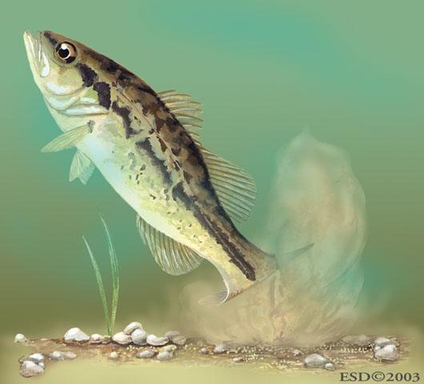
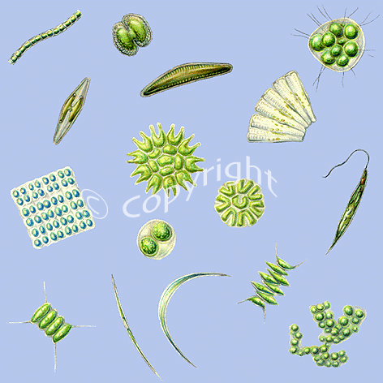
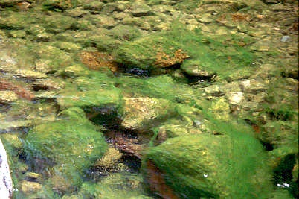
Power and Matthews (1983)

