Slide 1
STREAM DISCHARGE
AND ITS MEASUREMENT

Slide 2
Stream Flow
Flowing water is the definitive characteristic of a stream.
Everything that a stream ecosystem does happens because water flows.
This lecture concerns the measurement and dynamics of flow.

Slide 3
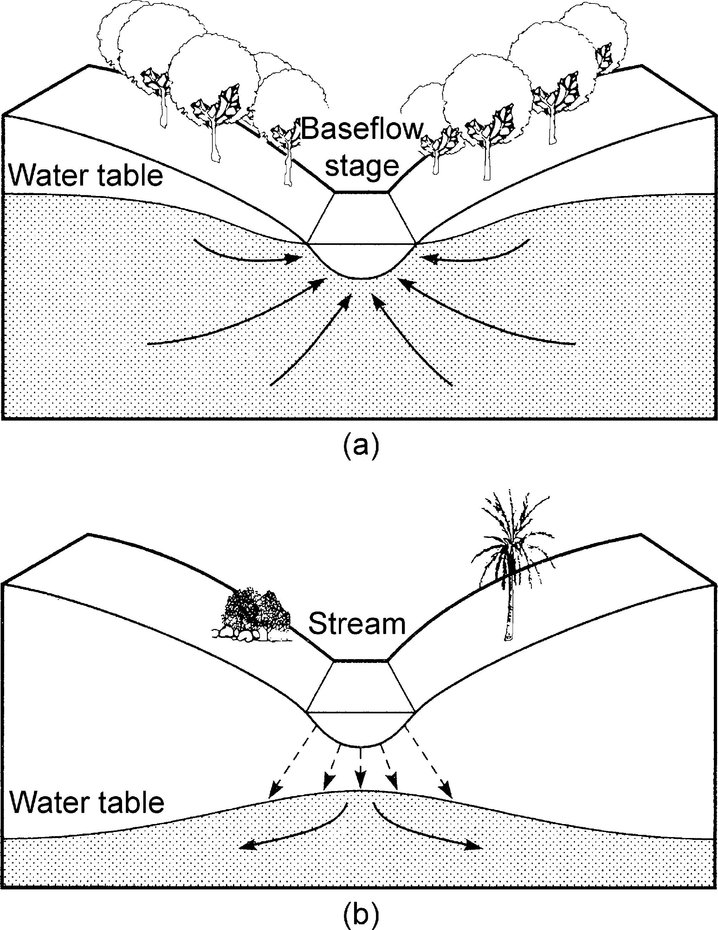
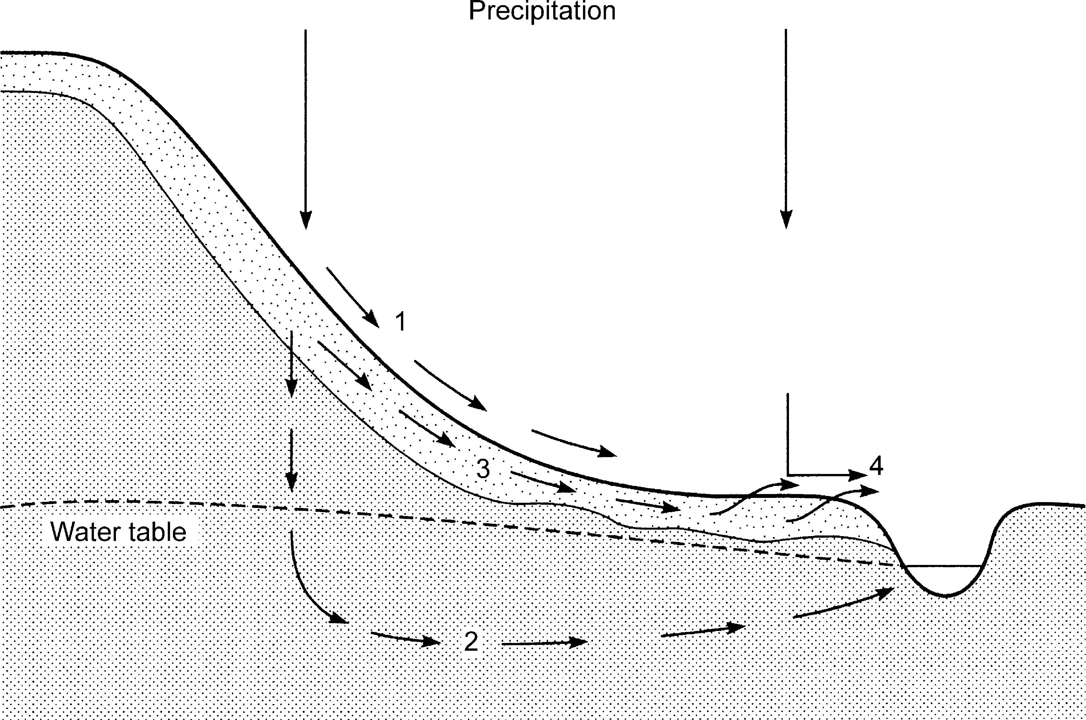
Precipitation and Stream Flow

Slide 4
Stream Flow Measurement
Stream flow, also referred to as discharge, a volumetric measurement.
Is the volume of water passing a particular point in a stream over a particular period of time.
The volume is computed as the velocity (distance/time) times the stream’s cross-sectional area (mean depth times width).
Most common unit of flow in English Units is cubic feet per second or cfs; cubic meters per sec or cumecs in SI (metric) units.

Slide 5
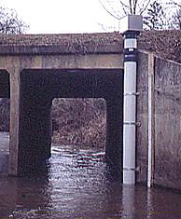
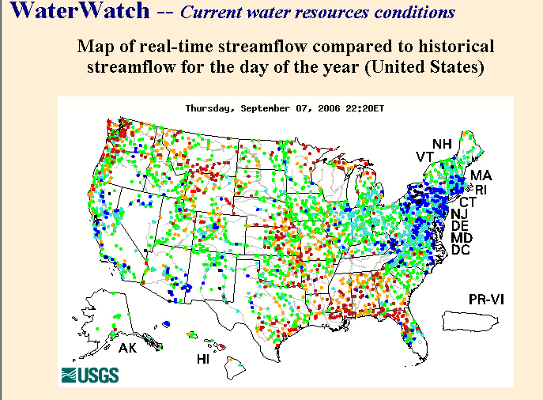

Stream flow monitoring
Stream gauging stations
record the height or stage
of the surface of the water
relative to a fixed datum
(national geodetic datum
~ mean sea level) at
15-minute intervals.

Slide 6
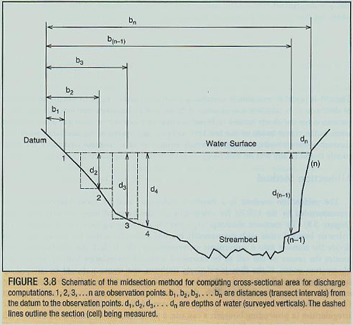
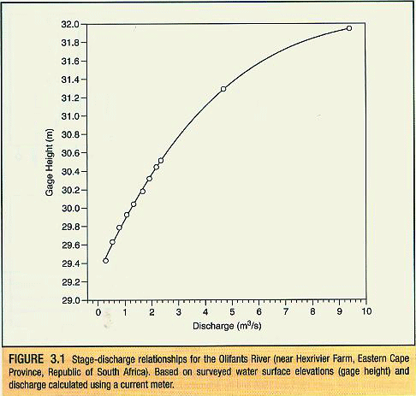
Stream flow monitoring cont’d
Stream cross-sectional area computed at monthly intervals. Hydrologists produce
a rating curve showing how stream stage or gage height relates to discharge,
then use this to extrapolate discharge for the various stage measurements.

Slide 7
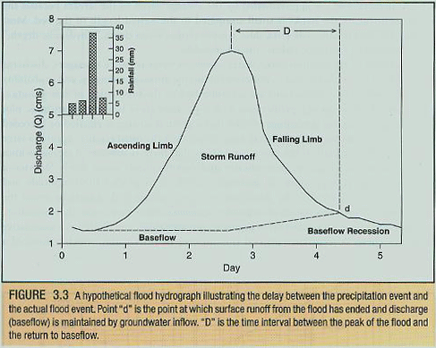
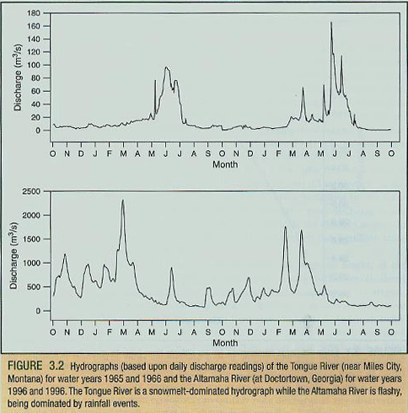
Hydrographs
Graphs depicting how stream flow varies
over time (short or long intervals) are
called hydrographs. By studying patterns
in hydrographs, hydrologists or stream
ecologists can determine the runoff and storage characteristics of different
watersheds, or the tendency and frequency of floods and droughts.

Slide 8
Flow Storage
The length of time it takes a daily hydrograph to respond to a rainfall event depends of the storage characteristics of the watershed.
The more porous the soils and the larger and more dense the vegetation cover of surrounding landscape, the greater the storage capacity and the longer the hydrographic response (contrast a city to a forest).
The more storage there is, the longer a stream is charged by groundwater flow.

Slide 9
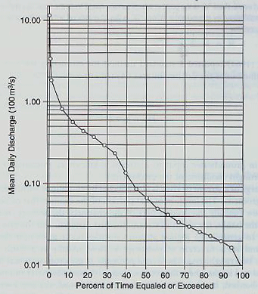
Flow Duration Curves
Flow-duration curves relate discharge
to the percentage of time (typically
over the course of a year) that particular
discharges are equaled or exceeded.
Streams with steeply-sloped curves
receive most of their discharge as
runoff.
Streams with flat curves have high
storage.

Slide 10
Flood Frequency Curve
A flood-frequency curve shows the
periodicity of floods of different
magnitudes (e.g., 100-year flood).

Slide 11
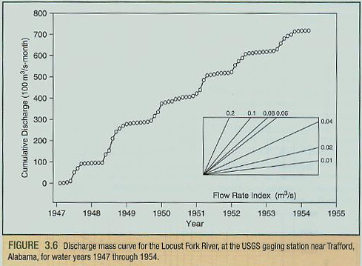
Cumulative Discharge Curve
Another way of depicting
discharge pattern or
variability over time is with a
cumulative-discharge curve.
Changes in the shape of the
curve from year to year or
over longer periods represent
changes in discharge
patterns.

