Slide 1
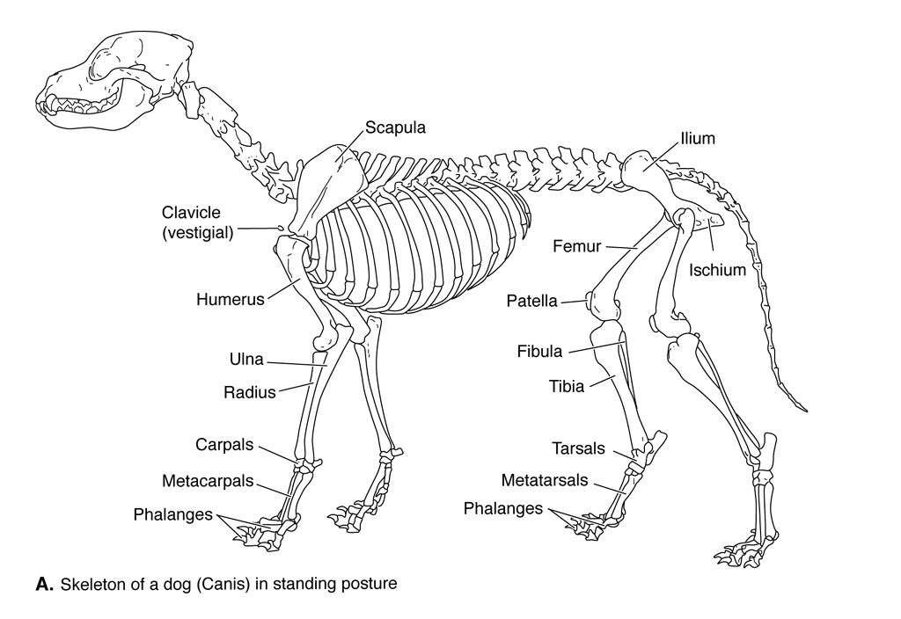
APPENDICULAR SKELETON
Appendicular skeleton in vertebrates consists of the appendages
(fins or limbs) and their internal skeletal supports.

Slide 2
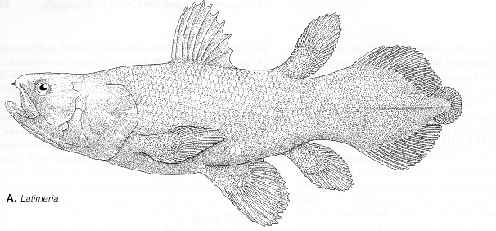
Fins
Fins of fishes are simple folds of skin that extend out from the
body. Internal skeletal supports of fins function to keep fins
erect. Fish have medial fins along the midline of the body
(dorsal, caudal, anal), which function to prevent rolling in
swimming. Paired fins (pectoral and pelvic) are found along
the lower sides of the body in fishes, where they function as lift
-producing or as paddling and braking structures.

Slide 3
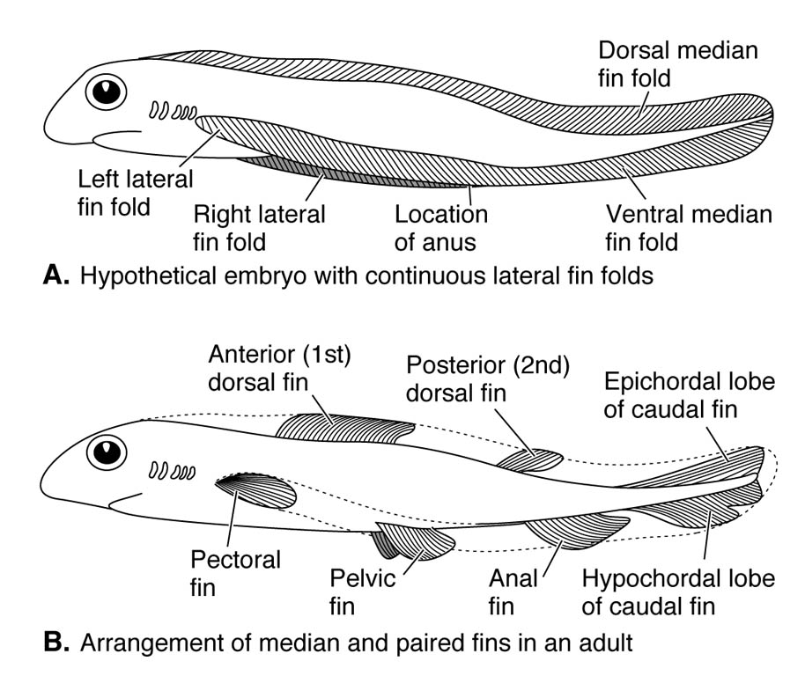
Fin-Fold Theory
Fins are believed to have
evolved from the fin fold,
which encircles the body
of cephalochordates and
primitive jawless fishes.
The fold is medial along
the top and around the
back of the body, then
divides into paired
ventrolateral folds. Fins
are believed to have
evolved by selective
retention of parts of
this fold.

Slide 4
Fin elements
Skeletal supports of fish fins are of two types: ceratotrichia
of sharks, composed of a horny material similar to keratinized
skin (but dermally derived); and lepidotrichia, which are
derived from scales and composed of bone.
Ceratotrichia and lepidotrichia are attached to cartilages or
bones called radials located at the base of the fin. Radials in
turn articulate with cartilages or bones called basals, which
are embedded within the body musculature.
The basals and radials are referred to collectively as
pterygiophores (fin bearers).

Slide 5
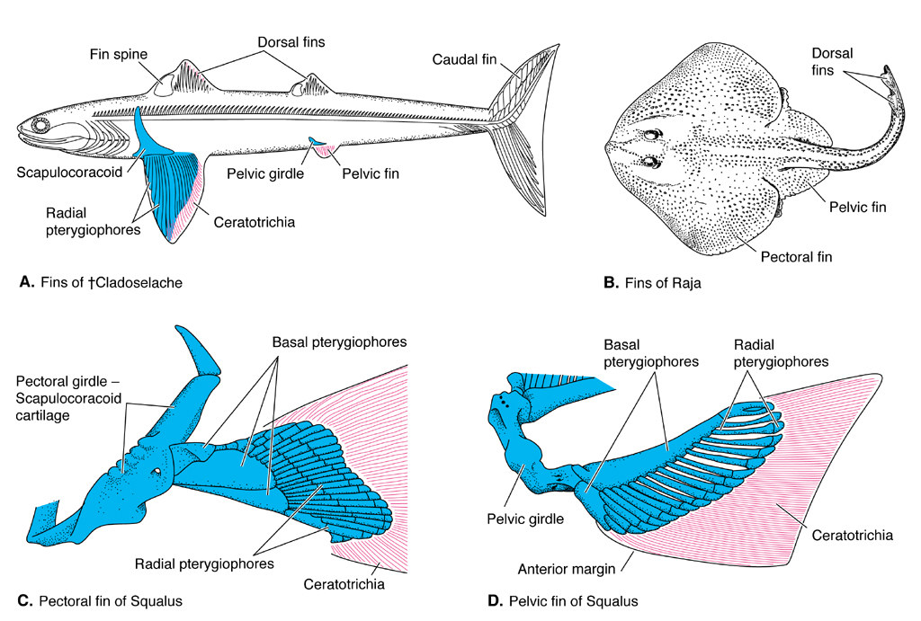
Paired-fin support: chondrichthyans
Paired fins of fishes
are supported on
girdles of cartilage
or bone (replacement),
which are homologous
to girdles that support
limbs in tetrapods. In
chondrichthyans, the
pectoral and pelvic
girdles are solid masses
of cartilage. Pectoral
girdle referred to as
scapulocoracoid bar; pelvic called puboischiatic bar. Both girdles
are free of the axial skeleton.

Slide 6
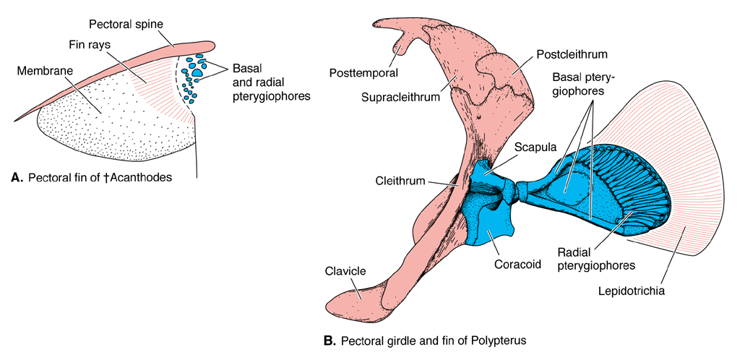
Paired-fin support: bony fishes
In bony fishes, pectoral fin supported on a large dermal bone
called the cleithrum. A small clavicle may be seen on the leading
edge of the cleithrum. Other dermal bones above the cleithrum
connect the pectoral girdle to the head. The scapulocoracoid
differentiates into a separate scapula (dorsal) and a coracoid
(ventral). The pelvic girdle is undifferentiated and consists of a
paired bones called basipterygia.

Slide 7
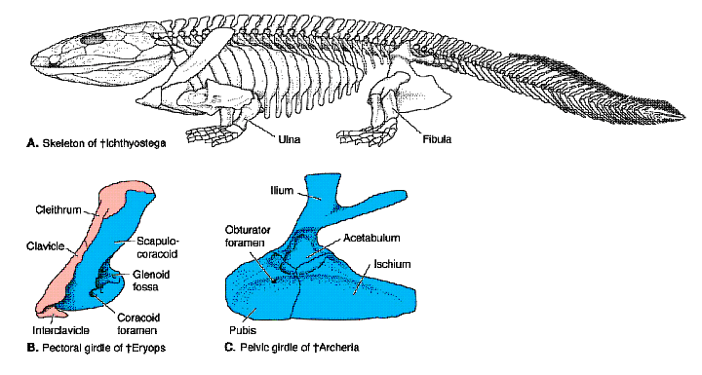
Limb support in tetrapods
In tetrapods, main
bones of the pectoral
girdle are scapula
and coracoids;
cleithrum and
clavicles are minor
elements.
Pelvic girdle composed of three bones: dorsal ilium; anterior
pubis; and posterior ischium. The three bones fuse in adults
of many vertebrates, forming the innominate bone. Ventral
bones often articulate midventrally, forming the pelvic
symphysis.

Slide 8
Amphibian limb supports
In early amphibians,
bones above the
cleithrum lost,
freeing pectoral's
connection to the
head and permitting
head movement
independent of the
shoulder.

Slide 9
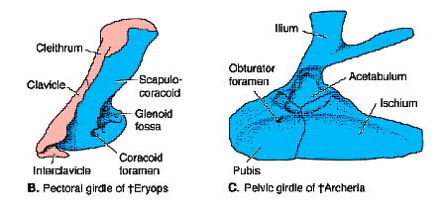
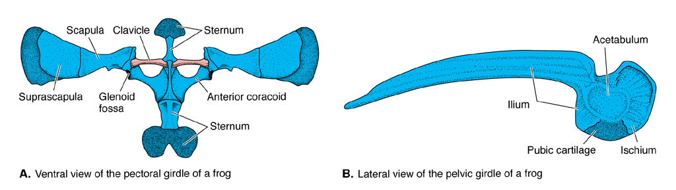
Modern amphibians
Modern amphibians lose
cleithrum. Primitive
amphibians have a solid,
triagular pelvis. Pubis is
distinguished by the
presence of the obturator
foramen.
In frogs, ilium is long and
inclined; pubis is small
and cartilagenous.

Slide 10
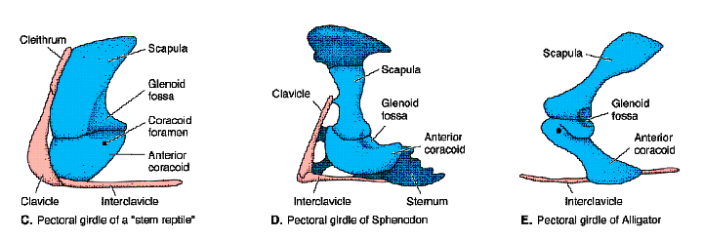
Reptilomorph pectoral supports
Stem reptiles, synapsids and monotremes retain the interclavicle
and cleithrum; scapula is large and there are anterior and posterior
coracoids.

Slide 11
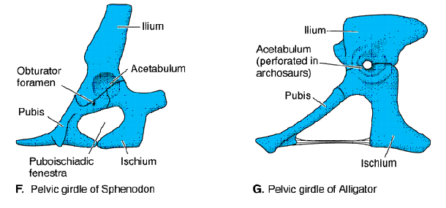
Reptilomorph pelvic supports
Pelvic girdle is more firmly attached to the vertebral column.
There is a large puboischiadic fenestrum between the
ventral bones.

Slide 12
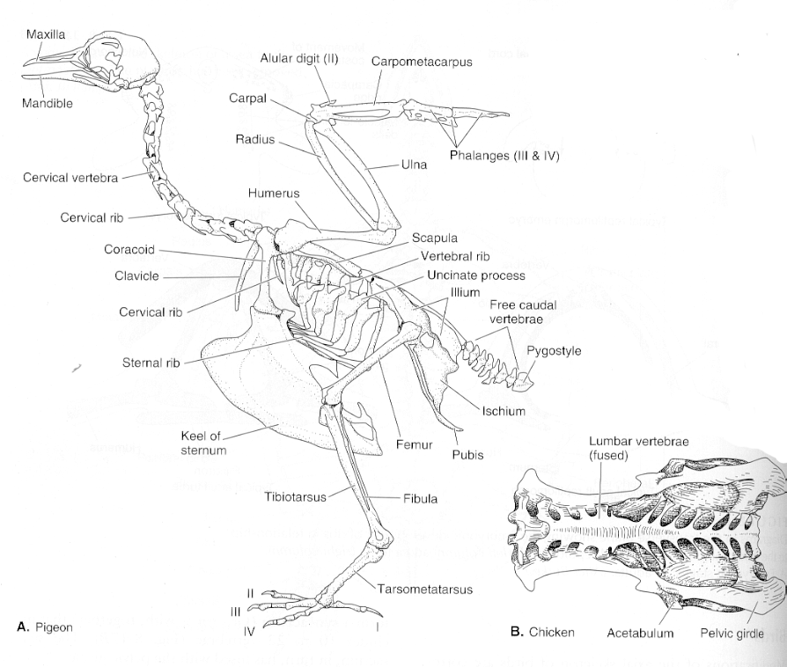
Avian limb supports
In birds, scapula is long
and blade-like; anterior
coracoid is enlarged and
articulates with sternum;
posterior coracoid is lost;
clavicles and
interclavicles fuse
ventrally to form
the furcula (wishbone).
Pelvic girdle is large and
firmly fixed to the
sacrum. Ilium is
elongate, extending
anterior and posterior of the acetabulum, socket that receives the
femur. Pubis extends backward as well and there is no pubic
symphysis.

Slide 13
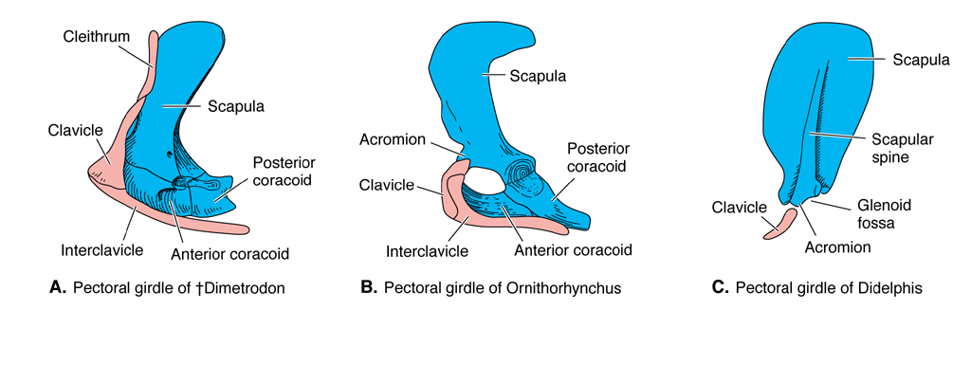
Mammalian limb supports
In therian mammals, anterior coracoid is lost and posterior coracoid
fuses to scapula, forming coracoid process. Spines form on scapula
with acromion as the ventral most process. In pelvic girdle, ilium
is long and extends forward of acetabulum. Obturator foramen
combines with the puboischiadic fenestrum. Public symphysis is
almost always present.

Slide 14
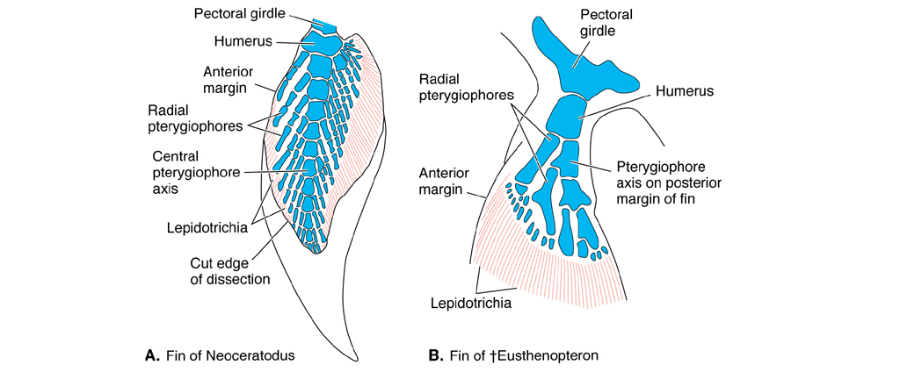
Origin of limbs
Two types of internal supports for the paired fins are seen in
lobefin fishes: a primitive type, called archipterygium, with
radials extending out from both sides of a central axis; and a
derived uniserial type with radials only on one side of the central
axis of the fin (crossopterygian or metapterygian).

Slide 15
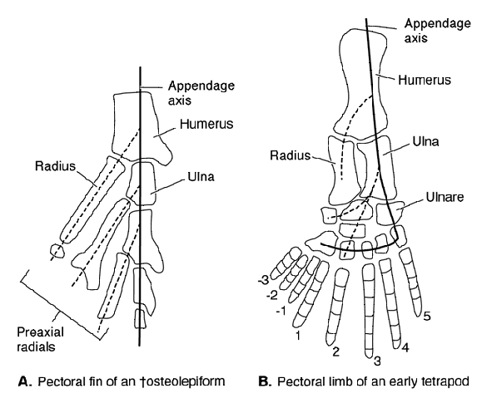
Origin of limbs
Clear that the tetrapod
limb is descended from
crossopterygian type
of lobe fin. Proximal
bones of the main axis
became the main limb
bones (humerus and
ulna in the forelimb;
femur and fibula in
hindlimb). First radial
becomes the radius. Other distal axial elements and radii become
the podials (carpals and tarsals), metapodials (metacarpals and
metatarsals), and phalanges.

Slide 16
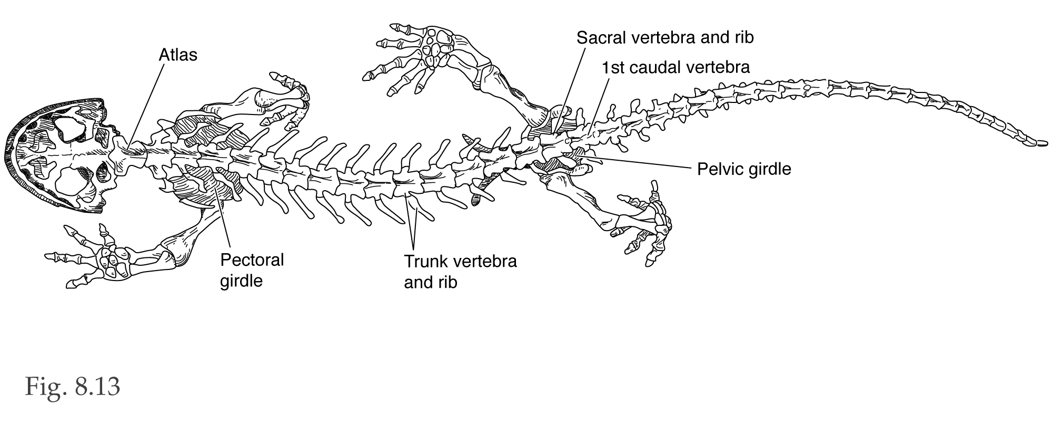
Limb changes in tetrapods
In amphibians, the limbs are short and splayed to side of body.
Limbs are advanced by side-to-side twisting of the body. Limbs
are longer in modern reptiles, but still sprawled out from side of
body. In dinosaurs, mammal-like reptiles, and mammals, limbs
are rotated under the body, a position that allows for more rapid
locomotion.

Slide 17
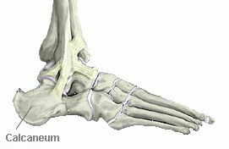
Limb specialization in mammals
In mammals, the fibulare of tarsus forms the calcaneus or
heel bone. The tibiale joins with the adjacent intermedium
to form the astragulus or ankle bone, which overlies the
calcaneum. The ulna has a characteristic posteriorly projecting
process in elbow region called the oleocranon, which serves
as attachment point for upper arm muscles.

Slide 18
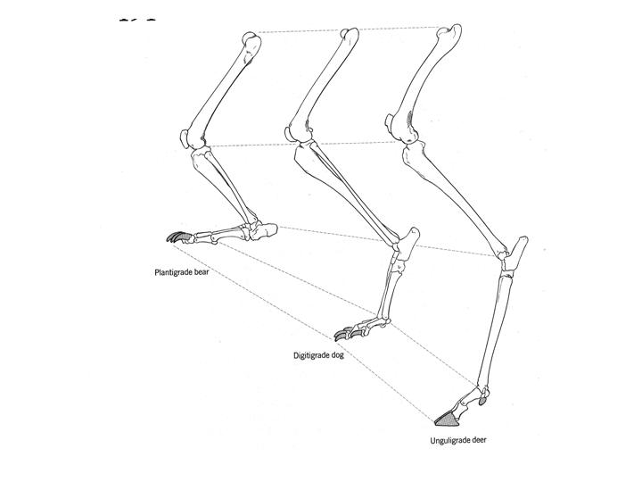
Limb postures in mammals
Some mammals stand on foot (plantigrade), using calcaneum
for rear support. Others stand on digits (digitigrade) or toes
(unguligrade).

Slide 19
Digits
Amphibians have five digits on hind feet, but only four on
front feet. Reptiles have five digits on front and back feet. In
mammals, number of digits is primitively five, but many groups
show fusion or loss of toes.

Slide 20
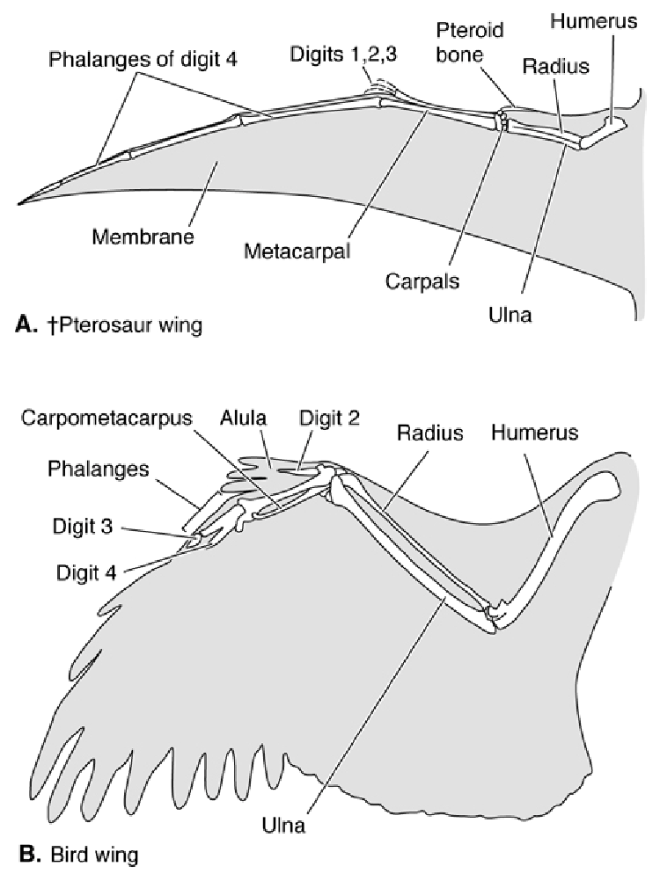
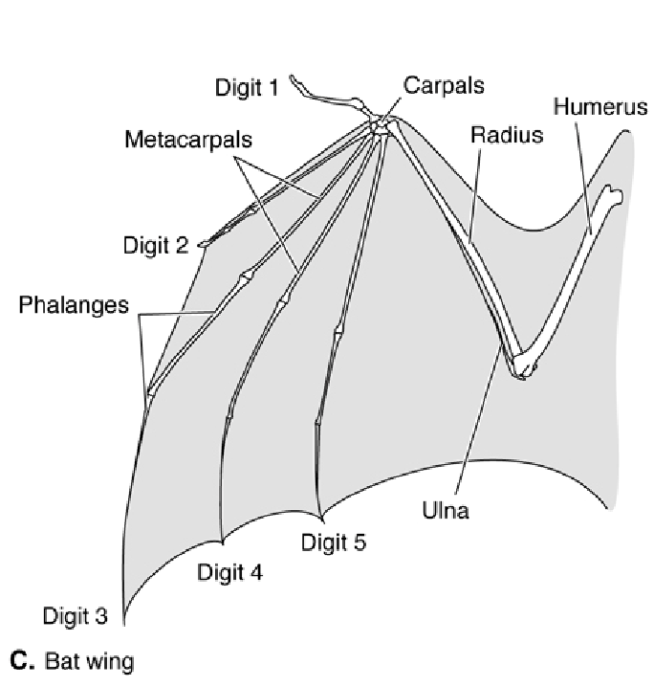
Wings
Wings in tetrapods are formed
by folds of skin between forelimb
and body. They are supported
internally by digits.
Pterosaur wings supported by
digit 4;
Birds wings supported by digit 3;
Bat wings supported by digits
2-5.

Slide 21
Miscellaneous bones
Nodules of bone called sesamoid bone sometimes form
over joints. The patella or kneecap is the largest example.
Sometimes tendons themselves ossify (as in the drumsticks
of turkeys).
A bone called the baculum is present in the penis or clitoris
of certain mammals (carnivoes, rodents, insectivores, some
primates).
Small bones are also found in eyelids of crocodiles, crests of
birds, snouts of pigs, pinnae of rodents, and aortic arches of
artiodactyls.

