Slide 1
Circulatory System
Vertebrate circulatory system is responsible for transporting
substances throughout the body and (largely) for maintaining
homeostasis.
Has two components: blood vascular system and lymphatic
system.
Blood vascular system includes heart, blood vessels and blood.
Lymphatic system includes lymphatic vessels, lymph nodes, and
lymph (fluid portion of the blood).

Slide 2
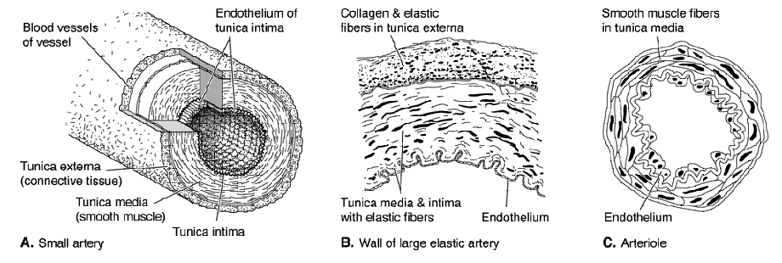
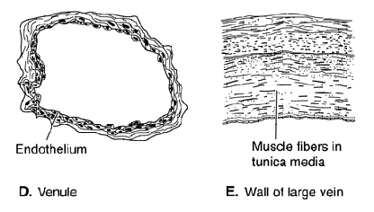
Blood vessels
Arteries
Veins
Blood vessels are of two main types: thick muscular arteries
(ranging from large aortae to small arterioles) which carry blood
away from the heart, and thinner, more elastic veins (ranging
form large sinus venosus or vena cavas to small venules) which
return blood to the heart. Fewer exceptions to this rule than rule
that arteries carry only oxygenated blood; veins deoxygenated
blood (opposite for pulmonary arteries and veins).

Slide 3
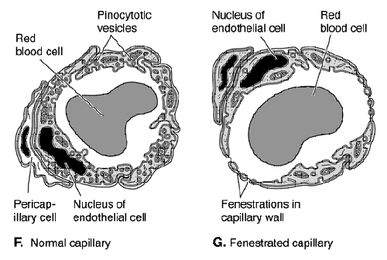
Capillaries
Between arterioles and venules, or sometimes within arterial
(e.g., renal corpuscles, hypophysis of pituitary) or venous
vessels (e.g., hepatic portal system) are very small, very thin-
walled, very densely-networked capillaries which are composed
of only thin endothelium and are designed to leak fluids.

Slide 4
Microcirculation
No vertebrate has enough blood to service all of its capillary
beds at the same time. Instead, sphincters in arterioles control
blood flow to capillary beds (microcirculation). Arteriole-
capillary-venule systems have shunts which allow blood to
bypass capillaries altogether.
Flow of blood through capillaries is controlled by nerves and
hormones, which regulate how blood is distributed.

Slide 5
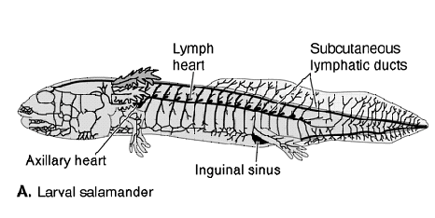
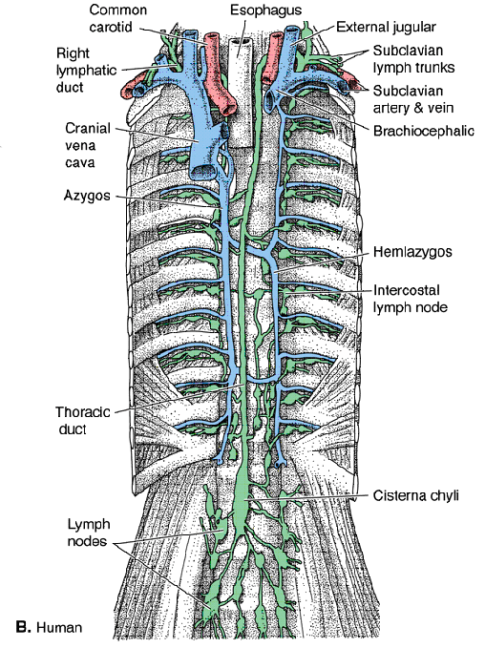
Lymphatic system
Although vertebrate circulatory
system is closed, lymph leaves
blood vessels at capillaries and
diffuses out into tissues, where
gas and nutrient exchange takes
place.
Fluids are returned to blood via
lymphatic system vessels, which
are blind vessels resembling
veins that siphon up lymph and
return it to the blood at several
points along the venous system.

Slide 6
Heart and blood pressure
Heart functions to pump blood through vessels and to maintain
hydrostatic pressure. Muscles in arteries help to spread the high
(systolic) pumping pressure of heart over the arterial system.
Pressure supplied by recoil of muscles in arteries is referred to as
diastolic pressure.
Most of the pressure of blood is lost when lymph leaves
capillaries. Return of lymph to the veins and venous blood to
heart on the venous side is dependent on milking action of
muscles and suction of the heart. Lymph vessels and veins have
valves to prevent backflow. In lower vertebrates, lymphatic
sinuses sometimes have weak lymph hearts.

Slide 7
Heart development
Circulatory system is first of all organ systems to become
functional and heart is the first component of circulatory system
to form. Heart forms from splancnic layer of hypomere just
posterior to pharynx and ventral to gut. Walls thicken as the two
sides of splanchnic hypomere merge and fuse along the midline.
Initially, heart is a longitudinal tube with two layers: inner
endocardium which consists of a smooth inner endothelium
and a thick elastic connective layer, and an outer
epimyocardium which consists of thin, serous outer layer
(epicardium) and thick inner muscle layer (myocardium).

Slide 8
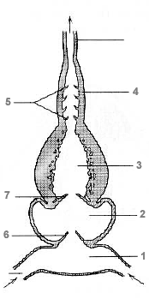
Ancestral vertebrate heart
Amphioxis has pulsating vessel in
area where vertebrate heart
develops; resembles embryonic
primordium of heart and believed
to be homologous. Ancestral
vertebrate heart was most
likely a straight tube with four
compartments: posterior most
sinus venosus (1) which receives
blood from body (cardinal veins);
thin walled but muscular atrium (2);
thick, muscular ventricle (3);
moderately thick muscular conus
arteriosus (4) with many
semilunar valves (5).

Slide 9
Ancestral vertebrate heart
All compartments contract in
sequence producing a single
stream of flow of deoxygenated
blood through heart. Sinuatrial
valve (6) separates sinus venosus
from atrium; atrioventricular
valve (7) separates atrium from
ventricle. Both function to
prevent backflow.

Slide 10
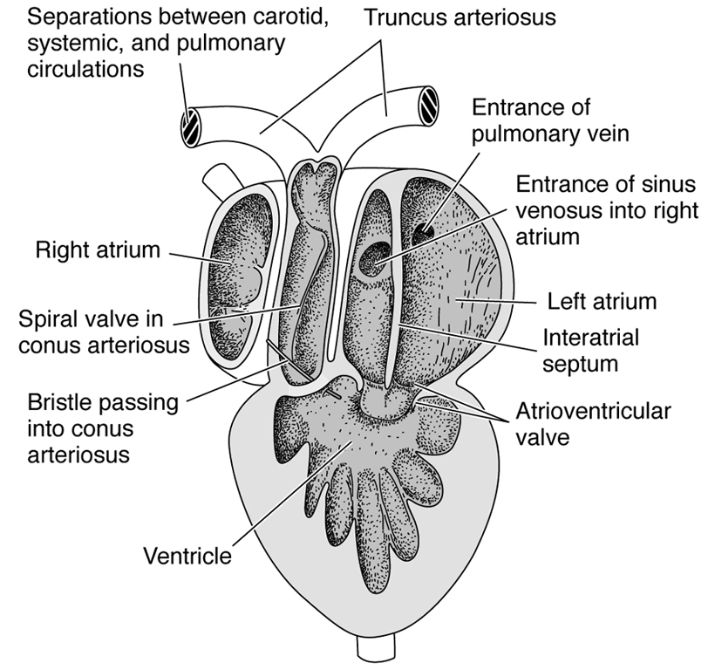
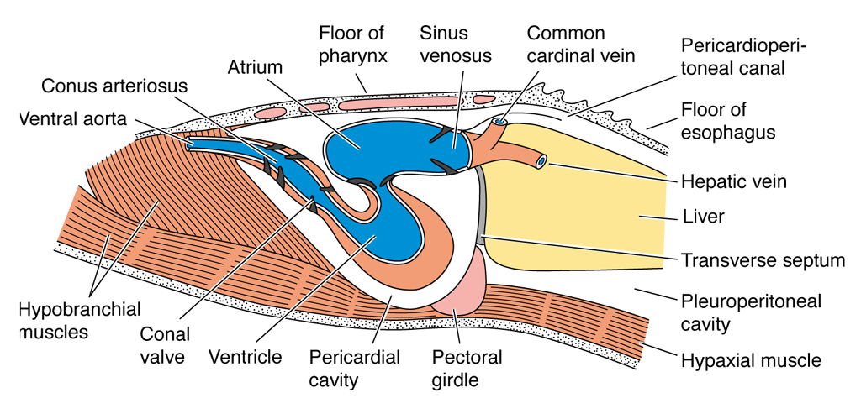
Heart changes in evolution
Trend in higher vertebrates is for sinus venosus and atrium to move
to dorsal and then anterior positions. Sinus venosus shifts to right
side only and becomes incorporated into atrium. Atrium and
ventricle each become divided into right and left sides by a septum.
Sides serve systemic and pulmonary circulation.

Slide 11
Most fishes: single-stream heart
Sinus venosus is largest in sharks. Atrium in sharks and other
jawed fishes occupies dorsal position. Conus arteriosus is long
and active as a pumping and pressure-equalizing vessel in
elasmobranchs and primitive bony fishes. Teleosts and, curiously,
cyclostomes, have bulbous arteriosus instead; thinner than conus,
with more elasticized walls which works passively to equilibrate
pressure.

Slide 12
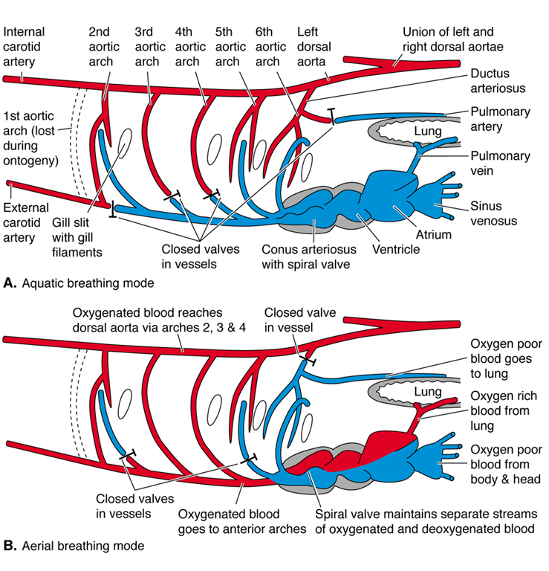
Lungfishes: intermediate 2-circuit heart
Heart receives only
deoxygenated blood from
sinus venosus, but has
capacity to alternatively
send blood to anterior gills
and body, or posterior gills
and lungs, depending on
mode of respiration they
are using. Atrium partly
divided by an interatrial
septum. Deoxygenated
blood comes in on right side.
Ventricle also partly
divided by interventricular
septum. Conus has shunt.

Slide 13
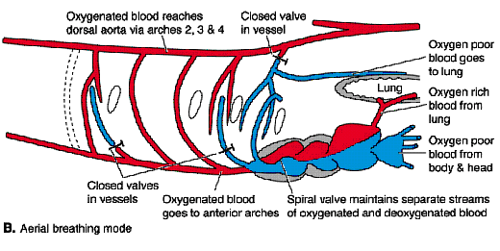
Lungfishes continued
The conus is no longer contractile in lungfishes and has an internal
spiral fold which shunts unoxygenated blood from right side of
ventricle to 5th and 6th aortic arches and oxygenated blood
(returning from lungs) on left side to 3rd and 4th aortic arches
(anterior gills and anterior and posterior body respectively).
A pulmonary vein forms to return oxygenated blood to heart
from lungs.

Slide 14
Amphibian heart
In amphibians, atrium is
completely divided into right
and left sides. Oxygenated
blood returning from skin
joins with systemic veins
carrying deoxygenated blood.
Ventricle is undivided, but
manages to shunt
deoxygenated blood from
right side to pulmonary trunk
on left side, and oxygenated
blood from left side to
systemic arch on right
(actually middle). Both types
of blood may enter left systemic arch.

Slide 15
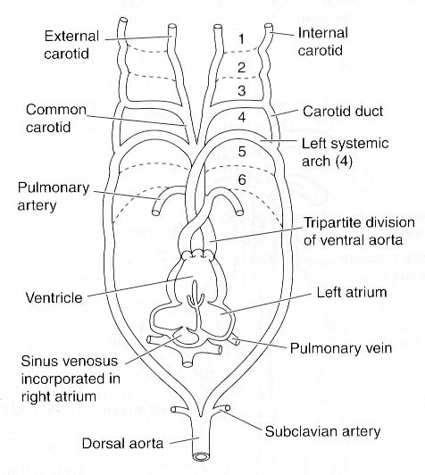
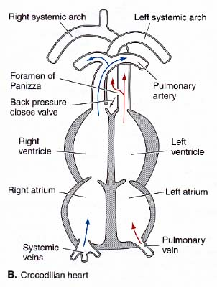
Reptilian heart
In reptiles, division of conus into separate pulmonary and
right and left systemic trunks is complete. Sinus venosus
fuses to right atrium and is no longer distinct. Ventricle
is incompletely divided into dorsal and ventral compartments
by a horizontal septum as well as left and right compartments
(short vertical septum). In crocodilians, the interventriclar
septum in complete except for foramen near base.

Slide 16
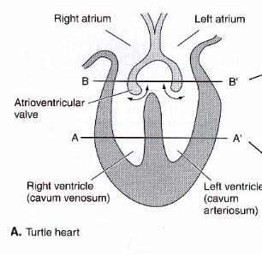
Reptile heart function
When reptiles inhale, pulmonary vessels dilate, drawing blood
in direction of lungs. As it becomes disadvantageous to send
blood to the lungs (as when turtles dive or hibernate) pulmonary
vessels constrict, discouraging pulmonary flow and shunting
blood toward systemic trunks.

Slide 17
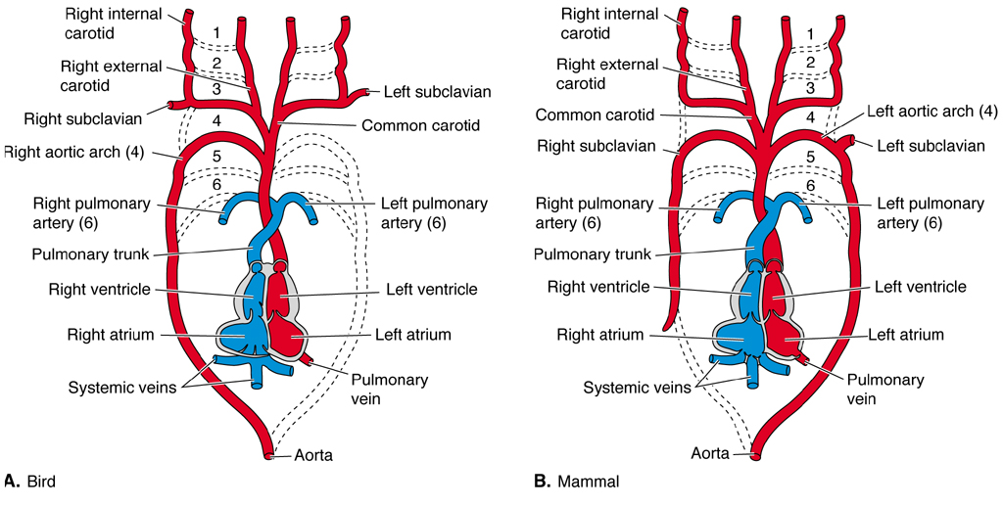
Birds and mammals
Heart of birds and mammals (homeotherms) is a complete
double-circuit pump: right side is low pressure pulmonary circuit;
left side is high pressure systemic circuit. Ventricle is completely
divided and disproportionately stronger on left side. There is only
one systemic trunk; it loops to right in birds and to left in mammals.

Slide 18
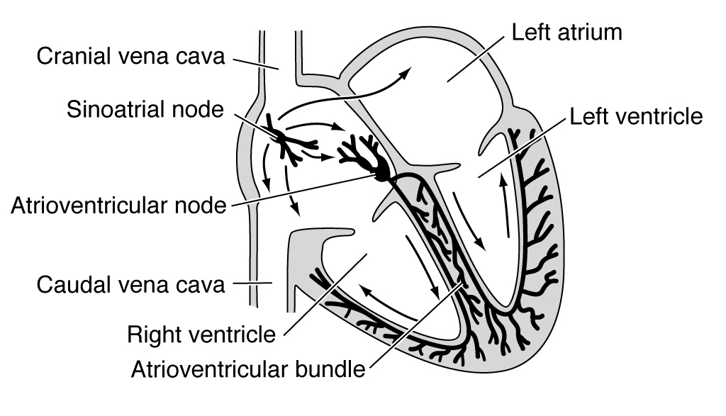
Heart beat
Although cardiac muscle has innate capacity to beat rhythmically,
beat is controlled externally by a combinations of autonomic nerves,
hormones and temperature.

Slide 19
Heart beat cont’d
Ventricle is first chamber to form and beat in embryo and does so of
its own powers. Atrium forms next and passes its faster rhythm to the
ventricle. Sinus venosus forms next and passes still faster rhythm to
atrium and ventricle, taking over control of entire heart. Beat impulse
initiated by sinoatrial node; transmitted across atrium muscle to
atrioventricular node which propagates impulse through fibers
down to apex of ventricle and up sides squeezing blood out.

Slide 20
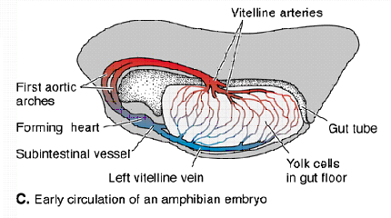
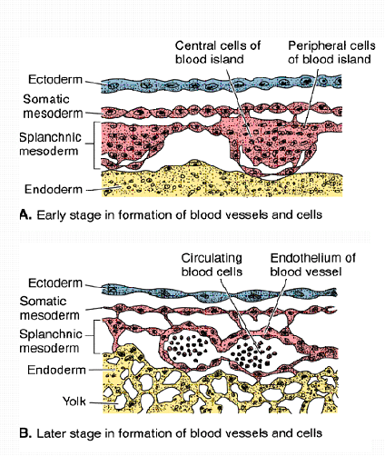
Blood vessels: development
First indication of blood vessel
formation is appearance of blood
islands on the embryonic yolk sac.
First vessels to form are tiny
capillaries within the islands.
Larger vessels form from smaller
vessels. Vessels on either side of
the heart develop different
characteristics, becoming the first
arteries and veins. As other
tissues form, mesenchyme within
forms capillaries and then large
vessels.

Slide 21
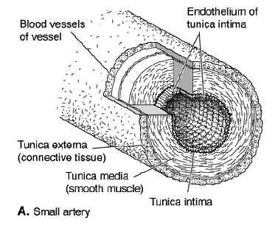
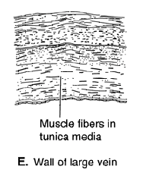
Arteries vs. veins
Initially, all vessels are the same: smooth endothelium and
surrounding loose connective layer (both combined = tunica
intima, seen in capillaries). Arteries and veins develop other
external layers: muscular tunica media and connective tunica
externa. Only difference is relative thickness of these two layers.
In arteries, tunica media is thick and connective layer is relatively
thin. In veins the tunica media is thinner, whereas the tunic
externa relatively thick.

Slide 22
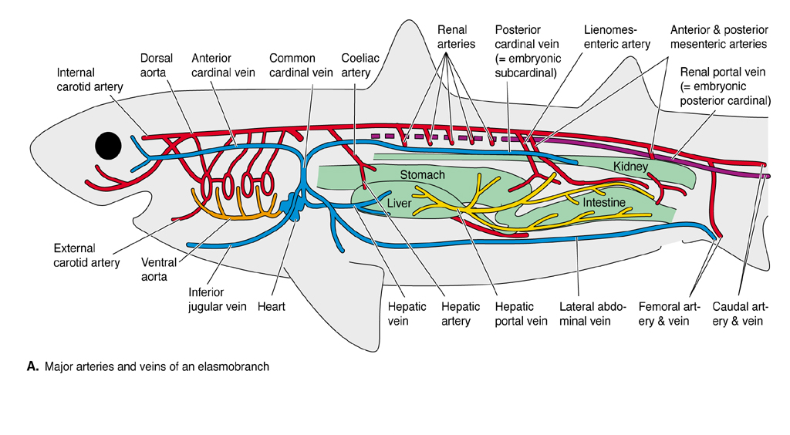
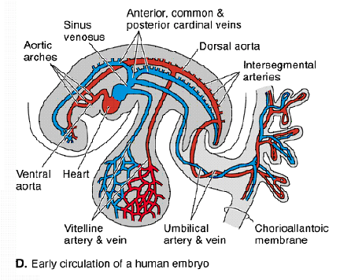
Basic pattern of circulation
The basic pattern of the vessels is virtually the same in all
vertebrate embryos and closely resembles pattern seen in
amphioxis: heart pumps blood forward through ventral aorta
which primitively distributes blood to gill arches for gas
exchange. Blood collects above gills in dorsal aorta, which
carries blood forward to head and rearward to rest of body.
Venous blood returning to heart collects in cardinal veins,
(anterior and posterior) which meet just outside heart.

Slide 23
Basic pattern of arteries cont’d
Blood coming to dorsal aortae from anterior efferent branchials
runs forward to head through carotid arteries. Blood coming
from posterior arches runs posteriorly and is distributed to other
parts of the body through an unpaired dorsal aorta with many
branches.

Slide 24
Dorsal aorta: trunk and tail
Dorsal aorta conservative behind the throat in vertebrates. Runs
posteriorly to tail (caudal artery). Has two main visceral
branches: celiac artery, which runs to the stomach, duodenum,
pancreas and liver; and one or more mesenterics, which run to
small and large intestines.

Slide 25
Dorsal aorta: trunk and tail
Lateral branches of dorsal aorta serve urogenital organs (genital
and renal arteries). These are numerous in anamniotes (kidneys
are long), but few in tetrapods. Dorsal somatic branches of aorta
serve spinal cord, muscles and skin. These include the subclavian
and iliac arteries which continue into appendages as brachial and
femoral arteries, respectively.

Slide 26
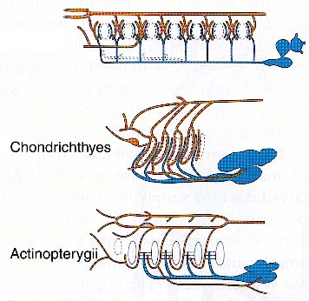
Aortic arches: most fishes
Cyclostomes have an elongate
ventral aorta with eight or more
aortic arches. Jawed vertebrates
have six aortic arches as embryos.
The first (associated with the
mandible) is nearly always
vestigal. In Chondrichthys
through Chondrostei, second
aortic arch (hyoidean) is
retained as the afferent
hemibranch (sharks have
five afferent branchials total
(2nd-6th). Second arch lost in
teleosts (4 arches total, 3rd-6th).
Lampreys

Slide 27
Aortic arches: lungfishes
Lungfishes have shunt inside conus arteriosus that diverts blood to
5th and 6th afferent branchials. Pulmonary arteries branch
from efferent branches of these and carry blood to the lungs.

Slide 28
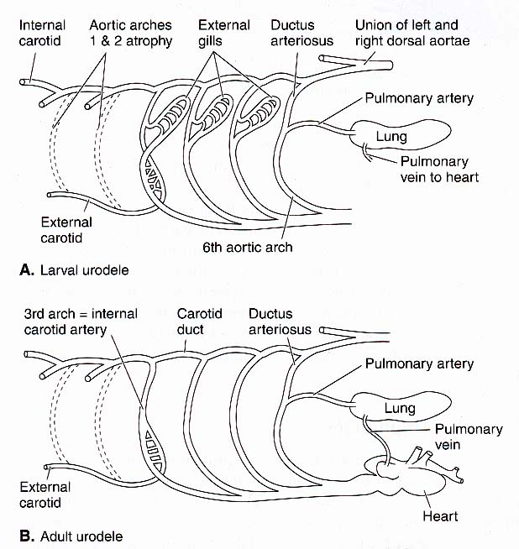
Aortic arches: amphibians
In amphibians, the 3rd
efferent branchials carries
blood forward to the
carotid system (common,
internal, external carotids)
of head. Fourth efferent
arches deliver blood
posteriorly to body.
Urodeles that retain gills
retain functional 5th and
6th efferent banchials.
Anurans lose 5th arch.

Slide 29
Aortic arches: reptiles
In reptiles, aortic arches
form three channels,
pulmonary arteries and
right and left systemic
arches derived from 4th
arch. Carotid system
becomes associated
with right arch only.

Slide 30
Aortic arches: birds and mammals
Birds have elongate internal carotids in long neck. Right 4th
branchial becomes the main systemic arch. In mammals,
carotid system is less modified than in birds and left 4th
branchial is the main systemic arch.

Slide 31
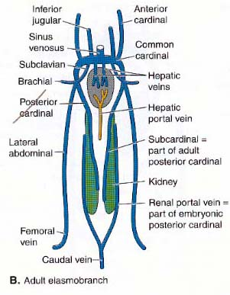
Basic pattern of veins
Three somewhat separate systems
of veins are seen in embryos
and early phylogenetic stages:
1) subintestinal-vitelline veins
drain tail, digestive tract (subintestinal
component) and yolk sac (vitelline
component), pass through liver and
continue to heart; 2) cardinal system
drains head, dorsal body wall and
kidneys (main vessels are anterior,
posterior and common cardinals);
and 3) abdominal veins, which drains
the ventral body wall and appendages (consists of lateral abdominal
veins which receive subclavian and iliac veins on each side).

Slide 32
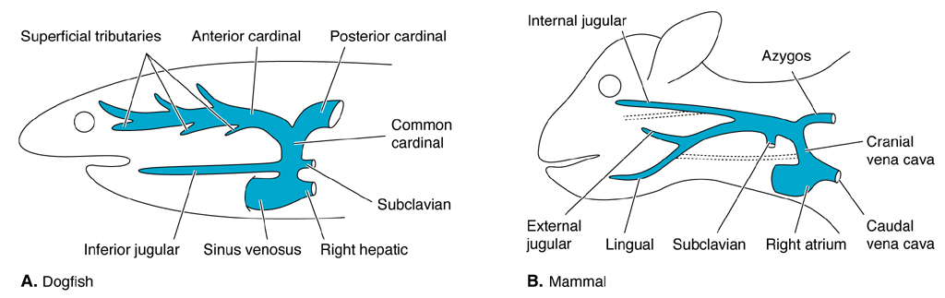
Anterior cardinals/jugulars
Anterior cardinal veins drain dorsal head and brain in fishes. In
tetrapods, these are called jugular veins. Internal jugulars drain
dorsal portions of the head. External jugulars drain ventral portions
of head in tetrapods. Inferior jugulars drain same portion of the
head in fishes.

Slide 33
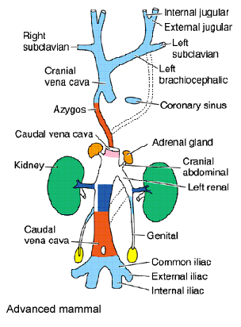
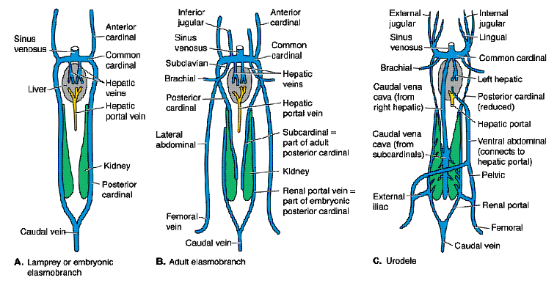
Common cardinals
Common cardinals are paired in fishes. In tetrapods, derivatives
of common cardinals called precavae. In all but advanced
mammals, they are also paired all the way to heart. Advanced
mammals have a shunt called the brachiocephalic or innominate
vein, which carries blood from left side jugulars to right precava.

Slide 34
Hepatic portal system
System of venous vessels which collect
blood from gut and transports it to liver.
Evolution relates to subintestinal-
vitelline component of ancestral venous
system and is conservative. Adults of
all vertebrates have single hepatic portal
vein, which forms by selective retention
of left and right subintestinals. Vessels
break up into sinusoids (venous capillaries)
inside liver and continue forward to heart
as hepatic veins. Primitively (hagfishes)
hepatic portal drains the tail as well as gut.
Connection to tail lost in other vertebrates;
caudal blood returned via cardinal system
derivatives.

Slide 35
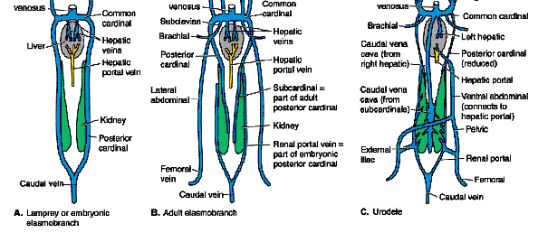
Renal
portal
system
The renal portal system evolved from ancestral posterior cardinal
veins. Cyclostomes and larval jawed fishes retain ancestral condition.
In adult fishes, break develops in posterior cardinals just anterior to
kidneys. Posterior segments form renal portal veins; pass through
kidneys and emerge as subcardinal veins, which transmit blood to
anterior segments of the posterior cardinals. Lungfishes and
salamanders add a new vessel, postcava or caudal vena cava, which
receives most of the blood from the kidney. Anterior segments of
the posterior cardinal continue to drain the body wall.

Slide 36
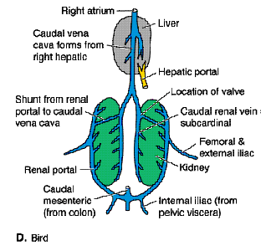
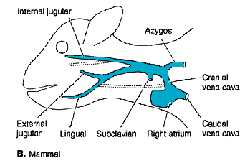
Renal portal system
In anurans and reptiles, anterior
segments of posterior cardinals
reduced even further. Blood in
renal portal system goes to kidney
but may be shunted through as
opposed to actually entering renal
capillaries. In birds, nearly all
blood shunts through, entering the
kidneys only if vein is occluded.
Renal portal system is lost
altogether in mammals; have only
the azygous vein (or a vestige
of it) which drains part of the
thorax

Slide 37
Renal portal system function
Vertebrates that produce large
quantities of urine (freshwater
fishes, amphibians, mammals)
have to have high pressure arterial
flow to kidneys to ensure proper
filtration of the blood. Use same
flow to resorb substances the
body wants to keep. Vertebrates
that must conserve water and salt
(marine fishes, reptiles, birds)
reduce filtration potential by
reducing arterial flow to kidney.
Supply low pressure blood to tubules
(via renal portal system) to ensure water
and salt are efficiently resorbed.

Slide 38
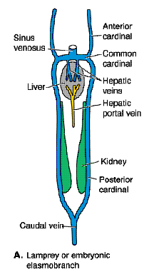
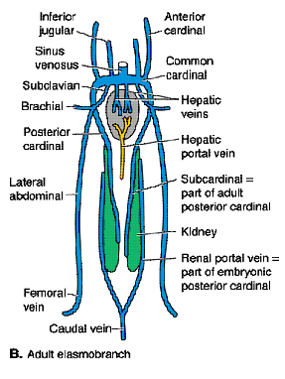
Posterior somatic and placental veins
In sharks, abdominal system veins drain pelvic fins and ventral
body wall (curiously absent in cyclostomes and rayfins).

Slide 39
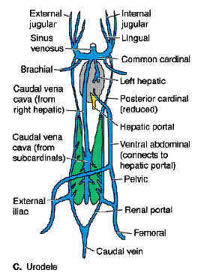
Posterior somatic and placental veins cont’d
In lungfishes, amphibians and
reptiles, abdominal veins joined
by caudal circulation and enter
liver anteriorly. Thus, in
amphibians and reptiles, blood
from the hind limbs has two
return routes: through kidneys
via renal portal veins, or into
abdominal veins en route to
liver.

Slide 40
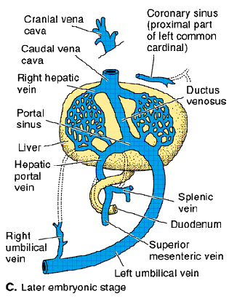
Posterior somatic and placental veins cont’d
Birds and mammals have abdominals as embryos (allantoic or umbilical veins) but lack them as adults. The venous
duct connects fetal abdominals to hepatic veins, so fetal circulation is not functionally portal.

Slide 41
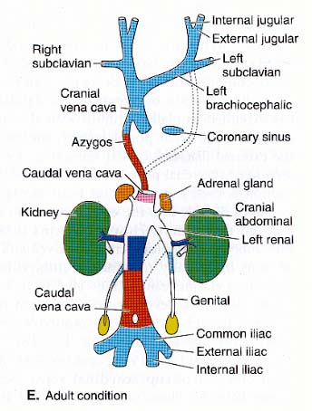
Postcava (caudal vena cava)
Postcava (caudal vena cava) is
another major posterior somatic
vein in lungfishes and tetrapods.
Extends only to posterior end of
the kidneys in amphibians and
reptiles. Complicated formation
in mammals from parts of the
right posterior cardinal and
subcardinal veins. Collects blood
from the tail and hind limbs (no
renal portal system to substitute).

Slide 42
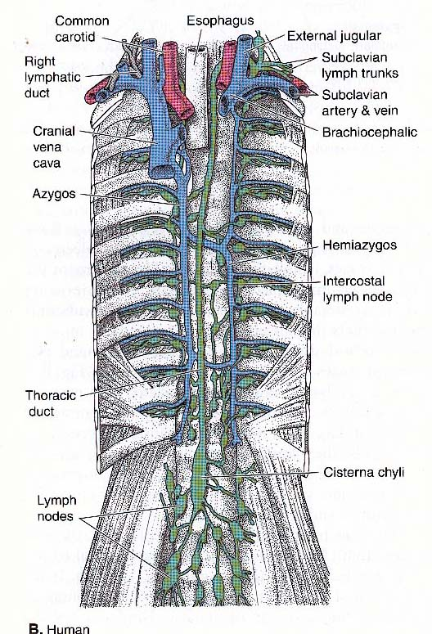
Lymphatic system
Amphioxis lacks a lymphatic
system. Cyclostomes, sharks and
chondrosteans have a hemo-
lymphatic system. True lymphatic
system occurs in all other
vertebrates. Has multiple ducts in
lungfishes, teleosts, amphibians
and reptiles. Birds and mammals
have fewer ducts (only one
entering left subclavian vein in
mammals). Mammals have
numerous lymph nodes, sparse in
other tetrapods, absent in fishes.

Slide 43
Blood
Vertebrate blood consists of cells suspended in a fluid plasma.
Plasma is a solution of nutrients, metabolic wastes, salts,
hormones and proteins. Protiens include albumens, globulins
(antibodies) and fibrinogen. Lymph is plasma minus the
proteins.
Blood cells are of three main types: red cells or erythrocytes,
white cells or leucocytes, platelets or thrombocytes.

Slide 44
Blood cells
Erythrocytes vary from large in amphibians, to small, flat and
enucleate in mammals. Contain hemoglobin for gas transport.
Leucocytes occur in lymphatic system as well as blood vessels.
Fight infection and eliminate unwanted substances in various
ways. Have ability to transform themselves into highly mobile,
amoeboid cells which leave capillaries and fan out into damaged
tissues. Phagocytize foreign bodies or produce antibodies
(immune response). Two main types are granulocytes (large)
and lymphoid cells (including lymphocytes).
Thrombocytes are cells involved in clotting process. Seen in all
vertebrates except mammals which have enucleate fragments of
cells called platelets

Slide 45
Blood-forming tissues
Blood cells form in various regions of body (hemopoietic
regions).
Initially form in blood islands of yolk sac. Blood vessels
themselves produce blood cells in fishes. Also form in digestive
tract, thymus, kidney, liver, parts of nasopharynx in other verts.
All blood forming sites are reticular tissues (resembling liver)
with sinusoids that carry blood through, cells that buds off
primordia of blood cells and phagocytic cells in walls that
remove dead cells.

Slide 46
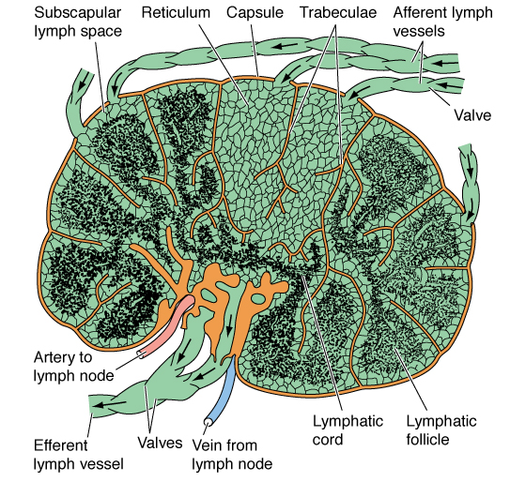
Blood-forming tissues continued
Lymphocytes form mainly in lymph nodes (mammals and few
birds).

Slide 47
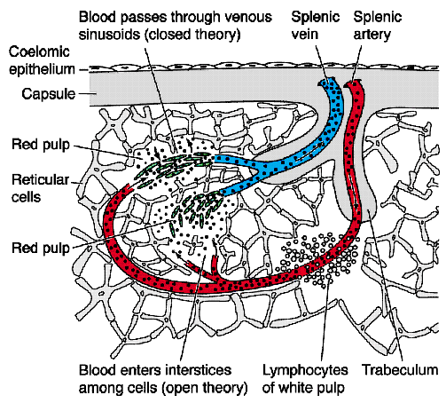
Blood-forming tissues continued
Spleen is an important
blood forming and
recycling center
in vertebrates.
Primitively (cyclostomes)
exists as islets of tissue
in submucosa of gut,
but forms separate organ
in other vertebrates.

Slide 48
Blood-forming tissues continued
Other major blood forming site is bone marrow. Red marrow in
ends of long bones and within ribs forms all blood cell types in
tetrapods other than mammals and all but lymphocytes in mammals.
Yellow marrow in central cavity of bone forms leucocytes.

