Slide 1
Early Development and Comparative Embryology
Embryology is the study of development of organisms
through early life stages
Provides some of the best evidence of the evolution of
morphology
“Ontogeny recapitulates phylogeny” Embryology is a replay
of evolutionary history (Haeckel’s Biogenic Law)
Mammal embryos develops through fish-like, amphibian-like,
and reptilian-like stages in the course of their development,
the same sequence through which it presumably evolved.

Slide 2
Biogenic law is not without exceptions...
Embryos can show unique adaptations (e.g., the
shellbreaker adaptation of reptiles and birds).
Developmental sequence of ancestor may be altered in
descendant (e.g., digestive system of larval amphibians
becomes functional before formation of limbs; appendages
develop first in birds and mammals).
Embryonic or larval structures of ancestors may come to be
adult characters of descendants (e.g., gills of Necturus).
Generally speaking, the embryo of a descendant can repeat
early developmental stages of its ancestor, but not later
stages.

Slide 3
Heterochrony
Structures in embryos are not only added and subtracted
from those of ancestors, but the development process itself
can be accelerated or retarded.
Some of the most interesting developmental phenomena
seen in vertebrates result from heterochrony (differing
rates of development of somatic and reproductive systems).
Accelerated somatic development relative to reproductive
development results in recapitulation in classical sense
(organism develops through ancestral stages).

Slide 4
Heterochrony (cont’d)
Accelerated reproductive system development relative to
somatic development (progenesis) results in retention of
ancestral juvenile characteristics (paedomorphosis).
Retarded somatic development results in neoteny
(paedomorphosis by another route)
Retarded reproductive development allows ontogeny to
extend beyond ancestral limits (hypermorphosis,
greatly enlarged antlers of Irish elk).

Slide 5
Developmental process is conservative...
Embryonic development is a delicate and conservative process.
Slight changes in development can result in great changes
in adult form; however, even the slightest changes increase the probability the process will fail completely.
The developmental process is similar even in very different groups of vertebrates.

Slide 6
Developmental process is conservative...
The developmental process constrains adult morphology.
Only a fraction of the possible adult body forms have ever
evolved. Not due to sorting effect of natural selection, as
once believed.
Developmental processes are more stable than their products
and embryos retain the ability to assume ancestral forms...

Slide 7
Overview of Embryology lectures
Here we review the process of embryonic development
in vertebrates, from fertilization through the formation of
fetal membranes.
We will compare the development process in chordates
with different strategies of nourishing the developing
embryo.
We will describe the embryonic origins of the various
organ systems in the vertebrate body.
Later, as we talk about each of the organ systems in detail,
we start with embryology.

Slide 8
Process of embryonic development
Process of development is initiated by fertilization
(union of egg and sperm).
Gametes are haploid cells (contain half the normal
complement of DNA of somatic cells)
Fertilization restores the diploid condition.

Slide 9
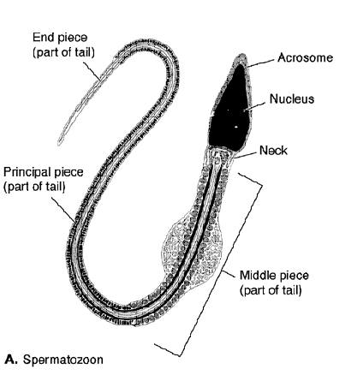
Sperm
Sperm cells have same
basic form in all
vertebrates: consist
of a head containing
the haploid nucleus,
capped with a
package of digestive
enzymes, and a tail
with mitochondria to
propel the cell to the
egg.

Slide 10
Eggs
Eggs of vertebrates have different forms and sizes
depending on how the embryo is nourished.
Eggs of amphioxis are called microlecithal because they
are small and contain little yolk.
In amphibians and primitive bony fish, eggs contain
moderate amounts of yolk and are called mesolecithal.
Heavily yolked, macrolecithal, eggs are found in birds and
reptiles.
Therian mammal eggs are secondarily microlecithal because
of their direct means of nourishing young.

Slide 11
Eggs continued
Prior to ovulation eggs are encased in a delicate vitelline
(yolk) membrane, a thicker zona pellucida and a layer of
follicle cells called the corona radiata.
Following ovulation and fertilization eggs of vertebrates
become variously encased in jelly layers and horny,
membranous or calcareous shells.

Slide 12
Fertilization and Embryogenesis
Product of fertilization is a unicellular zygote.
Process of development from the zygote stage to the stage
of organ and tissue differentiation is called embryogenesis.
Zygote is totipotent; it has the flexibility to develop into the
full variety of cells in the vertebrate body.

Slide 13
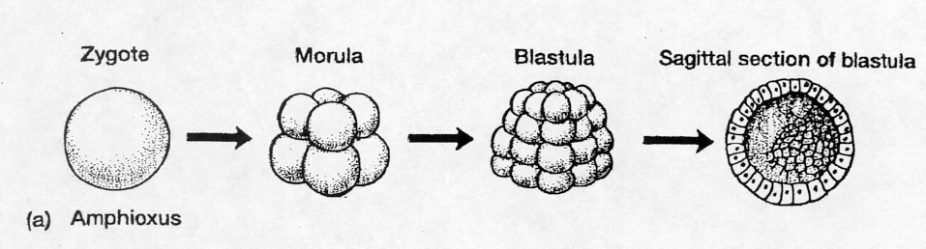
Cleavage
Zygote is transformed into a multicellular, hollow ball of
cells called a blastula by a process called cleavage.
The cavity inside the ball is called a blastocoel.
In vertebrates with microlecithal eggs, cleavage is total
(holoblastic) resulting in blastomeres of equal size.

Slide 14
Cleavage continued
Yolk is a thick material that complicates the process of cell
cleavage; yolk tends to concentrate on one side of the egg
(vegetal pole)
Yolk-free side of egg is called animal pole because it
encompasses the actively developing embryo).
Eggs such as these with asymmetrical yolk distribution are
called telolecithal.

Slide 15
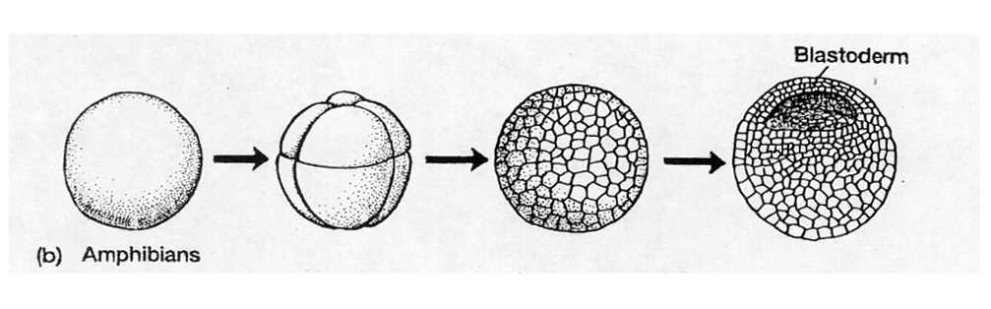
Cleavage continued
In mesolecithal eggs, cleavage is total but yolk masses in
vegetal hemisphere and impedes cell division, producing
larger blastomeres at a slower rate (unequal cleavage).

Slide 16
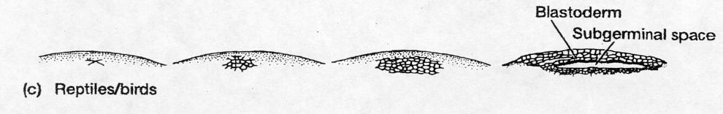
Cleavage continued
In macrolecithal eggs, the yolk mass is simply too great to
be penetrated by cleavage furrows. Cleavage is limited
to a small yolk-free patch (blastoderm) at the animal pole
and is called meroblastic or discoidal (most extreme).
Blastoderm is separated from yolk mass by a thin blastocoel
cavity.

Slide 17
Gastrulation
Blastula is converted to a gastrula by an invagination
process called gastrulation
Cavity formed by gastrulation is called gastrocoel or
archenteron (primitive gut), which enlarges at expense
of blastocoel.
Opening formed by the gastrulation process is called
the blastopore. In chordates (deuterostomes), it is
destine to become the anus.

Slide 18
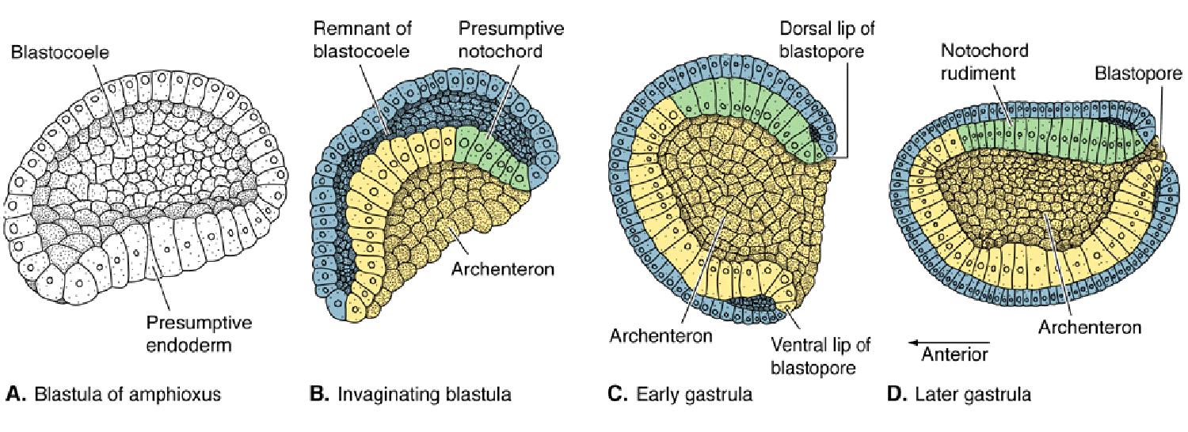
Gastrulation (continued)
Outer layer of cells in the gastrula is ectoderm; gives
rise to skin, the nervous system, and a number of
skin related structures
Inner layer of cells in the gastrula is endoderm; it gives
rise to gut

Slide 19
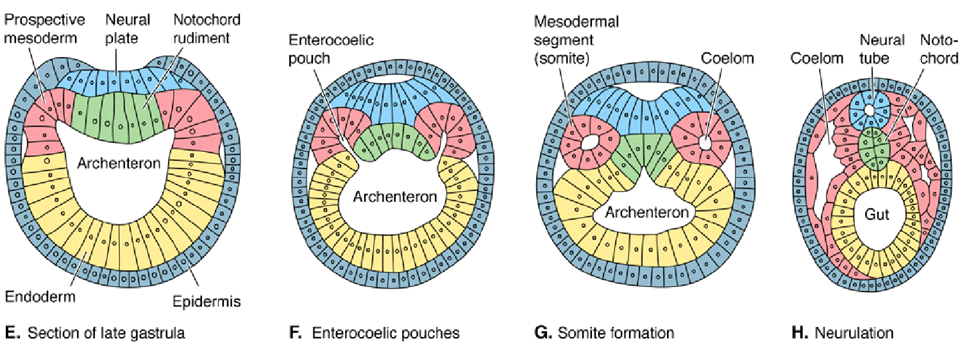
Gastrulation (continued)
Middle layer called mesoderm forms between
ectoderm and endoderm and gives rise to muscles,
internal organs and most of the skeleton
In amphioxis and lampreys, mesoderm forms from
outpocketing of the roof of the archenteron (enterocoely).
Midline portion of archenteron (chordamesoderm) forms
notochord; lateral pockets form coelom and somites

Slide 20
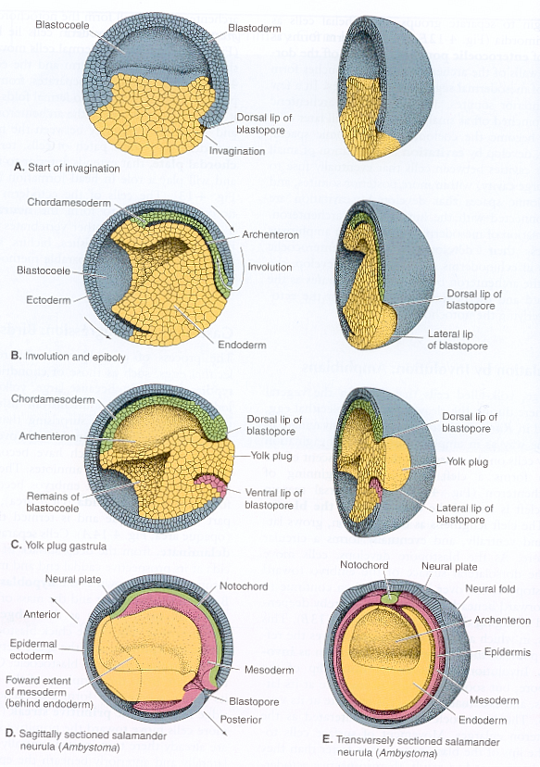
Gastrulation (continued)
In yolk laden (mesolecithal)
blastulas, gastrulation is an
inward rolling process called
involution; most rapid at the
dorsal (yolk-free) lip of the
blastopore.
Roof of developing archenteron
forms mesoderm: the midline
(chordamesoderm) forms the
notochord, and the sides form
somites.

Slide 21
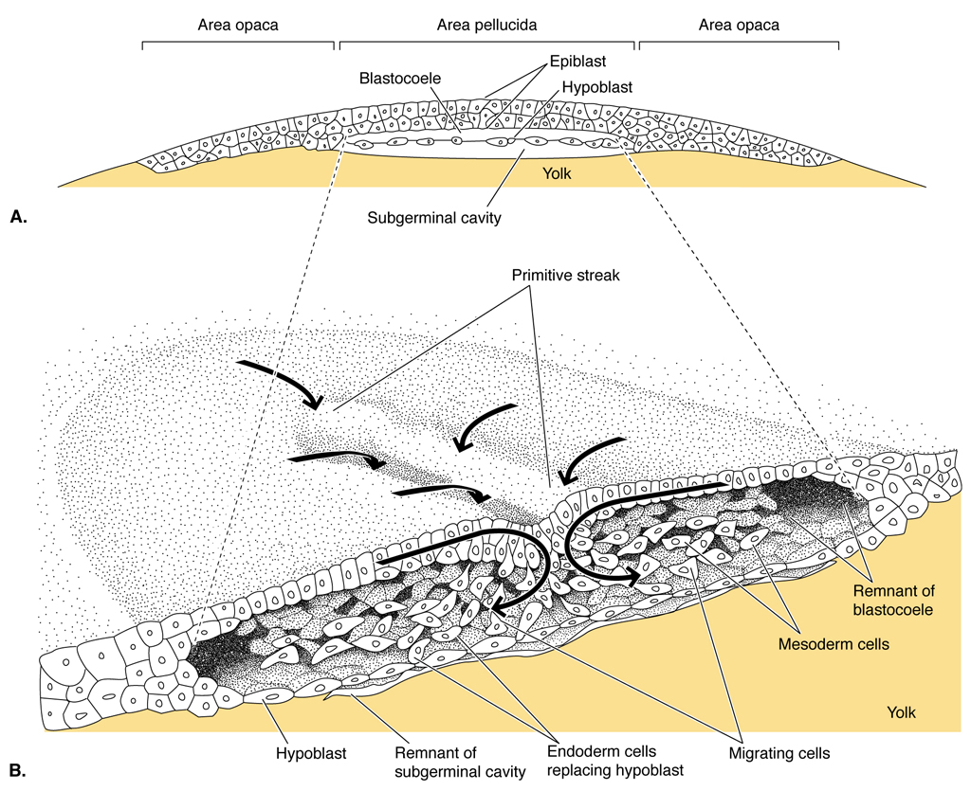
Gastrulation (continued)
In macrolecithal eggs
with partial cleavage
(e.g., birds), gastrulation
is even further
complicated by the yolk
mass.
Endoderm forms under
the blastoderm patch by
a process called
delaminiation wherein
cells detach as a
layer from the original
blastoderm.

Slide 22
Gastrulation (continued)
Some mesoderm also
forms by delamination.
Additional mesoderm
forms by ingression
towards the rear of the
germinal disk from a
lengthwise thickening
called the primitive
streak.
Cells on the surface
stream toward the
streak and ingress forming a third tissue layer between the
ectoderm and endoderm. Some cells move directly forward
into the anterior embryonic area and form the notochord.

Slide 23
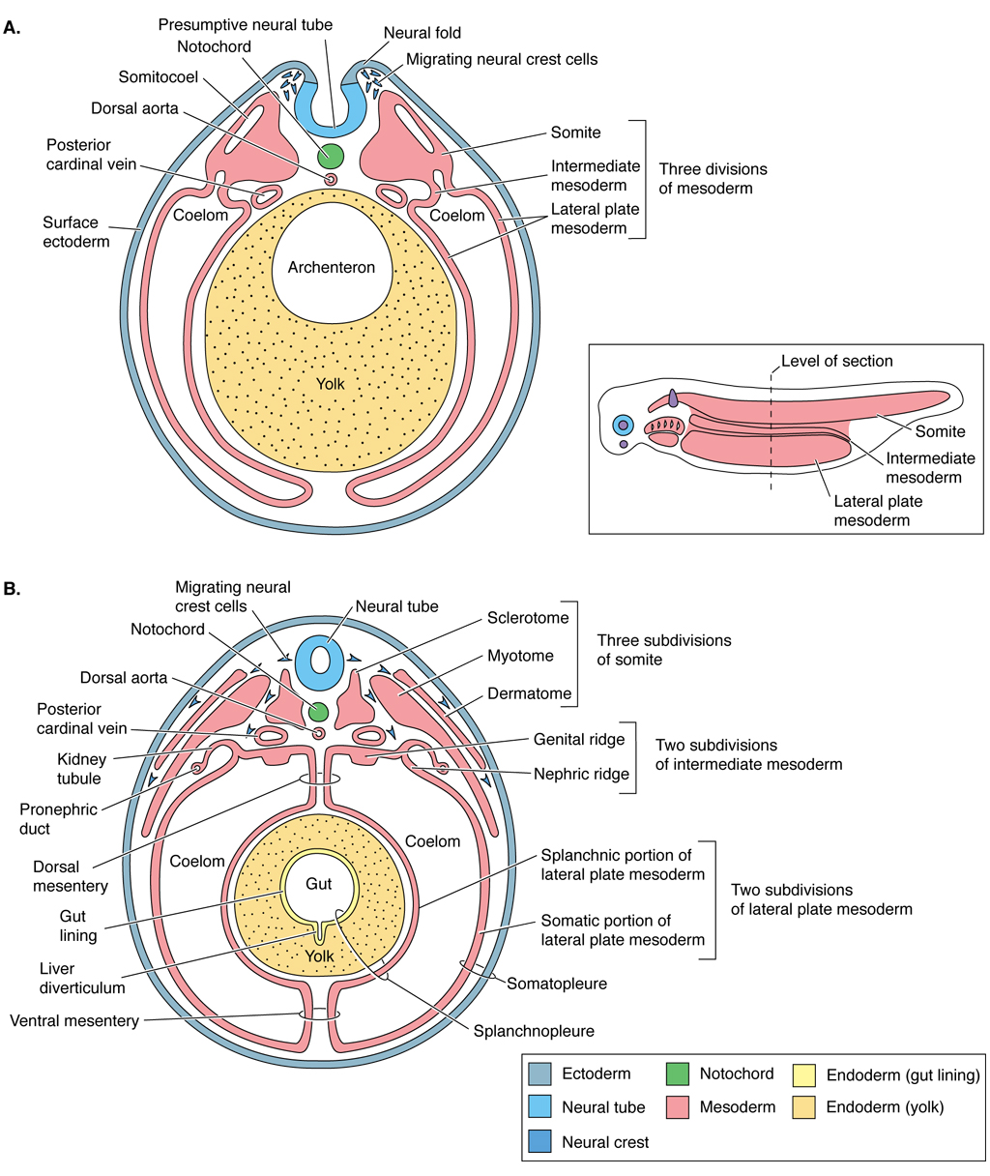
Coelom formation
In vertebrates above lampreys, coelom forms from splits
in the lateral mesoderm (schizocoely) rather than
outpocketing (as in amphioxis)

Slide 24
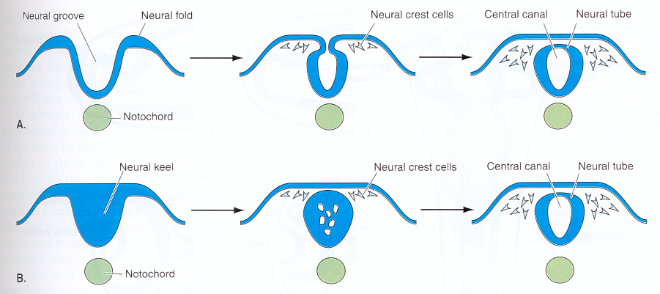
Neurulation
Gastrulas are converted to neurulas by a process called
neurulation, which establishes the central nervous system.
Chordamesoderm induces theoverlying ectoderm to thicken
and form lateral neural folds, which arch inward and join
forming the hollow neural tube (neurocoel inside). Some
cells pinch off in the angles of the neural folds forming
neural crests, which later give rise to various skeletal,
nervous and glandular structures.

Slide 25
Neurulation continued
In microlecithal eggs with total cleavage, neurulation causes
the embryo to lengthen forming a head and tail.
In mesolecithal eggs, head and tail forms at opposite ends
of a distended belly area.
In macrolecithal eggs, germ layers develop face down on
the surface of uncleaved yolk like an oval rug draped over a
large ball. As the head and tail form, they lift up from the
ball of yolk like the head and tail of a bear skinned rug. The
embryo is later lifted away from the yolk by a stalk which
includes the yolk sac.

Slide 26
Organogensis
In chordates (deuterostomes), the head forms opposite the
blastopore end and later develops a mouth. Endoderm lining
the archenteron differentiates into gut and derivatives like liver,
pancreas, lungs or gills, endocrine glands, yolk sac, allantois,
and the urinary bladder.
Outermost "somatic" ectoderm forms integument and
derivatives like hair, nails, claws, lens of eye, olfactory organ,
inner ear, pituitary gland (in part), lining of the mouth, and
contributes to formation of teeth and certain scales.
Neural tube ectoderm forms brain, spinal cord, motor nerves,
retina and rest of the pituitary. Neural crest ectoderm forms
ganglia, sensory nerves, part of skull, adrenal gland (in part),
certain pigment cells, and also contributes to formation of teeth
and scales.

Slide 27
Organogensis continued
Mesoderm forms
muscular, skeletal,
circulatory, and
urogenital systems.
Chordamesoderm
forms notochord.
Mesoderm flanking notochord grows downward around the
archenteron, splits to form coelom, then divides into three
blocks: segmented upper block called epimere, partially
segmented middle section called mesomere, and
unsegmented lower section called hypomere.

Slide 28
Organogensis continued
Mesomere forms urogenital organs. Epimere further
specializes into a lateral dermatome, a medial sclerotome
and a myotome between. The dermatome spreads out to
form the dermis of the skin.

Slide 29
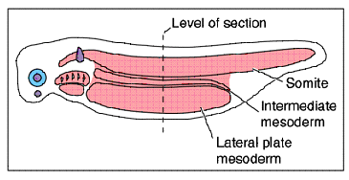
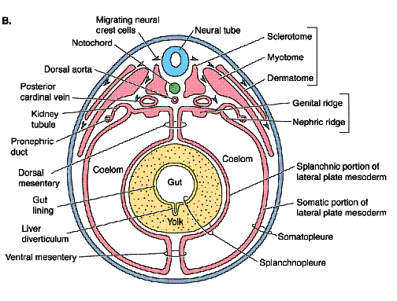
Muscles/vertebrae
Myotome forms muscles
(somites) of the spine,
throat, and eye, and
muscles and skeleton
of the limbs.
The sclerotome more or
less forms the vertebrae.

Slide 30
Coelom formation (continued)
Coelom may be retained in the epimere, mesomere and
hypomere, but expands only in the hypomere separating
a lateral somatic layer from a medial splanchnic layer.

Slide 31
Coelom formation continued
Somatic layer lines body cavity
and buds off mesenchyme that
contributes to bone and muscle
in the limbs. Splanchnic layer
forms head muscles, heart,
mesenteries and muscles of the
gut.
Somatic mesoderm joins with
outer ectoderm to form the inner
body wall (somatopleure).
Splanchnic mesoderm joins with
endoderm to form the outer wall
of the gut (splanchnopleure).

Slide 32
Extraembryonic membranes
Where yolk does not cleave extraembryonic circulation is
needed to absorb yolk and carry it to the body.
To accomplish this, a membrane (yolk sac) composed
of tissues from all three germ layers grows out from the
body stalk, encases the yolk and becomes vascularized
and functional.
Where development occurs in water (fishes), respiration
and excretion can occur by direct contact and no other
membranes are needed.

Slide 33
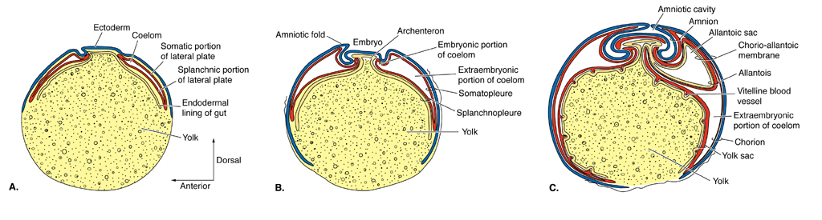
Extraembryonic membranes continued
On land, additional membranes are needed to protect
processes of respiration and waste elimination.
In land vertebrates with external development (reptiles and
birds), the yolk sac forms by the normal process then quickly
splits to form a large coelom.

Slide 34
Extraembryonic membranes continued
Splanchnopleure lies adjacent to the yolk and forms the yolk
sac; somatopleure forms folds that lift over and encase the
embryo.
Outer wall of somatopleure becomes the chorion; inner wall
becomes the amnion which soon fills with embryonic tissue
fluid.

Slide 35
Extraembryonic membranes continued
Somewhat later, a fourth vessel emerges from the hind gut and
expands into the hind portion of the extraembryonic coelom.
This splanchnopleuric vessel, the allantois, becomes
vascularized and comes to rest along the inside portion of the
shell where it serves in respiration and as a receptacle for
excretory wastes.

Slide 36
Modifications in therian mammals
In therian mammals, development is internal and young
are nourished by direct exchange between fetal and maternal
blood streams via a structure called the placenta.
In marsupials and some rodents, the yolk sac is the principal
fetal membrane contributing to the plancenta.
In most eutherian mammals, the allantois in the principal
membrane forming the placenta.
The placenta makes yolk unnecessary, hence, the eggs of
therial mammals are secondarily microlecithal.

Slide 37
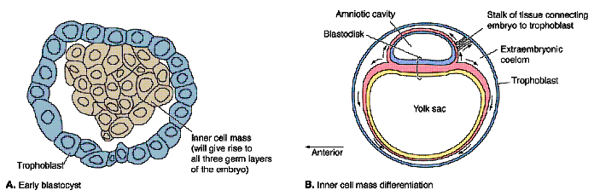
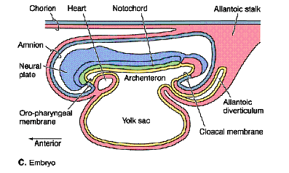
Modifications in therian mammals
When blastula stage is reached, maternal fluid builds up in the
ventral blastocoel and enlarges it greatly.
Endoderm forms by delamination from the inner cell mass,
and spreads to line the outer trophoblast. The inner cell mass
flattens and forms a primitive streak, which in turn forms
notochord and mesoderm for the fetal membranes and trunk
of the embryo.

