Slide 1
Digestion
Digestion is the physical and chemical reduction of food to its
simplest molecular components. Occurs in the largely
endodermally derived digestive system in vertebrates.
Physical reduction of food is accomplished by 1) chewing and
grinding action of teeth (oral and pharyngeal); 2) softening and
dissolving action of fluids produced in mouth, stomach, and
intestine, 3) churning action of stomach, gizzard and (rarely)
small intestine, and 4) emulsification of fats by secretions of
liver.
Chemical reduction of food is performed by enzymes produced
by the stomach, intestine and pancreas, or by bacterial
fermentation in storage organs such as cecae, colon and stomach.

Slide 2
Digestion general
After food is broken down, food molecules are absorbed.
Some absorption occurs in stomach (water, starch); some
occurs in large intestine (water, electrolytes); but most occurs in
small intestine.
Absorption requires surface area. This is provided by complex
folding of the lining of the intestine.
Once the breakdown products of digestion absorbed, wastes
are expelled from end of the digestive tract.

Slide 3
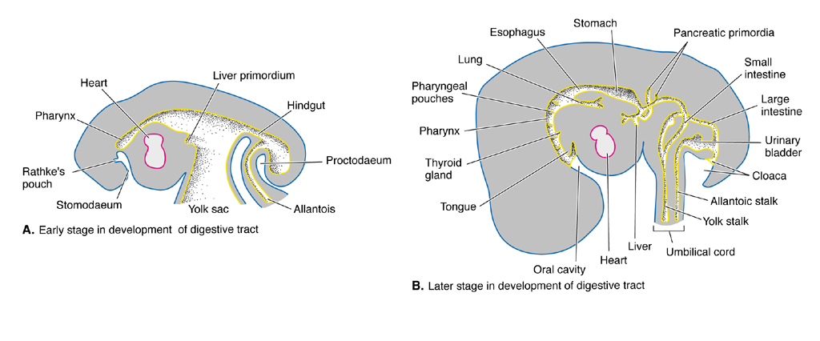
Digestive system development
Gastrulation provides early embryo with an inner tube of endodermal
tissue (archenteron) that ultimately gives rise to gut. Muscular and
connective tissues associated with outer walls of gut tube are
mesodermal in origin (derived from splanchnopleure of hypomere).
In embryos provided with a yolk mass, mid gut is continuous with
yolk sac, which surrounds and gradually absorbs yolk, delivering it
directly to the gut.

Slide 4
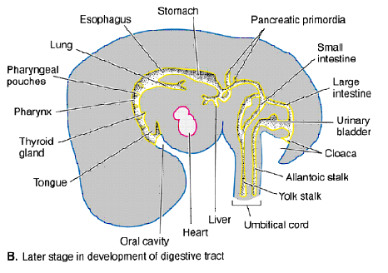
Digestive system development
Gut tube is drawn out as embryo lengthens; breaks through
ectoderm at opposite ends to form openings to the digestive
track. Tube starts out straight but gradually coils and sends
out diverticula (primordia of various digestive organs) as
development proceeds.
Respiratory and endocrine
organs develop from diverticula
in the head, pharyngeal and
thoracic regions. Diverticula
posterior to the developing
stomach form liver, gall bladder
and pancreas. In amniotes, a
diverticulum near the posterior
end gives rise to the allantois.

Slide 5
Jawless fishes
Ancestral vertebrate was a filter feeder like amphioxis and
larval lampreys. These chordates have small mouths, no buccal
cavity, and a perforated pharynx lined with ciliated cells and
mucus-secreting cells. Mucus trapped food passing out of
pharynx openings with respiratory water. Cilia carried back to
simple intestine.
Adults of living jawless fishes have abandoned the primitive
filter-feeding mode. The mouth is modified for sucking and
rasping. The gut is a simple tube because nourishment is soft
tissue or liquid.

Slide 6
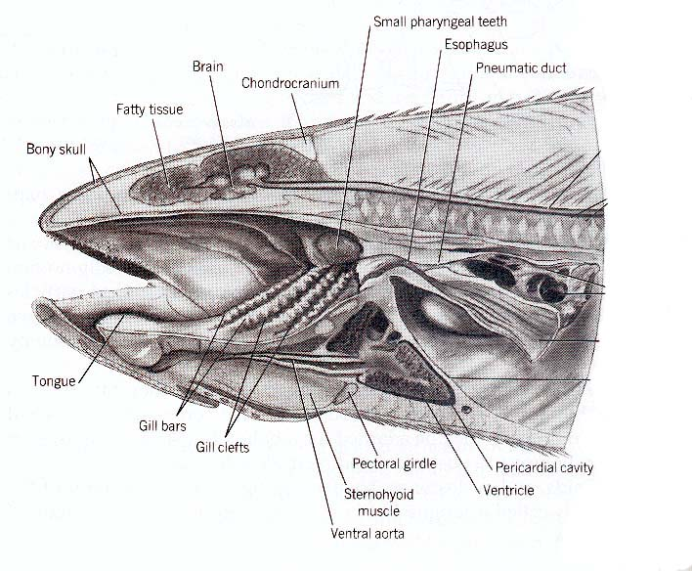
Mouth in jawed fishes
Cartilageous and bony fishes
have jaws and a distinct oral
cavity, both of which may be
equipped with teeth. Tongue
is immobile and supported by
basal elements of the visceral
skeleton. Interestingly, gill
bars in pharyngeal region have
food strainers (gill rakers).
Bony fishes have teeth in the
throat (pharyngeal teeth) which
may form a complex grinding
mill. No need for oral glands in mouth of fishes because food
is wet.

Slide 7
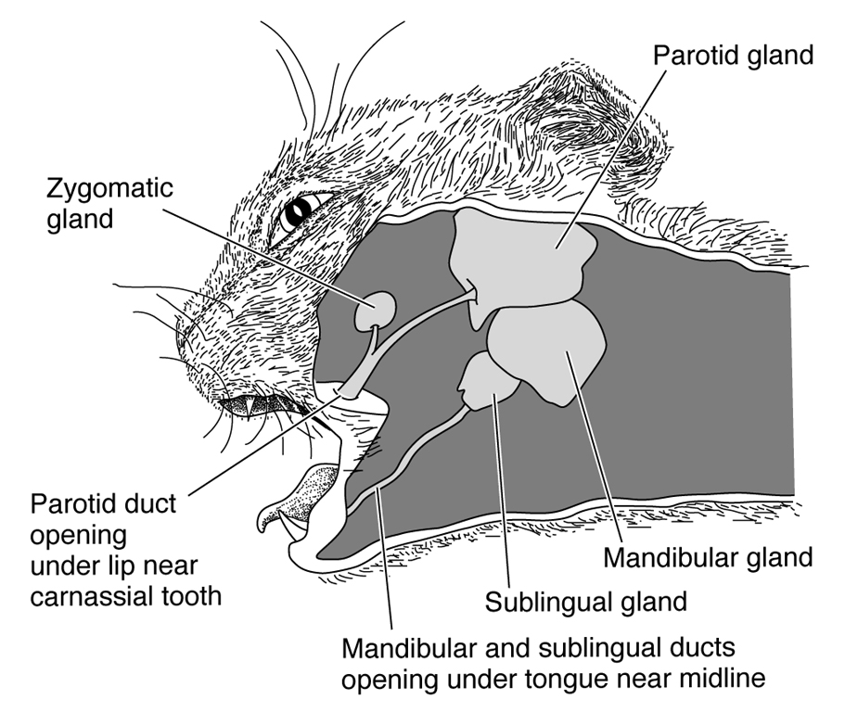
Tetrapod mouth
Tetrapods show trends of
increasing oral lubrication
of food through development
of salivary glands, and
increasing mobility and
muscularization of tongue,
which becomes increasingly
involved in catching and
manipulating food and
swallowing. In mammals,
saliva has some starch
digesting ability. In snakes,
lizards and shrews, salivary glands produce poisons that help in
immobilizing prey. In blood feeders such as lampreys and bats,
oral secretions have developed an anti-coagulating quality.

Slide 8
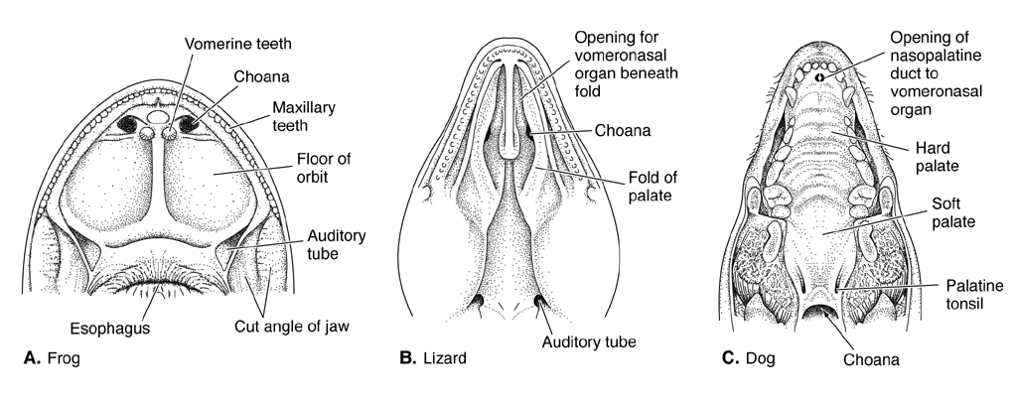
Palates
Roof of mouth (palate) of tetrapods receives internal nares (choanae),
and openings to vomeronasal organ and auditory canals

Slide 9
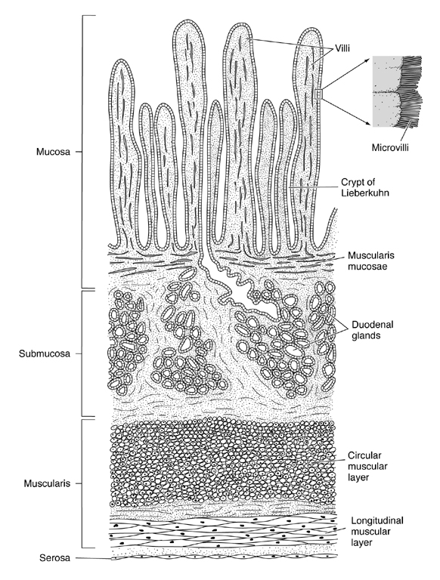
Gut tube general
The vertebrate gut is constructed
in layers. Innermost layer is the
mucosa. Consists of surface
epithelium, deeper (vascular)
lamina propria, and a thin
muscular layer called muscularis
mucosae that controls motion of
lining of gut. Cells of the
epithelium are typically columnar
and ciliated. Interspersed among
these cells are mucus-secreting
cells and glands that secrete
enzymes or hormones. Surface
may be smooth or villous.

Slide 10
Gut tube general
continued
Below mucosa is a connective
layer called submucosa that
contains nerves, blood vessels,
and glands. Outermost principal
layer is muscularis externa,
which consists of an inner layer
of circular muscle for constricting
the gut and an outer layer of
longitudinal fibers for shortening
the gut. Outermost lining of the gut
is a serous membrane called the
serosa.

Slide 11
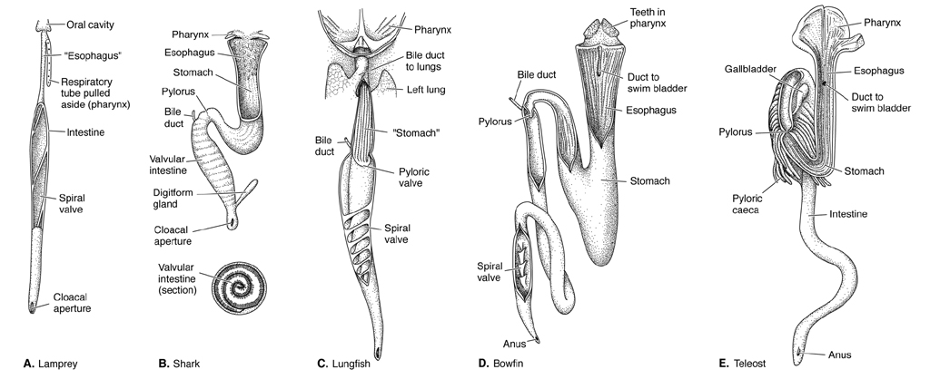
Esophagus general
The vertebrate esophagus is a slender tube that connects the pharynx
to the stomach. The wall of the esophagus is expandable to permit
swallowing of large food items. Lining of the esophagus may be
mucus secreting and ciliated to ease the passage of food, or it may be
keratinized (birds, turtles) to prevent abrasion (coarse food).

Slide 12
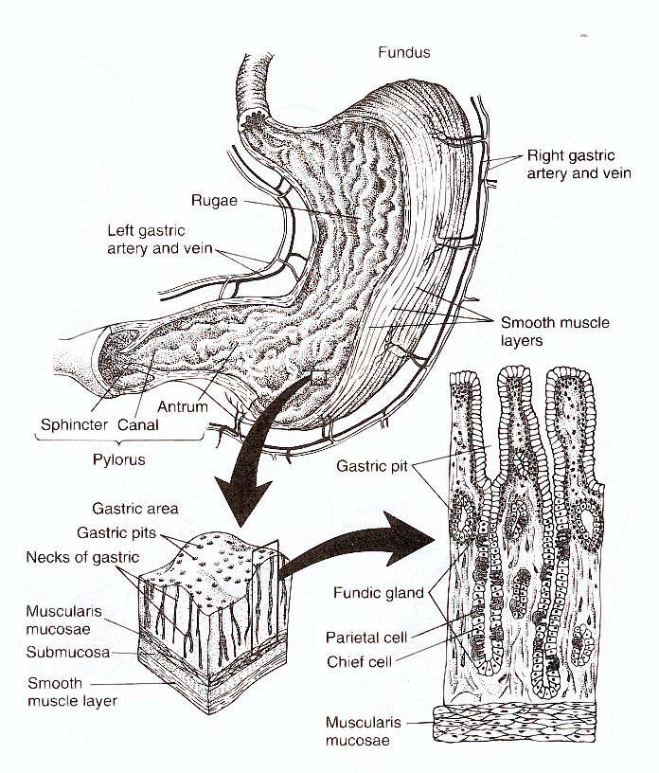
Stomach general
The stomach is an expanded sac below
the esophagus. In many vertebrates it
functions as a churning and protein-
degrading organ. Muscularis externa
is thick and gives stomach its
muscular qualities. Sphincters at
each end (cardiac and pyloric)
keep the chyme in. Inner wall of
stomach has folds called rugae,
especially in middle (fundus) region,
and contains numerous gastric pits.
Pits are connected to glands, which
produce gastric juice (a mixture of
acid, enzymes and mucus).

Slide 13
Small intestine general
When chyme is suitably digested
in stomach it is released to small
intestine through pyloric sphincter.
Absorption of nutrients occurs
through the walls of the small
intestine, which has numerous
finger-like projects called villi,
and extensive folds to increase
surface area (up to 600 times).
Lining of intestine also secretes
enzymes, hormones and mucus.

Slide 14
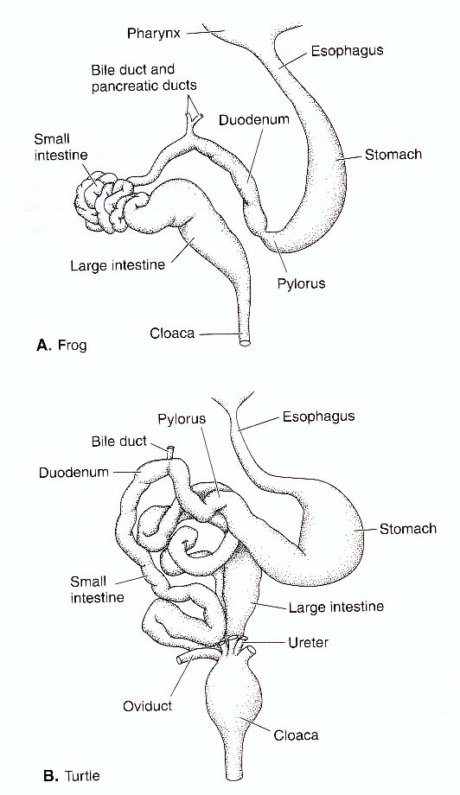
Small intestine general
The top portion of small intestine
(duodenum) receives secretions
of liver and pancreas. Middle
portion (jejunum) is main
absorptive portion and shows
highest degree of folding.
Lower portion (ileum) is less
folded and forms the connection
to the large intestine. A sphincter
(ileocolic valve) controls flow
of chyme from the ileum to large
intestine.

Slide 15
Large intestine
Lowermost portion of the intestine
(large intestine or colon) functions
in absorption of water and
electrolytes. Villi and microvilli are
absent, mucous glands are abundant.
Rectum is last part of intestine. It
passes out of coelom and through
pelvis to anus. In many vertebrates,
end of intestine and urogenital tract
modified into common chamber
called the cloaca.

Slide 16
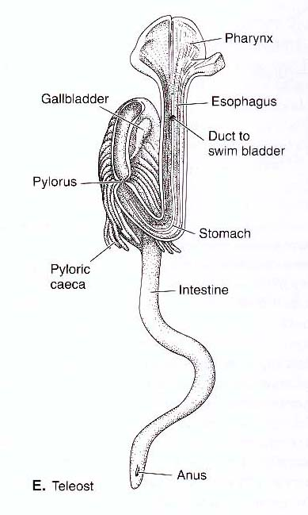
Cecae
Vertebrates have one or more
diverticula called cecae
associated with the intestine,
which function in fat digestion,
storage and fermentation. Cecae
are numerous and found in
association with pyloric region of
intestine in carnivorous fishes
(pyloric caeca). Tetrapods have
only one or two cecae located at
the junction between small and
large intestines (colic caeca). These
function in storage and fermentation.

Slide 17
Survey of vertebrate
digestive systems
In general, where diets are small and nutritious, gut is short
and lacks storage structures. Where the diet is soft or liquid,
stomach is absent.
Carnivores have short expandable guts with capacious storage.
Herbivores have a diet that is difficult to digest. Tend to have
long guts, grinding organs and storage chambers that permit
microbial fermentation.

Slide 18
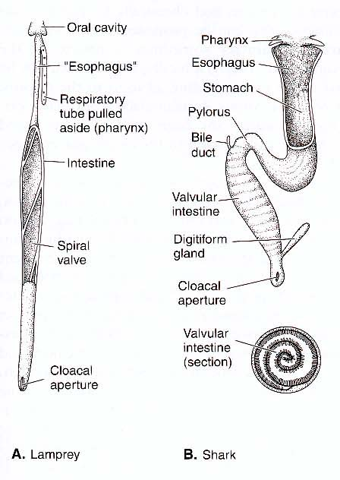
Jawless and cartilagenous fishes
Living jawless fishes lack an
esophagus and stomach. The
intestine is straight with little
differentiation. Lampreys have
spiral fold running the length
of the intestine (spiral valve).
In sharks, the esophagus is short
and papillose. The stomach is “J”
shaped. The intestine is short and
has a spiral valve. Sharks have
a short rectum with a rectal
gland for salt secretion. The
digestive tract ends in a cloaca.

Slide 19
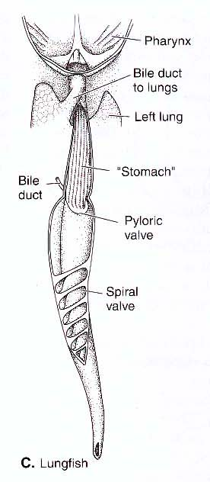
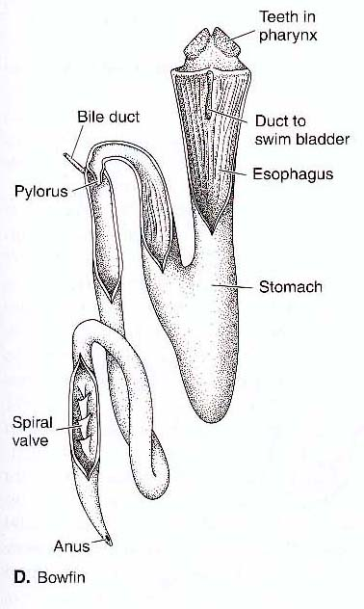
Bony fishes
Bony fishes also have a short esophagus. In primitive bony
fishes, the intestine is short and has a spiral valve. In
lungfishes, the digestive tract ends in a cloaca.

Slide 20
Teleosts
A spiral valve is lacking in
teleosts. Intestine length varies
based on the amount of plant
material in the diet (may be as
much as 12 body lengths in
herbivorous fishes). Cecae are
present in the pyloric region and
may be numerous where diet is
high in fat content. Rectal gland
is lacking and gut has a separate
outlet from the urogenital system
(no cloaca).

Slide 21
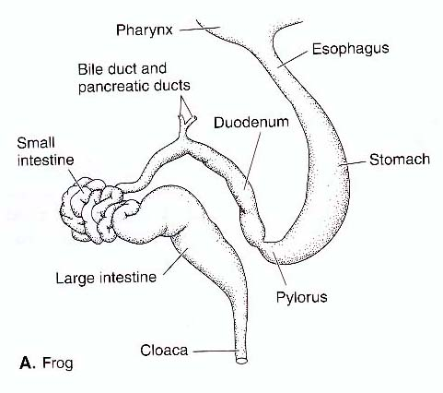
Amphibians
In amphibians, the esophagus
is short and grades into a
rather indistinct stomach.
The intestine is also
relatively short (0.5 to 3.5
body lengths). The small
intestine is coiled and may
be set off from short large
intestine by a colic cecum.
A cloaca is present.

Slide 22
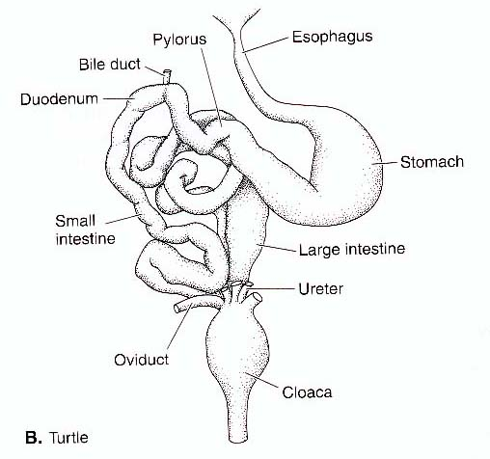
Reptiles
The esophagus is longer in
reptiles, mostly because of
a longer neck. The esophagus
is ciliated where soft foods
are eaten and cornified where
food is coarse (turtles). The
stomach is simple and straight
or gently curved. The intestine
is moderately coiled and from
0.5 to 2 body lengths. Reptiles
have a colic caecum and a
cloaca.

Slide 23
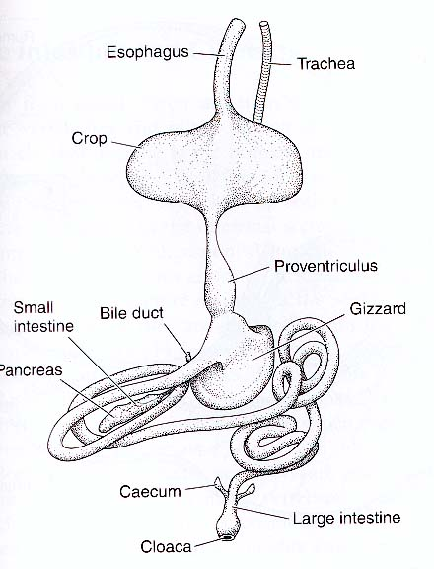
Birds
The esophagus of birds is long
(long neck) and usually has a
keratinized lining. The lower
part of esophagus is expanded
into a storage organ called the
crop. The stomach is modified
into an anterior, glandular
proventriculus, and a posterior,
muscular ventriculus or gizzard
The small intestine is long with
many coils and a distinctive
duodenal loop. The large intestine
is villous with two colic cecae. A
cloaca is present with a diverticulum
called the cloacal bursa.

Slide 24
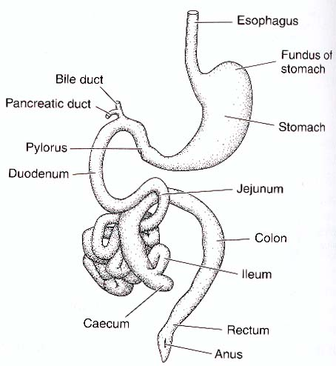
Mammals
In mammals, the esophagus is
long and devoid of cilia. In
herbivores, it is cornified. The
stomach may be simple and sack-
like or highly compartmentalized
and esophageal (ruminants). In
monotremes, the entire stomach
is cornified. The intestine is
long (2-25 body lengths). The
small intestine is coiled; the large
intestine is longer than in birds
and may be bulky. One colic
cecum is typically present, but
primitively mammals have two.

Slide 25
Feeding Mechanisms of Vertebrates
1. Suspension-feeding (= filter-feeding) - filter small particles (alive or dead, depending on species) out of water column
2. Suction-feeding - open mouth, suck in food
3. Ram-feeding - open mouth, swim over food
Ram-Suction Index - compares movement of food relative to movement of feeder
4. Inertial-feeding - inertia of food is used to move it in oral cavity
5. Transport - movement of food within oral cavity (by water currents in aquatic vertebrates or tongue in tetrapods)
6. Mastication - physical reduction of food size by chewing

Slide 26
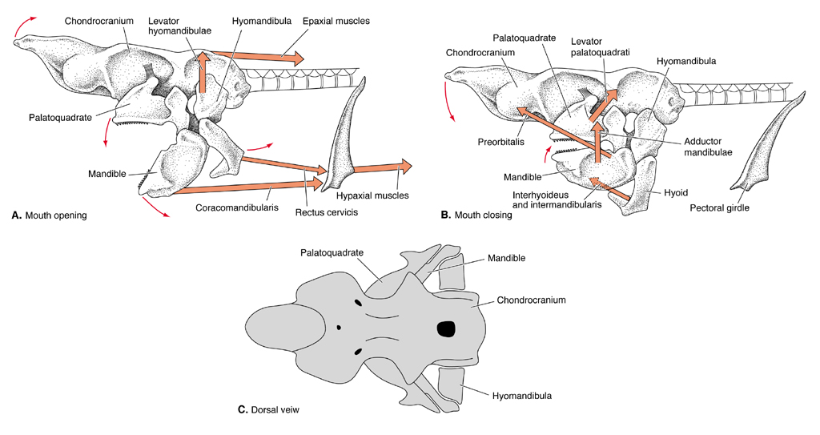
Mechanics of Suction Feeding in Sharks

Slide 27
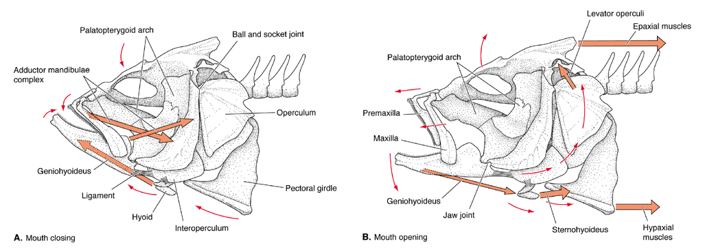
Mechanics of Suction Feeding in Teleosts

Slide 28
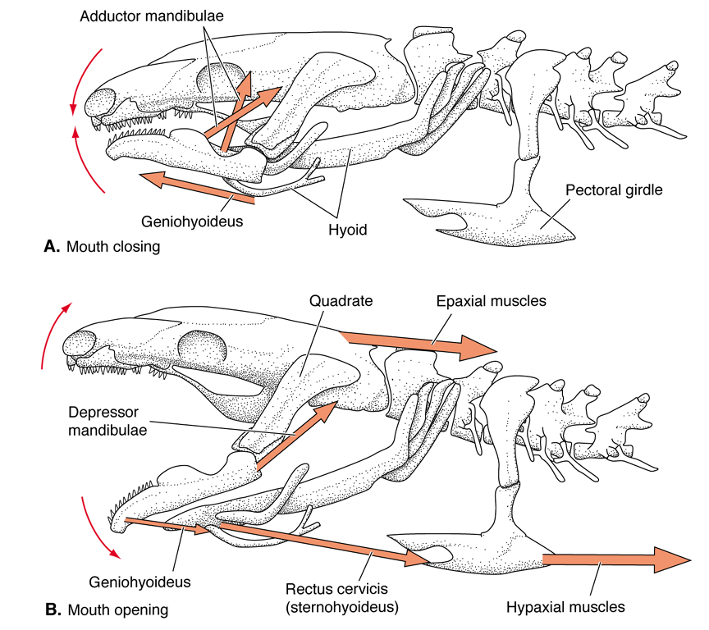
Jaw Mechanics of Aquatic Salamanders (Ambystoma)
Fig. 16.13

