Slide 1
Fish-like vertebrates
Subphylum Vertebrata includes animals commonly referred
to as fishes, amphibians, reptiles, birds, and mammals.
All of these groups were once treated as classes of equal rank.
However, "fishes" clearly includes several distantly related
and separately evolving groups (classes) of vertebrates.
A number of the groups are so old that they predate the evolution
of jaws, paired fins and even vertebrae! Many of the groups are
known only as fossils (denoted †)

Slide 2
Fish-like vertebrates continued
The groups of vertebrates traditionally classified as fishes are
generally treated as a unit because they show common
adaptations to life in water.
All fishes generally respire through water (using gills) and
have a morphology that reflects the constraints of an aquatic
environment (smooth streamlined body, generally with fins
for locomotion).
However, it is now clear that all of the groups of “fish-like”
vertebrates do not form a natural group in an evolutionary
sense (i.e., share a common ancestry separate from other groups
of vertebrates).

Slide 3
Jawless fishes
The most primitive kinds of fish-like vertebrates are the
so-called jawless fishes (agnathans). Four distinct lines
(classes) of jawless fishes are recognized.
As a group, agnathans lack paired fins and have cartilagenous
endoskeletons. The notochord is persistent and prominent, and
the only trace of vertebrae are small blocks of cartilage above
the notochord.
Most exhibit the primitive gill filtering mode of feeding seen
in protochordates.
The fossil record of jawless fishes is extensive, dating back to
Cambrian, 550 million years ago (mya).

Slide 4
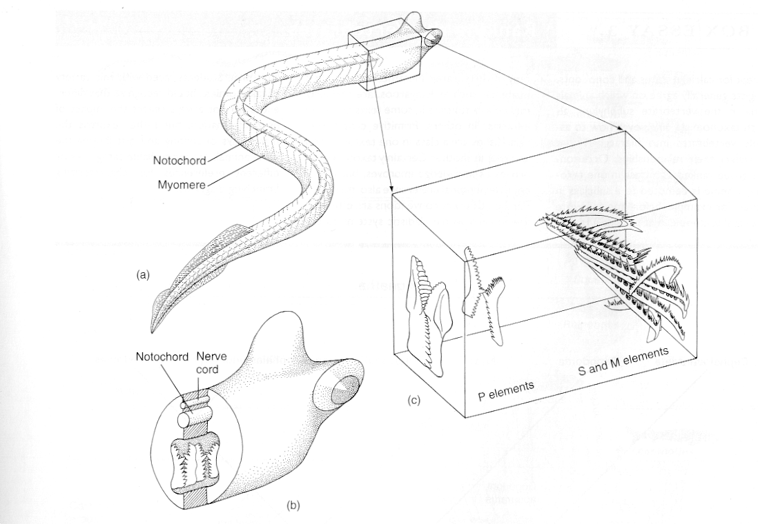
Conodonts
Conodonts (†Class Conodonta) are believed to be the
most primitive vertebrates. These organisms were long
known only from teeth. However, a complete conodont
fossil was discovered in the late 1980's. The body of this
fossil was unarmored and eel-like with clear chordate
affinities

Slide 5
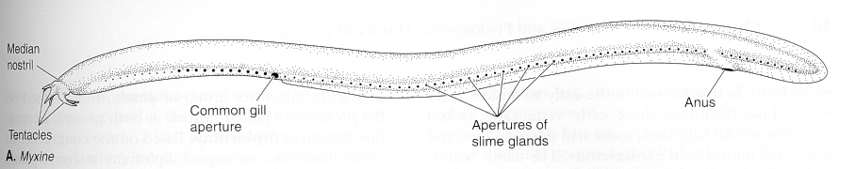
Hagfishes
Hagfishes (Class Myxini) are an extant group of jawless
fishes with uncertain affinities to other groups (fossil and living).
Hagfishes are deepwater, marine scavengers, with unarmored,
eel-like bodies, numerous slime pores along the side of the body,
a single medial nostril and a variable number of gill openings

Slide 6
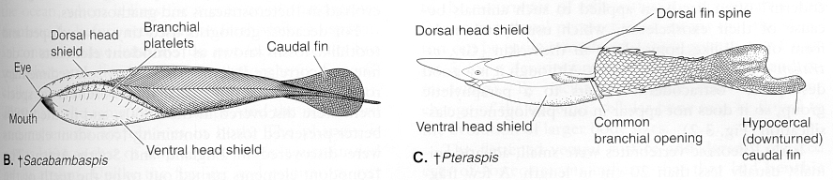
†Arandaspids and †Heterostracans
Some of the oldest and best known fossil jawless fishes
were armored forms commonly referred to as
ostracoderms (actually comprises several different groups).
†Arandaspids and †Heterostracans had two nostrils
(diplorhinous), a bony head shield, pointed snout, single
opening to gill chamber, and an asymmetrical heterocercal
tail, with the lower lobe larger than the upper lobe

Slide 7
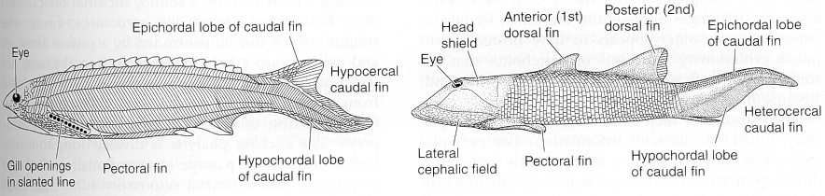
Monorhinus agnathans
Another group of jawless fishes (sometimes classified as Class
Cephalaspidomorpha) comprises at least three separate lines:
extinct cephalaspids and anaspids, and modern lampreys. Members
of this group possess a single medial nostril (monorhinous) and
numerous gill openings. Cephalaspids had strongly compressed
bodies with lateral projections extending for the head shield.
Anaspids were more streamlined, with spikes in the pectoral region.

Slide 8
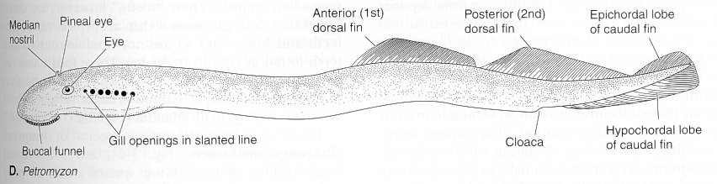
Lampreys
Modern lampreys lost all traces of exterior bony armor. The
adults of most lamprey species are parasitic, but the larvae live
buried in sediment and show the primitive gill-filter feeding
mode of existence .

Slide 9
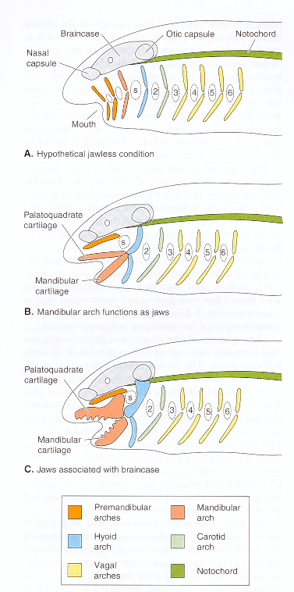
JAWS
Jaws evolved from anterior supporting
arches of the visceral skeleton of agnathans.
Homology of jaws to the visceral arches
of lampreys isn't entirely clear. It appears
that two arches anterior to the arch that
gave rise to the jaws were lost. The third
visceral arch (mandibular arch) gave rise
to the jaws. The fourth visceral arch gave
rise to the jaw support mechanism (hyoid
apparatus or suspensorium). Evolution
of jaws opened up a whole new realm of
feeding possibilities. Jawed vertebrates
form a natural group (Gnathostomata).

Slide 10
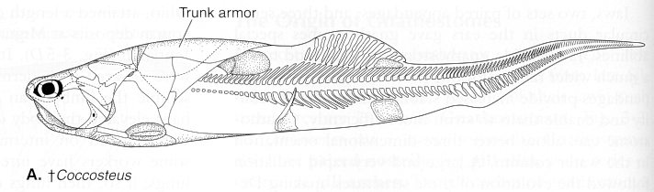
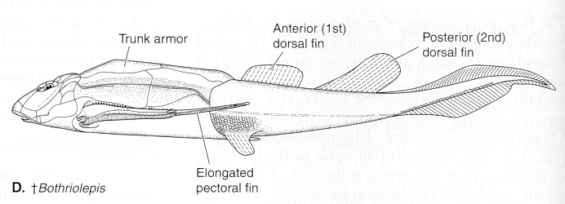
Placoderms
†Class Placodermi - early group of jawed fishes. Bodies
heavily armored, especially in head region. Armor jointed
to permit movements of the head. Endoskelton entirely
cartilagenous. Evolved in freshwater; later invaded sea.
Greatest diversity during Devonian (350 mya). Many
superficially resemble sharks and rays. Decline attributed
to radiation of cartilagenous fishes

Slide 11
Cartilagenous fishes
Class Chondrichthyes - jawed fishes with cartilagenous
endoskeletons and much reduced external body armor (only
small tooth-like scales remain).
Fertilization internal and aided by male pelvic or head structures
called claspers.
Development internal or external; females in a number of groups
independently evolved internal means of nourishing embryo
("placentae").
Many with small spiracle opening behind eye (ancestral gill slit
between jaws and the suspensorium).
Intestine with spiral valve for increased absorptive surface.
Two subclasses: Elasmobranchii and Holocephali.

Slide 12
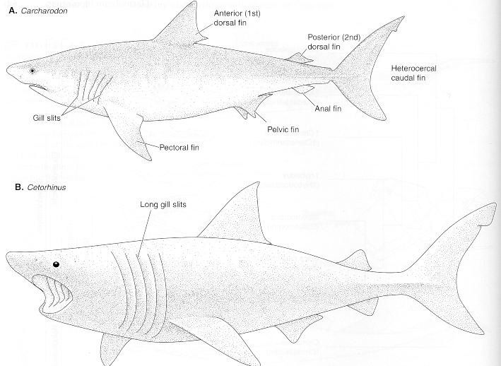
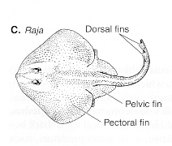
Elasmobranchs
5-6 gill bearing arches with plate-like external slits. Sharks are
active-swimming, predacious fishes. Rays are dorsoventrally
flattened bottom dwellers; expanded pectorals forming “wings”;
gills rotated under body; large spiracle for gas exchange while
resting. Elasmobranchs may have originated in freshwater, but
the group is mostly marine now.

Slide 13
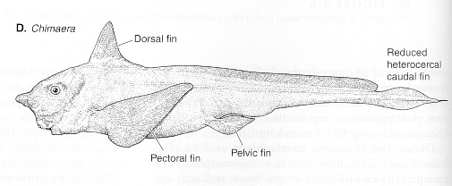
Holocephalans
Holocephalans are a divergent group of chondrichthyans with
broad heads and long whip-like tails (hence familiar name
ratfishes). Fleshy operculum covering their gills, no spiracle,
and head and pelvic claspers in males. Upper jaw is fused to
cranium, hence the name holocephali.

Slide 14
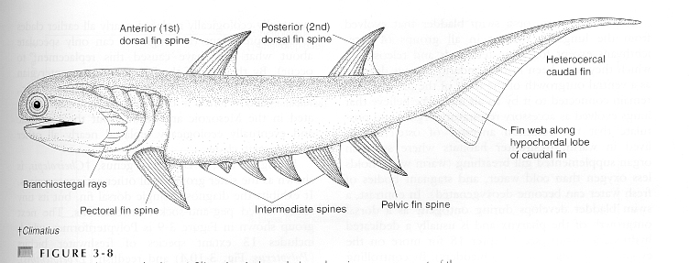
Acanthodians
†Class Acanthodi includes the earliest known jawed fishes.
Had streamlined bodies, large eyes and mouths, and heavy
spines associated with all fins. Cartilagenous endoskeletons,
but reduced external body armor relative to ostracoderms and
placoderms. Most lived in freshwater and were active swimming
sight feeders.

Slide 15
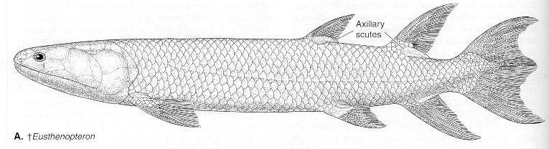
Bony fishes
Traditional to talk of bony fishes (Class Osteichthyes) separate
from land vertebrates. However, the separation is unnatural, as
many of the characteristics we would use to distinguish "bony
fishes" are seen in amphibians and even some reptiles.
Now customary to refer to all bony vertebrates as members of
Class Teleostomi, and place one of the two main groups of bony
fishes (lobefin fishes) with land vertebrates in Subclass
Sarcopterygii.

Slide 16
Bony fishes continued
Bony fishes have a bony operculum covering gills and
uniquely constructed fins, scales, and vertebrae. The girdles
that support paired fins are more firmly attached to the skeleton
than in other jawed fishes. Bony fishes evolved in freshwater
400 mya. Two groups (subclasses of Class Teleostomi) are
recognized: Actinopterygii (rayfin fishes), which have fins
attached directly to the body; and Sarcoptergygii (lobefin
fishes and descendants) which have fins at the end of fleshy
stalks (or limbs).
One of the important anatomical differences between fishes
and land vertebrates is presence of gills in the former and
lungs in the latter for gas exchange. However, "lungs" are seen
in many groups of "fishes".

Slide 17
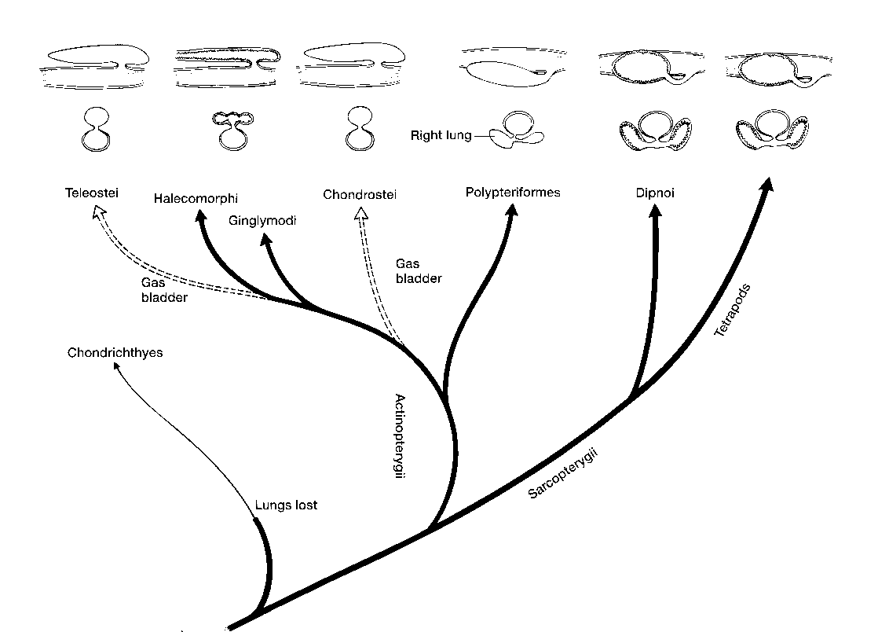
Lungs and swimbladders
Earliest lungs were paired ventral structures with clear homology to
lungs of tetrapods.
In fishes, lungs moved dorsal
to prevent rolling tendency
in swimming. Earliest dorsal
lung retains ventral connection
to gut. Lung is reduced to
a single swimbladder with
dorsal connection to gut in
early rayfin fishes
(physostomous condition).
Connection is lost in advanced
rayfins (physoclistic
condition).

Slide 18
Trends in rayfin fishes
Actinopterygians (rayfins) underwent several design
modifications over the course of their evolution.
Trends of increasing bone in the skeleton, followed by decreasing
bone in most advanced marine groups.
Tails change from heterocercal to a more symmetrical homocercal
type.
Scales changed from heavy ganoid type to thin and flexible
bony-ridge scales.
Structures that presumably evolved for air breathing (lungs)
modified into a buoyancy structure (swimbladder) and subsequently
lost in advanced deepwater marine groups.

Slide 19
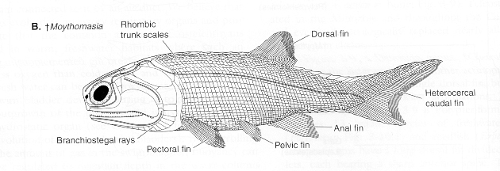
Chondrosteans
Earliest rayfins (Chondrostei) share many features with
chondrichthyans, including an essentially cartilagenous
endoskeleton, heterocercal caudal, spiracle, and intestinal
spiral valve. Have unique (ganoid) scales (derived from
cosmoid scales of sarcopterygians). Early chondrosteans
(Palaeoniscoids) dominated marine and freshwater habitats
in the Paleozoic.

Slide 20
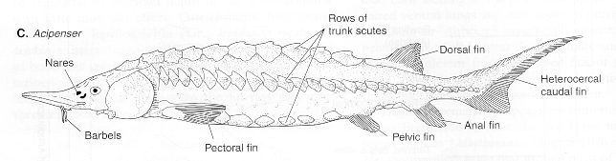
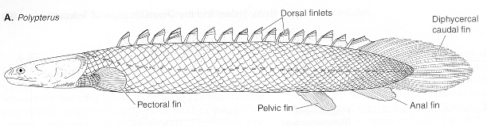
Modern chondrosteans
Only two degenerate groups of chondrosteans survive today
Acipenseriforms (sturgeon and paddlefish) are large river fishes.
Bichirs (Cladistia) is a peculiar aberrant group adapted to
tropical freshwaters of Africa. Has lobate pectoral fins and
ventral lungs, similar to sarcopterygians.

Slide 21
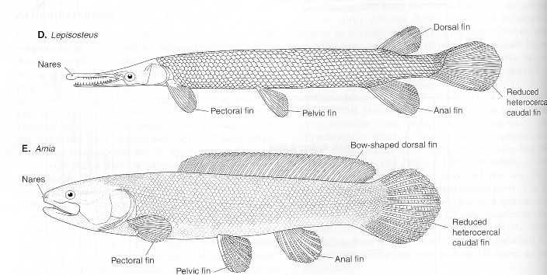
Neopterygians
Modern rayfins are grouped in Infraclass Neopterygii.
Show increased mobility of the fins and jaws compared to
chondrosteans. Primitive and advanced groups are recognized.
Earliest neopterygians (holosteans) retain ganoid scales, and
slight degree of asymmetry to tail. Later ones (Teleosts) have
thin bony-ridge scales and a symmetrical homocercal tail,
advances that aided swimming.

Slide 22
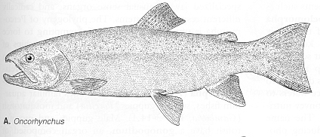
Teleosts
Teleosts are the most successful vertebrates (30,000 species).
Early teleosts retain primitive neopterygian condition of having
maxillary bone toothed and included in the gape, fins without
spines, a single dorsal fin (small adipose fin sometimes present),
low, obliquely angled pectoral, and abdominal pelvics. Advanced
teleosts have toothless maxilla excluded from gape, spines in fins
(hence larger effective body diameter), two dorsal fins, lateral,
vertically-attached pectorals and thoracic or jugular pelvics.

Slide 23
Lobefins
Lobefin fishes (sarcopterygians) represent an early radiation of
bony vertebrates with few surviving groups. Have internal nares
(nostrils that open into mouth), functional gills and lungs, and
circulatory adaptations that permit shunting of blood to either gills
or lungs. Evolved in tropical freshwater habitats prone to
stagnation. Fleshy lobate fins permitted ancestors to move about
over land in search of oxygenated water. Lungs permitted them to
breath air to survive the journey. Thus, these fishes were
preadapted to life on land and clearly gave rise to amphibians.

Slide 24
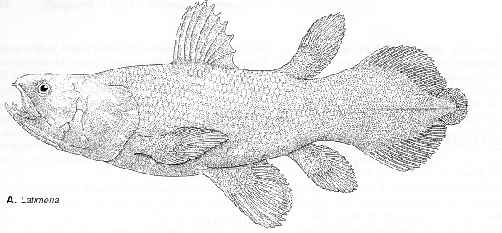
Lobefins continued
Three distinct lines of sarcopterygian fishes: coelacanths
(Actinistia), lungfishes (Dipnoi), and Rhipidistians (includes
ancestors of tetrapods). Coelacanths represent an early marine
group. Surviving forms (genus Latimeria) inhabit deepwater
habitats and lost air breathing features.

Slide 25
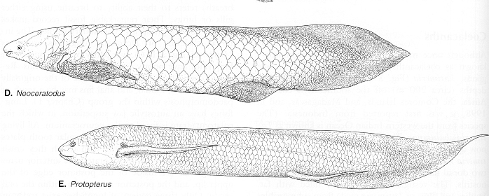
Lungfishes
Early lungfishes had heterocercal tails and primitive cosmoid
scales. Surviving forms have reduced scales and symmetrial
diphicercal tails; lobefins are reduced to filaments. Confined
to tropical climates in the southern hemisphere (Africa, South
America, Austrailia). African lungfish estivates in mud and
can survive long periods of drought.

Slide 26
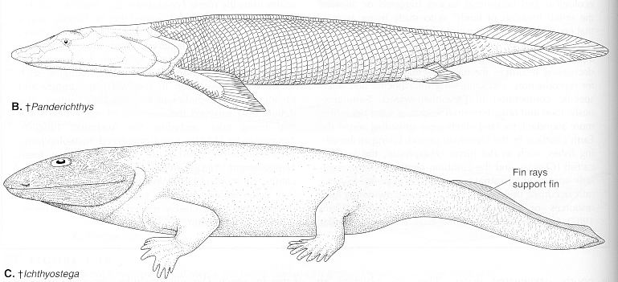
Rhipidistians
Rhipidistians are an extinct group of lobefins which show a
transition from fish-like to amphibia-like stages. The earliest
amphibians share a number of anatomical similarities with
rhipidistians.

