Slide 1
INTEGUMENT AND DERIVATIVES
Integumentary system forms the covering of the vertebrate
body.
It is largest (by weight) and most varied organ system.
Functions in protection, water balance, thermoregulation,
excretion, respiration, coloration, and energy storage.
Derivatives aid digestion and locomotion.

Slide 2
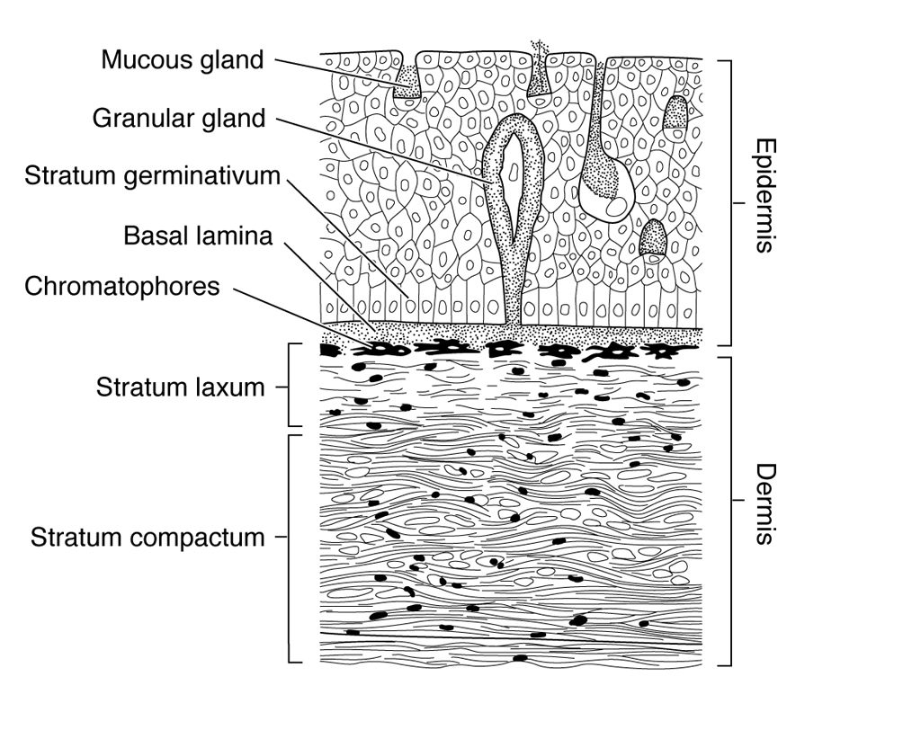
Epidermis and Dermis
Integument is a composite of two distinct tissue layers: outer
cellular epidermis derived from ectoderm; inner, mostly
acellular dermis derived from dermatome of mesoderm and
some neural crests.

Slide 3
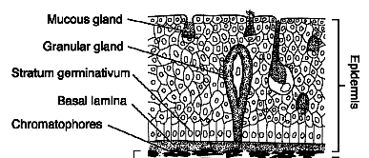
Epidermis
Epidermis is multilayered (stratified). Innermost layer is
germinal layer called stratum germinativum. Cells produced
by this layer are pushed outward and form the surface layer of
the epidermis, which is either living or dead in vertebrates.
Cells of epidermis are secretory in nature (secrete mucus,
poison, keratin, alarm substances, etc.).

Slide 4
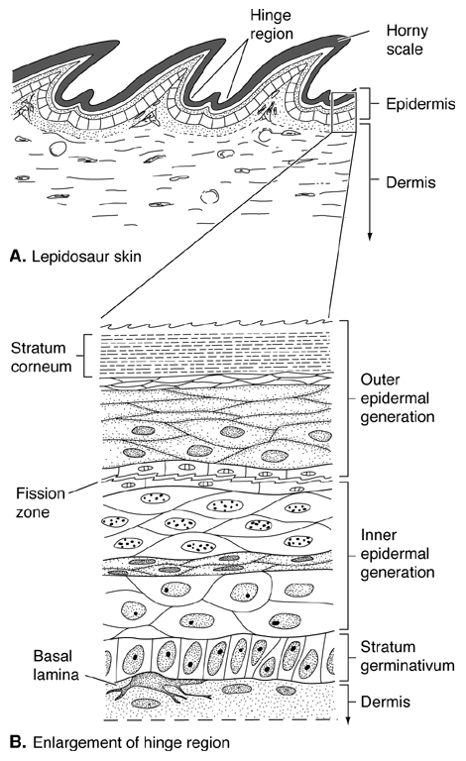
Keratin
Keratin is a horny protein
that gives epidermis a
rough texture. Two types:
soft and flexible alpha
-keratin; hard beta-keratin
found in hair and nails. In
tetrapods, surface epidermis
is layer of dead keratin
-filled cells called stratum
corneum. Reduces
desiccation depending on
thickness.

Slide 5
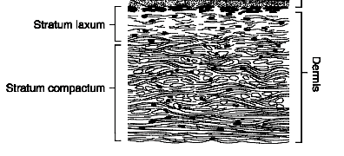
Dermis
Dermis is usually thicker than epidermis and composed of
relatively few cells in a meshwork of fibers (collagen and
elastin). Upper layer of the dermis is spongy, vascular layer
called the stratum laxum or spongiosum with nerves and
pigment cells. Lower layer is denser stratum compactum and
comprises a fat deposition layer and a connective layer for
attaching dermis to underlying muscle.

Slide 6
Integumentary development
During development of the integument there is always
communication (induction) between ectodermal (germinal)
and mesodermal (mesenchymal) components of the skin,
regardless of whether the derivative contains both tissue types.
In fact, it is usually the nature of the overlying dermis that
determines the type of epidermis that develops.
All of the various integumentary structures seen in vertebrates
develop by the same basic process of dermal induction of
superficial integumentary layers.

Slide 7
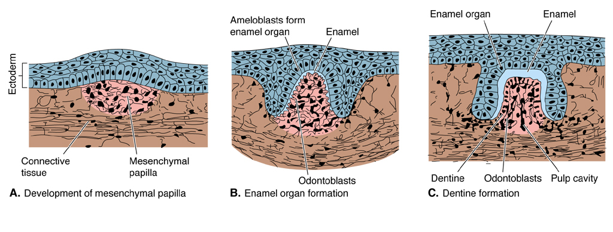
Integumentary hard tissues
In general, hard tissues of the dermis and gums develop from
an association between neural crests and mesenchyme of the
dermatome. Dermal papillae form in the dermis and induce
the overlying epidermis to form enamel organs. Enamel organs
in turn induce papillae to form dentine (where it develops) and
bone. Enamel organs (or their homologs) may alternatively
form horny scales or their derivatives.

Slide 8
Vertebrate hard tissues
Three principal types of hard tissue found in the skin of
vertebrates: enamel, dentine, bone. Enamel is the hardest
and most external (ectodermal). It is composed of crystals
of hydroxyapatite. Found in teeth, dermal denticles, scales
and armor plates of fishes.
Ganoine is a type of enamel. Dentine is softer than enamel
but harder than bone. It is dermal in origin. Also found only
in teeth, denticles and armor plates, and is between enamel
and bone. Cosmine and enameloid are types of dentine.
Bone is usually medial to dentine, usually cellular and the
softest of the three hard substances.

Slide 9
Chromatophores
Pigment cells (chromatophores) are usually in the dermis, near
the epidermis basement membrane. Derived from nerve cells
(neural crests). Produce color effects by dispersing or
concentrating pigment.

Slide 10
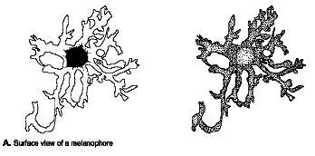
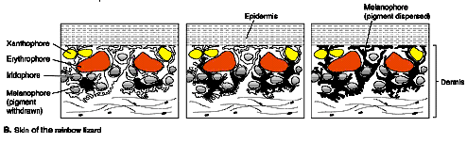
Chromatophores continued
One type, melanophore, contains the pigment melanin, which is
responsible for black and brown hues. Xanthophores and
erythrophores contain pteridines and carotenoids, which
produce yellows and reds. Iridophores contain crystals and
produce various hues by reflecting light.

Slide 11
Coloration
Body coloration is produced by combining color effects of
different types of chromatophores and is under endocrine and
nervous system control.
Melanophores are important in producing constant or
morphological coloration (only changes seasonally, if at all).
Poikilotherms characteristically have chromatophores confined
to dermis and are capable of rapid color changes (physiological
color).
Homeotherms have pigment cell in the epidermis and
can’t change color rapidly.

Slide 12
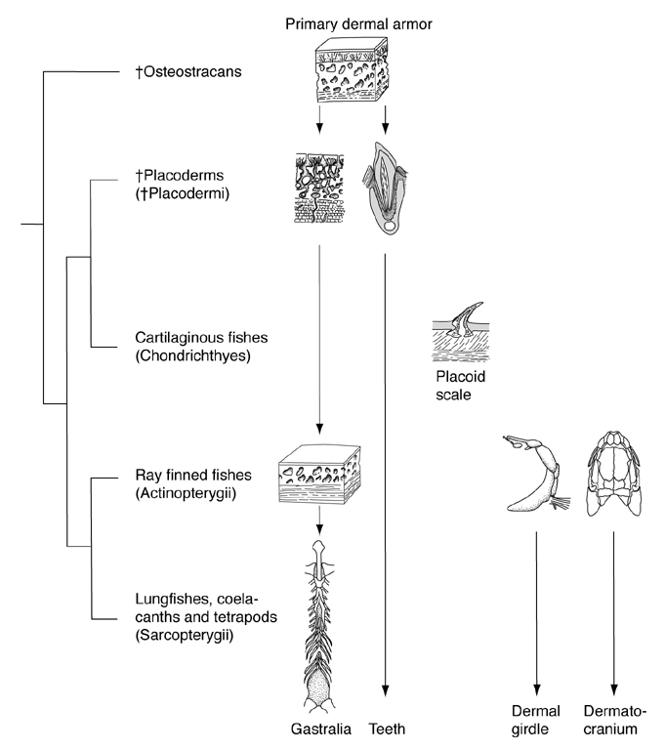
Jawless fishes
Early jawless fishes
(ostracoderms) had heavy armor
composed of enamel, dentine and
bone. Differed in size from large
plates (head shield) to small
denticles (usually covering rear
of body). Aspidomorphs lacked
head shield and showed a trend
of reduction of body armor
leading to living jawless fishes.
Epidermis of living lampreys is
relatively thin with mucous and
granular cells, and thin acellular
cuticle covering. Dermis is also
thin and there are no scales.

Slide 13
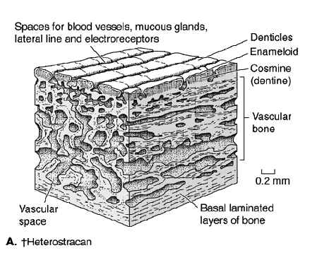
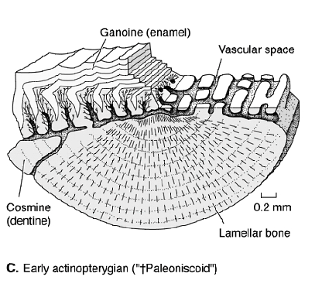
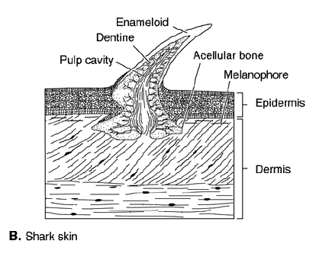
Early gnathostomes
Placoderms, crossopterygians
and early dipnoans have
cosmoid scales consisting of
outer ganoine enamel, Inner
cosmoid dentine, and basal
layer of bone. Ganoid scales
seen in cladistians, chondrosteans
and early holosteans primitively
have ganoine, cosmine and bone
and later lose cosmine (ganoine
and bone). Sharks and their
relatives have dermal denticles
of enamel and dentine
(placoid scales).

Slide 14
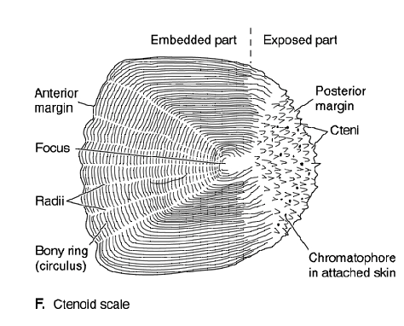
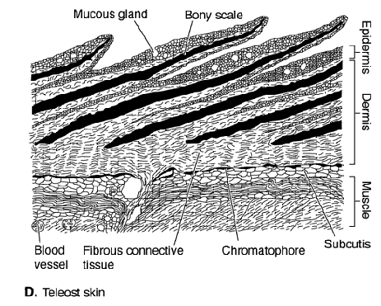
Teleosts
Teleosts have scales composed entirely of thin flexible bone.
In general, entire epidermis in fishes is living and forms the
outermost layer of skin. Dermis is thick and has scales
embedded within it.

Slide 15
Tetrapods
Skin of tetrapods emphasizes epidermal derivatives.
Various hard tissues of tetrapods are derived from scales
of fishes. Scales of caecilians, osteoderms seen in
labyrintyhodonts, crocodiles, turtles and lizards are all
composed of dermal bone.
Shell of armadillo is cornified epidermis overlying dermal
ossicles.

Slide 16
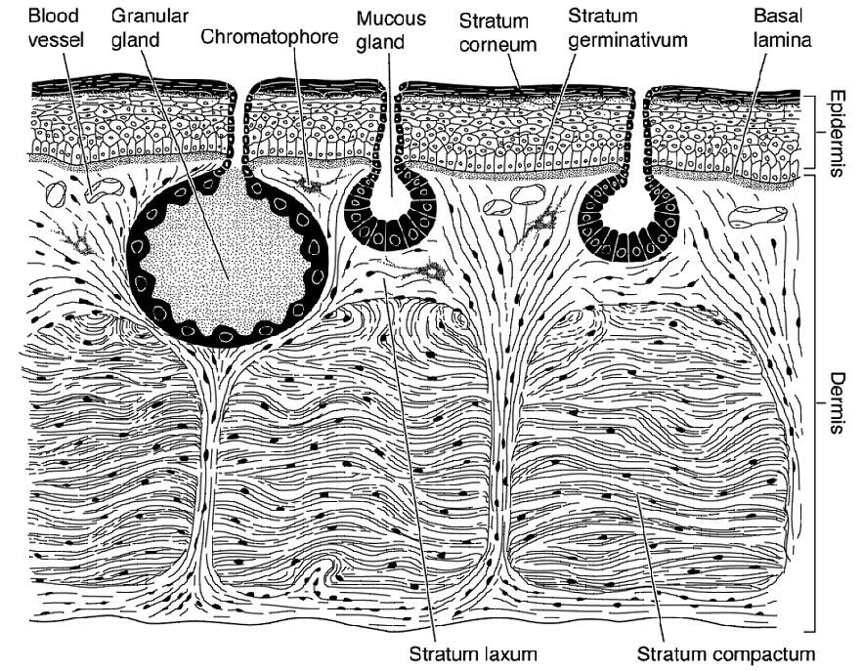
Amphibians
In living amphibians,
epidermis is thin with
only outermost layer
keratinized (alpha
keratin). Secretes
polysaccharide to reduce
dessication. Skin also
has mucous glands, and
a granular gland that
secretes a distasteful or
toxic substance (form warts
on toad skin). Generally
require moist habitats.
Extinct forms had thicker skin and were probably more terrestrial.

Slide 17
Reptiles
Reptiles have horny scales
formed from keratinized
epidermis.
Beta keratin forms the outer
most layer of skin. Forms flat
plates or scutes in crocodilians
and chelonians. Multi-layered
in lepidosaurs with two germinal
layers that produce alternating
generations of skin.
Epidermal scent glands produce
pheromones. The dermis is thin.

Slide 18
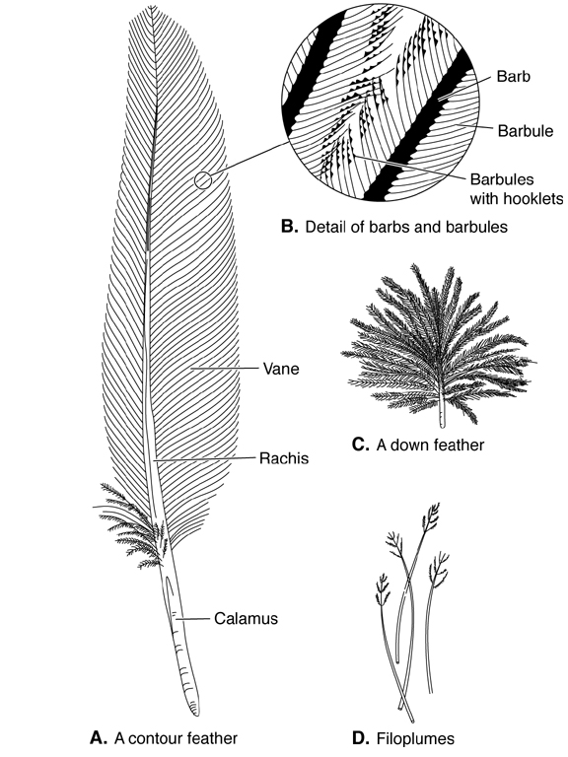
Birds
Birds have a thin, weakly
keratinized, loosely joined
skin.
Feathers are keratinized
epidermal appendages of
skin. Descended from
reptilian scales (birds
still have reptile-like
scales on their legs).

Slide 19
Feathers
Feathers composed primarily
of beta keratin. Two main
types: contour feather and down.
Base of contour feather is hollow
quill. Barbs branch from the shaft
and barbules branch from the barbs.
Barbules have hooklets which
interlock, producing a strong, but
extremely light web.
If barbules disengage, reattached
by preening. Epidermally
derived uropygial gland above
the tail secretes an oil used to
lubricate and waterproof the
feathers.

Slide 20
Feathers cont’d
Little or no shaft in down
feathers, and no hooklets
for engaging barbs
and barbules. So, the
feather is soft and fluffy.
Feathers molted annually
(gradual replacement).

Slide 21
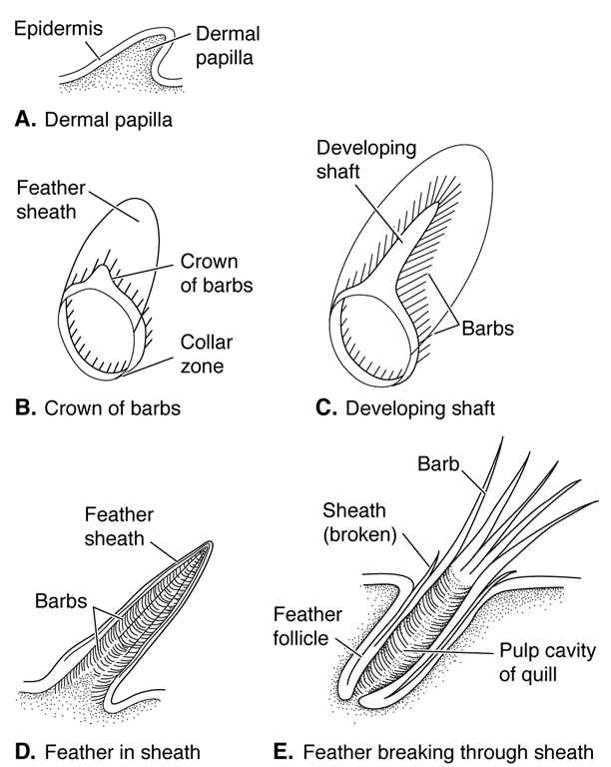
Feather development
Feather development starts with
dermal papilla with epidermal
cap. Papilla sinks into the skin
producing shallow depression
called feather follicle. Feather
formed entirely of epidermis, but
growth nourished from beneath by
dermis. Developing feather
surrounded by keratinized sheath,
which later falls away. Shaft grows
out under sheath, branching barbs
and barbules. Structure keratinizes
from distal tip to base.

Slide 22
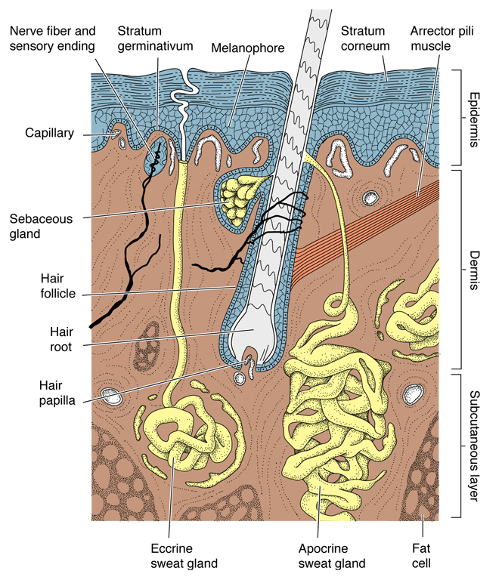
Mammals
Skin of mammals is thick,
especially the dermis (leather),
but epidermis also becomes
thick or callused on heavily used
surfaces (palms, soles, knee
pads).
The stratum corneum may
form scales, as on the tails of
oppossum and rats. Nails and
claws are composed of keratinized
epidermis. Baleen plates of whales
are epidermal outgrowths from the
buccal cavity.

Slide 23
Hair
Most obvious feature of
mammalian skin is hair.
Hypothesized that hair
evolved from tactile
mechanoreceptors found
between scales of reptiles.
Develops in epidermal sheaths
called hair follicles, that sink
deep into the dermis.
Keratinized epidermal
cells that are continually
sloughed off the surface of
the epidermis, are plastered
together in the hair follicle
forming a hair shaft. Shaft
grows outward as more and more cells are added.

Slide 24
Hair continued
Each hair has a small papilla
at its base with a tiny nerve
plexus. Each hair also has a
tiny muscle called an arrector
pilli, which causes the hair to
stand when contracted.
Hairs also have one or more
sebaceous glands, which
produces an oily secretion
(sebum) for lubricating the hair
and overlying skin.

Slide 25
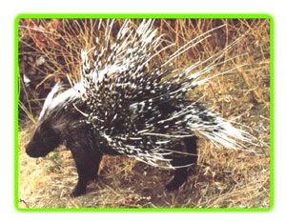
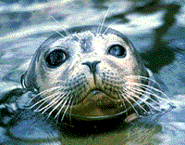
Hair continued
Whiskers (vibrissae) are modified hairs that function
as tactile organs. Quills of porcupines and echidnas
are enlarged and hollowed out hairs.

Slide 26
Sweat glands
Mammals are unique in having two kinds of epidermally
derived sweat glands: eccrine sweat glands which produce
a watery secretion important primarily for thermoregulation
(evaporative cooling) and secondarily for excretion (urea
and salt balance); and apocrine sweat glands which are
typically associated with hairs in certain parts of the body
and produce a milky, odiferous secretion important in sexual
communication.
Scent glands of mammals are modified apocrine sweat glands
important in social communication. Moll's glands of the eyelids
and wax glands of the ears are also modified sweat glands.
Mammary glands are believed to be highly modified, concentrated
sweat glands.

Slide 27
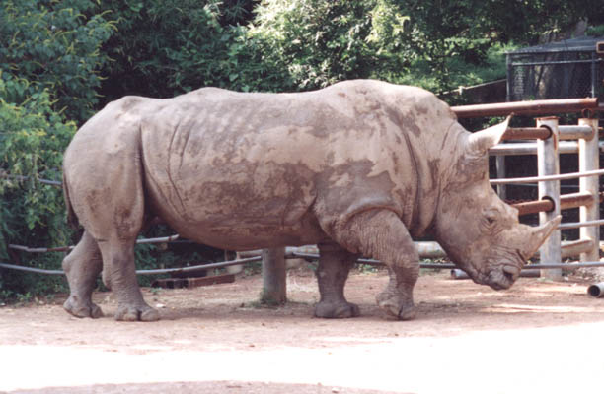
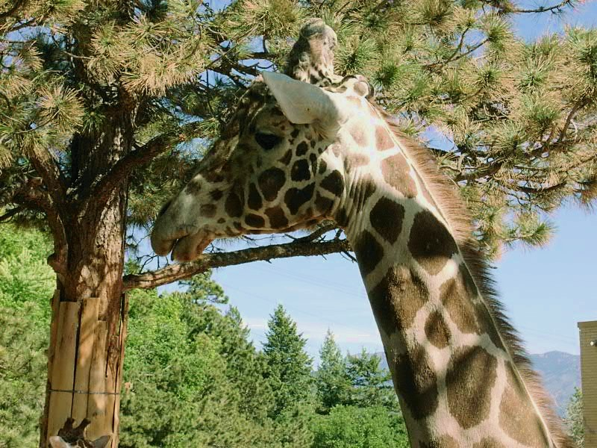
Horns and antlers
Horns and antlers of
tetrapods are variously
composed of keratinized
epidermis and bone.
Rhinocerous horn is mostly
cornified epidermis with
only a small dermal core.
Giraffe horns are bones that
project out from the skull
and are covered with skin.

Slide 28
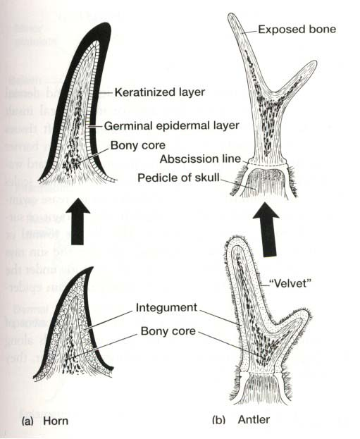
Horns and antlers continued
True horns found in cattle, African
antelope, and certain dinosaurs and
lizards are permanent bones covered
by an ever-growing horny epidermis.
Antlers of deer, moose and elk are
also bony outgrowths from the skull,
but their growth is nourished partly
from an overlying integumentary
velvet, and they are sloughed off
annually due to a weakening of bony
core at base. Antlers of pronghorn
antelope are like deer antlers except
they are coated by a horny skin that
is shed and re-grown each year.

