Slide 1
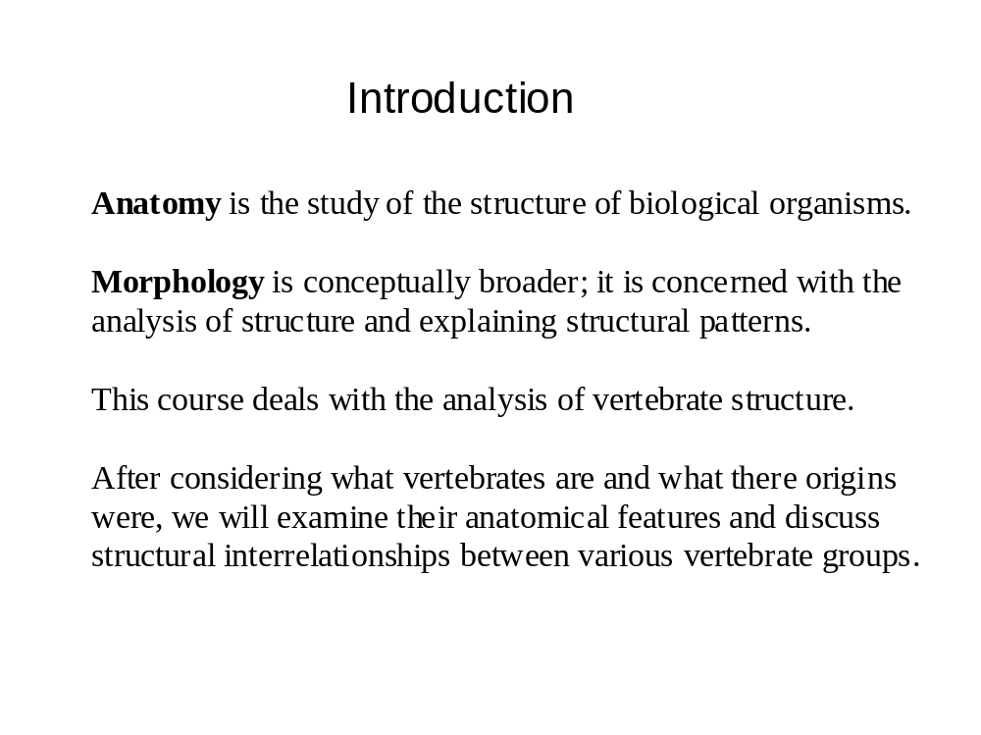

Slide 2
Why study Vertebrate Morphology?
Morphology is important to:
Art - importance of underlying structure to external form
Biomechanics - bones, muscles and their attachments are
responsible for the nearly fluid range of motion and great feats
of athleticism vertebrates are capable of
Medicine - close correspondence between the organ systems
of humans and those of other kinds of mammals
Paleontology - skeletal elements and other hard parts of Recent
vertebrates provides clues about the morphology of extinct ones
...And many other areas of study

Slide 3
Underlying assumption: evolutionary theory
Vertebrates shown similarities in form because they share
a common ancestry.
All of the diversity of form seen in the vertebrates resulted from
evolutionary change brought about by a slow and deliberate
process of mutation and natural selection.
All vertebrates are connected by their history of descent
(phylogeny) and details of this history are revealed by their form.

Slide 4
Important terms and principles
Adaptation - process of becoming or being adjusted to a
particular set of environmental conditions.
Environments change and organisms constantly adapt to
keep pace with those changes.
Evolutionary change results from an interplay between
changing environments and adapting organisms.
Because of adaptation, the form of anatomical structures
generally reflects use (function). However, there are many
instances in vertebrates where forms evolve for purposes
other than those for which they are ultimately used
(preadaptation).

Slide 5
Homology
Homologous structures are features in two different organisms
that are related because of common ancestry. Homology
is similarity due to common ancestry. Homology is established
by comparing structures in different groups of organisms.
Homologous structures show similarity in details of anatomy
that cannot be evolved independently.

Slide 6
Serial Homology
Serial Homology - homologous structures repeated in series
(e.g., vertebrae). Each serial homolog has the capacity for
change independent of other homologs. Best examples of serially
homologous structures in vertebrates are vertebrae: form groups
(cervical, thoracic, lumbar, sacral) and take on different
appearances based on their different functional roles in the spine.

Slide 7
Analogy
Analogy is similarity due to common function. The forelimbs of
birds, bats and pterosaurs have similar forms do to common use in
flying. Analogous similarity is superficial; detailed study of the
anatomy of wings of birds, bats, and pterosaurs reveals that they
have different origins. When different structures evolve a similar
appearance, we say they converge in morphology. Another term
for analogous similarity and convergence is homoplaisy.

