Slide 1
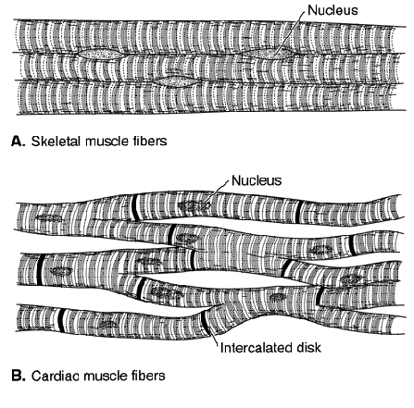
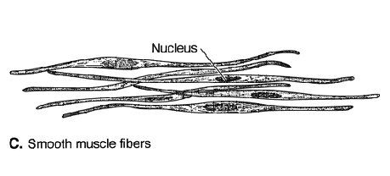
Muscles
Muscles are responsible for all
movements in the vertebrate body.
Muscles accomplish movements
either by shortening or creating
tension. Three types of muscle
are recognized in vertebrates:
Skeletal muscle is associated
with the skeleton and is composed
of long cells (fibers) with many
striations. Cardiac muscle is
found in the heart and has
interconnect fibers separated by
disks. Smooth muscle is found
in blood vessels and many organs
and has spindle-shaped fibers.

Slide 2
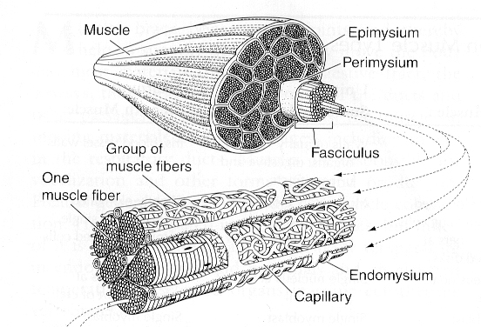
Muscle attachment
Loose connective tissue, called fascias, surround muscles, attach
muscle to muscle, and muscle to skin. Muscles attach to skeletal
elements by collagenous connective tissue called tendons, or by
way of flat sheets of connective tissue (aponeuroses) that
distribute forces over broad areas.

Slide 3
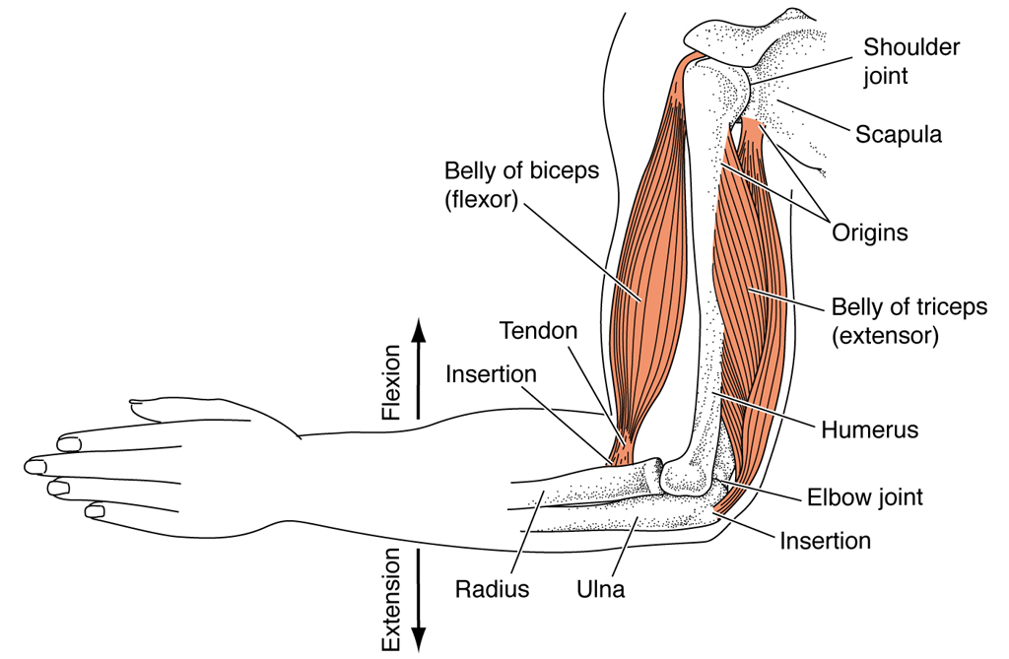
Muscle action
Typically, one
attachment point
is fixed (origin)
and the other is
free to move
(insertion).
A muscle's action
is the movement
it produces. Muscles are named according to their origin and
insertion points (in that order) or by the type of movements they
produce. Flexors are muscles that reduce the angle between
adjacent elements, as with the angle of the forearm. Extensors
are muscles that increase angles.

Slide 4
Muscle action continued
Adductors move parts inward toward the midline of the body.
Abductors move parts away from the midline. Levators raise
body parts (e.g., closing jaws); depressors lower body parts
(opening jaws). Protractors push parts away from their bases
(tongue extension); retractors draw them back in. Sphincters
constrict openings; constrictors compress spaces; dilators
expand openings. Rotators turn parts about their long axes.
Rotators that turn palms upward are supinators; those that turn
the palms downward are pronators.
Muscles with opposing actions are called antagonists. Those
that supplement one another are called synergists.

Slide 5
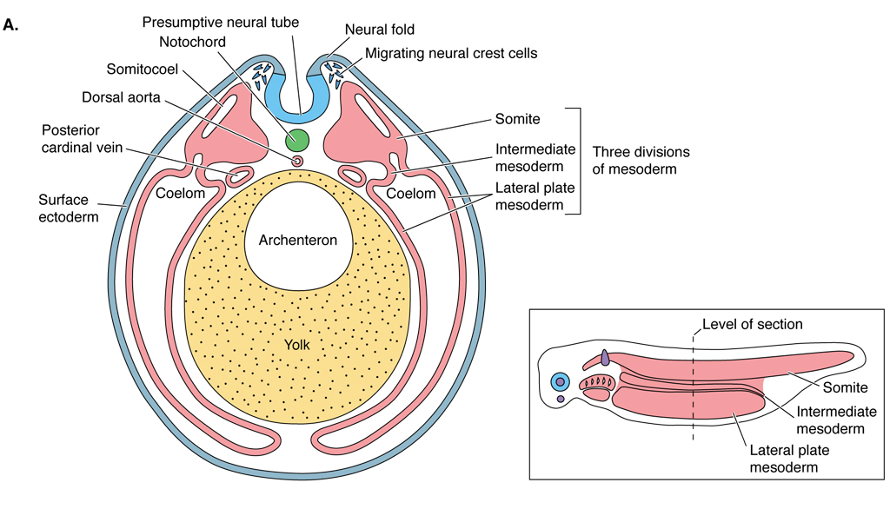
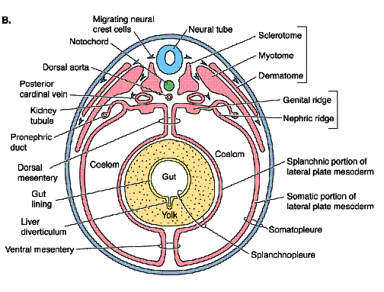
Muscle development
Muscle is mesodermally derived tissue. Recall that mesoderm
of the early embryo is differentiated into a dorsolateral segmented
epimere, intermediate mesomere and a ventrolateral hypomere.
The epimere further divides into dermatome, myotome and
sclerotome. Dermatome forms muscle associated with the skin.
Virtually all of the other muscle is formed from myotome and
hypomere.

Slide 6
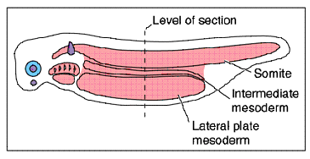
Muscle development continued
Musculature of the body wall (axial muscle) is formed by
myotomes behind head and pharyngeal region. A lateral
septum forms to divide the axial muscles into epaxial and
hypaxial masses. In higher vertebrates, hypomere contributes
to formation of the hypaxial mass.

Slide 7
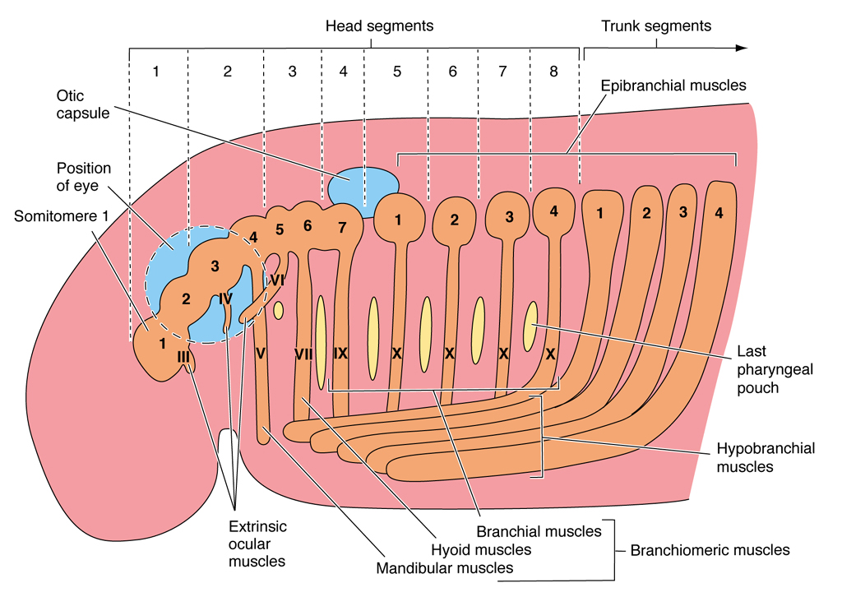
Muscle development continued
Anterior epaxial myotomes form extrinsic eye muscles, which
move the eyeball. Ventral sections of the hypaxial myotomes
migrate forward into the gill region to form the hypobranchial
muscles.

Slide 8
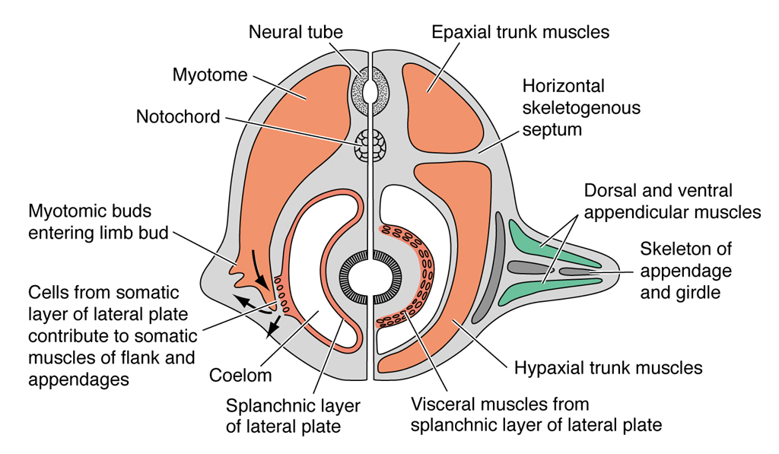
Muscle development continued
Appendicular
muscles also
form, at least
in part, from
extensions of
ventral hypaxial
myotomes.
Mesenchyme from
hypomere also
contributes to
appendicular musculature in higher vertebrates.
After it splits to form coelom, inner splanchnic layer of hypomere forms
heart in the thoracic region and muscles of the viscera behind this.
Branchial muscles also form from splanchnic hypomere in this region.

Slide 9
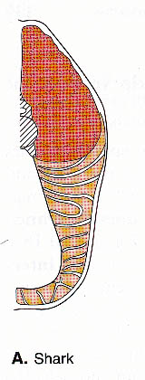
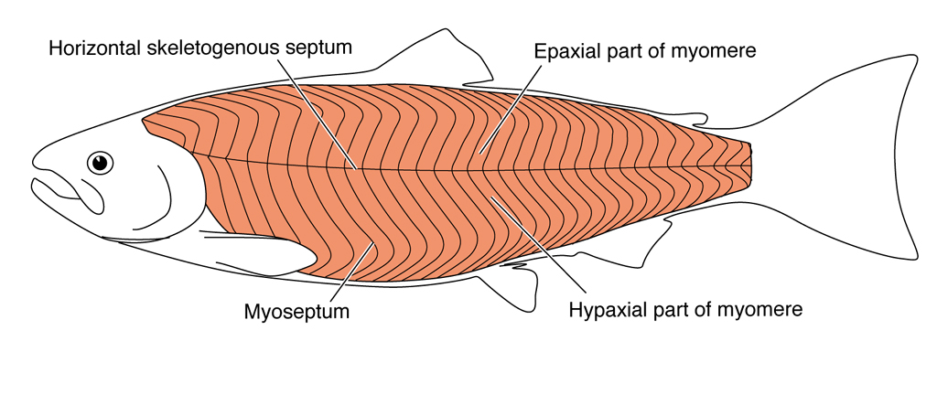
Fishes
The muscular system of living jawless fishes is simple and
primitive. It lacks a lateral septum. Jaw and appendicular
muscles are also lacking. In jawed fishes, there are strong axial
muscles divided into epaxial and hypaxial sections by a lateral
septum. Myotomes are angled much more so than in cyclostomes.

Slide 10
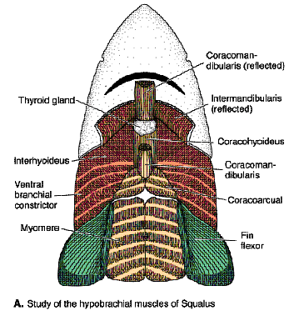
Fishes cont’d
Strap-like hypobranchial muscles
extend from gills to visceral arches
and serve to open jaws and pull
down gills.
Pelvic and pectoral girdles are
anchored to axial musculature
and skeleton.
Appendicular muscles (dorsal
abductor and ventral adductor)
evolve with the fins.

Slide 11
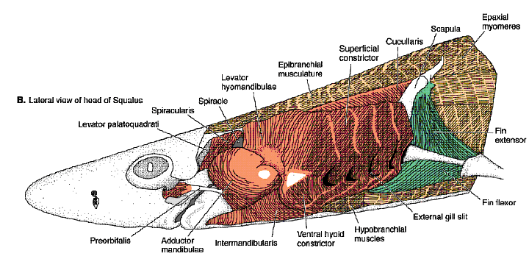
Fishes cont’d
Muscles of the first two visceral arches are, of course, specialized to serve jaws. The adductor of mandibular arch enlarges to form the adductor mandibulae. Ventral constrictors of the mandibular and hyoid arches form the intermandibularis and interhyoideus respectively. Levators mass over the gills as the cucullaris or its derivative, the trapezius.

Slide 12
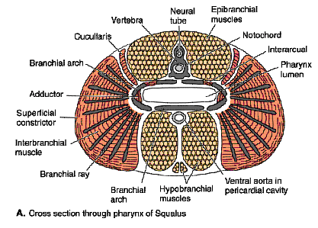
Fishes cont’d
Branchial muscles in fishes consist of superficial constrictors which compress the pharynx, levators which lift the gills from above, and adductors which collapse the gills by closing the angles between gill arches.

Slide 13
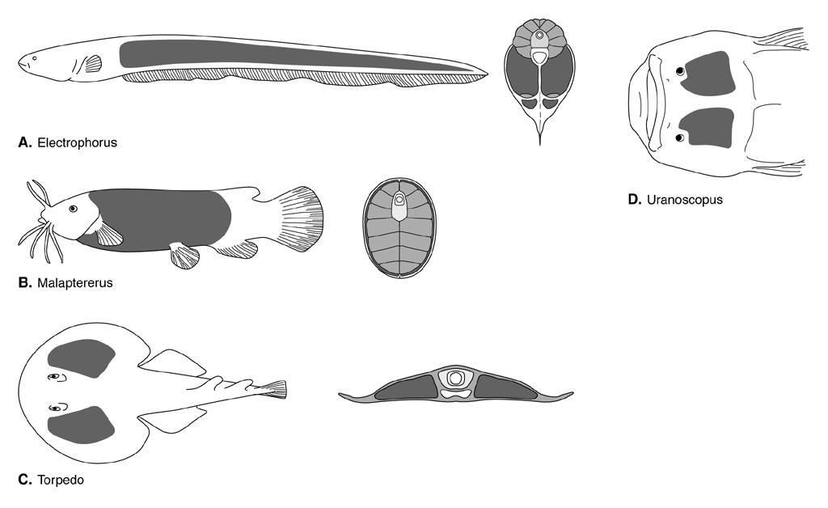
Electric organs
Electric organs are specialized muscles found in nearly 500 species
of fishes. May be on the head, tail, fins, behind eye, or covering much of trunk. Function in communication, orientation, prey detection and immobilization. Apparently evolved many times. Functional unit is electroplax; produce currents of up to 500 V, 50 A.

Slide 14
Tetrapods
Axial muscles that functioned for propulsion in fishes diminish
in tetrapods as limbs take over locomotory function.
Myosepta also regress and eventually disappear. Epaxial
muscles of amphibians posses myosepta, however, those of
reptiles and mammals lack myosepta and become layered in
the neck region.
The axial musculature of birds is reduced considerably.

Slide 15
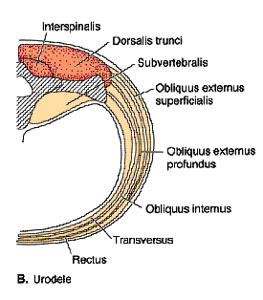
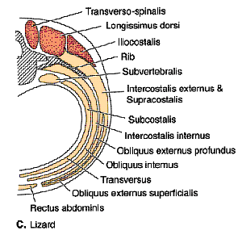
Tetrapods continued
Hypaxial muscles of tetrapods are
grouped into a subvertebral
group, the rectus abdominus, and
the three-layered lateral body
wall (internal and external obliques
and transversus) which produce
intercoastals between ribs anteriorly.
Muscles that suspend pectoral girdle
(serratus, levator scapulae,
rhomboideus) and diaphragm also
evolve from lateral hypaxial muscles.

Slide 16
Tetrapods continued
Muscles of the pectoral limb of tetrapods arise from three
general sources: appendicular muscles of fishes, branchial
muscles, and axial musculature. Muscles of the pelvic limb
are essentially all derived from appendicular muscles of fishes.

Slide 17
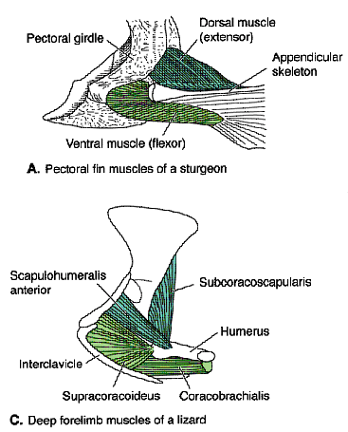
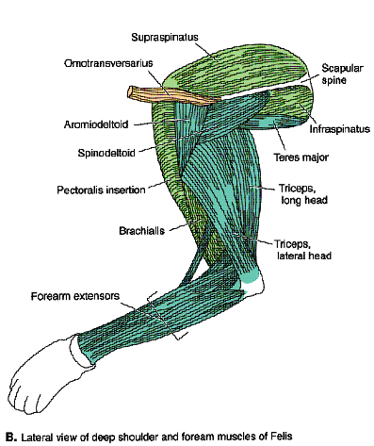
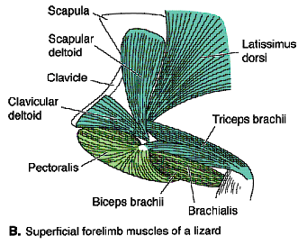
Pectoral muscles

Slide 18
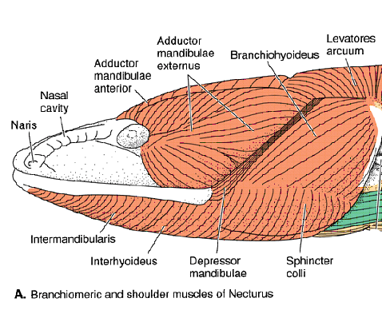
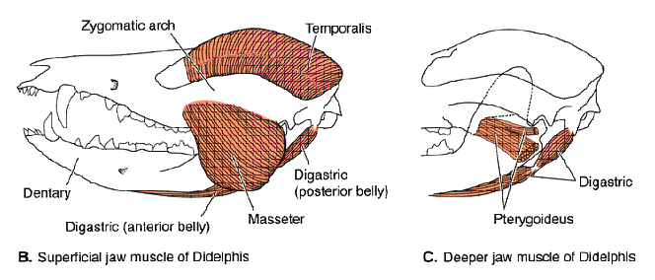
Fate of branchial muscles in tetrapods
Branchiomeric muscles undergo several modifications in tetrapods.
Adductor mandibulae complex of lower tetrapods differentiates
into muscles like masseter, temporalis, and pterygoids in
mammals. Depressor mandibulae of lower tetrapods is lost
and replaced by a new muscle, the digastric. Muscles of the
larynx and constrictors of the throat are also derived from
branchial muscles.

Slide 19
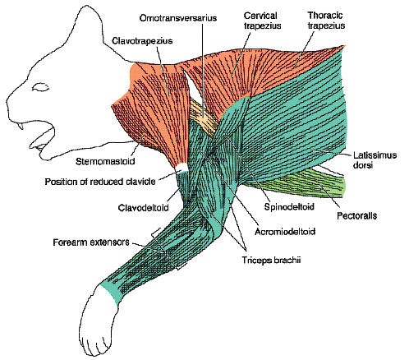
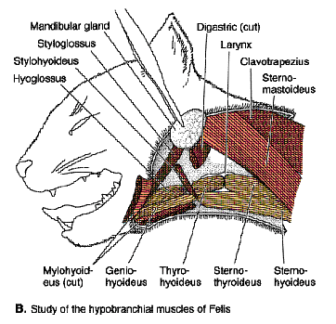
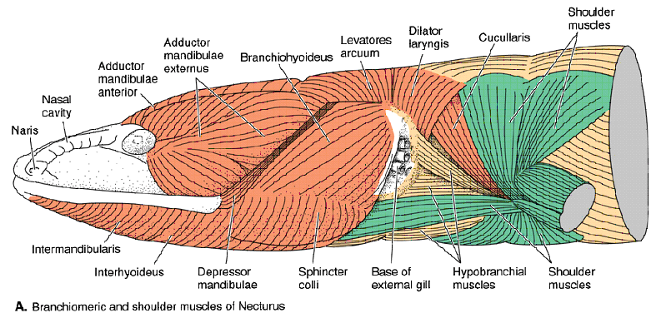
Fate of branchiomeric muscles
Orange = branchimeric; yellow = axial;green = appendicular.

Slide 20
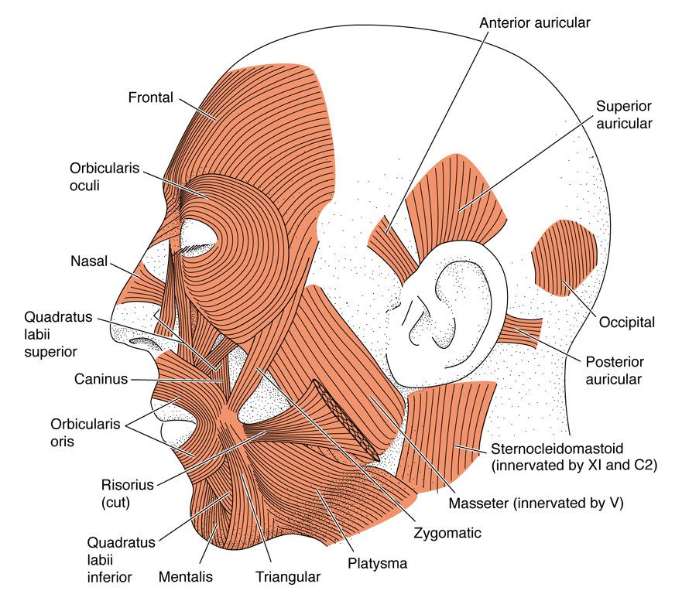
Skin muscles
Fishes and amphibians lack
extrinsic skin muscles,
which function to move the
skin. Extrinsic skin muscles
are rare in reptiles (snakes
have muscles that attach to
scutes and may aid in
locomotion) and
characteristic of mammals
and birds. A derivative of
the constrictor of the second
arch in mammals gives rise
to a complex of facial
muscles collectively known
as theplatysma.

