Slide 1
Nervous system
The vertebrate nervous system is an electronic network, which
receives stimuli from one or more receptors, processes the
information and transmits the body’s response to one or more
effectors. The effectors are both mechanical effectors such as
muscles, and chemical effectors such as glands.
The system consists of two integrated components: the central
nervous system (CNS), which includes the brain and spinal cord
(the processing center); and the peripheral nervous system
(PNS), which comprises all of the nervous tissue outside of the
CNS.
The nervous system comprises billions of interconnected cells.
There is still great mystery over many of the tasks the system
performs, such as thought, memory, and sensations of emotion.

Slide 2
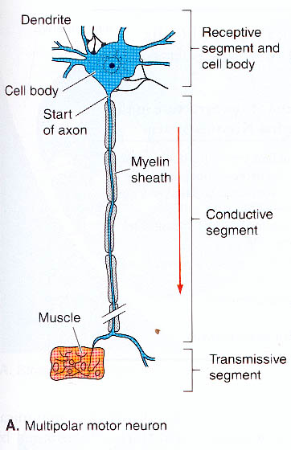
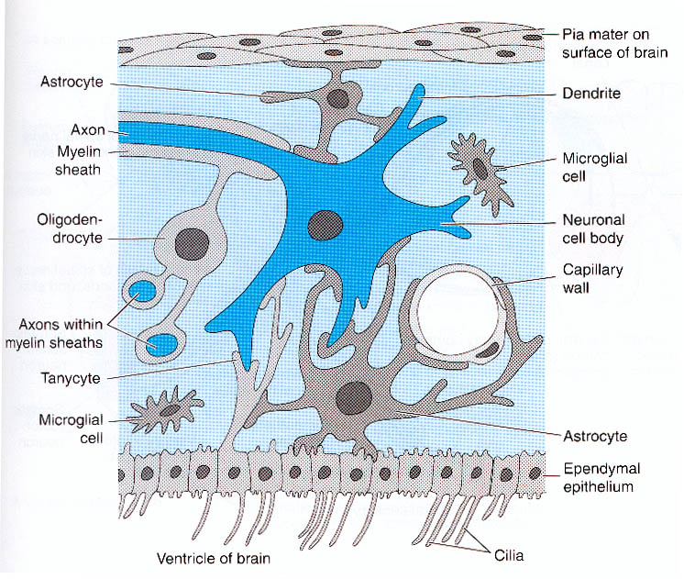
Nervous system cells
The nervous system consists of two basic types of cells:
neurons and neuroglia. Neurons are designed for
transmission of electrical stimuli. The neuron is the basic
structural and function unit of the nervous system, just as
the nephron was the functional unit of the kidney.

Slide 3
Neurons
A neuron consists of a central cell
body (perikaryon) and thin
cell processes called nerve fibers.
Nerve fibers are of two
types: axon (generally one per cell)
and dendrites (generally
one to many per cell). Dendrites
receive impulses coming into
the cell and transmit them short
distances to the cell body; axons
carry impulses away from the cell
body (generally longer distances).
Nerve cells may be uni-polar,
bipolar or multi-polar, depending
on how may fibers they have.

Slide 4
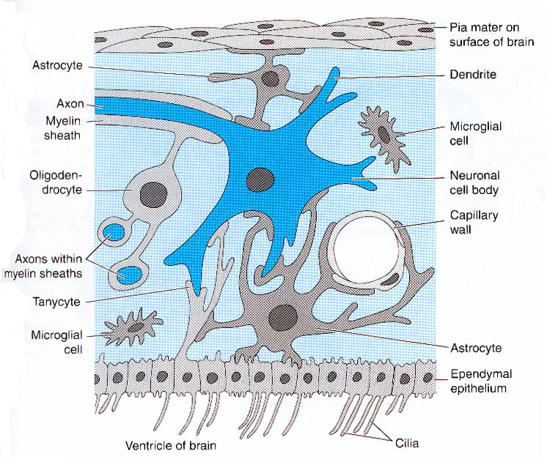
Neuroglia
Neuroglia are specialized cells
that do not transmit nervous
impulses, but rather nourish
and protect neurons.
Astrocytes are specialized
neuroglia that pass nutrients
from blood capillaries to
neurons; microglia protect
neurons by engulfing foreign
particles and bacteria.
Ependymal cells line the
central canal of the brain
and spinal cord, forming a
protective inner sheath.

Slide 5
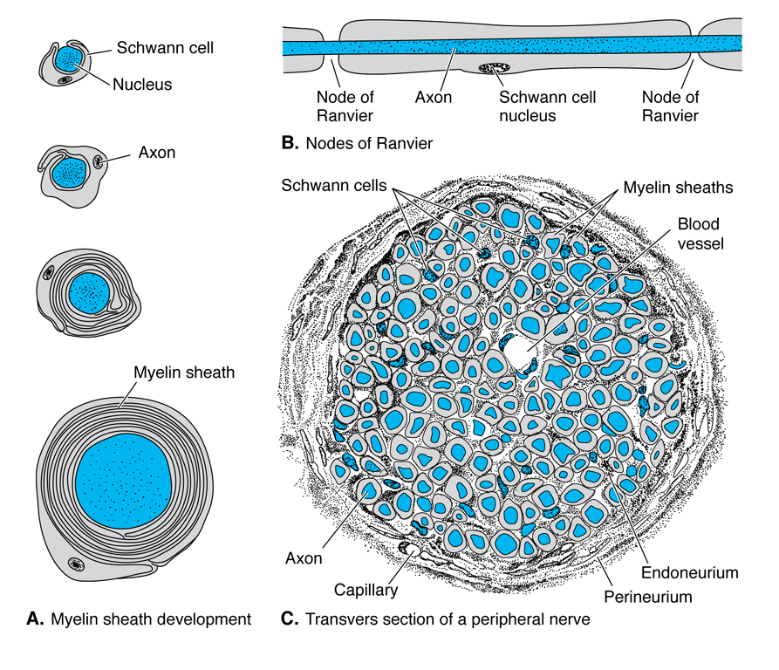
Neuroglia continued
Other types of neuroglia, called schwann cells and oligodenroglia
insulate neurons to prevent short circuiting. The insulating
material of a nerve cell is called myelin.

Slide 6
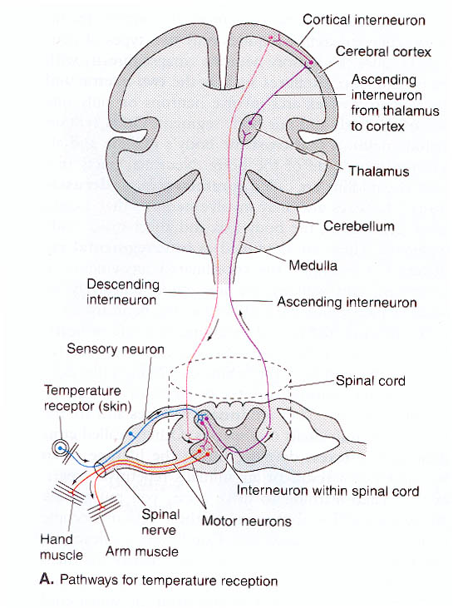
Nerves
Nerves are collections of neurons and
their supporting neuroglia. Nerves
and their components take different
names depending on whether they
serve the CNS or the PNS. For
example, a collection of axons
coming from the PNS is called
a nerve; but a collection of axons
in the CNS is called a tract; a
collection of nerve cell bodies
is called a ganglion in the PNS,
but a nucleus in the CNS.

Slide 7
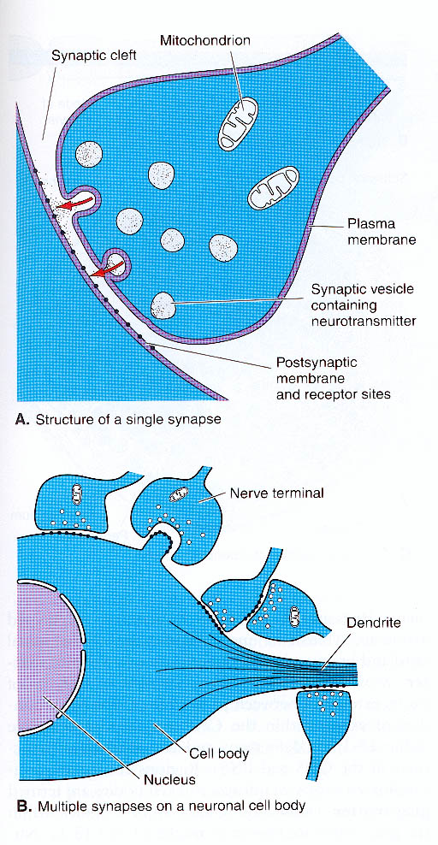
Impulses and synapses
Information travelling through the
nervous system is transmitted
in the form of electrical and
chemical signals. The electrical
signals only travel within the neurons
and are called nerve impulses.
Chemical signals are generated in
the gaps (synapses) between neurons.
Chemical signals involve substances
called neurotransmitters, which are
released at the axonal end of a
neuron and travel across to the
dendritic or nerve cell body
part of an adjacent neuron.

Slide 8
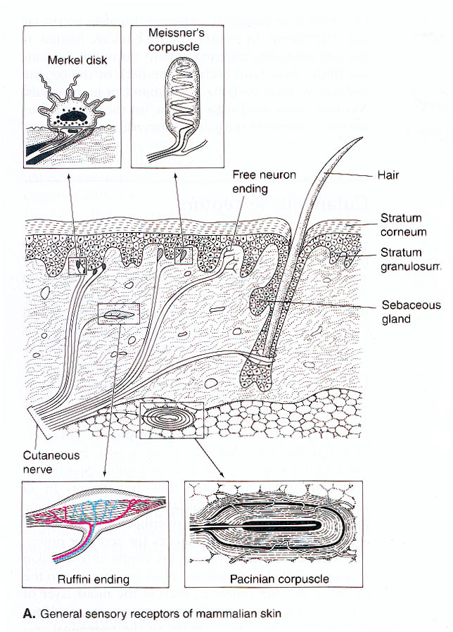
Sensory receptors
Sensory receptors that gather
information from inside the body
are called interoceptors.
Examples include body
temperature and pH receptors
and proprioreceptors, which
assess the degree of bending
of joints and extension of limbs.
Sensory receptors that gather
information on conditions outside
the body are called exteroceptors.
These include organs of sight,
smell, taste, touch, and surface
temperature.

Slide 9
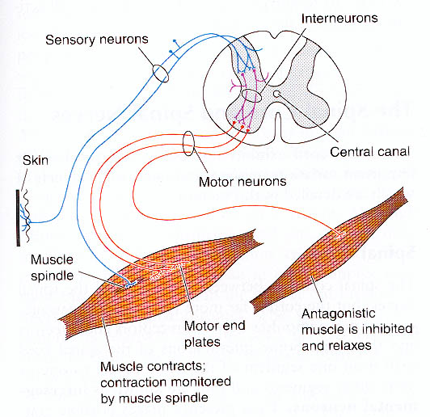
Centralized control
The CNS is the central
processing system of the
vertebrate nervous system.
It receives information from
sensory receptors located
both inside and outside the
body. The CNS’s response
system is a separate system of
neurons running from the CNS
to various effector organs or
tissues. Because many of these
tissues are muscles, the system
is referred to as a motor system.

Slide 10
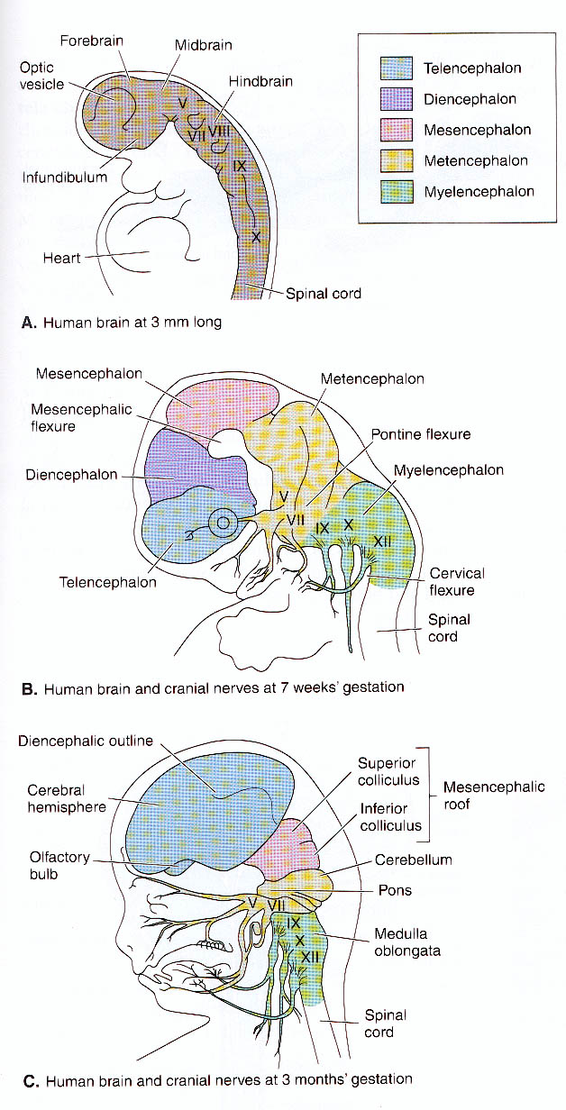
Brain
The early brain consists of three
compartments: anterior prosencephalon
or forebrain, medial mesencephalon or
midbrain, and posterior rhombencephalon
or hindbrain. Forebrain ultimately
encompasses the cerebrum (telencephalon),
the thalamus (diencephalon),
hypothalamus and pituitary gland.
The midbrain encompasses the sensory
tectum and motor tegmentum. The
hindbrain encompasses the cerebellum
and related pons (metenchephalon) and
medulla oblongata (mylencephalon).

Slide 11
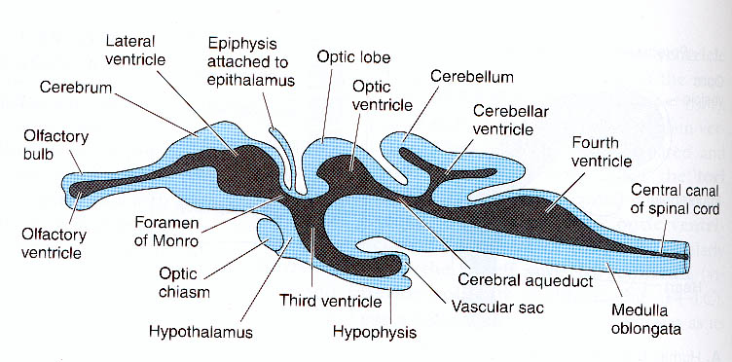
CNS
cavities
The vertebrate CNS is hollow, the result of fusion of embryonic
neural folds during the neurula stage. The central canal develops
cavities called ventricles in the vicinity of the brain, but remains a
simple canal through the spinal cord. The ventricles and central
canal of the spinal cord are filled with a slightly viscous
cerebrospinal fluid that flows out of the blood at tufts of blood
vessels (choroid plexes) projecting into the ventricles and surrounds
the brain. The fluid is the same as lymph fluid and serves to cushion
the brain against shock.

Slide 12
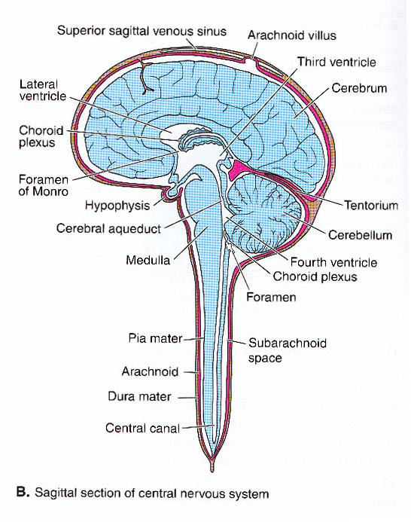
Meniges
The brain and spinal cord are wrapped
in connective tissue layers called
meninges. Mammals have three
meninges: a tough outer dura mater;
an intermediate web-like layer called
arachnoid; and an innermost pia
mater. The pia mater contains blood
vessels that nourish the underlying
nervous tissue. Fishes have one
meninx around the brain; amphibians,
reptiles and birds have two. The
second meninx is believed to have
evolved to better contain cerebrospinal fluid,
and thereby protect the brain from concussions
in the less supportive terrestrial environment.

Slide 13
Spinal Cord
The vertebrate spinal cord, like the
brain, has two distinct regions. The
core of the spinal cord is a darker
gray matter containing nerve cell
bodies, with distinct dorsal and
ventral horns containing cell bodies
of sensory and motor neurons,
respectively. Surrounding the gray
matter is a lighter white matter
composed primarily of nerve fibers
(bundles of axons) that form tracts
linking the various parts of the
spinal cord to each other and to
the brain.

Slide 14
Spinal Cord
The spinal cord controls various
reflexes of the body without
necessarily involving higher
centers in the brain. At the
same time that motor nerves
cause reaction (e.g., flexion
to lift a limb) on one side
of the body to avoid danger, it
communicates to motor neurons
on the other side of the body
to perform a compensating action
(extension of a limb to support
the body).

Slide 15
Nuclei and tracts of the Brain
Nerve cell bodies, which are found
primarily in the interior gray columns
of the spinal cord, mass in the outer
cortex of the brain or within
discontinuous clusters called nuclei
within the brain. Neuronal fibers
(white matter), which occur primarily
on the outer border of the spinal cord,
occur in the core of the brain forming
whitish arbor vitae. Tracts called
commissures connect corresponding
sides of the brain and permit
integration of sensations and
learning from the two sides of the
body.

Slide 16
Brain
The early brain consists of three
compartments: anterior prosencephalon
or forebrain, medial mesencephalon or
midbrain, and posterior rhombencephalon
or hindbrain. Forebrain ultimately
encompasses the cerebrum (telencephalon),
the thalamus (diencephalon),
hypothalamus and pituitary gland.
The midbrain encompasses the sensory
tectum and motor tegmentum. The
hindbrain encompasses the cerebellum
and related pons (metenchephalon) and
medulla oblongata (mylencephalon).

Slide 17
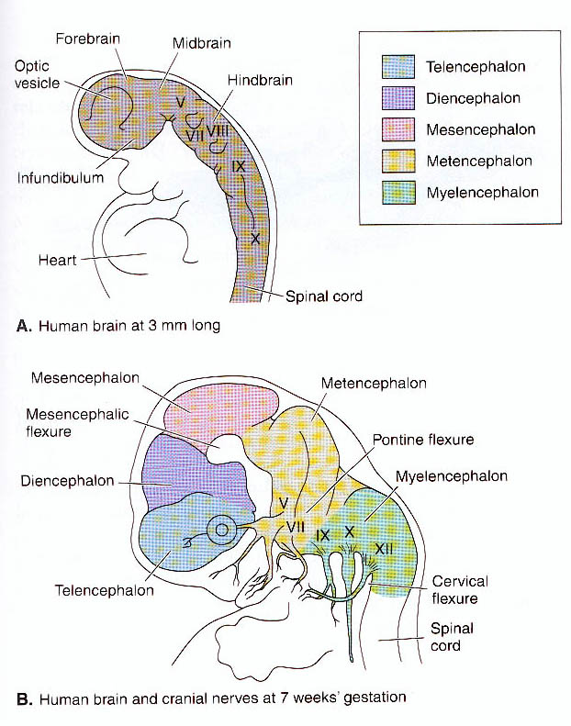
Brainstem
Brainstem forms the ventral,
central axis of the brain. It is
the least variable and the first
region to form embryologically.
It receives all cranial nerves
except the olfactory. It comprises
part of metencephalon, and all
of the diencephalon,
mesencephalon and
myelencephalon.

Slide 18
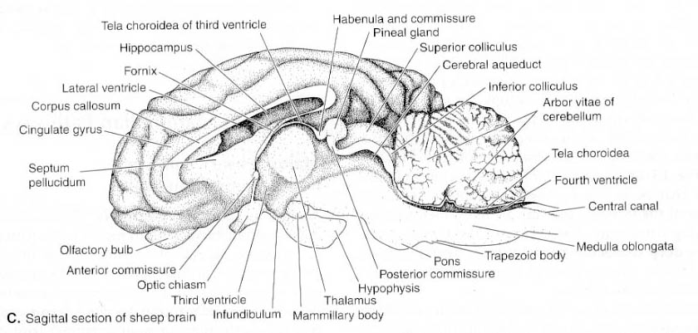
Roof of the posterior brainstem (fourth ventricle) is covered
by a highly vascularized membrane called posterior choroid
plexus. Roof of anterior brainstem (diencephalon) consist of
narrow, non-nervous shelf called epithalamus, and more anterior
choroid plexus of the third ventricle. Posterior to the epithalamus
is the habenular nuclei, which coordinates olfactory reflexes.
The posterior commissure marks the posterior boundary of the
epithalamus.

Slide 19
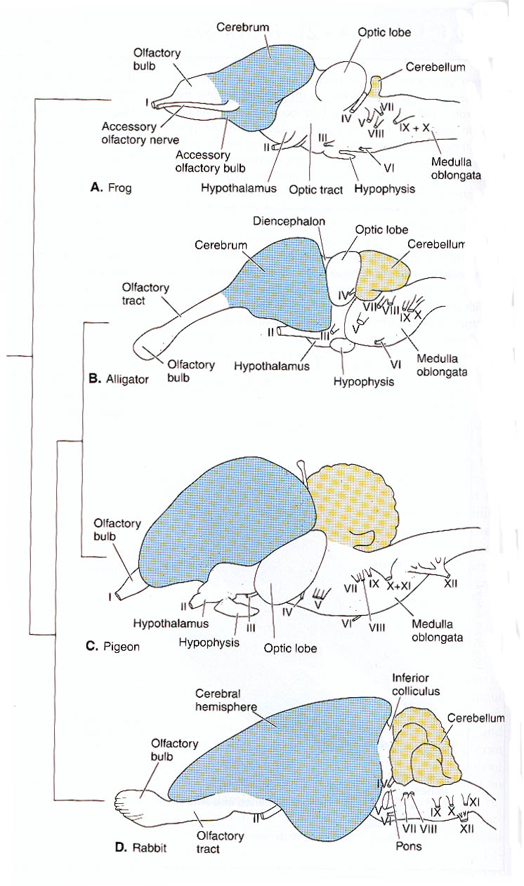
Midbrain
The cerebellum and related
pons are the principal adult
derivatives of the metencephalon.
Cerebellum is a conspicuous
appendage of the brainstem in
amniotes and some fishes,
covering much of its dorsal
surface. Pons forms by ventral
migration of cells from the
cerebellum. Becomes a secondary
monitoring and relay center of the
cerebellum.

Slide 20
Midbrain
Roof of the midbrain is called tectum
(covering). In all vertebrates except
mammals it consists of a prominent
pair of hemispherical eminences
called optic lobes. The optic lobes
are conspicuous in vertebrates that
use vision to locate food. In mammals,
visual perception is largely transferred
to the cerebrum. Optic lobes are reduced
and take the name anterior colliculi.
These together with the posterior colliculi
(possibly involved in auditory reflex
coordination) form the
corporaquadrigemma

Slide 21
Forebrain
Lateral walls of diencephalon are the thalamuses. They are
bordered by (outer) lateral ventricles and (inner) third
ventricles. In the middles of the third ventricle the
thalamuses form a large commissure called the intermediate
mass.

Slide 22
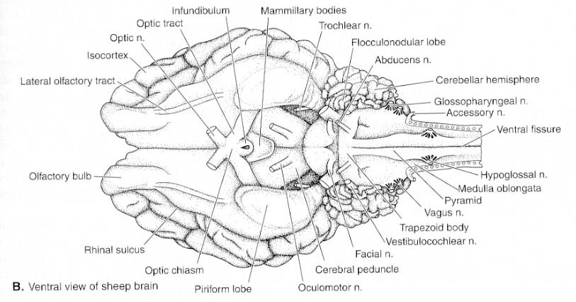
Forebrain
Ventral part of the diencephalon is the hypothalamus.
Consists of about a dozen nuclei which together coordinate
most autonomic (reflex) function. On the ventral surface
of the hypothalamus is the optic chiasma where optic nerves
converge and cross. Posterior to the optic chiasma is an area
enclosing several nuclei of parasympathetic system called
tuber cinerium.

Slide 23
Forebrain continued
Tuber cinerium subtends a special gland called the pituitary
gland or the hypophysis. Hypophysis has two parts (anterior
and posterior) only one of which (anterior) is derived from the
brain. Primary function is endocrine. Posterior to (beneath)
the hypophysis are two small nuclei bearing bodies called
mammillary bodies which are also involved in olfactory
coordination.

Slide 24
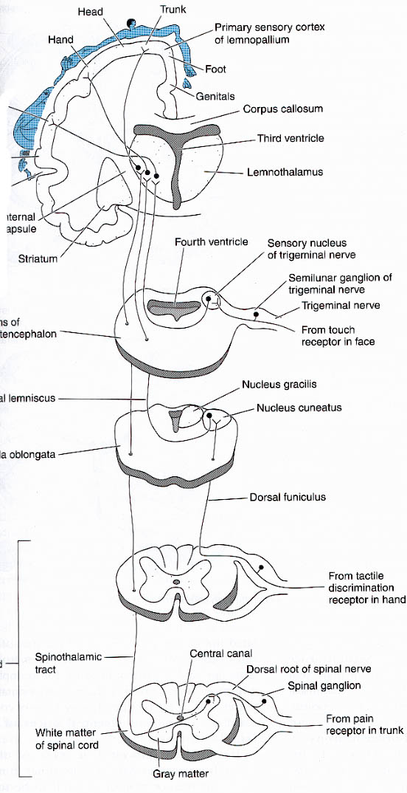
Cerebrum
The cerebrum is the adult derivative
of the telencephalon. Gradually
enlarged and added new functions
evolutionarily in vertebrates. Consists
of anterior frontal, posterior parietal,
and vertrolateral temporal lobes,
which coordinate sensory, motor and
association functions, respectively.
Therian mammals have a large
commissure called the corpora
callosum joining right and left
hemispheres of the cerebrum. The
fornix is another commissure ventral
to the corpora callosum.

Slide 25
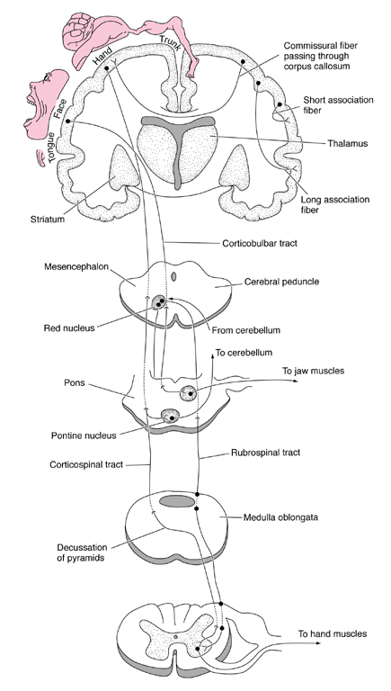
Fig. 14.20

Slide 26
