Slide 1
Postcranial skeleton
Postcranial skeleton consists of the vertebral column, other
axial elements such as ribs and sternebrae, the appendicular
skeleton, and miscellaneous skeletal elements.
We will first discuss the vertebral column and other axial
components.
The appendicular skeleton will be discussed in a separate
lecture.

Slide 2
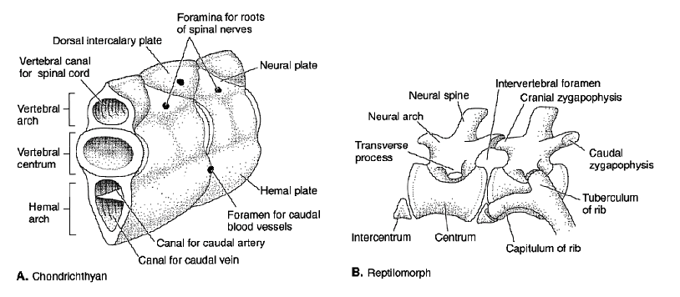
Vertebrae
Characteristic feature of vertebrates is the presence of a vertebral
column consisting of a series of separate vertebrae. Each vertebra
consists of a centrum with one or more accessory elements.
In fishes, centrum is solid mass of cartilage or bone. In tetrapods,
centrum composed of an anterior intercentrum and posterior
pleurocentrum.

Slide 3
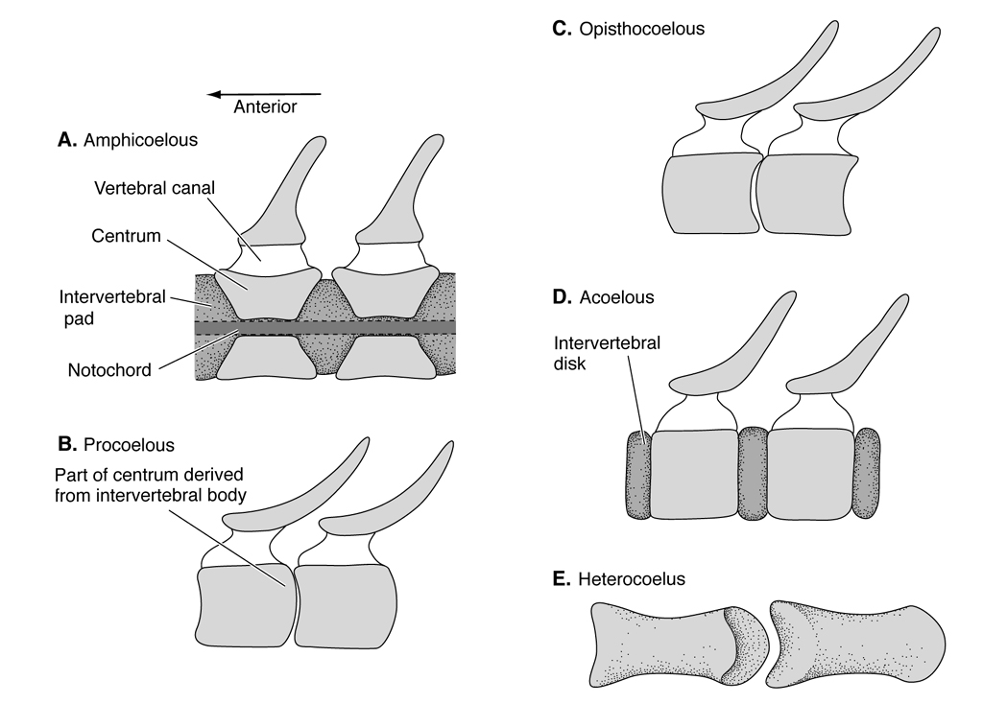
Vertebrae continued
Vertebral centra are
typically concave
on both ends
(amphicoelus), but
some are concave
anteriorly and convex
posteriorly (procoelus).
Others are convex
anteriorly and concave
posteriorly (opisthocoelus).
Some centra are flat on both
ends (acoelus or platyan). Some
are saddle shaped (heterocoelus).
Flat centra withstand compression. Saddle-shaped vertebrae provide
vertical and lateral flexion but not rotation about the vertebral axis.

Slide 4
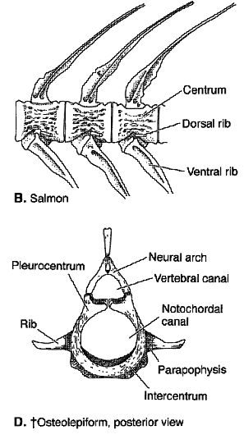
Vertebral processes
All vertebrae have a dorsal
neural spine with an archway,
the neural arch, for passage
of the spinal cord. Vertebrae
adjacent to the body cavity
have ribs to protect the
internal organs. In fishes,
they are called trunk
or precaudal vertebrae.

Slide 5
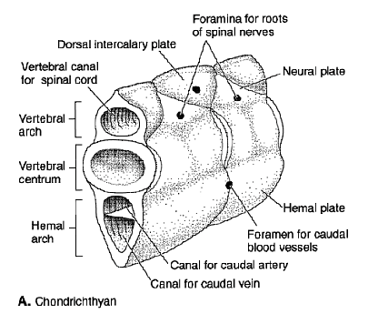
Vertebral processes
Vertebrae behind the trunk are called caudal vertebrae; have
ventrally projecting hemal spines with hemal arches for passage
of blood vessels.

Slide 6
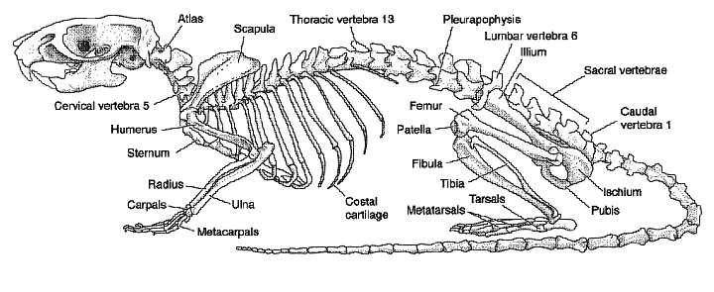
Vertebral processes
Tetrapods tend to have distinct neck (cervical), lower back
(lumbar) and pelvic (sacral) vertebrae.

Slide 7
Vertebral processes continued
In fishes, vertebrae fit together end
to end, with no overlap. Vertebrae
of tetrapods have anteriorly and
posteriorly projecting processes
called zygopophyses (anterior =
prezygopophyses; posterior
= postzygopophyses), which
overlap to stiffen the spine. Other
processes project laterally to serve
as sites for muscle attachment.
Most prominent of these are the
transverse processes found mainly
in the lumbar region.

Slide 8
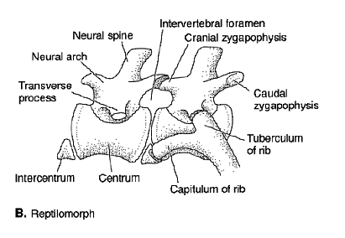
Ribs
Ribs (pleurae) attach to
lateral processes or vertebral
centra themselves. Head of
rib is capitulum. More
posterior point of attachment
is tuberculum, which
articulates with lateral
process called diapophysis.
Ribs may be attached to the
breastbone (true ribs), attached to other ribs (false ribs) or free
(floating ribs).

Slide 9
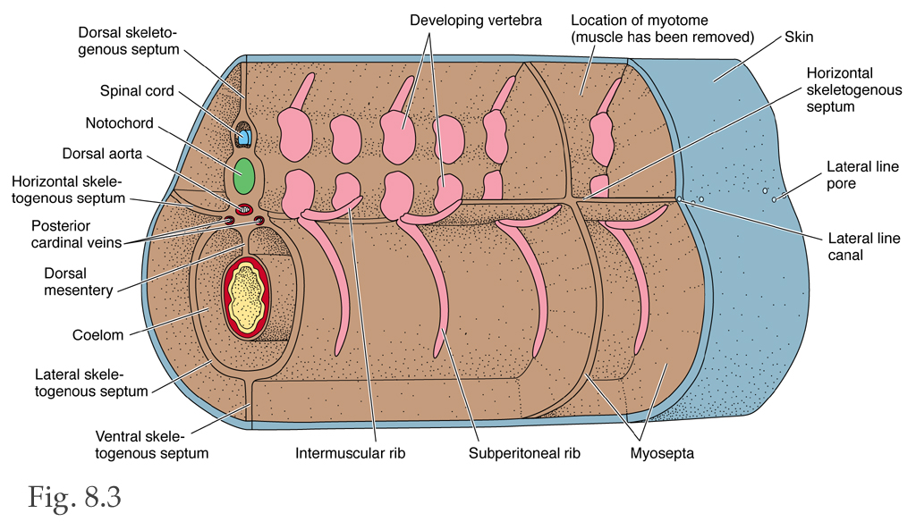
Rib development
Ribs develop within connective tissue that forms
horizontal septum (dorsal ribs), and the lining of body cavity
(ventral ribs).

Slide 10
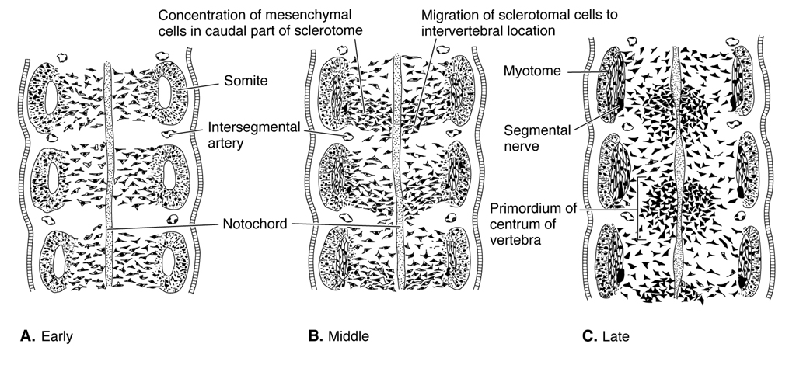
Vertebrae development
Vertebral centra are derived from mesenchyme of the segmental
sclerotome. Oddly, each centrum is formed of the back half of
one sclerotome and the front half of the next one in series.

Slide 11
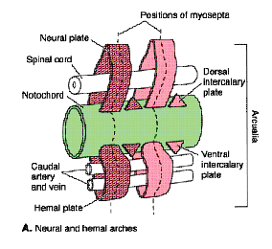
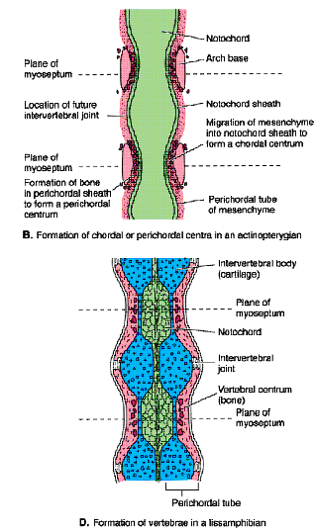
Vertebrae development cont’d
The neural arch is the first vertebral
element to develop (phylogenetically
and ontogenetically). Its formation
is important for protecting the nerve
cord. As centra develop, they first
restrict, then replace the notochord.

Slide 12
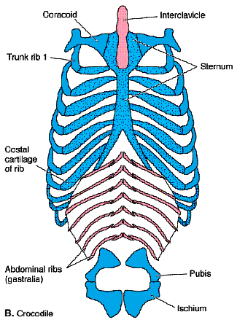
Ventral axial elements
Breastbone (sternum) composed of
series of endochondral bones
(sternebrae) that develop from
connective tissue of the ventral body
wall. Seen only in tetrapods. Ribs
connect to the sternum, forming rib
cage that functions to protect lungs.
Sternum links with coracoid elements
of pectoral girdle anteriorly. Anterior
most sternebra called the manubrium;
posterior-most the xiphisternum.
Gastralia are ventral ribs in abdominal
region of body. Seen in amphibians
and reptiles; may be homologous to
ventral abdominal bones of some fishes.

Slide 13
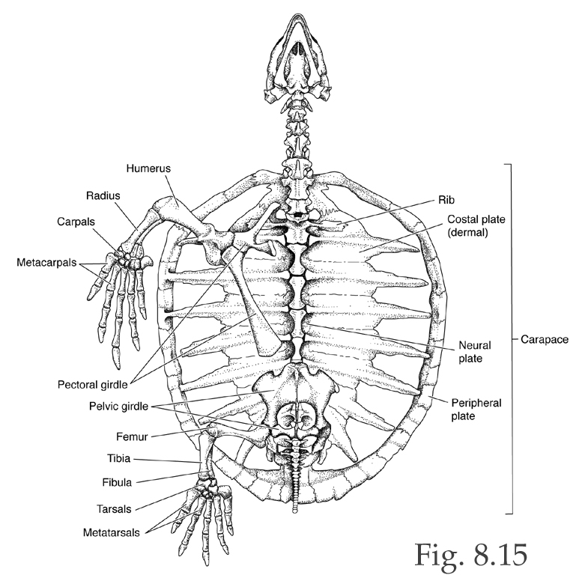
Turtle shell
The shell of a turtle is a
peculiar axial skeletal
structure consisting of a
dorsal carapace composed
of plates of dermal bone
fused with ribs and
vertebral elements, a ventral
plastron composed of fused
pectoral, sternal and gastral
bones, and a covering of
epidermal scutes.

Slide 14
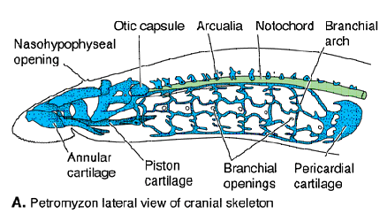
Jawless fishes
In jawless fishes, only precursors of vertebrate are cartilagenous
neural arch elements that rest on top of the notochord.

Slide 15
Early gnathostomes
Placoderms, acanthodians and
early sharks show little evidence
of constriction of the notochord
or development of vertebral
centra. In more modern sharks
the notochord is constricted
into a series of beads by prominent
calcified centra with cartilagenous
neural, hemal, and pleural elements.

Slide 16
Bony fishes
In chondrosteans (primitive
bony fishes), notochord is
likewise unrestricted, but neural,
hemal and pleural elements are
much more prominent than
in sharks. Neopterygians have
prominent ossified vertebral
centra that fit together end to
end but do not overlap. This
morphology is adapted to
withstand compression
in swimming.

Slide 17
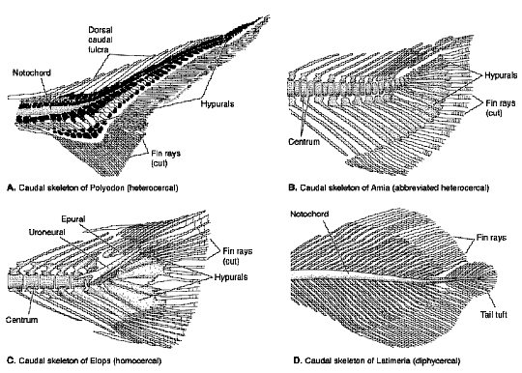
Fishes tails
Tail fin in fishes supported
by ventral elements of caudal
skeleton, a condition that
stems from fact that tails of
rayfin fishes are descended
from heterocercal tails of
chondrosteans. Epichordal
lobe of the heterocercal tail
becomes reduced over the
course of rayfin evolution,
creating a tail that is
symmetrical (homocercal)
in external appearance. Some rayfin fishes and many sarcopterygians
(including surviving forms) have symmetrical, diphycercal tails.

Slide 18
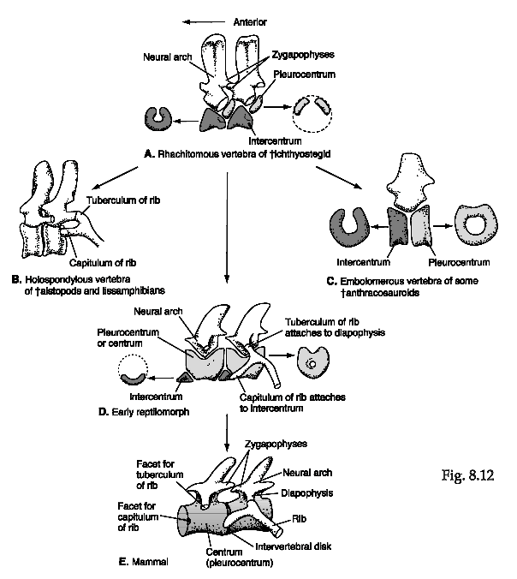
Centrum evolution in tetrapods
Tetrapod vertebrae show an
interesting pattern of evolution,
in which pleurocentra and
intercentra alternate in forming
the main body of the centrum
and the various vertebral
elements are alternately separate
or fused. Tetrapods were
classified this way (some groups
still are, e.g., Lepospondyli)
until it was recognized that
vertebral morphology is sensitive
to lifestyle (terrestrial vs. aquatic), and sometimes changed
(or didn't) as early tetrapods moved back and forth from
terrestrial to aquatic habitats.

Slide 19
Vertebral specialization
Important difference in vertebrae of fishes and tetrapods is
regional specialization. In tetrapods, vertebrae have different
appearances depending on how they function in the vertebral
column. Differences mainly relate to vertebral processes, which
serve as points of rib, muscle, and ligamentary attachment, and
are very important for suspending the spine.

Slide 20
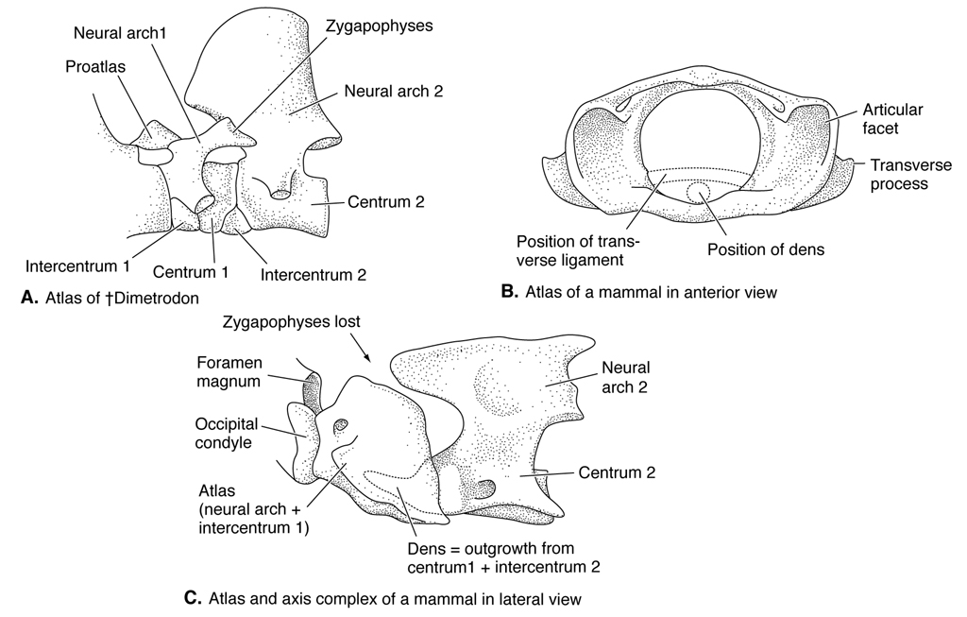
Atlas and Axis
Tetrapods have
head separated
from the body
by a neck that
permits side to-
side and rotational
movements of the
head. Head
attached to skull by
ball-and-socket
connection
produced by occipital condyle of the skull and specialized cervical
verteba called the atlas. Another specialized cervical vertebra – axis
– articulates with the atlas to allow rotation of the head.

