Slide 1
Origin of the Vertebrates
Vertebrates are chordates (Phylum Chordata)…
Notochord
Dorsal hollow nerve cord
Pharyngeal gill slits
Post-anal tail
Vertebrates are deuterostomes...
Mouth forms from second embryonic opening
cleavage pattern is radial
mesoderm forms by enterocoely

Slide 2
Vertebrates are classified in subphylum Vertebrata
Show cephalization (i.e., have
head with sensory structures such
as eyes, ears, olfactory organs),
Solid liver
Hepatic portal circulation
Pancreas and spleen
Unsegmented urogenital system.
All vertebrates don’t have vertebrae
Better classified as Subphylum Craniata

Slide 3
Phylum Chordata includes two
"invertebrate" subphyla:
Subphylum Urochordata
“Tunicates”
Subphylum Cephalochordata “Lancelets”

Slide 4
Urochordates
Nonmotile filter-feeding
organisms
Adults show no evidence of
cephalization;
Simple sack-within-a-sack
morphology.
Water enters the gut through
siphon; filtered through
pharyngeal slits.
Food particles trapped
by sticky mucus lining slits.
Water leaving pharynx enters
outer atrium; channeled out
of body through excurrent siphon.

Slide 5
So why are Urochordates considered chordates?
Chordata characteristics (notochord, dorsal-hollow nerve
tube, post-anal tail, ventral heart, segmented body plan)
seen only in the larval stage, which is free-swimming.

Slide 6
Free swimming tunicate larva
Morphology of the tunicate larva is consistent with the
earliest vertebrates.
Retention of larval characteristics of an ancestor in the adult
stage of a descendant is a well known evolutionary
phenomenon known as paedomorphosis.

Slide 7
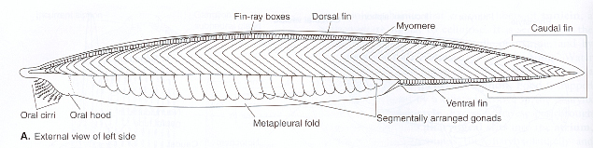
Cephalochordates
Sedentary filter-feeding organisms found in shallow
coastal areas.
Only two living genera, but known from fossils dating to 530
million years ago.
Morphology appears to be well suited for active
swimming (body stream-lined and muscular).
Fins circle the midline of the body; divide ventrally into
lateral folds

Slide 8
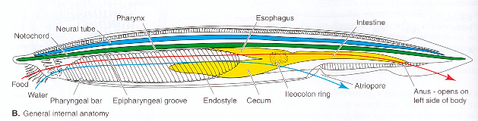
Cephalochordates (cont’d)
Persistent notochord that runs the entire length of the body.
“Skeletal elements” in the fins, pharynx and oral hood.
Pharynx perforated by numerous slits. Water passing
through slits, enters atrial cavity, exits the body through
separate atrial pore.
Closed circulatory system which lacks a heart.
Gonads and excretory organs are numerous, segmental
and asymmetrical.

Slide 9
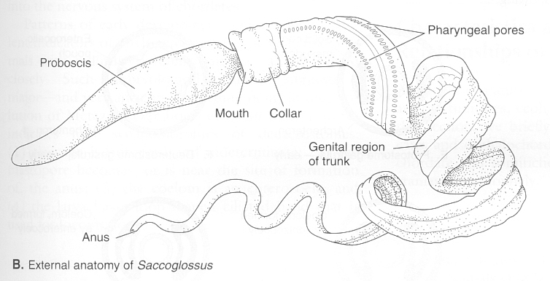
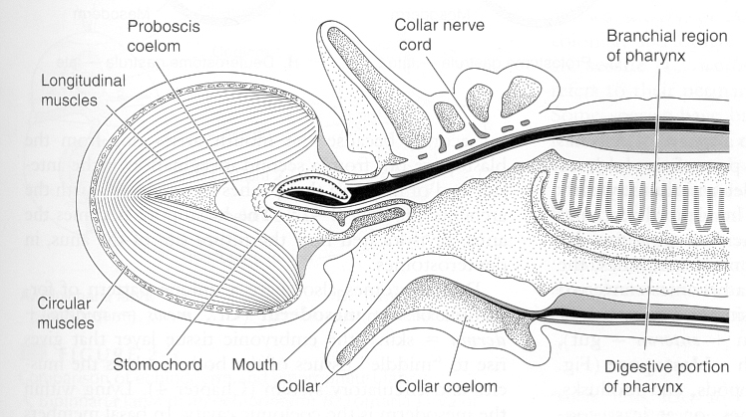
Where did chordates come from?
Among invertebrate phyla, chordates are most similar
to acorn worms of Class Enteropneusta
(Phylum Hemichordata).
Acorn worms are sedentary filter feeders with a
muscular proboscis supported internally by a structure
similar to the notochord, called a stomochord.
They have a dorsal nerve cord that is a least
partially hollow, and they have "pharyngeal" gill slits.

Slide 10
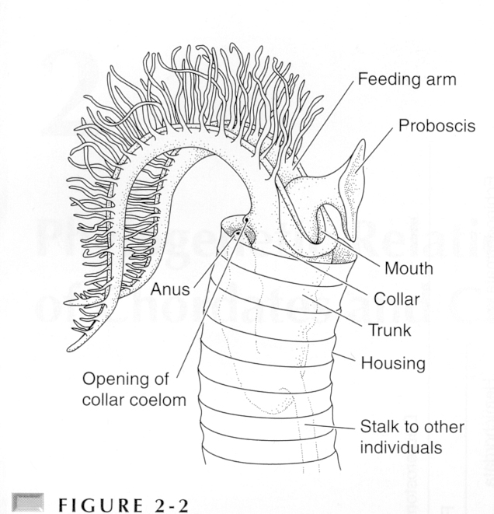
Class Pterobranchia
Class Pterobranchia, a second class in Phylum Hemichordata,
bears no resemblance to chordates, but is clearly related to
enteropneusts (snout-like proboscis anterior to mouth and
collar region behind).
However, pterobranchs lack pharyngeal slits and the pharyngeal
mode of filter-feeding. Instead, they use a tentacle-bearing
structure called a lophophore to trap food and carry it to the
mouth.

Slide 11
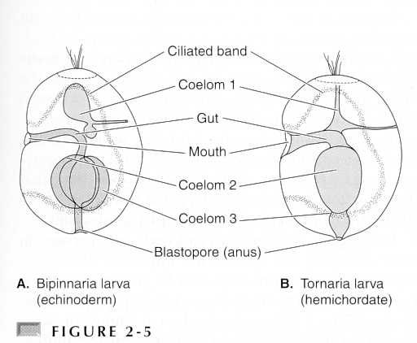
Pterobranchs (cont’d)
Possession of lophophore in pterobranchs links hemichordates
to echinoderms (crinoids). A similar linkage is suggested by the
morphology of larva of acorn worms, which closely resembles
that of echinoderms.

Slide 12
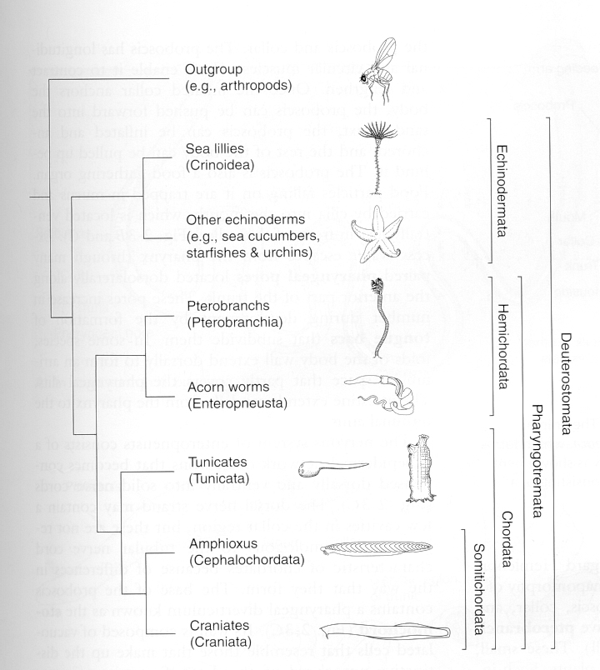
So where did vertebrates come from? (whole story)
Primitive, sessile arm
feeder gave rise to
primitive echinoderms
and pterobranchs.
Pterobranchs shifted
from arm feeding to
gill feeding (tunicates).
Ancestral tunicate
matured in larval form,
gave rise to lancelets
and vertebrates.

