Slide 1
Reproductive system
The reproductive system functions to produce and deliver sex
cells (eggs and sperm) and to provide for the nourishment and
early development of the embryo.
Sex cells are produced in organs called gonads. Gonads in males
are referred to as testes; gonads in females are called ovaries.
The reproductive system is closely intertwined with the urinary
system and shares many structures (in fact the two systems are
often discussed as a unit - urogenital system)

Slide 2
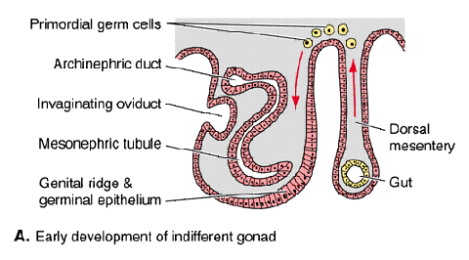
Early development
Primordia of sex organs (gonads) come from two diverse
sources: mesomere and primitive streak. First, genital ridges
appear on mesial surfaces of opisthonephroi or mesonephroi.
Lining of coelom thickens where it is reflected over the genital
ridges, and becomes embryonic germinal epithelium. Primitive
streak contributes primitive sex cells, which migrate individually
from splanchnic mesoderm of the gut, up body stalk and
mesenteries, and laterally into the genital ridges.

Slide 3
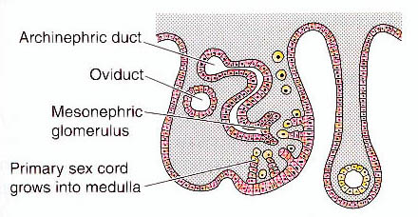
Development continued
Connective tissue forms at the center of the developing gonad,
called blastema. Germinal epithelium sends out cords of another
type of connective tissue called primary sex cords which penetrate
into the blastema. Primitive sex cells then distribute throughout
the germinal epithelium and sex cords…

Slide 4
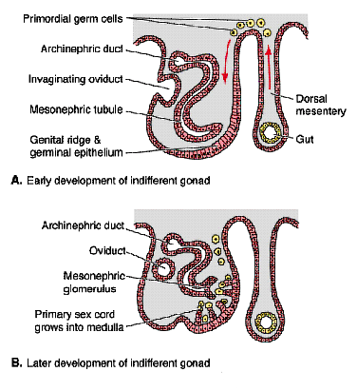
Development continued
Development in the two sexes
is identical to this point,
called indifferent stage.
Outer portion of the early
gonad is called cortex; inner
portion is medulla.
By end of indifferent stage
cortex and medulla are in
physiological competition
with outcome directed by
genetic sex…

Slide 5
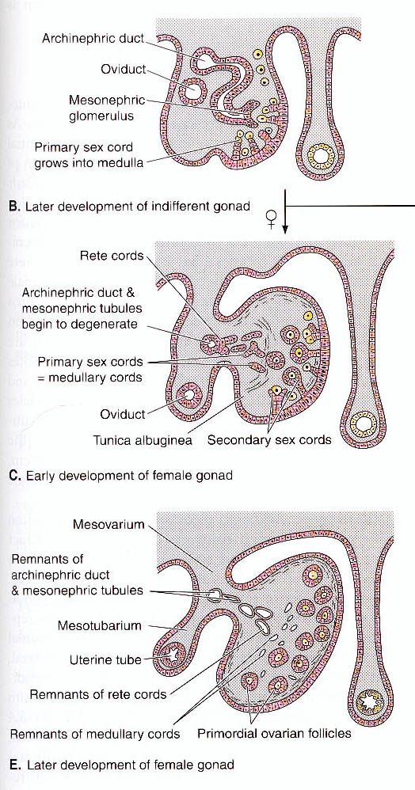
Development continued
Dominance of cortex in
subsequent development
produces a female;…

Slide 6
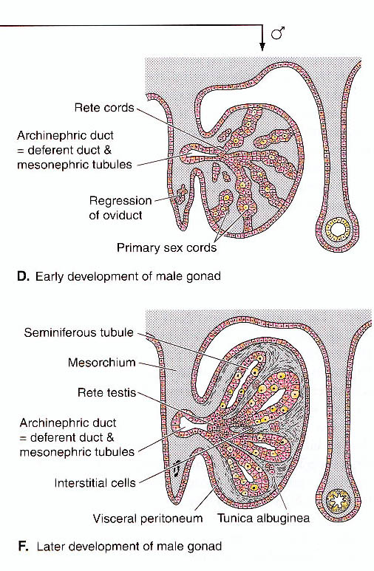
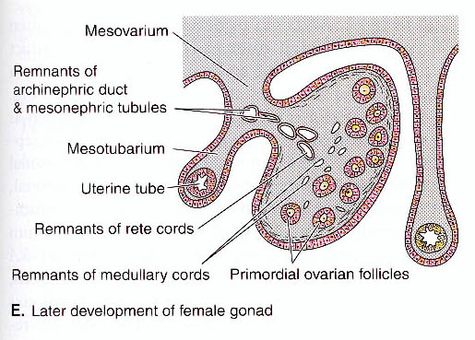
Development continued
...dominance of medulla
produces a male.
Front and back portions of
genital ridges form fat bodies
and mesenteries that support
the gonads: called mesorchia
in males and mesovaria in
females.

Slide 7
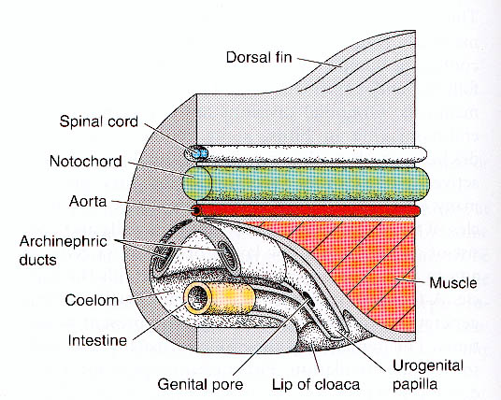
Genital ducts general
Genital ducts develop from urinary ducts. Cyclostomes are
unique in having nephric ducts, but no genital ducts. Gametes
enter the coelom and exit into the cloaca via a pair of genital
pores. Abdominal pores of sharks and other fishes may be
nonfunctional homologs.

Slide 8
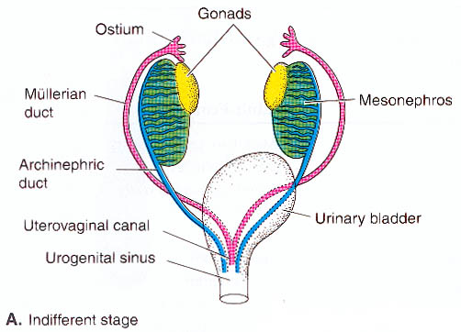
Genital ducts general cont’d
Gnathostomes have two pairs of urogenital ducts that are
similar in the two sexes until the end of the indifferent stage.
One pair is the nephric ducts associated with the anterior and
middle kidneys. The other pair is referred to as
paramesonephric ducts. They are of varied and uncertain
origin.

Slide 9
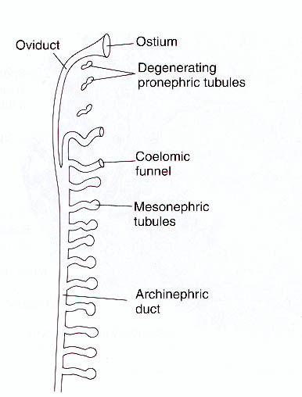
Genital ducts general cont’d
In sharks and urodeles,
paramesonephric ducts form
by lengthwise splitting of
nephric ducts. In other
vertebrates, they develop
from concavities that extend
back to the cloacal area. Other
structures that contribute to
the formation of urogenital
ducts of adults are the ureter
(amniotes), accessory ducts
(anamniotes), and parietal
peritoneum (teleosts).

Slide 10
Vertebrate Ovaries
Cortical emphasis in subsequent
development transforms the
indifferent stage gonad into an
ovary.
Primary sex cords of the
indifferent stage degenerate, and are
replaced by secondary sex cords.
Blastema of the indifferent stage
becomes stroma, a matrix
of connective tissue, in females.

Slide 11
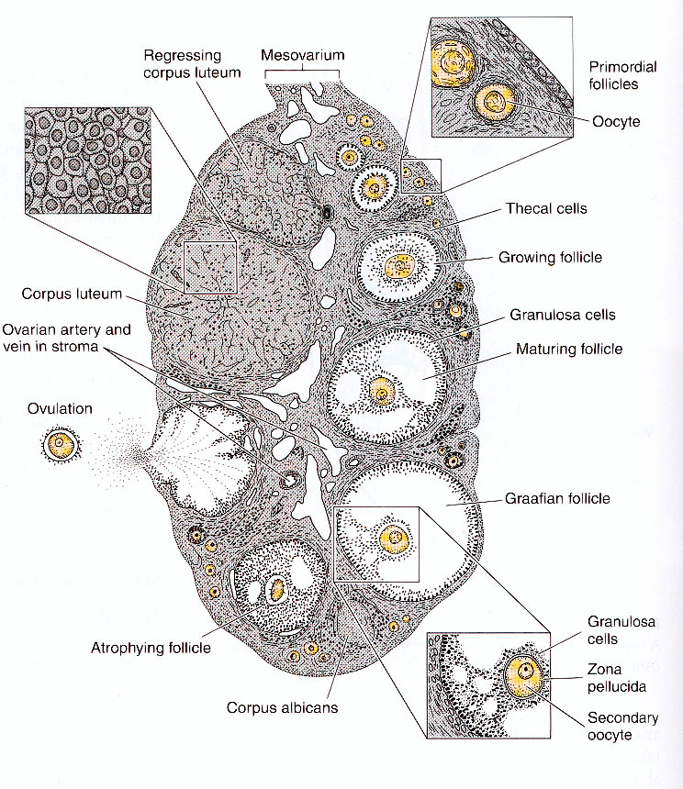
Ovaries continued
Germinal epithelium of ovary
is one cell layer thick and
includes thousands of diploid
cells called oogonia, which
undergo oogenesis to produce
eggs or ova. Secondary sex
cords form nourishing cells,
called follicle cells, plus an
enveloping theca.

Slide 12
Ovaries continued
When a follicle matures, the
ovum bursts from the wall
of the ovary and enters the
general coelom by a process
called ovulation. Follicles
of mammals (likely the case
in other vertebrates as well)
are converted into corpora
lutea which have endocrine
functions (secretions help
maintain the lining of the
uterus in mammals).

Slide 13
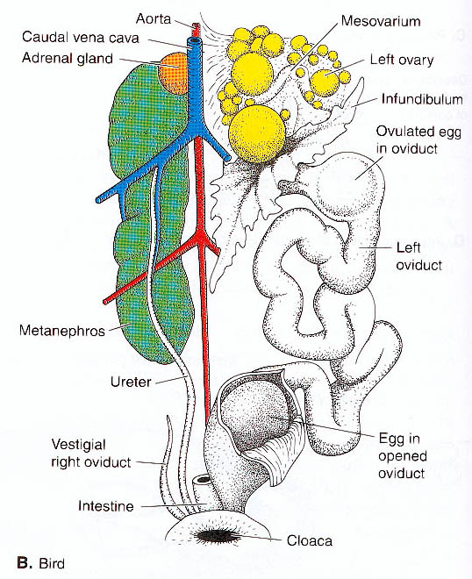
Vertebrate ovaries
Ovaries are usually paired in
vertebrates, but development
is often asymmetrical. The left
ovary is partly suppressed in
cartilagenous fishes; the right
ovary is suppressed in hagfishes
and birds.
Where symmetrical, ovaries may
take turns producing eggs in small
numbers or both may produce very
large numbers of eggs.

Slide 14
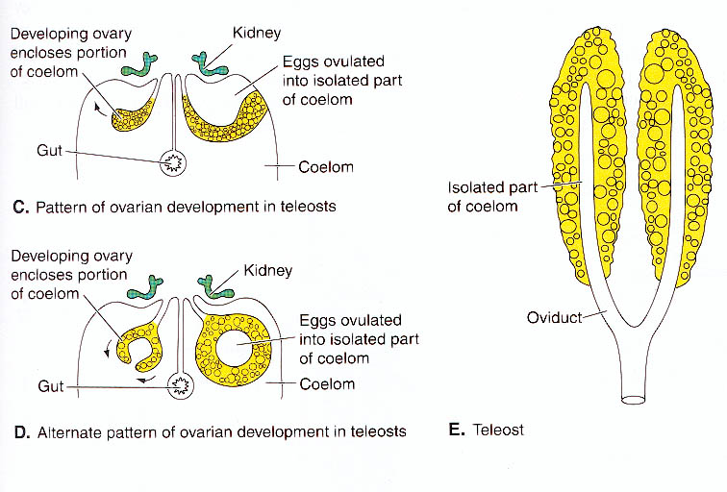
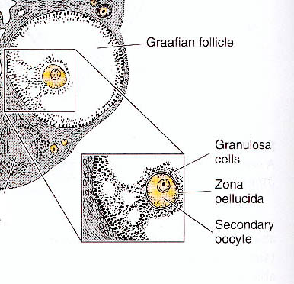
Ovarian cavities
Teleosts have cavities in
ovaries of an unusual origin:
ovary itself folds over and
seals off a piece of the general
coelom. Ova are ovulated to
this coelomic space, but it
represents a special chamber,
not oviduct.
In mammals a large space
appears inside each mature
graafian follicle.

Slide 15
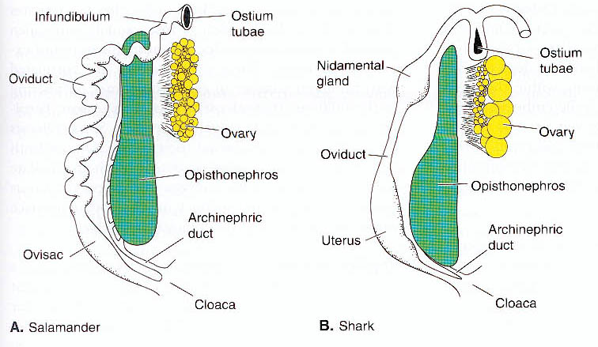
Survey of female ducts
Opisthonephric ducts and ureters carry only urine in females,
but drainage of opisthonephros is curiously supplemented by
accessory ducts in some sharks and urodeles. This leaves nephric
ducts free to function as oviducts. Recall that oviducts are
separate ducts (paramesonephric ducts)derived by lengthwise
splitting of archinephric ducts.

Slide 16
Survey of female ducts cont’d
Eggs of other gnathostomes enter
the coelom before entering
the oviducts.
Anterior ends enlarge to form
funnels (infundibula) with ciliated
openings called ostia. These are
thought to represent anterior most
pair of pronephric tubules and their
associated nephrostomes. In most
vertebrate groups, posterior sections
of oviducts become muscular to expel
eggs, and/or glandular to provide a
protective and nutritive coat

Slide 17
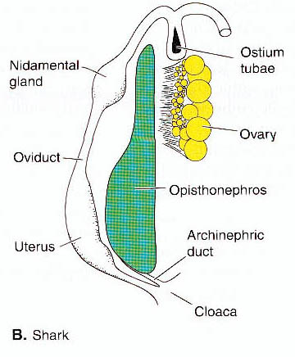
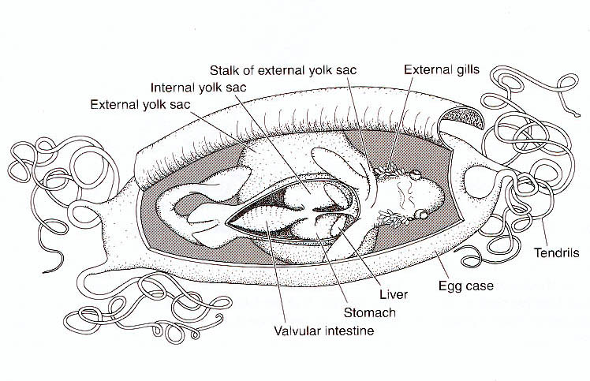
Female ducts in chondrichthyans
Ovarian funnels of chondrichthys are positioned far forward in
the body and often fuse in the midline. Oviducts lead into
shell glands, which secrete leathery case. Some shark embryos
develop internally in expanded ovisacs or uteri and sometimes
receive direct maternal nourishment through yolk sac placentae.

Slide 18
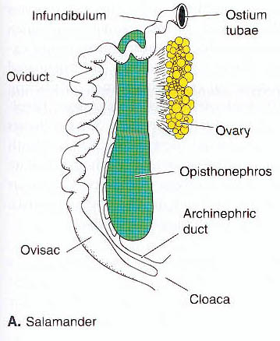
Female ducts in other anamniotes
Dipnoi and primitive rayfins
have paired oviducts apparently
also derived from paramesonephric
ducts.
Amphibia have coiled, glandular
oviducts. Coelom is lined with cilia
that beat toward ostia. Posterior
parts of tract apply coats of jelly
to eggs.

Slide 19
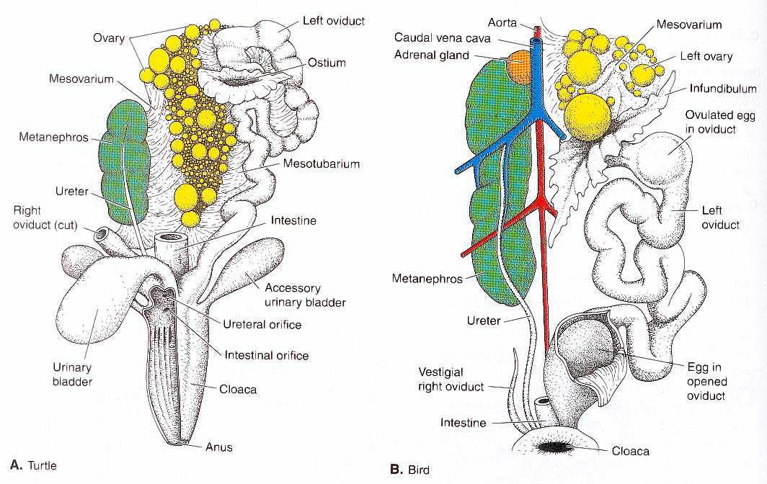
Female ducts in reptiles and birds
Right side of ovarian tract is large in reptiles but tends to
be vestigial in birds. Ovarian funnels are large. Albumin
and shell glands are present.

Slide 20
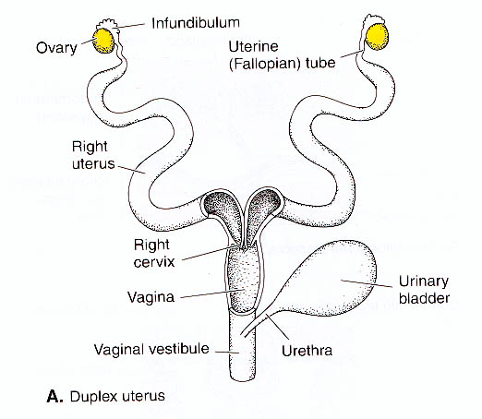
Female ducts in mammals
In mammals, female tract is
divided into three regions:
oviducts, uterus, and vagina.
Vagina is a chamber for
receiving the male penis.
Uterus houses fetus during
pregnancy. Contributes the
maternal portion of placenta.
Has inner mucous/vascular
lining (endometrium) and outer
muscular lining (myometrium).
The uterus is closed posteriorly
by a muscular cervix.

Slide 21
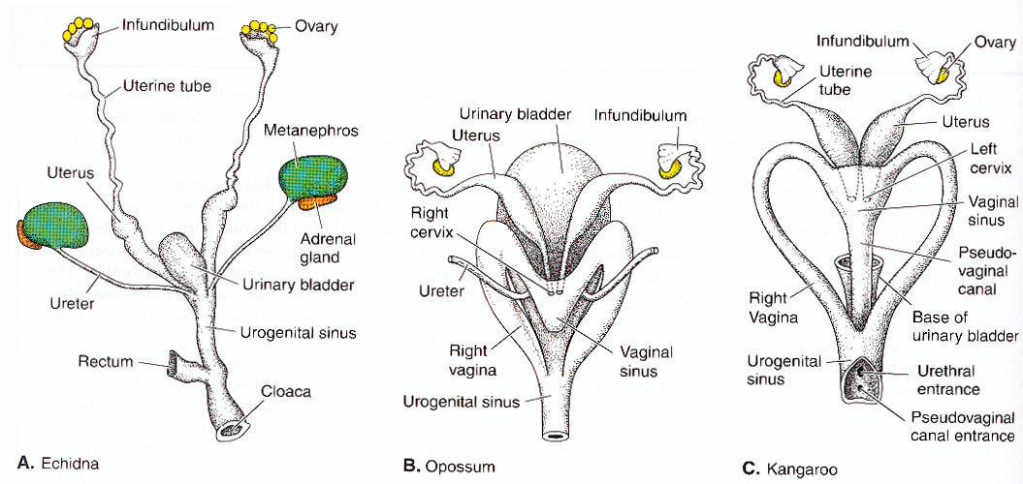
Variation in females ducts in mammals
Posterior of female tract is fused in monotremes and marsupials
forming a single urogential sinus or canal. Paired uteri and
vaginae are retained anteriorly in marsupials, and a medial
pseudovagina grows down from cervices to meet the urogenital
canal.

Slide 22
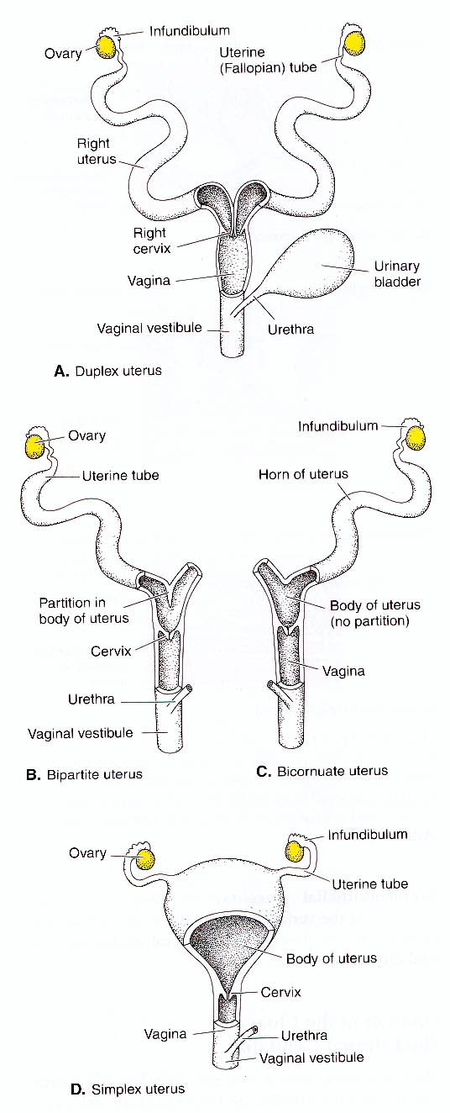
Uteri and vaginae
in mammals
If there are two uteri and two
cervices (as seen in monotremes,
marsupials and primitive placentals)
entire tract is said to be duplex.
If uterus is Y shaped externally
but partially fused internally at the
rear (ungulates, carnivores) said to
be bipartite. If posteriorly fused
said to be bicornate. And if
completely fused into single uterus
said to be simplex (primates).

Slide 23
Testis structure
Testes tend to develop a bit earlier
than ovaries and development
emphasizes medulla of the indifferent
stage. Germinal epithelium forms
only the covering of the adult testis.
Primary sex cords do not degenerate
as they do in females; they separate
from the germinal epithelium and
become hollow, producing coiled
seminiferous tubules (amniotes),
saclike seminiferous ampullae
(cyclostomes and urodeles) and
intermediate structures elsewhere.
Secondary sex cords do not form.

Slide 24
Testis structure cont’d
Blastema of indifferent stage
forms supportive tissue and
(tetrapods) rete tubules, which
form an anastomosis to conduct
sperm to the margin of the
testis.

Slide 25
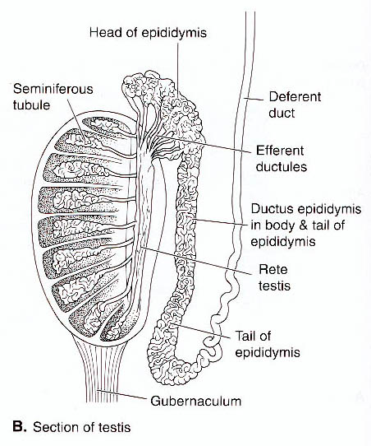
Testis structure cont’d
Testes are smaller, smoother, and
firmer than ovaries. They are
usually paired, but may be
completely (cyclostomes) or
partially (elasmobranchs) fused.
Testes are long and slender in
cyclostomes, bony fishes, urodeles,
and caecilians. They are compact
and ovoid in cartilagenous fishes,
anurans and amniotes. Mammalian
testes are encased in a tough envelope
of connective tissue (tunica
albuginea). They are lobed and septate
internally.

Slide 26
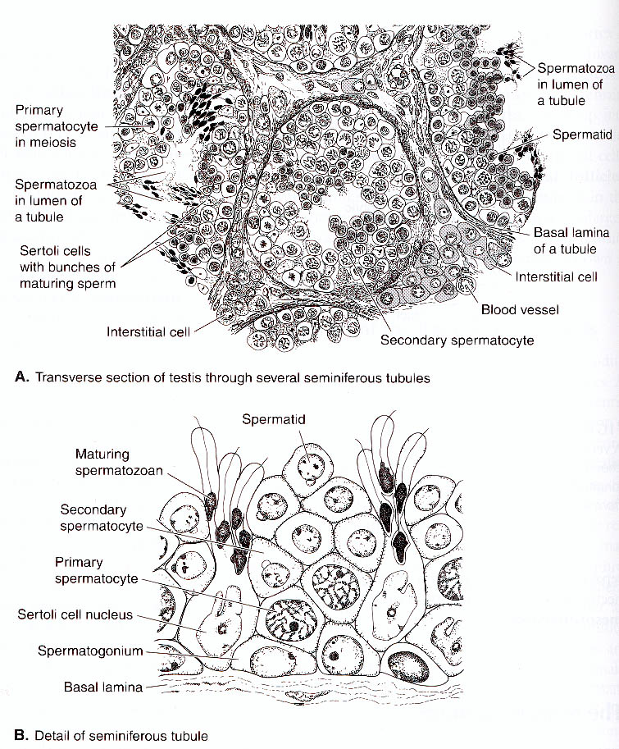
Spermatogenesis
Spermatogenesis occurs within
the seminiferous ducts. In
ampullae, germ cells enter from
adjacent tissue, divide many
times to forms clusters of
spermatids, which mature together and are evacuated all
at once. Interstices of seminiferous tubules are packed with interstitial cells which secrete hormones. They are most obvious in mammals,
but present in other vertebrates as well.

Slide 27
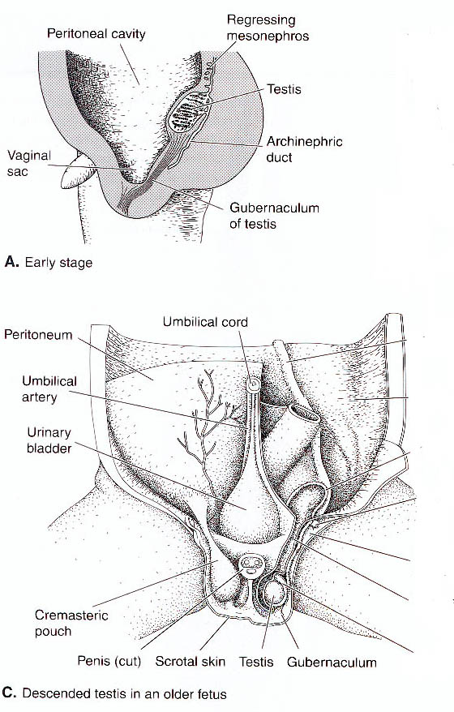
Spermatogenesis cont’d
Spermatogenesis ceases when
body temperatures are warmer
than 36.5 C. Abdominal air sacs
of birds probably function to cool
testes. In mammals, testes occupy
low abdominal or pelvic position
and often descend from body into
a coelom filled pouch called the
scrotum. Scortal muscles provide
some temperature control, raising
and lowering the testes as necessary.
Labia majora, which flank the
vaginal area in females of some
mammals, are sexual homologs of
male scrota.

Slide 28
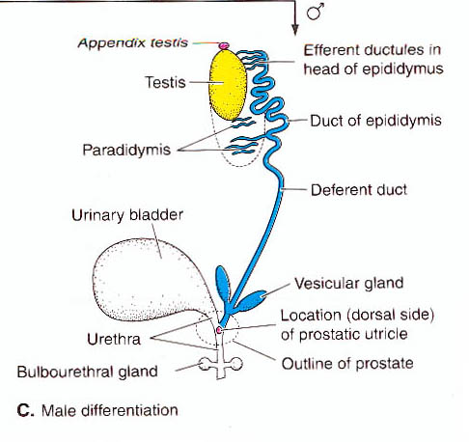
Male ducts
Fetal paramesonephric ducts
always regress in males. Sperm
are conveyed in a duct system
derived from the urinary system.
Efferent ductules derived from
anterior (pro)nephric tubules
carry sperm from testes across
mesorchium to the common
(pro)nephric duct, which then
takes the name deferent duct.

Slide 29
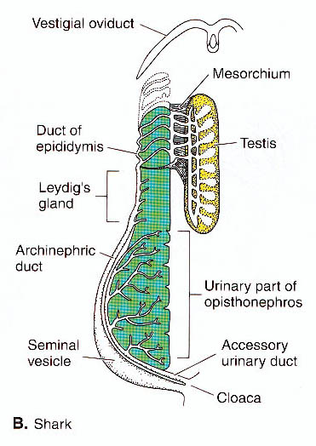
Chondrichthyans
Chondrichthyans have paired
deferent ducts that carry only
sperm. Anterior end of each
is convoluted to form an
epididymus where sperm are
stored. Posterior end expands
to become seminal vesicle.
Urine is carried in accessory
ducts.

Slide 30
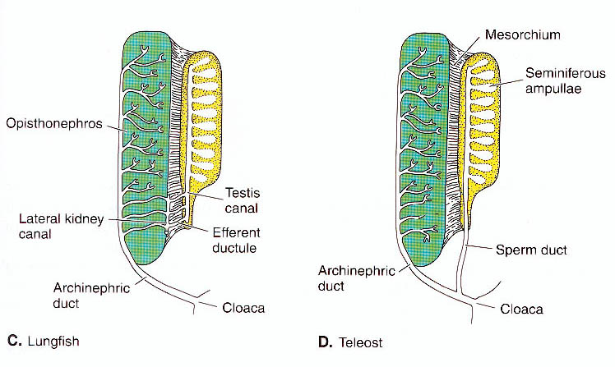
Bony fishes
Bony fishes show a variety of patterns. Whereas some primitive
rayfins and dipnoans have anterior deferent ducts, which carry
urine and sperm, others have short ducts (efferent ductules) which
carry only sperm back through opisthonephroi to nephric ducts. In
teleosts separate sperm ducts develop from folds in the peritoneum.

Slide 31
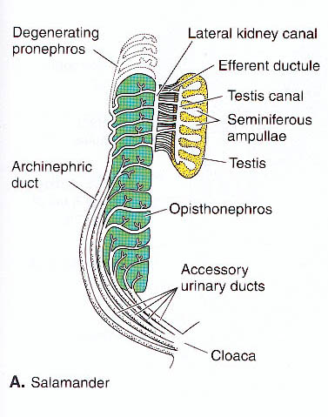
Amphibians
Amphibians have deferent
ducts that in some species
convey only sperm while
in others carry urine and
sperm. Accessory ducts
are present or absent,
draining only posterior
parts of kidneys when
present. Seminal vesicles
and epididymides are
usually present.

Slide 32
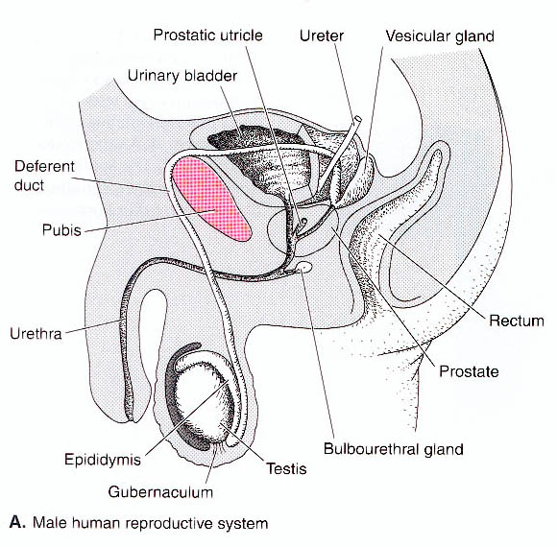
Amniotes
Deferent ducts of amniotes
carry only sperm. Each duct
forms an epididymis (except
in birds) and (except in birds
and reptiles) seminal vesicles.
Mammals have glandular
outgrowths of deferent ducts,
vesicular glands, which
augment seminal fluid.
Prostate gland is an
outgrowth of urethra that
also augments seminal fluid.

Slide 33
Cloaca and derivatives
Cloaca is chamber that receives digestive, urinary and genital
products. Hagfishes, elasmobranchs, dipnoans, amphibians,
reptiles and birds all retain the primitive arrangement of having
nephric ducts (or derivatives) and paramesonephric ducts that
merge with the hindgut at the cloaca.
Lampreys, chimeras and bony fishes show the derived condition
of having outlets for these urogenital ducts separate from the gut
and posterior to the anus (no cloaca).
Situation in mammals is derived from the first group.

Slide 34
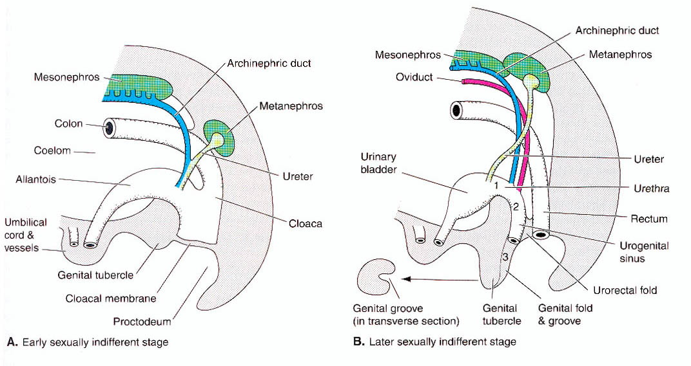
In early mammalian development, a septum forms and wedges
between gut and allantoic stalk, separating a dorsal fecal
chamber (coprodeum) from a ventral urogenital chamber
(urodeum). In monotremes, these two chambers come
together to form a common protodeum. In therian mammals,
embryonic septum extends back to completely separate dorsal
rectum from ventral urogenital structures, products of which
exit the body anterior to the anus.

Slide 35
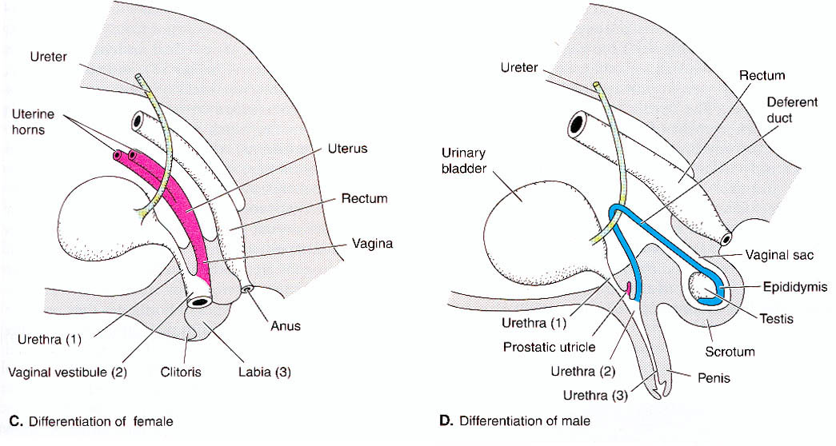
In females of most mammals, urogenital products are exchanged
via a common urogenital sinus, however in primates and some
rodents, there are separate openings to the urinary and vaginal
tracts. In males, urine and sperm are discharged through a
common urethra.

Slide 36
Copulatory organs
Copulatory organs are structures that internalize the
fertilization process with obvious advantages for fertilization
success.
Cyclostomes and most bony fishes discharge eggs and sperm
directly in water and thus need no copulatory organs.
A few teleosts have internal development and do practice
internal fertilization. These have developed copulatory structures
called gonopodia.

Slide 37
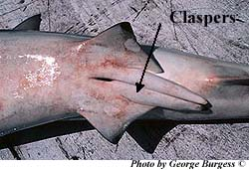
Chondrichthys
Fertilization is internal in cartilagenous fishes. Males have
copulatory structures called claspers associated with pelvic fins
and head (chimeriforms only). Head claspers are merely for
holding the female during copulation. Pelvic claspers have
grooves which direct sperm into female cloaca.

Slide 38
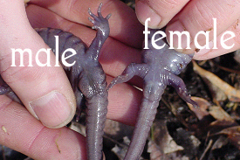
Amphibians
Amphibians return to water to breed and most show external
fertilization with no copulatory devices. Fertilization is internal in
urodeles, but males deposit packets of sperm called spermatophores
which females pick up with their cloaca. Females retain and nourish
sperm until ready to lay eggs (may be months).

Slide 39
Amniotes: Penises
Fertilization is internal in other
tetrapods and is facilitated by
a specialized copulatory organs
called penises. A penis is
composed of two spongy
vascular structures called
corpora cavernosa, which
elongate, close, and stiffen
when engorged with blood.
The shaft may be grooved
or ungrooved. The penis is
capped by a structure called
glans penis.

Slide 40
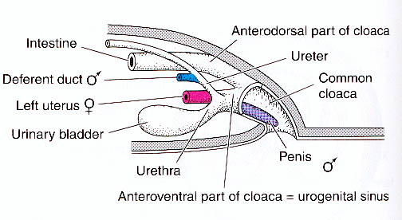
Reptilomorph penises
Penises are of two types in reptiles: paired hemipenes
(lepidosaurs) or a single penis (turtles and crocodilians).
Hemipenes reside in long sacs adjacent to cloaca. Males evert
them into female’s cloaca to hold cloacas of the two sexes
together. Turtles and crocodilians have a small penis which lies
on the internal ventral floor of the cloaca when not erect. The
small, erectile clitoris seen in female turtles and crocodiles is
he sexual homolog of the male penis.

Slide 41
Penises in birds and mammals
Birds copulate by pressing cloacas together. Males of
primitive bird groups have small penis, but most derived
groups have lost the structure.
As in reptiles, penis of mammals includes corpora cavernosa
and a glans penis, however, the glans is forked in monotremes
and marsupials to correspond to the divided vagina of the female.
The penis of many mammals also included a bone called the
baculum, which helps it to remain erect.

Slide 42
Therian mammals
During the indifferent stage of development, therian mammals
have a genital tubercle which is penetrated by the urethra in
males and extended from the body as the penis. Tubercle is
not penetrated or extended in females, but is retained as the
clitoris.

Slide 43
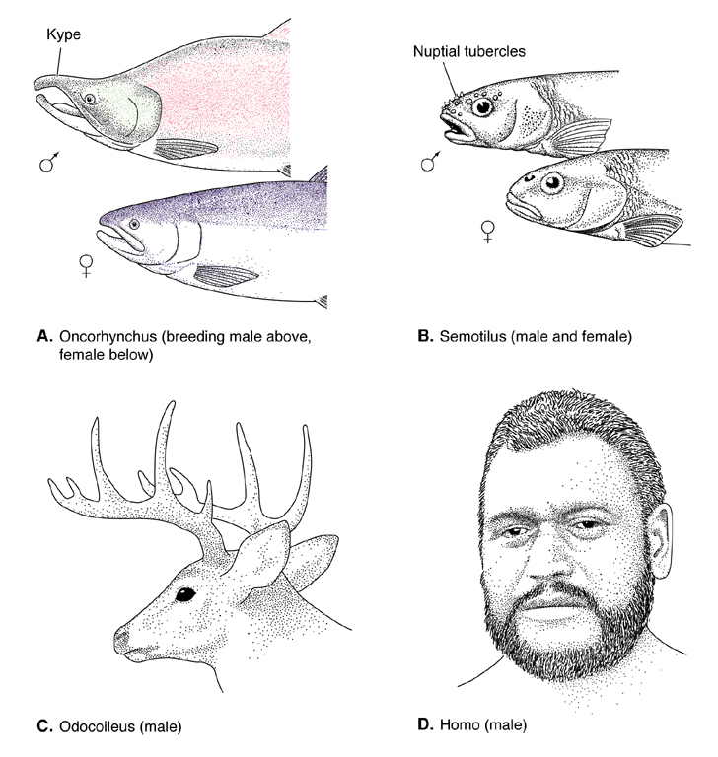
Sexual dimorphism
Sexes (male and female)
often exhibit
morphological
differences (sexual
dimorphisms) that are
important in sexual
communication and
reproduction.

Slide 44
Sexual dimorphism cont’d
Sexual dimorphism involves characteristics called secondary sex
characteristics, because they are secondary to primary (genetic)
determinants of sex (the gonads).
Secondary sex characteristics are either requisite - i.e., directly
involved in copulation, oviposition, or incubation (claspers,
gonopodia, brood pouches) or accessory - indirectly involved in
reproduction (breeding tubercles or colors).
Reproductive requirements of the species determine which sex is
larger. Females tend to be larger than males where reproductive
output is important because large size generally permits production
of larger numbers of eggs. Males tend to be larger where males
contest females.

Slide 45
Reproductive strategies
Nearly all vertebrates are dioecious (separate sexes)
Hagfishes and some teleosts are hermaphroditic (monoecious)
having both male and female gonads either simultaneously
(simultaneous hermaphrodites) or at different life stages
(consecutive hermaphrodites). Some fishes start life as
females and become males later (protogynous); some start life
male and transform to females later (protandrous)
Several teleosts, salamanders, and lizards have eggs that develop
parthenogenetically without incoporating sperm.

Slide 46
Egg-laying
Most vertebrates lay eggs that develop outside of the body
(oviparity - cyclostomes, some elasmobranchs, holocephalans,
most bony fishes, most amphibians, most reptiles, birds,
monotremes).
Number of eggs produced varies from one in some birds to
over 28 million in some fishes.
Each egg has a protective case, which may be leathery or a
calcareous shell, and each is invested with a quantity of yolk
to nourish the developing embryo to hatching.

Slide 47
Oviparity and Ovovivipary
Brooding of eggs is common and takes many forms. Many
vertebrates actively guard nest. Many fishes carry developing
on or in various body cavities…
Birds develop a highly vascularized, featherless area on breast
called brood patch for keeping eggs warm during brooding
.
Some vertebrates retain eggs inside body until hatching
(ovovipary - many fishes, a few amphibians and snakes).
Nourishment of the eggs is still via egg yolk.
However, parental (maternal) investment in the development
process is clearly higher in ovivipary.

Slide 48
Vivipary
In true vivipary or “live bearing”, nourishment of the embryo
is via physiological exchange with maternal tissues.
Viviparity has evolved many times (seen in teleosts,
elasmobranchs, caecilians, snakes, lizards, and all therian
mammals).
Exchange between fetal and maternal blood streams is
facilitated by a structure called a placenta. On the maternal
side, placenta always involves uterus. Yolk sac is most
commonly involved in placenta formation on fetal side,
although placenta of eutherian mammals characteristically
involves the allantois (“true placenta”).

