Slide 1
Respiration
Respiratory system is a system for exchanging gases associated
with cellular metabolism. Respiratory exchange occurs at three
levels with in the vertebrate body: across gills, skin or within lungs
(external respiration); between blood and tissues (internal
respiration); and within cells (cellular respiration).
Gas exchange process is by simple diffusion from external medium
(air or water) into blood across capillaries. Requires surface area.
Exchange across skin is called cutaneous respiration; seen in
fishes, frogs, and salamanders (one group of which loses lungs
and depends entirely on respiration across the skin). Most of these
are small vertebrates with relatively low metabolic demands and
live in moist environments.

Slide 2
Gill and Lungs
Gills and lungs are both derived from the gut tube.
Gills and lungs are highly vascularized membranes that permit
gas exchange through water and air respectively. Ventilation
is the process of breathing or actively moving gases across the
external exchange surface.
Gill ventilation is unidirectional (in all but the jawless fishes),
whereas lung ventilation is bidirectional or tidal.

Slide 3
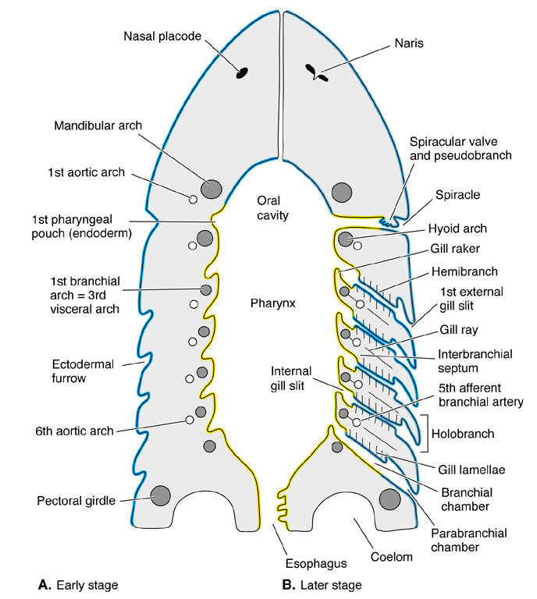
Gills
Gill openings start out as
lateral evaginations of the
pharynx called pharygeal
pouches. Lungs start out
as ventral evaginations of
esophogeal region of the gut.
Gill epithelium develops
along front and back margins
of gill arches;comes to be
separated either by the
arches themselves or
gill septa that extend from
the arches to varying degrees.

Slide 4
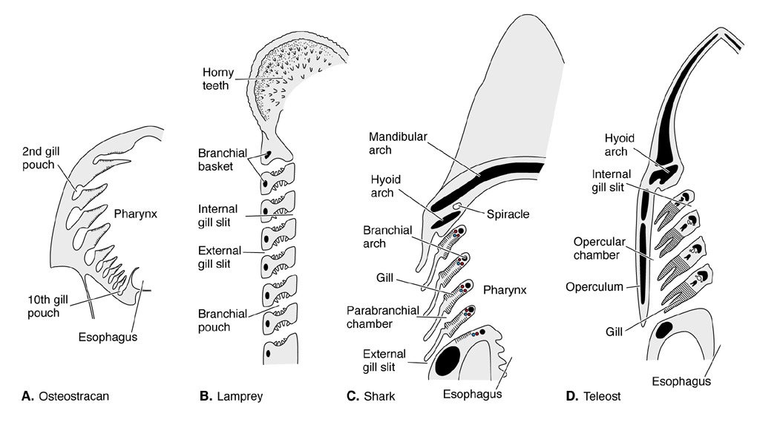
Gills continued
In lampreys, gills reside in pouches (marsipobranchs) with
openings to outside and respiratory portion of pharynx. In sharks
and rays, septa are elongate plates that wall off gill filaments on
each side of an arch. In bony fishes, septa are reduced, and gills
reside in a common chamber, covered by a bony operculum.

Slide 5
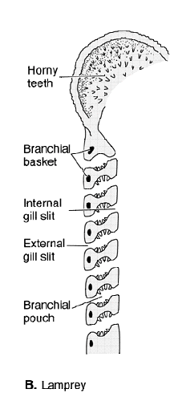
Jawless fishes
In lampreys, gills reside in pouches
(marsipobranchs) with openings
to outside and respiratory portion
of pharynx.
Since most lampreys spend most
of their time attached to fish,
they actively pump water in and
out of their gill pouches using
bidirectional (tidal) flow.
This is inefficient because respiratory
water is moving back and forth across
gills (inefficient for maximal oxygen
removal).

Slide 6
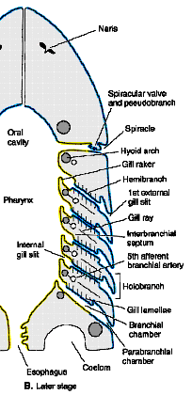
Gills cont’d
When gill tissue occurs on front
and back sides of a supporting
arch called a holobranch. If gill
tissue develops only on one side
of an arch it is called a
hemibranch.
Mandibular arch in elasmobranchs
has gill tissue only on posterior
margin which services the
spiracular cleft = pseudobranch.
Pharyngeal margin of gill arches
develop gill rakers which project
into pharynx and prevent food
from fouling gills.

Slide 7
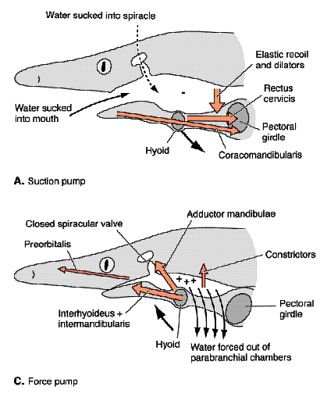
Gill ventilation
Fishes such as sharks, which
spend most of their time
swimming, ventilate gills by
swimming with their mouth
open (ram ventilation).
Some sharks and most rays
use spiracle to irrigate gills
when resting (water flow is
bidirectional).

Slide 8
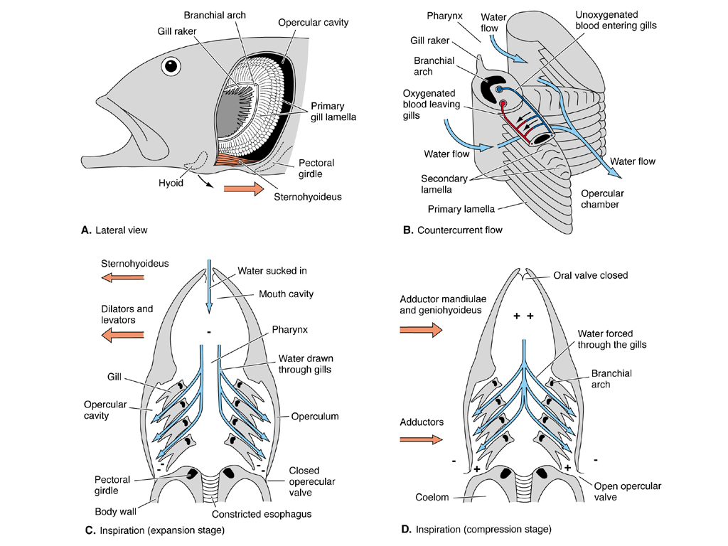
Gill ventilation continued
Ventilation of gills
in bony fishes is
usually accomplished
by alternate suction
and pumping action
of bucopharyngeal
region
(bucopharyngeal
pump).

Slide 9
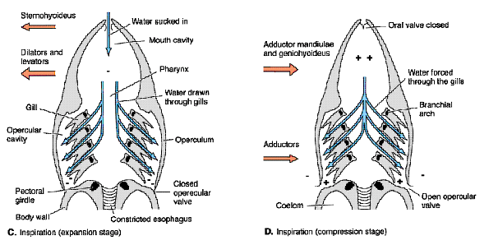
Bucopharyngeal pump
In suction phase, gill chamber is closed off by an opercular
membrane with bony rays (branchiostegals) to prevent it from
collapsing. First mouth, then pharygeal cavity enlarge drawing
water in. In pumping phase, mouth closes, opercular membrane
releases, and first mouth, then throat constrict, forcing water
through gill clefts and over gill filaments.

Slide 10
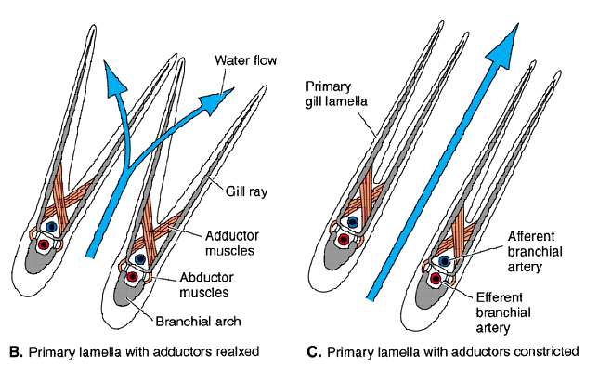
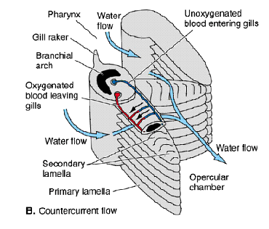
Gill structure
Gill tissue forms gill filaments which project into the gill
chamber and are supported internally by skeletal and muscle
tissue. Filaments are flat with numerous plate-like extensions
called lamellae on either side. Filaments of adjacent gill arches
touch and block the gill cleft forcing water to flow over filaments
and between lamellae.

Slide 11
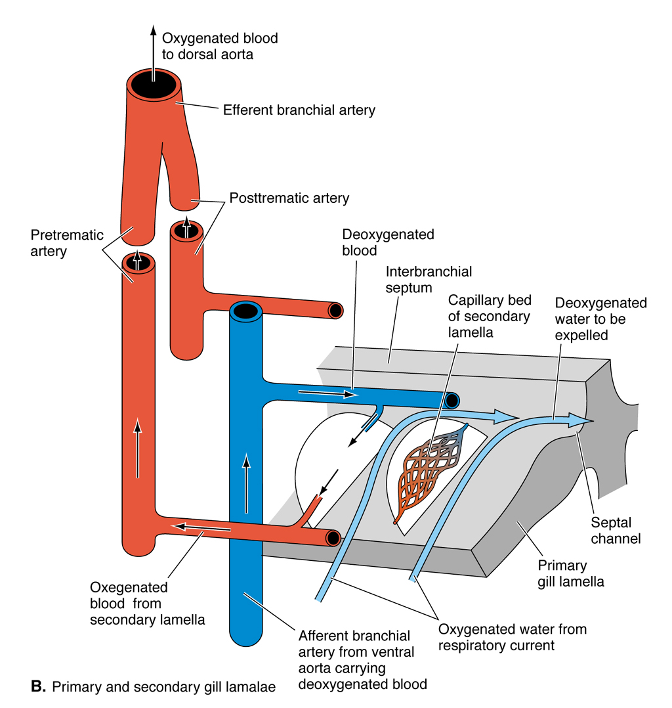
Gill structure continued
Each gill filament is serviced
by branch of the branchial
artery. Blood flow through
lamellae is opposite the
direction of flow of water
over gill filaments so that
deoxygenated blood entering
lamellae contacts water after
it has flowed past lamellae
(countercurrent flow). This
produces a continuous gradient
of relatively high oxygen in
water and relatively low
oxygen in lamellae.

Slide 12
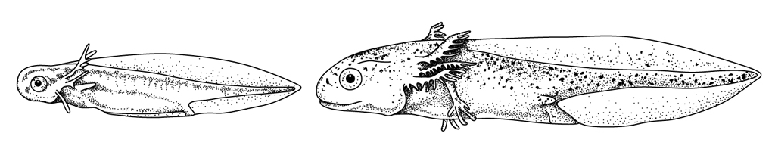
External gills
Ectodermally derived external gills develop in the larvae
of cladistians, lungfishes, and amphibians. Are filamentous
and feather-like. External gills are fanned by superficial muscles.

Slide 13
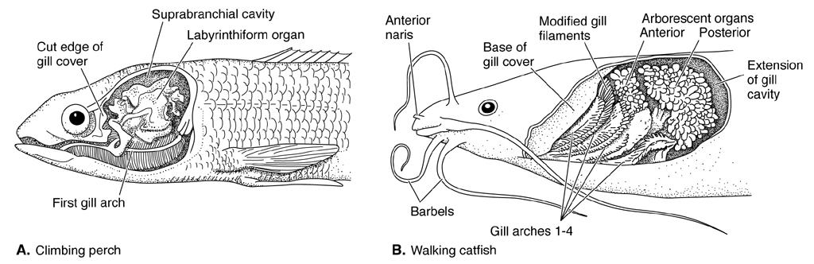
Air breathing
In swamps or other standing water habitats in warm tropical
climates oxygen content of water frequently too low to support
gill respiration. By comparison, air above is rich in oxygen. Not
surprising therefore that many fishes that live in these habitats
have adopted means of airbreathing. Air-breathing structures of
fishes range from true lungs, to vascularized chambers in mouth,
pharynx and even stomach, to structures that stiffen gills. All but
the last are merely thin-walled, highly vascularized chambers.

Slide 14
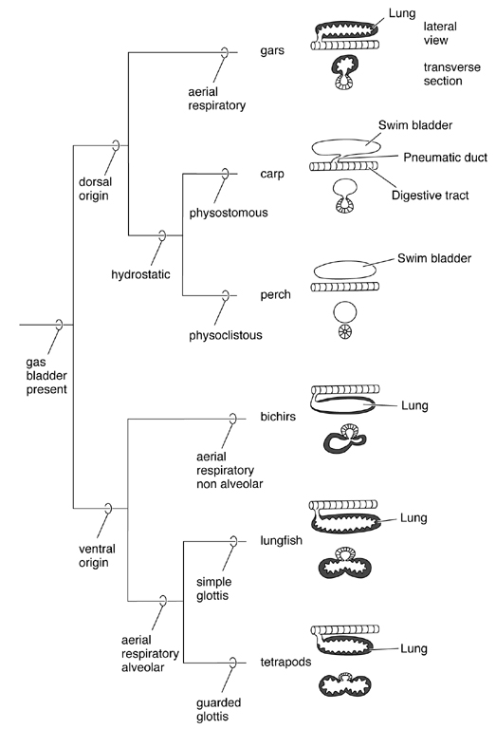
Lungs
Lungs evolved in fishes. Earliest
evidence of lungs is questionable
diverticula of the gut seen in
antiarchs (placoderms). Lungs
of lungfishes and possibly bichirs
are homologous to the tetrapod
lung, a paired ventral sack with
a ventral connection to the gut.
As fishes evolved, lung and
its connection moved dorsally,
became fused into a single
chamber, lost its function in
respiration, and became a
hydrostatic organ (called gas
or swim bladder) for buoying
body in the water.

Slide 15
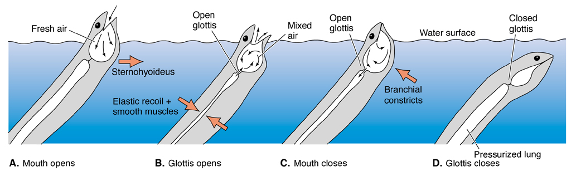
“Lung” use in fishes
Primitively, fishes emptied and filled the bladder through
the pneumatic duct, its connection to the gut (physostomous
condition). Mouth and throat muscles are involved in pushing
air through the duct to inflate the lung (s).

Slide 16
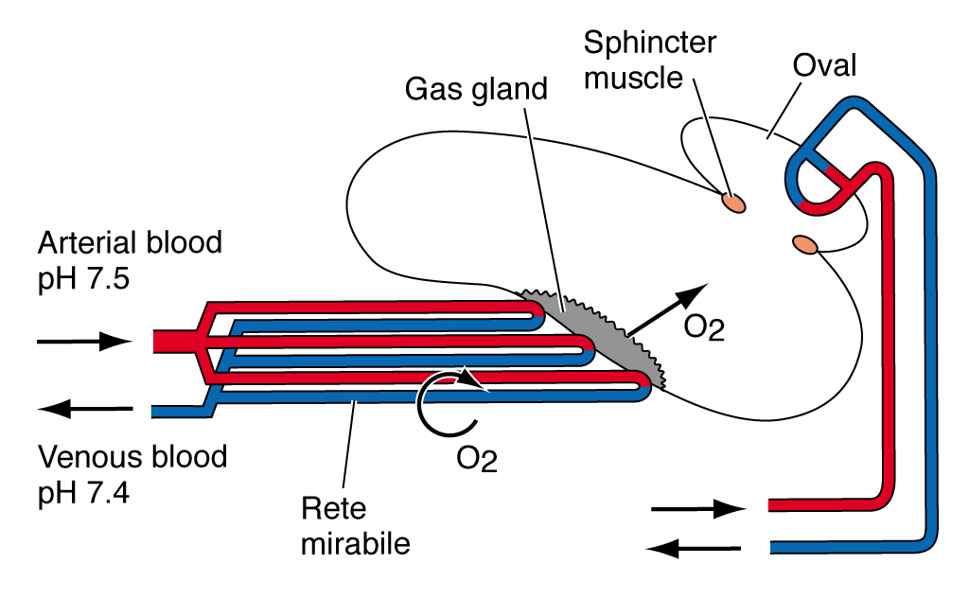
Physoclistic swim bladder
Advanced fishes lost pneumatic connection (physoclistic
condition) and "developed" circulatory means of filling and
emptying bladder. Wall of one lower portion of bladder is a
highly vascularized retial network called rete mirabile,
which is as a counter current multiplier.

Slide 17
Physoclistic swim bladder cont’d
Rete mirabile afferent and efferent vessels that flow close to one
another in opposite directions. Gland associated with rete (gas
gland) secretes lactic acid, which causes gases to be salted out of
blood where they are then free to diffuse into bladder. Bladder is
emptied at separate richly vascularized area called the oval.

Slide 18
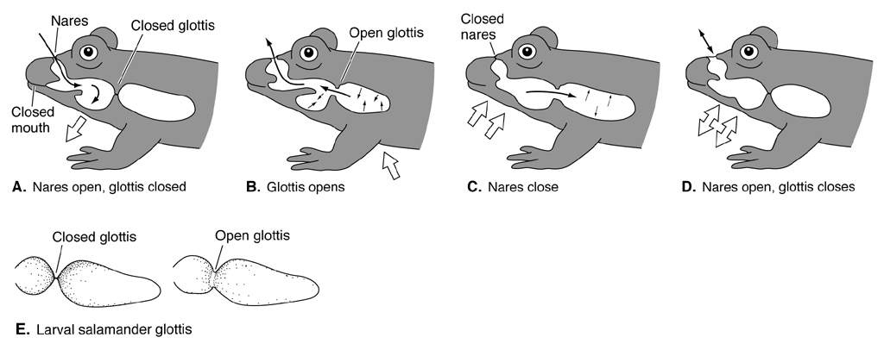
Amphibians
Lungs of amphibians are essentially the same as in lobefin fishes,
except that the pneumatic connection (trachea and bronchi)
develops cartilagenous supports to prevent collapse in breathing.
The opening between trachea and pharynx is called the glottis.
It is flanked by cartilages that form vocal chords. Top portion of
trachea (larynx or voice box) becomes reinforced with addition
cartilages derived in part from the hyoid apparatus. Amphibians
ventilate their lungs by taking air into mouth and swallowing it
using muscles of the throat.

Slide 19
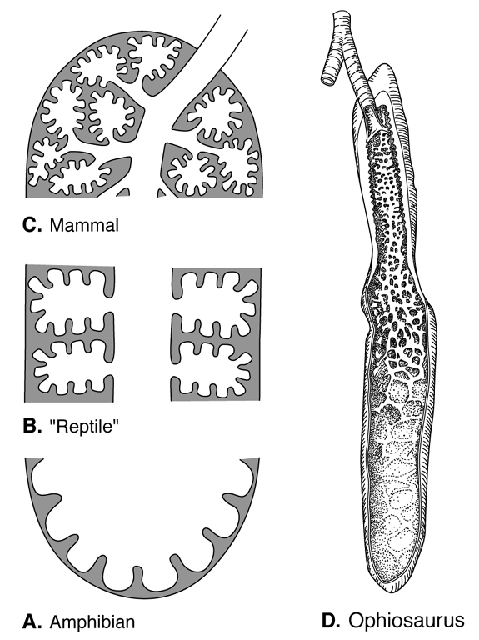
Tetrapod lungs
Lungs of amphibians (many of which
retain gills or respire cutaneously) are
simple sacks, without much internal
partitioning. Morphology of lungs
and trachea is essentially the same
in reptiles, except that reptiles - being
more terrestrial and of larger average
size - require more surface area inside
lungs for gas exchange. Show trend
of increasing compartmentalization
of lungs. This gives rise to situation
seen in mammals where respiratory
tree is highly branched, and lung is
solid "sponge" of respiratory epithelium.

Slide 20
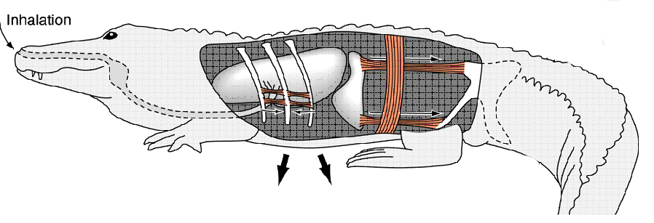
Reptilomorphs: inhalation
Higher metabolic demands means that reptiles need a more
effective means of ventilating lungs than swallowing air. Lungs
ventilated by expansion and compression of the rib cage by
intercostal and abdominal muscles. Diaphragm forms tight
ventral seal for pleural cavity. Air is taken into lungs by
contraction (flattening) of diaphragm and external intercostals,
which pull the rib cage forward, expanding pleural cavity. This
decreases pressure, pulling at walls of lung, thereby increasing
vacuum in lungs and causing air to be drawn in.

Slide 21
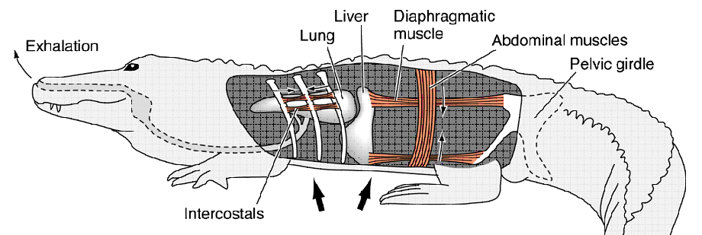
Reptilomorphs: exhalation
Exhalation is accomplished by relaxation (elevation) of the
diaphragm, and contraction of the internal intercostals, which
pull the rib cage back down, compressing the pleural cavity and
forcing air out of the lungs.

Slide 22
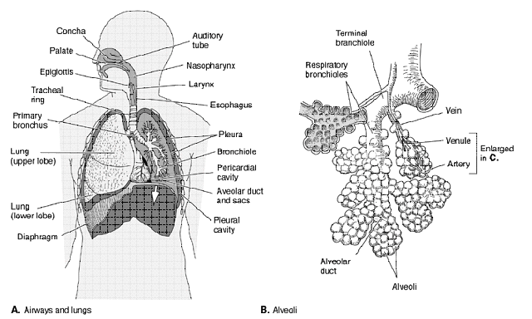
Mammals
Main difference between reptiles and mammals is that in latter
lung is solid "sponge" of respiratory epithelium with highly
branched bronchial tree ending in clusters of tiny grape-like
compartments called alveoli where gas exchange takes place.

Slide 23
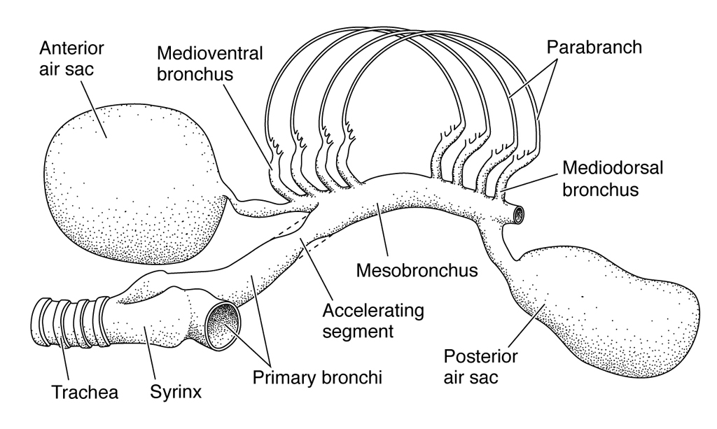
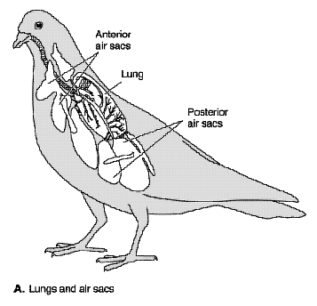
Birds
Birds have a peculiar external respiratory anatomy, consisting
of lungs with several avascular air sacks tucked among viscera
and even bones of the skeleton.

Slide 24
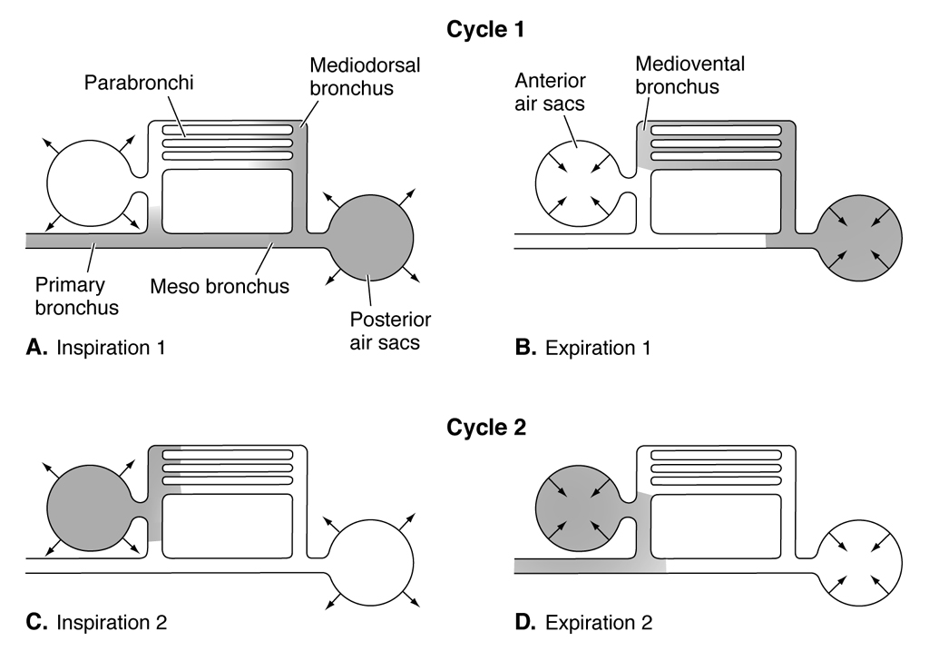
Birds
cont’d
Lung ventilation
occurs in two
phases.
During inhalation
phase 1, air passes
through lungs and
enters posterior
air sacs. During
exhalation phase 1, air makes its way through parabronchial
passages of lungs en route to anterior air sacks. It is expelled
during exhalation 2. In this way, birds exchange gases during
inhalation and exhalation of air.

