Slide 1
Sensory Perception
The vertebrate sensory system is a system for sensing conditions within
and outside the vertebrate body. It is a component of the nervous system.
In fact, it consist of a variety of types of specialized nerve endings
(sensory receptors), modified to convert various environmental stimuli
(light, smell, taste, pressure, temperature) into nerve impulses.
There are five basic categories of sensory perception in vertebrates:
chemoreception (smell and taste); mechanoreception (hearing,
orientation, touch/pressure and detection of water movements),
electroreception (electrical and electromagnetic reception),
photoreception (light) and thermoreception (temperature).
Sensory receptors can be named for the kind of reception or for their
position in the body (exteroreceptors vs. enteroreceptors)

Slide 2
Types of Vertebrates Sensory Receptors and their Functions
Chemical receptors
Olfactory cells (smell)
Taste buds (taste)
Mechanical, temperature and electrical receptors
Cutaneous receptors
Free nerve endings (pain, temperature and other modalities)
Meissner’s corpuscles (touch and pressure)
Merkel’s disks (touch and pressure)
Pacinian corpuscles (touch and pressure)
Ruffini endings (touch and pressure)
Eimer’s organs (touch and pressure)
Sinus hairs (= whiskers; touch and pressure)
Proprioreceptors
Tendon and joint receptors (tension)
Muscle spindles (degree and rate of contraction)
Lateral line, ear and electroreceptors
Hair cells (vibrations and gravity)
Ampullary organ cells (electric fields)
Tuberous organ cells (electric fields)
Photoreceptors and specialized thermoreceptors
Rod and cone cells (visible electromagnetic radiation)
Pit organ cells (infrared electromagnetic radiation)

Slide 3
Chemoreception
Chemoreception is important for monitoring various chemical
conditions within the body (oxygen, carbon dioxide, pH) and
for the senses of taste (gustatory reception) and smell
(olfactory reception).
Receptors that monitor internal body chemistry generally are
simple free nerve endings inside certain tissues (e.g., aortic
bodies inside arteries near heart).

Slide 4
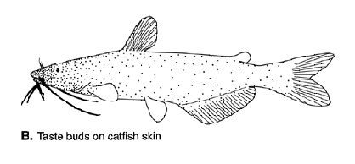
Taste buds
Gustatory receptors are generally concentrated on the tongue
(taste buds) and inside the mouth in tetrapods. In fishes, they
can occur inside the mouth, on structures outside the mouth
called barbels, and (catfishes) all over the body. Greater
dependence on taste reception correlates with greater
development of the facial and vagal lobes of the medulla
oblongata.

Slide 5
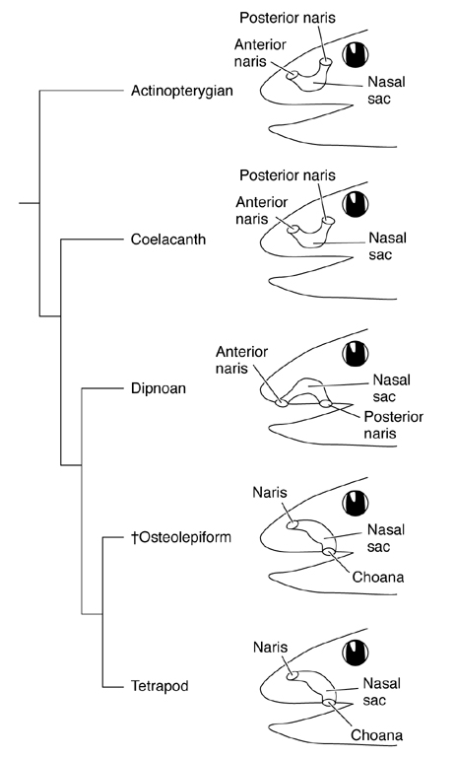
Olfaction in fishes
In cartilaginous and rayfin
fishes, olfactory receptors are
associated with ciliated pits on
the surface of the head called
nares. The pits are usually
divided into excurrent and
incurrent channels by a flap
of skin or extended to form
a tube with two openings.

Slide 6
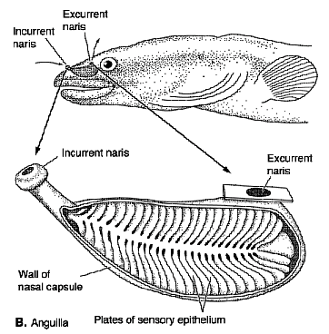
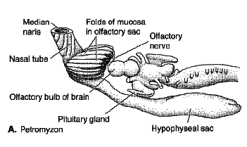
Olfaction in fishes
The olfactory receptor is a highly
folded epithelium situated at the
base of the pit called an olfactory
rosette. Minute quantities of
chemicals cause the epithelium
to transmit a stimulus to the
olfactory lobe of the brain. The
greater the dependence on
olfaction, the more extensive the
development of the pit and
rosette.
Olfactory cues are important in
salmonid homing behavior and
possibly other forms of imprinting
in fishes.

Slide 7
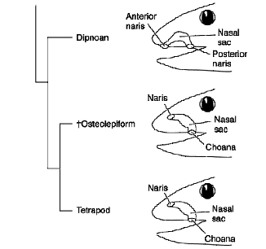
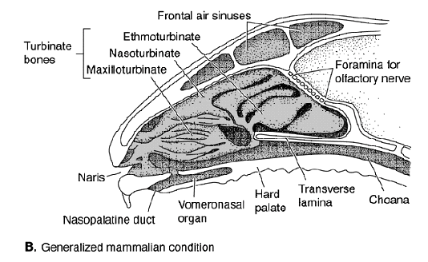
Internal nares
In sarcopterygians, the nares are
internal (open into the mouth)
forming structures called
choanae, which permit air-
breathing through the nostrils.
The olfactory epithelium occurs
along the lining of the choanae.
In mammals, coils of bone form
along the walls of the nasal
passages producing structures
called nasal turbinates. The
turbinates work like particle
accelerators, forcing particles
in the air to stick to mucus along
their walls.

Slide 8
Mechanoreception
Mechanoreceptors include cutaneous receptors for sensing
touch, vibrations, temperature, and other stimuli. Many of
the receptors are simply free nerve endings occurring at
different depths within the skin (affects sensitivity). Others
show differing degrees of layering or lamination with
connective tissue to influence sensitivity.

Slide 9
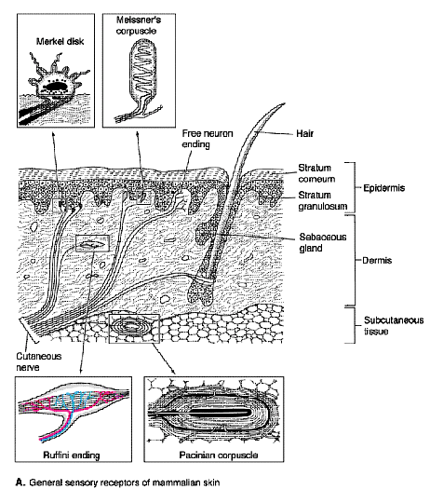
Cutaneous mechanoreceptors
Superficial cutaneous receptors
have small, localized receptor
fields receptors. Examples
found in mammalian skin
include Merkel’s disks (not
laminated, slow adapting) and
Meissner’s corpuscles
(laminated, fast adapting).
Receptors deeper in the
epidermis have wider receptor
fields. Mammalian examples
include Ruffini’s endings
(slow adapting) and Pacinian
corpuscles (rapidly adapting).

Slide 10
Hairs
Mammalian hairs are believed
to have evolved from tactile
receptors found between
scales in squamate reptiles.
Each hair has a nerve rapped
around its base called a nerve
plexus. Whiskers (vibrissae)
are specialized, highly
specialized hairs.
Cutaneous receptors occur in
other vertebrates, but are less
well known than in mammals.

Slide 11
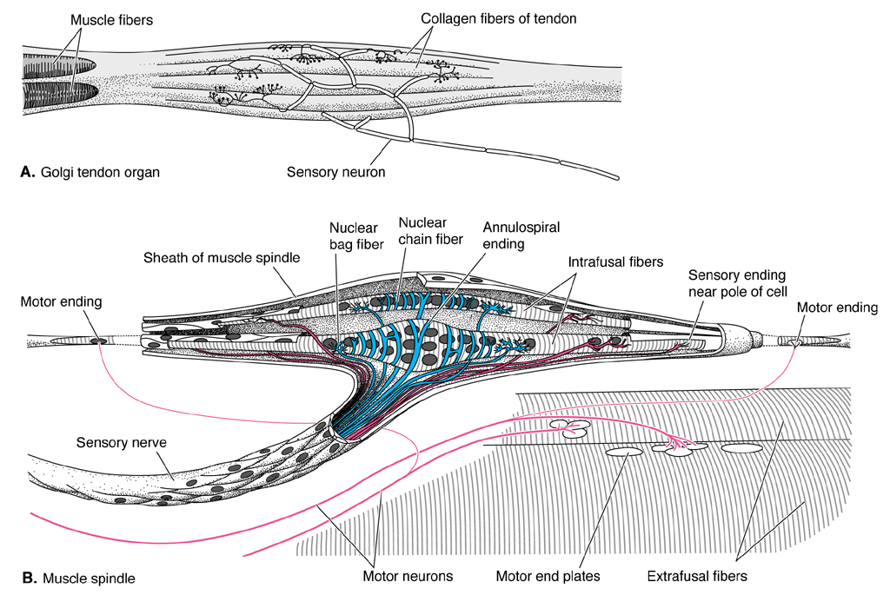
Proprioceptors
Proprioceptors
are receptors
that sense the
degree of
contraction and
activity of muscles.
This is important
for coordination
and maintaining
balance when
standing.

Slide 12
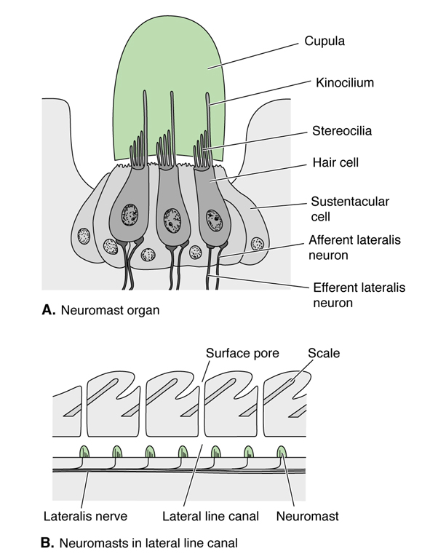
Lateralis system
The lateralis system or lateral
line in anamniotes is a system
for sensing vibrations and other
displacements of water (“distant
touch”). It consists of free
neuromasts and neuromasts in
canals that run along different
parts of the head and along the
mid side of the body. The
neuromasts are capped by a
gelatinous cupula. When
a current of water moves past the
neuromast it bends the cupula
creating a nerve impulse.

Slide 13
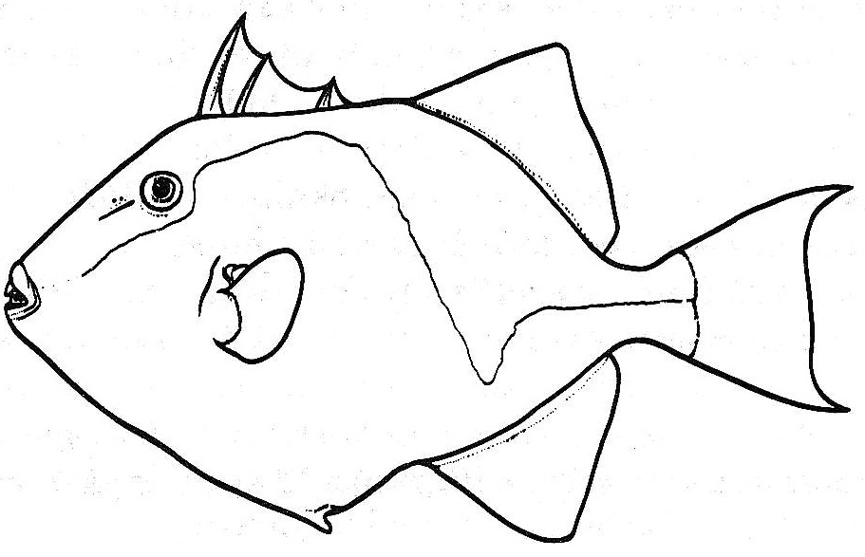
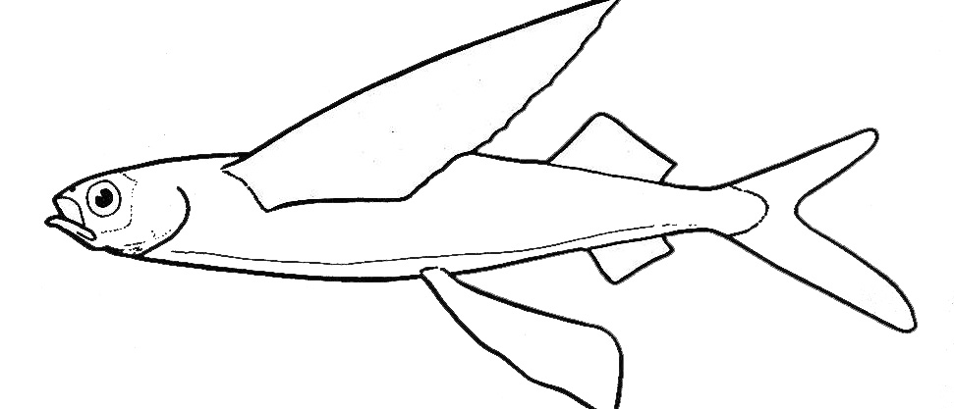
Lateral lines
The more turbulent the water the greater the proportion of
neuromasts in canals to reduce background noise.
Lateral lines angle up or down around the pectoral fins or
in the direction where it is critical to detect water movements.

Slide 14
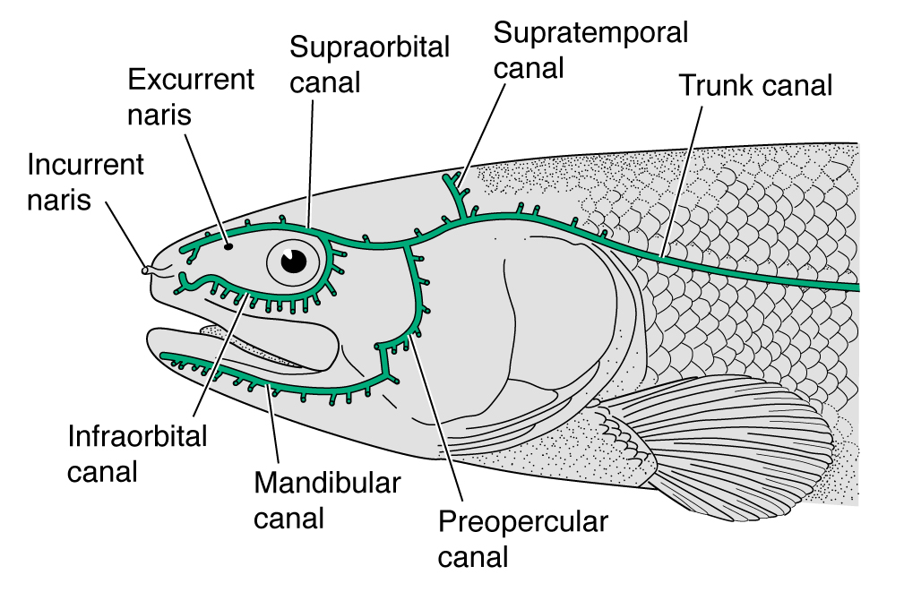
Cephalic lateralis system
The cephalic-
lateralis system
is so precise in
some groups that
very specialized
feeding is possible
without taste or
sight.
The cephalic
lateralis system can
also function as a
sonar device, detecting forward displacements of water
(produced in swimming) when they rebound off of distant
objects.

Slide 15
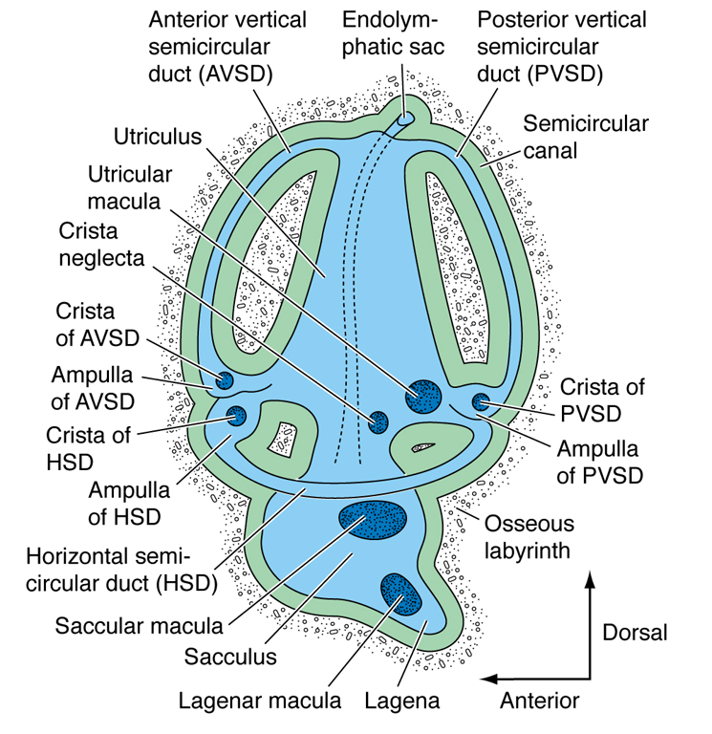
Auditory reception
The senses of hearing and
balance and equilibrium are
controlled by paired an organ
called the membranous
labyrinth or inner ear that
becomes incorporated into
the otic region of the
vertebrate skull. It consists
of a series of canals filled
with a lymph like fluid called
endolymph.
In many anamniotes, right and left half of inner ear connect
to a central duct called the endolymphatic duct that can
opens to the outside.

Slide 16
Inner Ear
The inner ear includes dorsal
canals called semicircular
canals, each with a bulbous
ampulla at its base containing
sensory hair cells capped with
a gelatinous cupula, as seen
in lateralis system neuromasts.
Semicircular canals are
responsible for the senses of
balance and equilibrium.

Slide 17
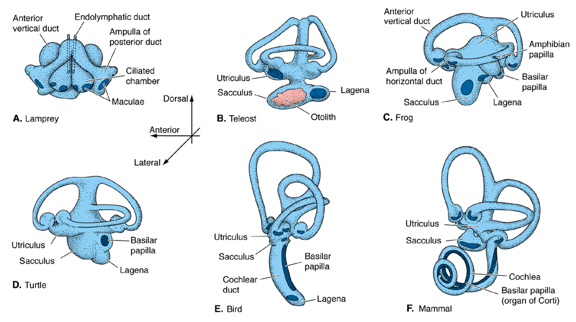
Hagfish have one, lampreys have two, all others vertebrates
(gnathostomes) have three. The canals are aligned in as many
as three different planes. Angular accelerations in either plane
cause the cupula to bend, thereby stimulating the hair cells to
conduct nerve impulses.

Slide 18
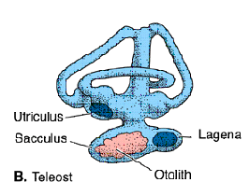
Hearing in fishes
The semicircular canals
connect to a sac called the
utriculus. Ventral to the
utriculus are two other
sacs called the saculus
and the lagena. Each of
these sacs is also filled
with fluid endolymph and
has a sensory epithelium called a macula composed of hair
cells. In fishes, the sacs contain concretions of bone called
otoliths or calcareous crystals mixed of exogenous material
called statoconia. Statoconia are seen in elasmobranchs
which form them from secretions and sand grains that enter
the ear through the endolymphatic ducts. Hearing sensations
are produced when sound vibrations cause the otoliths or
statoconia to bend hair cells, stimulating neural transmissions.

Slide 19
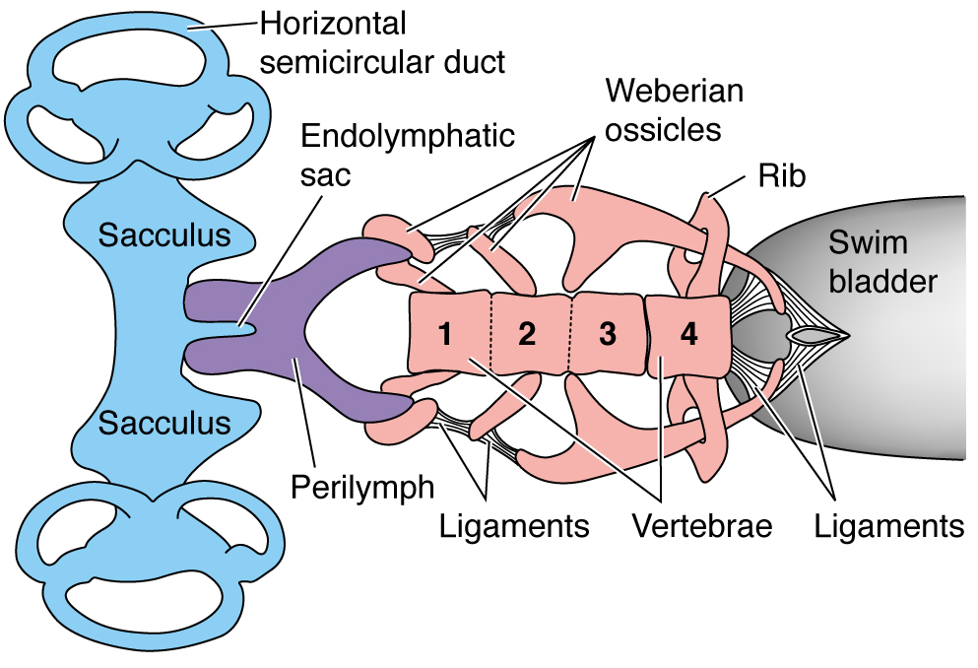
Hearing adaptations in fishes
In a number of fishes, hearing is aided by sound vibrations
pulsating off the swimbladder. The vibrations are carried to the
inner ear by a special extension of the swimbladder (herrings)
or a bridge of bones (Weberian ossicles of ostariophysans).

Slide 20
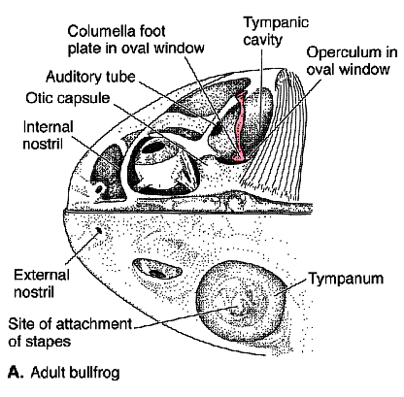
Hearing on land
With the exception of these
specialized hearing adaptations,
fishes are generally adapted to
hear low frequency sounds.
Sound pressure waves travel
more easily and at much high
frequency through air than water,
and land vertebrates have to
amplify the signals to sense
them. The canals leading to the
inner ear in land vertebrates is
covered by a bony membrane, called the tympanic membrane.
The membrane separates air-filled, ear canal (middle ear) from
the outside air.

Slide 21
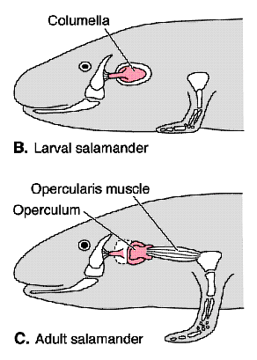
Amphibians and primitive reptiles
Bones that form part of the upper
jaw, jaw articulation and
suspensorium in fishes are
gradually moved out of association
with the jaws in tetrapods and form
hearing ossicles. Amphibians and
primitive reptiles have a single
ossicle (the collumella) which
represents the remains of the
hyomandibula. The footplate of
the collumella forms an oval
window on the lateral surface of
the otic capsule, in direct contact
with the lagena of the inner ear.

Slide 22
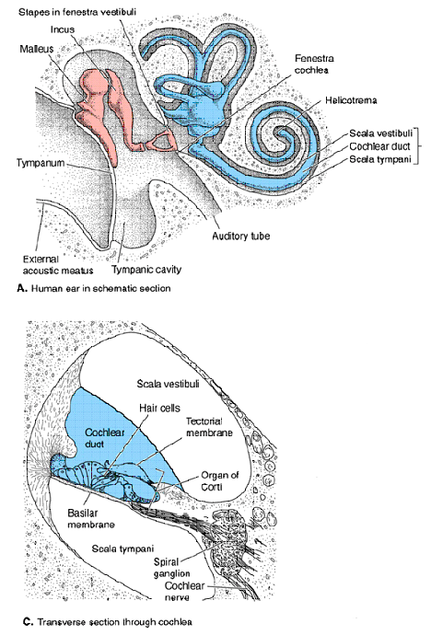
Advanced tetrapods
In more advanced reptiles and
mammals, the quadrate and
articular bones of the jaws form
two additional middle ear ossicles
(the malleus and incus,
respectively). Sound vibrations
hitting the tympanic membrane
are amplified as they travel
across the middle ear ossicles,
vibrating the oval window. The
vibrations produce waves in the
endolymph, which moves hair
cells of the maculae. The hearing
organ of mammals is a modified
(elongate coiled) lagena called
the cochlea.

Slide 23
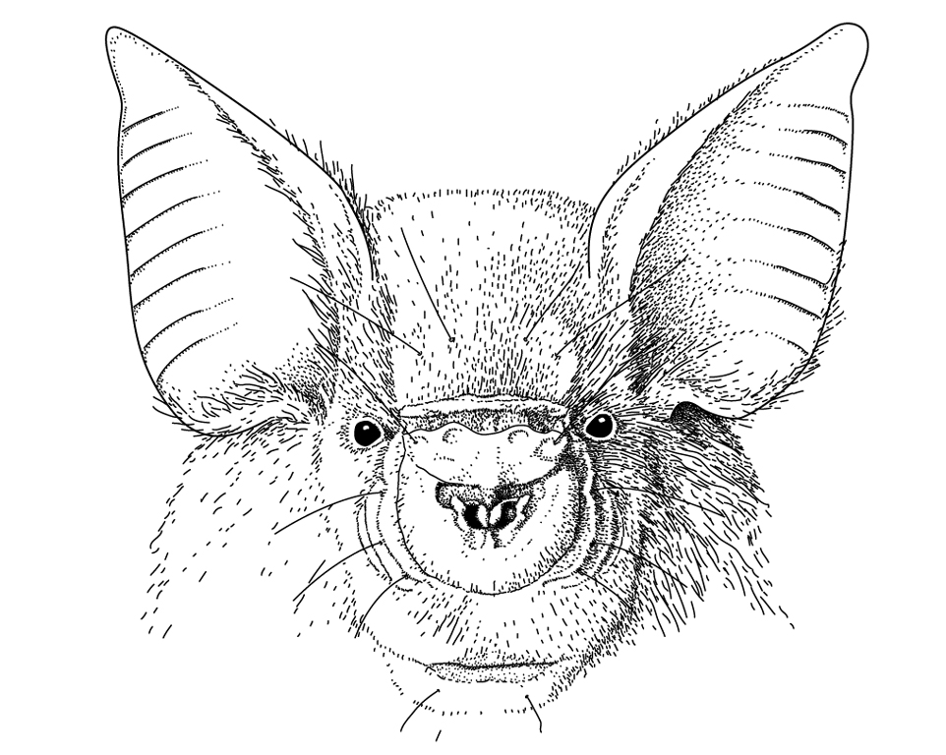
External ears or pinnae
What we commonly
refer to as ears in
vertebrates are actually
appendages called
external ears or pinnae
that function to funnel
sound vibrations into
the external ear canal.

Slide 24
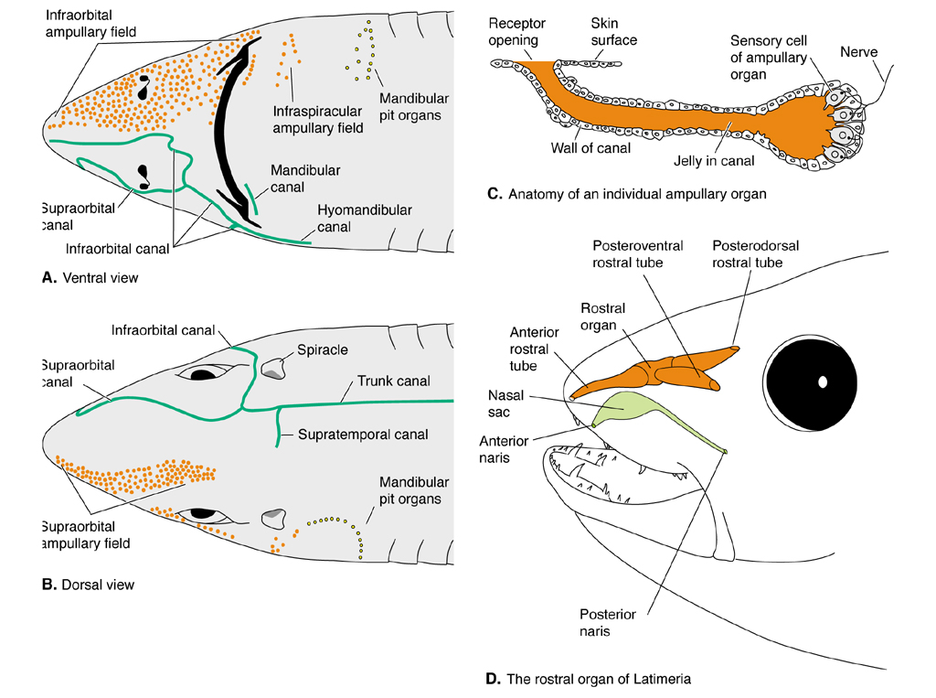
Electroreception
Fishes can
detect minute
electrical
currents
traveling
through water
using tiny
organs at
the base of
pits in the
skin. The
pits are
filled with
electrically
conductive gel.

Slide 25
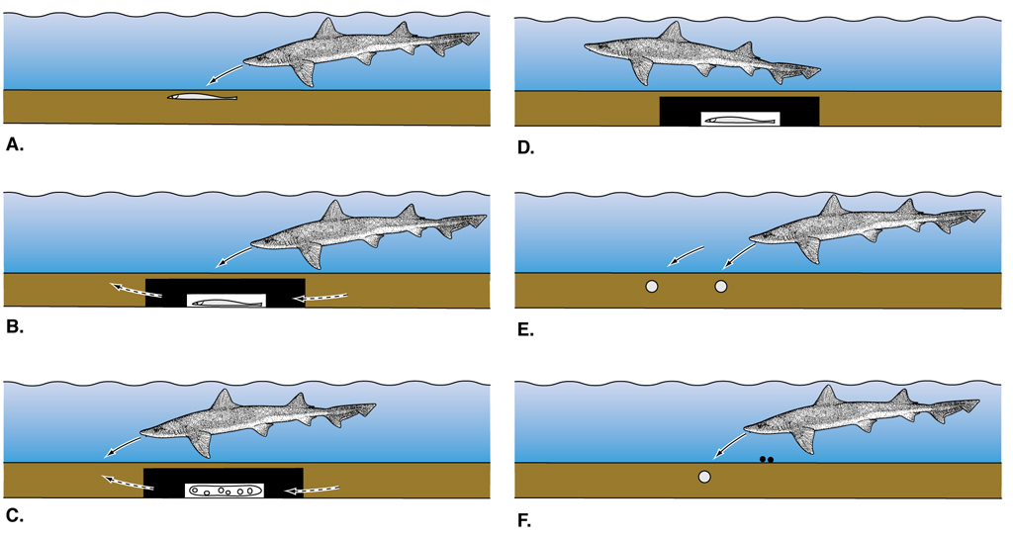
Uses of electroreception
In elasmobranchs the pit organs are called ampullae of
Lorenzini and can be the principal means of prey location.
Electroreceptors also give fishes an electromagnetic compass
sense useful in navigation. For instance, they can use them
to detect the electric current induced when the body passes
perpendicular to the earth's magnetic field.

Slide 26
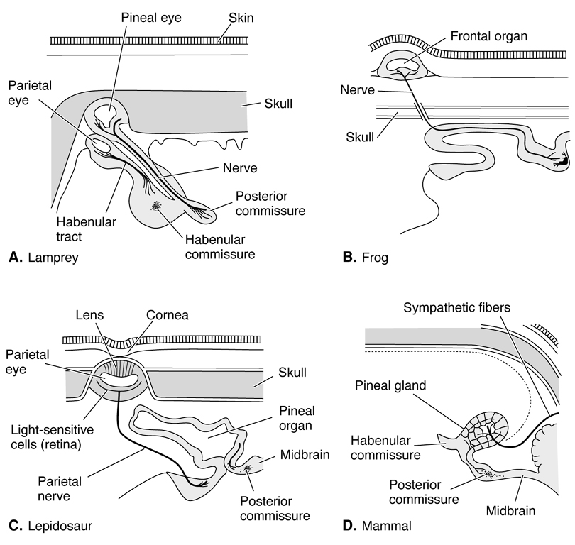
Photoreception
The eye is the primary
organ of photoreception
in vertebrates, however
we have already
mentioned the role the
pineal "eye" or body
plays is in clocking
photoperiod. The
pineal body is close to
the surface of the skin
in lower vertebrates
(lampreys), but moves
deeper within the brain
in mammals. Blind
cavefish and certain
other low light adapted fishes have photoreceptors in the skin.

Slide 27
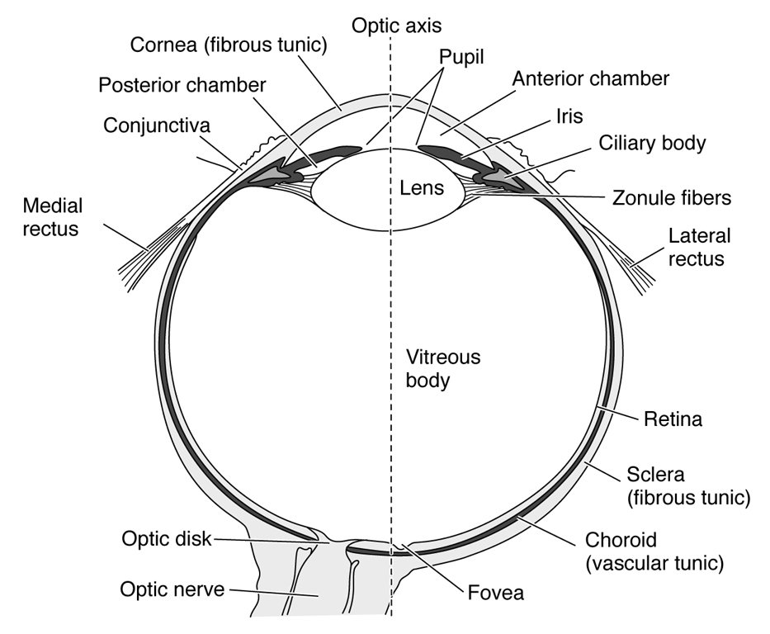
Vertebrate eye
The main organ for light
reception and sight in
vertebrates is the eye.
The vertebrate eye is
made up of three layers
of tissue. An outer
fibrous layer called the
sclera, a middle
vascular layer called the
choroid layer and an inner
sensory layer called the
retina. The front portion of
the scleroid layer forms a translucent cornea to allow light to
enter the eye. The front portions of the choroid and retinal
layers are modified into muscular diaphragm called the iris.

Slide 28
Vertebrate eye
Behind the iris is a large
lens for focusing light onto
the retina. The lens is
held in position behind the
opening of the iris by
muscles called ciliary
body.
The front compartment of
the eye (in front of the iris)
is filled with a watery fluid
called aqueous humor;
the back compartment is filled with a viscous fluid called
vitreous humor.

Slide 29
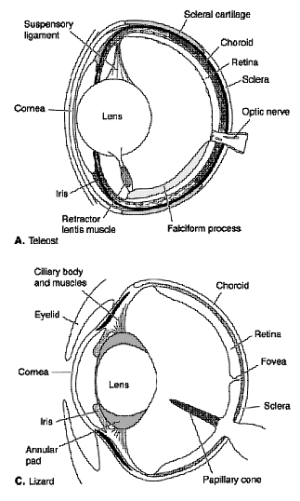
Teleost eye
In contrast to land vertebrates, the
teleostean eye has a cornea of
constant thickness and a spherical
lens responsible for all focusing.
The lens protrudes through the
pupil and the eye bulges from the
side of the body, giving the fish a
nearly complete field a view
around the body. Side to side
head movements in some fishes
can even the blind spot to the rear.
Some fish have eyes set far enough
forward on the head so that the
visual field overlaps (binocular vision).
Binocular vision is also possible with
dorsally or ventrally placed eyes.

Slide 30
Land vertebrates
In land vertebrates, the cornea
is thick in the center and tapers
toward its edges. The lens is
ellipsoid to flat and moved by
the ciliary body for focusing
on near and distant objects.

Slide 31
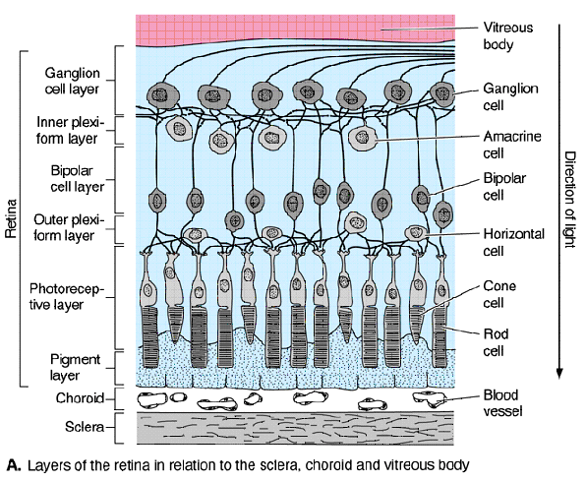
Retina
The retina has neurons
at its surface, special
sensory cells below this
called cones and rods,
and a pigment layer at
its base. Cones are
responsible for daylight
vision and color vision.
Rods are responsible for
black and white and low-
light vision. Cones and
rods contain different
types of visual pigments that absorb light, causing the cells to
transmit nervous impulses.

Slide 32
Retina function
Light and dark vision
adaptations of vertebrates
are largely accomplished
by retinomotor movements
of visual pigments in retinal
cells. Under bright light
conditions, the eye adapts
by moving melanin from
the pigment layer toward
the visual cells and
movement of the outer
segments of the rods into the pigmented area where they are
less exposed to the light. In dim light, the pigment is drawn
back and rods are pulled up. Movement of cones is opposite
that of rods, but the cones usually are not hidden by pigment.
Nocturnal species usually have more rods than cones.

Slide 33
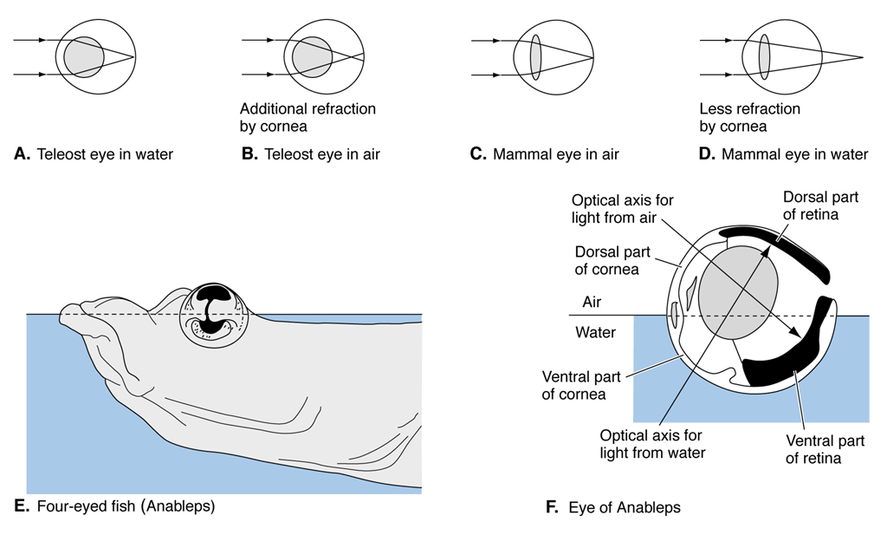
Aerial vision in fishes
Many fishes are
adapted for aerial
vision. Four-eyed
fish of Central
America swim at
the surface; a flap
of skin divides the
pupil at the water
surface level.
The lens is egg-
shaped so that light entering from above passes through the
short axis for aerial vision, and light entering from the side or
below passes through the long axis for aquatic vision. The
eyes have to be submerged periodically to prevent drying.

Slide 34
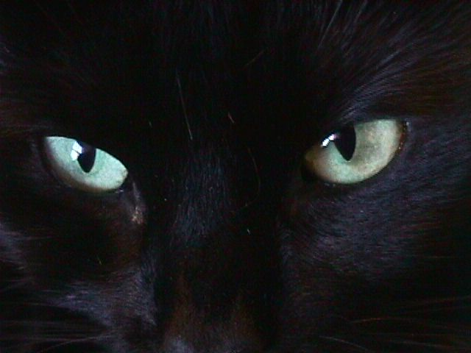
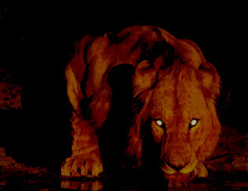
Light regulation adaptations
Regulation of incoming light can be accomplished by several
means. Many vertebrates can reduce the pupil to the size of
a pinhole or shape it into a horizontal, vertical or oblique slit to
restrict incoming light. The choroid layer of night-adapted
vertebrates has a tapetum lucidum for reflecting transmitted
light back through the retinal cells. This is what makes the eyes
appear shiny at night.

Slide 35
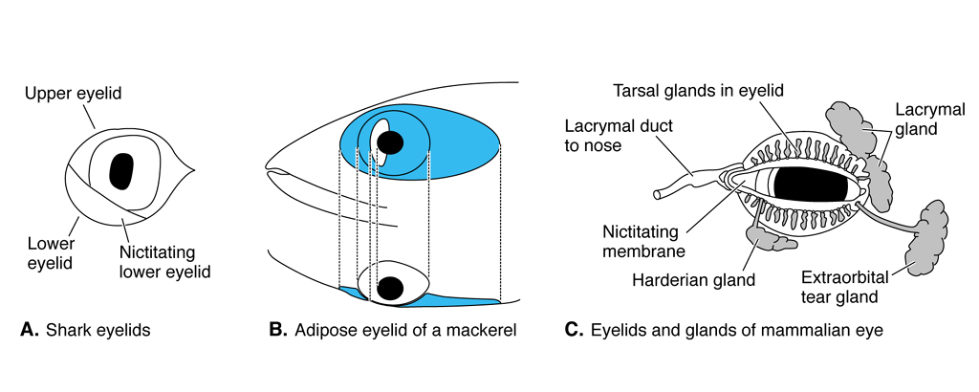
Eye lids
Fish do not have eyelids, but some species have nictating
membranes - fleshy build-ups on the front and back of the eye
for streamlining - which function as partial eyelids. Eye lids
are common in land vertebrates, as well as glands for
lubricating the eyes.

