Slide 1
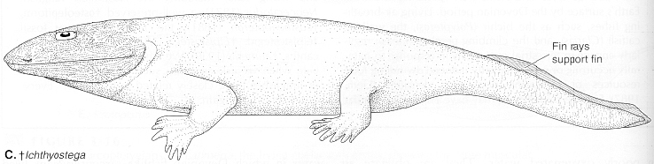
TETRAPODS
Tetrapods are vertebrates with four legs.
Also referred to as land vertebrates because as a group
they show adaptations to life on land.
Form a natural group with inclusion of lobefin fishes,
thus should be classified as sarcopterygians.

Slide 2
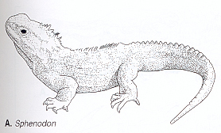
Tetrapods general
On land body no longer needs to be streamlined as in water.
Having a neck, as land vertebrates do, permits movements of
the head. Moving the head does not affect the mechanics of
locomotion on land, as it would in water.
The median fins seen in fishes are not useful on land and paired
fins are modified into limbs.

Slide 3
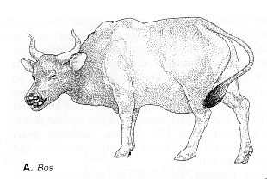
Tetrapods general continued
Limbs had to be strengthened to support the body on land
because air is much less dense than water.
Girdles that support the limbs had to be more firmly associated
with the axial skeleton than in fishes.
Axial skeleton itself had to be strengthened with vertebrae
interlocked to resist dislocation.

Slide 4
Tetrapods general continued
Gill were lost because they could not function in dry air.
Surface layer of skin had to be modified to resist desiccation.
Eyes, ears, and nose had to modified to work in air as opposed
to water. Glands were needed to moisten the dry food on land.
Eggs and developing larvae, which formerly developed in
water, needed a special protective environment in which to
develop on land. Solution was shelled eggs with membranes
that encased embryo in its own "aquarium" of sorts
(amniote egg).

Slide 5
Amphibians
Evolved from rhipidistian fishes in late Devonian. Reached
greatest diversity in the Carboniferous. Relatively few lines
survive to present. All show reduced characters and uncertain
affinities to early groups.
Skin of modern amphibians is moist and unable to withstand
prolonged exposure to dry air. Fetal membranes are lacking,
so eggs must be laid in water.
Hyomandibula, a bone that supports jaws in fishes, converted
to ear ossicle to assist hearing in air.
Evolved eyelids and eye gland to protect and moisten eyes.

Slide 6
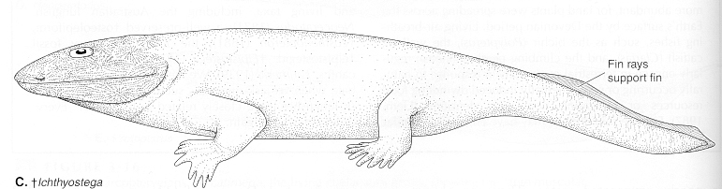
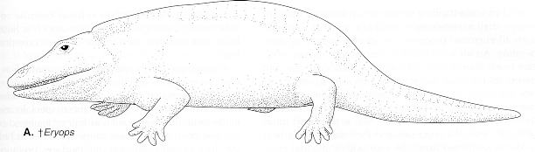
Early Amphibians
A number of groups of extinct amphibians recognized. Some
entirely aquatic; others appeared terrestrial, with stout limbs,
robust bodies and (probably) dry skin. Some were large as
alligators. A number had dermal scales in their skin.

Slide 7
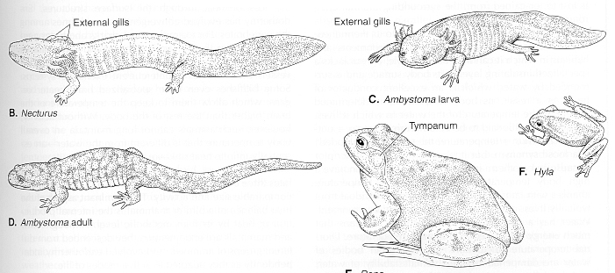
Modern Amphibians
Modern amphibians classified as Lissamphibia. Most less than
30 cm in length. Have moist skin with abundant mucous glands.
Most lack dermal armor in skin. Show many degeneracies of
ancestral condition: loss of toe on front foot; teeth simple or
absent. Three orders: Anura (frogs and toads); Urodela
(salamanders); and order Apoda (legless caecilians), members
of which have scales and primitive kidney.

Slide 8
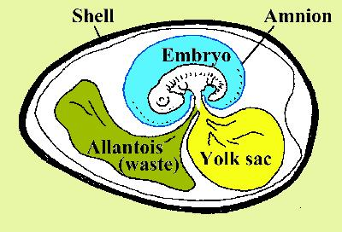
Amniotes
Source: www.wvup.edu/ecrisp/ imageJB7.JPG
All vertebrates above amphibians have features that make them
truly terrestrial, including fetal membranes and cornified
(keratinized) epidermis that resists desiccation. Amniotes
(reptiles, birds and mammals) evolved from early amphibians
in Carboniferous. Form a natural group equal in rank to
Amphibians.

Slide 9
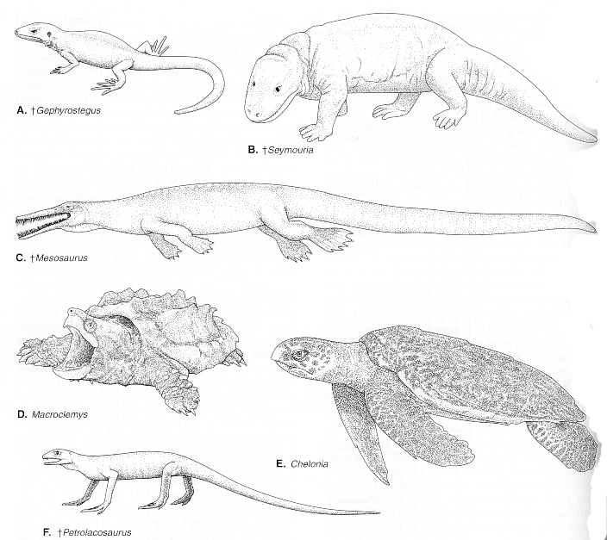
Reptiles
Earliest amniotes
commonly referred
to as "reptiles”.
Traditionally defined
as lizard-like creatures
with epidermal scales.
However, groups
recognized as reptilian
(turtles, lizards, snakes,
crocodiles, dinosaurs and
many other extinct groups)
have a complex history,
intertwined with histories of birds and mammals.

Slide 10
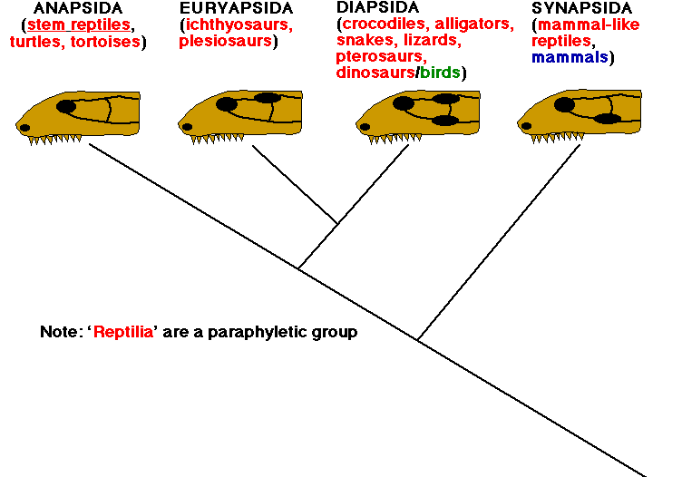
Temporal fenestrae
ethomas.web.wesleyan.edu/ ees250/diapsids.gif
Reptiles traditionally grouped based on presence and number
of openings (fenestrae) in temporal region of the skull. Four
conditions are recognized: anapsid - no temporal openings;
diapsid - two temporal openings bordered by squamosal and
postorbital bones; euryapsid - derived from diapsid condition
with lower opening lost; and synapsid condition, in which two
openings seen in diapsids fuse to form a single opening.

Slide 11
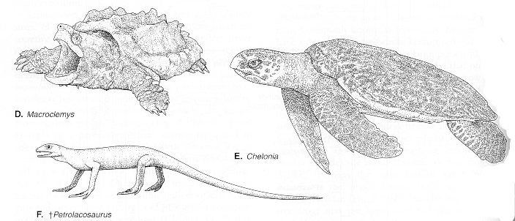
Anapsids
Two groups of anapsids are worthy of mention: †Cotylosauria,
small abundant lizard-like reptiles extinct since Permian, are
called stem reptiles because they gave rise to all other groups
of amniotes. Other group is Order Testudinata or Chelonia,
which comprises turtles, united by their broad armored bodies
and retractable heads.

Slide 12
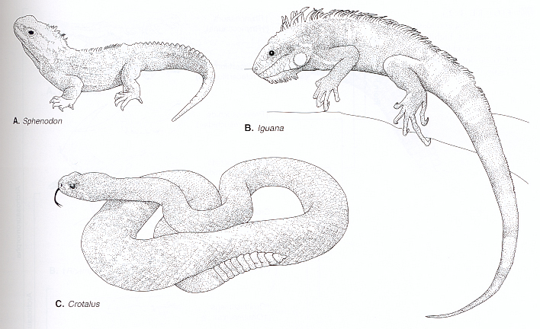
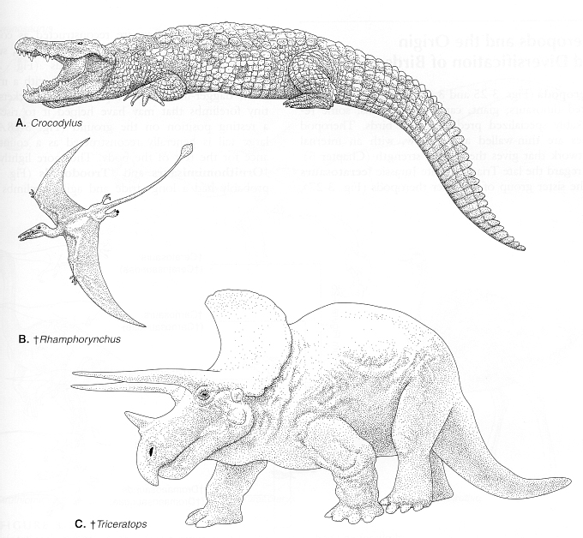
Diapsids
Includes amniotes having two temporal openings in skull or
number reduced to one.
Three groups: Lepidosauria (lizards, snakes, amphisbaenas,
and the tuatara); Sauropterygia (plesiosaurs and ichthyosaurs);
Arcosauromorpha (crocodilians, Ornithischian and Saurischian
dinosaurs, thecodonts, birds, and ichthosaurs.

Slide 13
Lepidosaurs
First group of diapsids to evolve after anapsids. Tuatara
of New Zealand is the only surviving member of the most
primitive line (Order Ryncocephalia) and only one that still
shows a diapsid skull. Other lepidosaurs are classified in
Order Squamata.

Slide 14
Arcosaurs
Referred to as "ruling reptiles"
because includes the dinosaurs.
Retain both openings in roof of
skull and have an open bony
palate. †Thecodontia were
predaceous reptiles that formed
basal stock and gave rise to birds.
Two other extinct orders,
†Saurischia and †Ornithischia
are "dinosaurs". Order
†Pterosauria were
flying reptiles. Only survivors
are Crocodilians and birds.

Slide 15
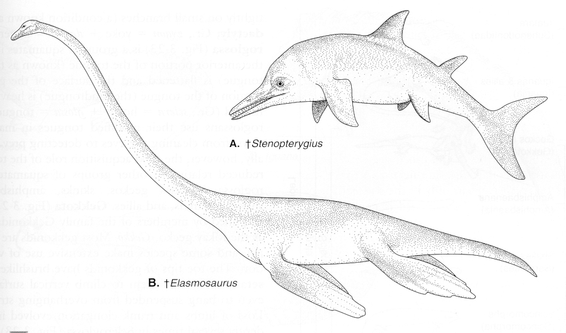
“Euryapsids”
†Plesiosauria (plesiosaurs) and †Ichthyosauria (ichthosaurs)
are aquatic adapted groups with a single temporal opening in
skull (euryapsid condition).

Slide 16
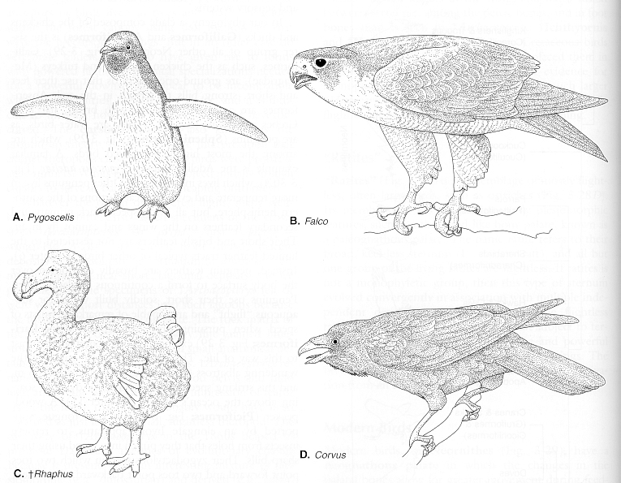
BIRDS
(AVES)
Birds (Aves) form a very homogeneous group because of
presence of wings, feathers and other adaptations for flight,
but clearly descended from bipedal archosaurs, which also had
long neck, similarly modified skull, robust hind limbs, and
elongate feet). A number of extinct groups (including
Archaeopteryx) show a clear transition from saurischian
dinosaurs to birds.

Slide 17
Birds continued
†Ondontognathae is a long extinct group of toothed birds
specialized for swimming. Palaeognathae includes large
flightless birds called ratites (ostrich, emu, cassowary).
All other birds are grouped in Superorder Neognathae
Modern birds (Neornithes) have tail feathers arranged
like fan around short tail, and fused bones in spine, brain
case, lower leg and head. Air sacks allow gas exchange
while air is coming and goings. The breastbone has an
enlarged keel from which flight muscles originate.

Slide 18
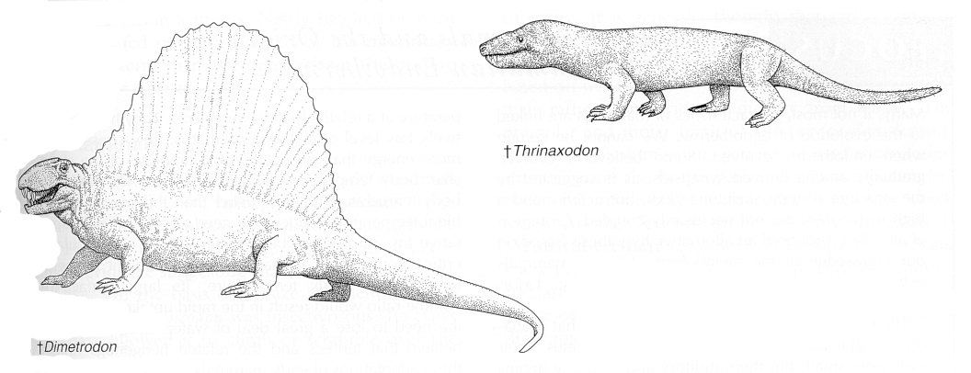
Synapsids
Earliest synapsids were terrestrial carnivores of moderate size
with only one, more ventrally positioned temporal opening.
Two orders recognized: †Pelecosauria - distinguished by large
"fin" on back formed by greatly extended neural arches, and
†Therapsida - mammal-like reptiles with robust legs placed
closer to center line of body, firmly rooted teeth that were
specialized for biting, chewing, tearing. Architecture of skull
and jaw came to resemble that of mammals also.

Slide 19
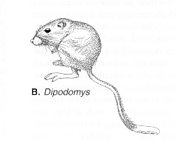
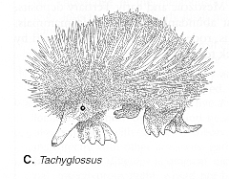
Mammals
Mammals distinguished by presence of hair and mammary glands.
First appear in the late Triassic. Transition from "synapsid reptiles”
well recorded in fossil record. Over 3000 genera are named
(2000 extinct). Two major groups: Protheria (egg-layers) and
Theria (live bearers).

Slide 20
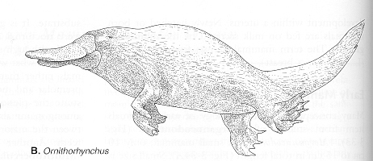
Protheria
Protheria includes several orders dating back to Mesozoic.
Monotremata (platypus and echidnas of Austrailia and
New Guinea) is only surviving group. So primitive that if known
only from certain bones, would mistake them for reptiles.
Monotremes are egg layers. Mammary glands not well formed;
consist of a series of small glands resembling sweat glands on
underside of body. Young lap milk up from the surface of
mother's belly.

Slide 21
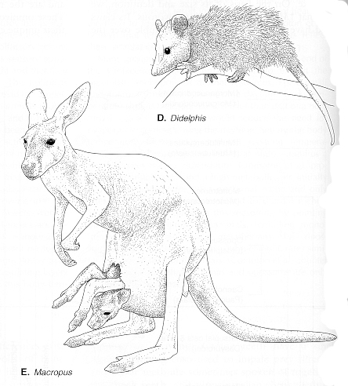
Therian mammals
Two groups of live bearing
mammals: Marsupialia and
Eutheria.
Marsupials are pouched mammals
(kangaroos, bandicoots, opossum,
wombats, koalas). Give birth to
embryos, which crawl into
marsupium, attach to a mammary
gland to complete development.
Largely confined to southern
hemisphere. Embryo nourished
for a time across vascularized yolk sac.

Slide 22
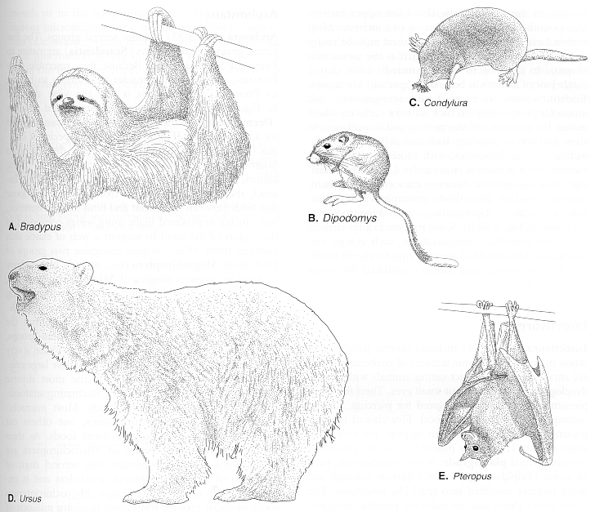
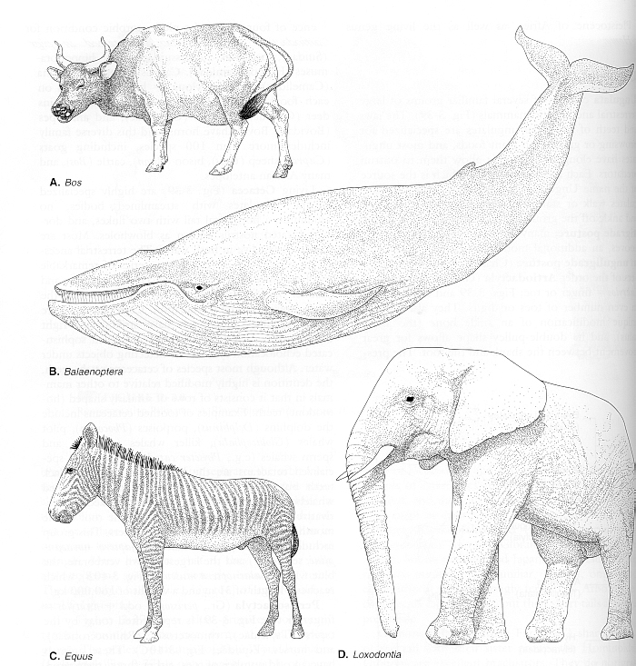
Placental mammals
Eutherian are referred to as placental mammals because they
possess a true placenta, vascularization forms across chorio-
allantoic membrane rather than yolk sac. Allows nourishment
of young across uterus and extraembryonic membranes for a
longer period of time than in marsupials.

