Slide 1
Excretory system
The urinary system is the main system of excretion and
osmoregulation in the vertebrate body. Excretion is process of
eliminating metabolic wastes from the body; osmoregulation
is the process of balancing water content.
Water is a by-product of cellular metabolism, but the need for
eliminating it varies among vertebrates according to habitat. In
terrestrial habitats, water provides a means of eliminating other
wastes from the body, hence the systems of excretion and
osmoregulation are interrelated.
Various organs of the body contribute to excretion and
osmoregulation in vertebrates (gills, lungs, skin, digestive tract,
various glands) but most discussions of excretion and
osmoregulation focus around the main organs of excretion: kidneys.

Slide 2
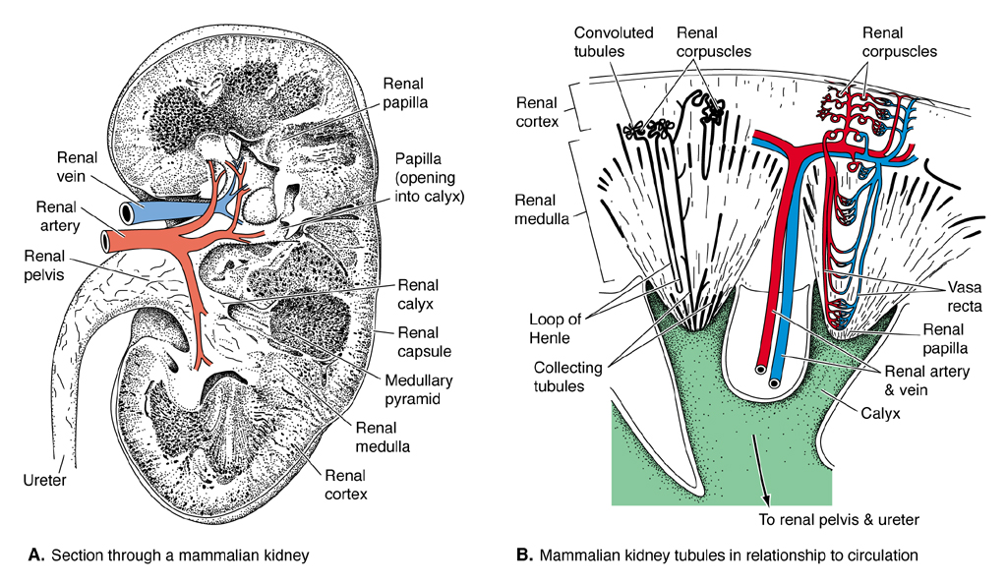
Kidneys
Kidneys of higher vertebrates are compact organs derived from
mesoderm. Consist of tubules called nephric or renal tubules
that open into the general coelom or derivatives of the
embryonic coelom, called renal capsules..

Slide 3
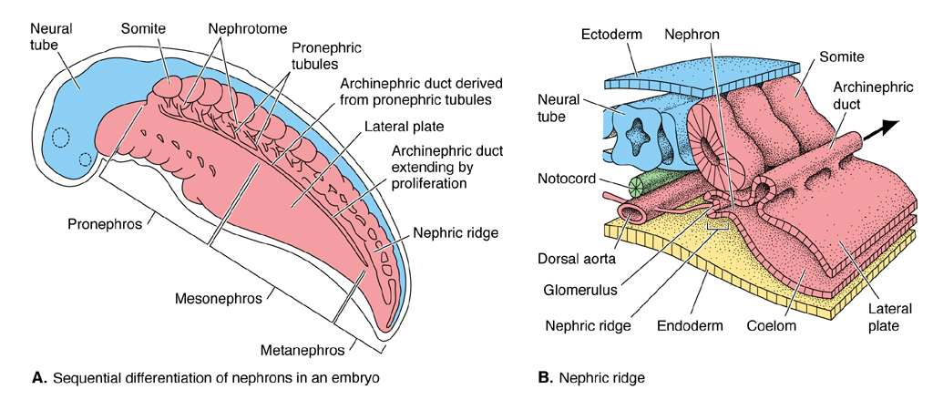
Kidney development
Kidney tissue develops from mesomere, an elongate partially
segmented strip of mesoderm, which encloses some coelomic
space. Development of mesomere is always anterior to posterior.
Anterior and posterior segments are retained in lower vertebrates.
Compact kidneys of higher vertebrates are actually remnants of
posterior portion of the embryonic kidney...(more later)

Slide 4
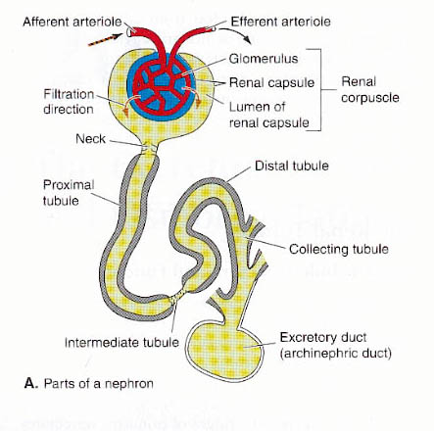
Kidney function
Functional unit of the kidney is
called a nephron. Consists of a
renal corpuscle and tubules.
Each corpuscle and/or set of tubules
has an associated capillary
circulation called a glomerulus, a
tuft of capillary loops that projects
into the renal capsule.
Detail of renal corpuscle…

Slide 5
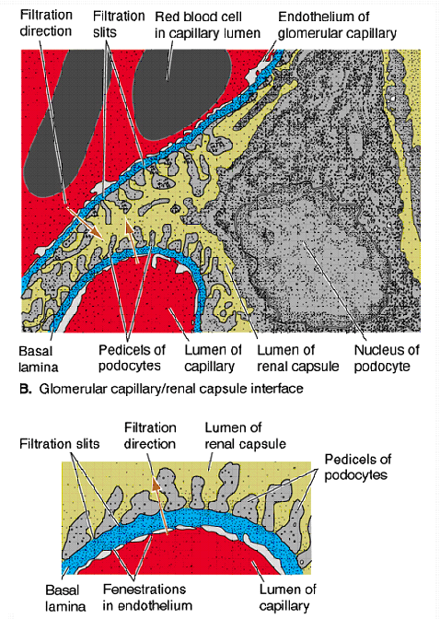
Kidney function continued
Outer wall of renal capsule is
lined with squamous or cubiodal
parietal peritoneum; inner wall is
visceral peritonenum with
blob-like cells called podocytes
that enfold the capillaries.

Slide 6
Kidney function continued
Glomerulus delivers fluids
filtered from blood to renal
capsule. The fluid contains
wastes, but also substances
(water, salts) the body
may need to retain.
Fluids recollected in kidney
tubules.

Slide 7
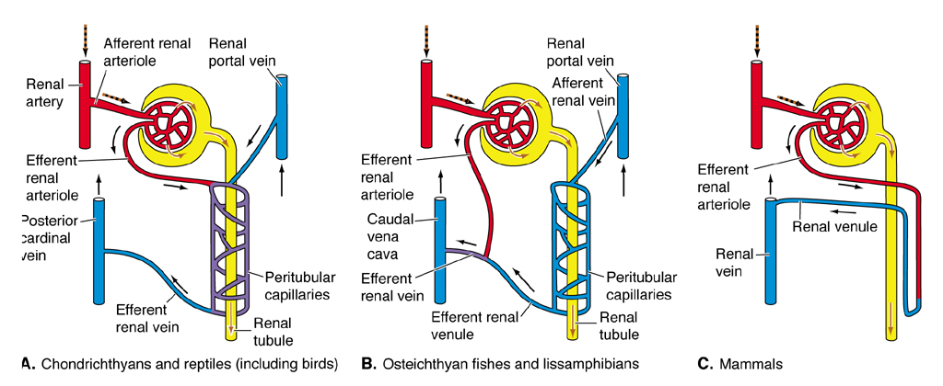
Kidney function continued
Tubules leading away from the renal capsule have proximal,
distal and intermediate segments, which permit passage of
sugars, salts, ions, vitamins and (depending on need) water.
A second capillary circulation (peritubular capillaries)
surrounds the renal tubules and selectively resorbs these
substances.

Slide 8
Kidney function continued
Substance remaining in the
tubules is called urine,
a solution with varying
amounts of water and
stabilized nitrogenous
wastes.
Nephron tubules
collect into a common
nephric duct, which
connects to the cloaca
or a derived holding
chamber called the
urinary bladder.

Slide 9
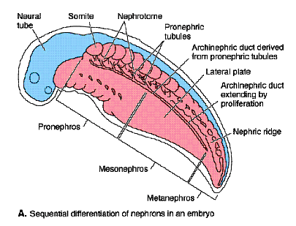
Kidney development continued
Development of mesomere
is always anterior to
posterior. Wave of
development is interrupted
in two places (intervening
tissues fail to develop)
causing anterior, middle
plus posterior, or just
posterior kidneys to form.
Sections form in sequence
with more anterior sections
usually degenerating as
posterior sections become functional.

Slide 10
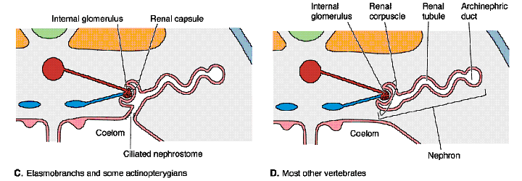
Kidney development
Anteriorly, mesomere arranged in blocks called nephrotomes.
Coelomic spaces within the blocks are called nephrocoels;
these become united with the general coelom by channels called
peritoneal canals. Openings to the coelom are ciliated and are
called nephrostomes.

Slide 11
Kidney development
Posteriorly, developing
mesomere forms a thick,
unsegmented cord called
the nephrogenic cord.
Posterior and middle
portions of entire kidney
bulge out into coelomic
space forming a nephric
ridge. Peritoneal canals
may form in posterior
kidneys, but usually do
not in tetrapods. Nephrocoels do form, however, and give rise to
renal capsules.

Slide 12
Kidney development
Nephric tubules form
either as lateral outgrowths
of the walls of the
nephrocoels or by caviation
of solid mesenchyme.
They gradually lengthen
and become convoluted.
Anterior tubules are the
first to form. Their outer
ends join to form a
connecting lateral duct
(the nephric duct) which
continues back to the cloaca.

Slide 13
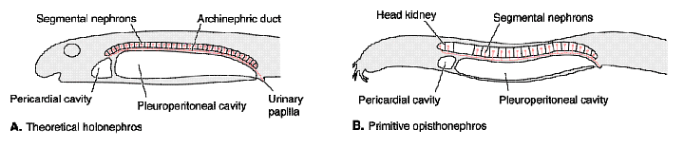
Holonephros
A somewhat hypothetical ancestral vertebrate kidney called
the holonephros can be envisioned based on embryological
and morphological evidence. It was long and segmented
throughout. Glomeruli were large, internal or external (with
respect to the renal capsule), and nephrostomes were present.
Only evidence of an actual holonephric kidney in vertebrates
is a structure seen in larvae of hagfishes and (interestingly)
caecilians.

Slide 14
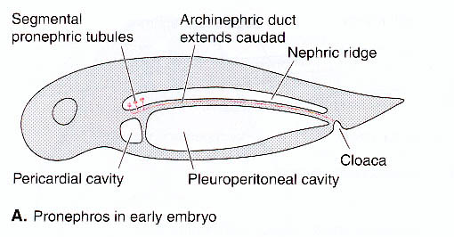
Pronephros
Most anterior and primitive kidney seen in vertebrates, and
first kidney to form embryologically, is the pronephros or
pronephric kidney. It incorporates few nephrotomes (1-12,
usually 4). Segments are distinct in larvae, but degenerate later
in development into a giant corpuscle called a glomus (paired or
fused at midline) Pronephric tubules are simple except where
related to the glomus.

Slide 15
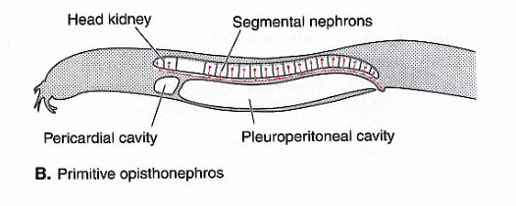
Pronephros continued
Pronephros appears in all vertebrates but is functional kidney
only in free-living larvae of bony fishes and amphibians, and in
greatly modified form (fused compact head kidney) in adults
of hagfishes and certain bony fishes. Where it isn't functional
(cartilagenous fishes, adult amphibians, birds) it degenerates
or leaves glandular or lymphatic remnants.

Slide 16
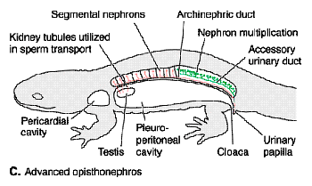
Opisthonephros
In most fishes and amphibians, mesomere fails to complete
development of a second break. So all kidney posterior to
pronephros forms the functional adult kidney, called
opistonephros or opisthonephric kidney. The opisthonephros
develops later in time than pronephros, and forms most of middle
and posterior portions of kidney. It is initially segmental but
segmentation lost with development of tubules. Opisthonephric
tubules tap into the existing (pro)nephric duct or contribute their
own duct called opisthonephric duct.

Slide 17
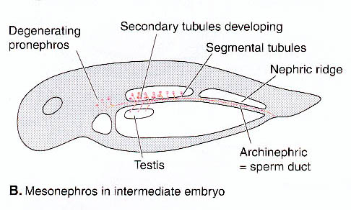
Mesonephrose
Second break in mesomere forms in amniotes, separating
opistonephros into mesonephros or middle kidney and
metanephros or tail kidney. Mesonephros is seen only in
embryos. Development in mammals is proportional to
excretory efficiency of the placenta.

Slide 18
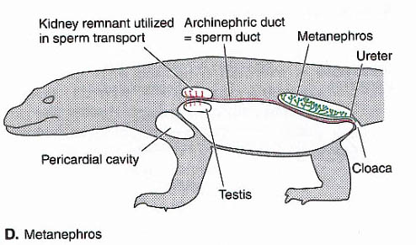
Metanephrose
Metanephros is the last section of kidney to develop
ontogenetically and phylogenetically, and is the functional
kidney of amniotes. It is never segmental and comprises
hundreds to thousands of nephrons. Glomeruli are always
internal, and nephrostomes are absent.

Slide 19
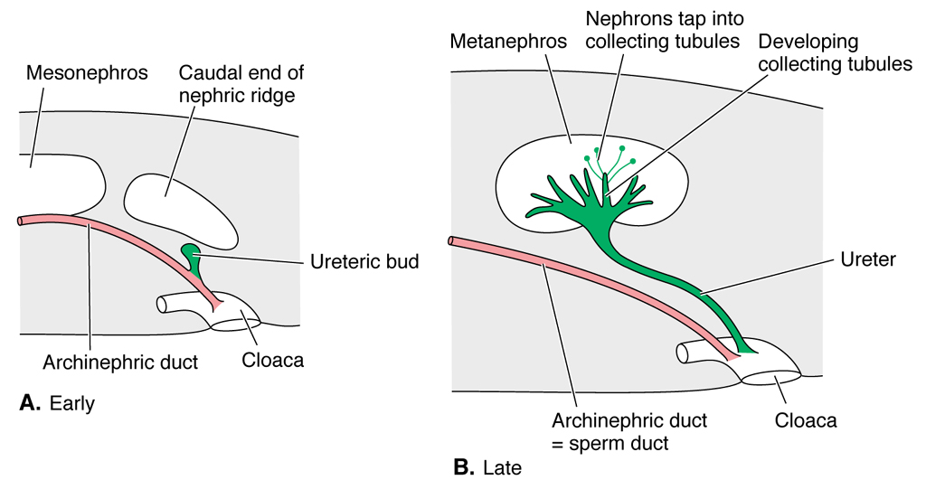
Ureter
In amniotes, embryonic (meso)nephric duct develops a ureteric bud
which grows up to meet metanephros forming a separate draining
duct called the ureter. Ureter branches at its end to form renal pelvis
and collecting ducts. Tail kidney of anamniotes is drained by
accessory ducts, which are probably homologous to ureter.

Slide 20
Osmoregulation
Osmoregulation is the process of balancing water content. Kidney
plays an important role, but other tissues are involved.
Hagfishes, like invertebrates, have body fluids that have the
same salt concentration as seawater (isotonic), and thus have
little need to osmoregulate.
Other vertebrates have body fluids that are hypotonic to
seawater (1/3 the salt of seawater) but hypertonic to freshwater.

Slide 21
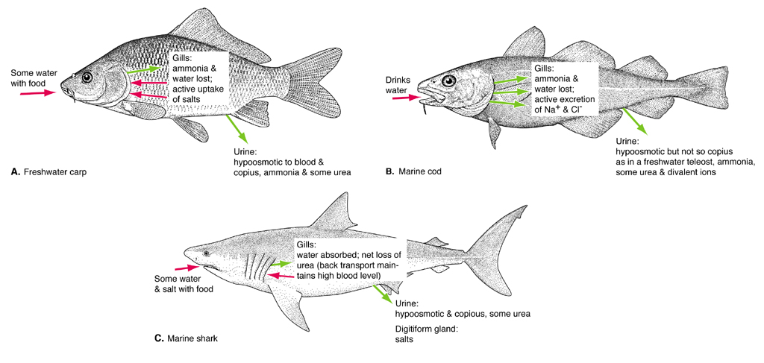
Most marine anamniotes
Cartilagenous fishes, coelacanth and marine toads retain urea
(an organic salt) to bring tissue fluid in balance with sea water.
Gills are impervious to urea and have large tubules for returning
urea to blood. Urea bolsters blood osmoticity to near that of
seawater. Excess salt from diet is secreted by rectal gland.

Slide 22
Marine teleosts
Marine teleosts have problem of constantly losing water to
environment (particularly through gills). To conserve water,
tend to have small and poorly vascularized renal corpuscles,
rudimentary capsules or none at all. Freely drink water and
excrete salt through gills.

Slide 23
Freshwater anamniotes
Freshwater fishes and amphibians have problem of constantly
taking in water despite waterproofing quality of their skin. These
groups scarcely drink water and constantly eliminate water through
their urinary system. They tend to have prominent renal corpuscles
and capsules but short renal tubules. Have to replenish salt from
the environment. Nitrogen is eliminated from gills as ammonia and
from the kidney as urea.

Slide 24
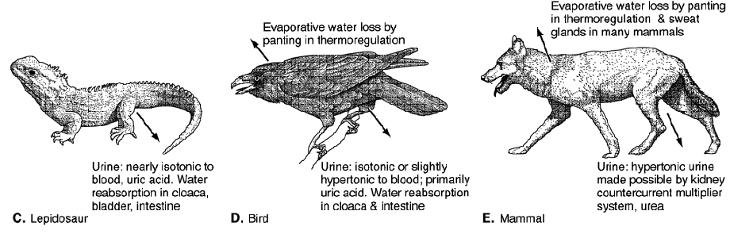
Amniotes
Drinking is main source of water for amniotes. Conserve water
mainly through kidneys. Excrete urea in insoluable form (uric acid)
which is semi solid and requires little water. Renal corpuscles are
small and poorly vascularized. Use lowpressure renal portal flow to
resorb water from tubules, depending on need. Marine birds and
reptiles have special salt secreting glands associated with their eyes
to eliminate excess salt from diet.

Slide 25
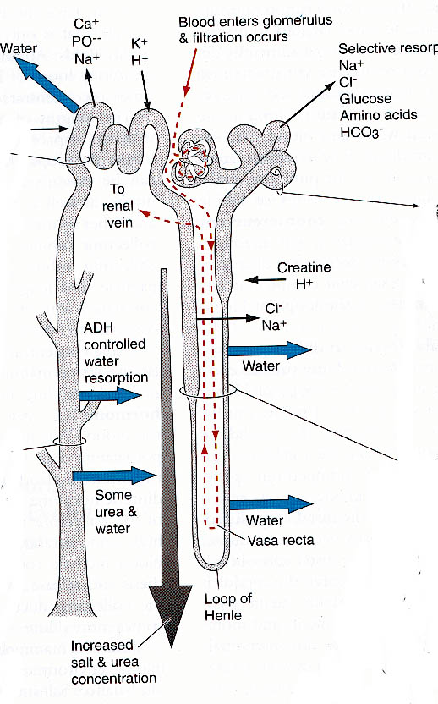
Water conservation
Mammals have prominent renal
corpuscles and produce large
quantities of dilute filtrate. However,
nephric tubules adapted to take water
back (only one 1/100 released on
average). Intermediate tubule forms
Loop of Henle with thin descending
arm and thick ascending arms running
deep into renal medulla. Sodium is
cycled between arms by counter-current
multiplication, increasing tendency for
water to be drawn out of the tubules
deep within medulla. Mammal urine
more concentrated than blood.

Slide 26
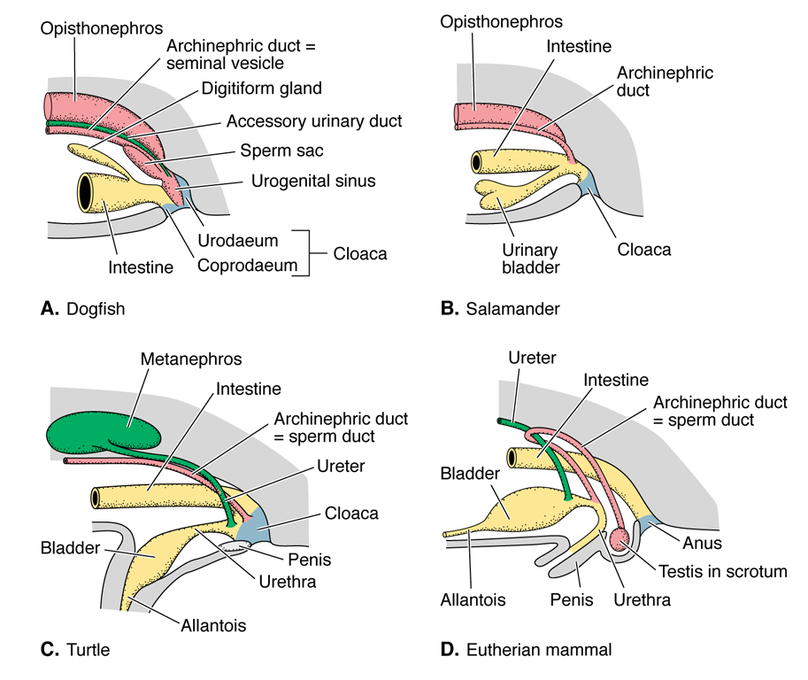
Urinary bladder
Urinary bladder is a urine
storage organ seen in most
vertebrates. Usually forms
by enlargement and fusion
of posterior nephric duct
(dipnoans, early rayfins,
elasmobranchs), by ventral
outpocketing of cloaca
(amphibians), or by seletive
retention of cloacal bladder
and allantoic stalk
(mammals, freshwater
reptiles, none in birds and
other reptiles).

