Slide 1
Chimeras: The Rat-fish
Chimeras belong to a primitive group of Chondricthyes in the Subclass Holocephali
also called ratfish, ghostfish, spookfish, and rabbitfish
have broad heads with long tail
about 30 living species
prefer deep marine water
little is known about these strange animal’s behavior in their natural habitats

Slide 2
The only living species belong to the Order Chimaeriformes in three distinct Families (http://ibs.uel.ac.uk/fish-bin/fishfan.pl?ordnum=3.html)
Callorhynchidae
- Plownose chimeras
- found in S. Hemisphere
- 1 living genus
Chimaeridae
- Shortnose or ratfish
- found in Atlantic, Pacific, and Indian Ocean in tropical or temperate water
- have poisonous spine on back
- prefer a depth of 200m or more

Slide 3
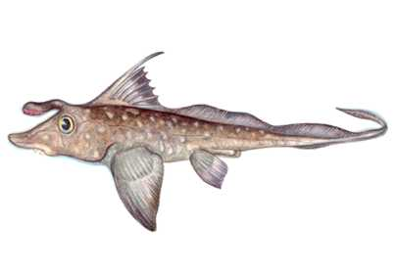
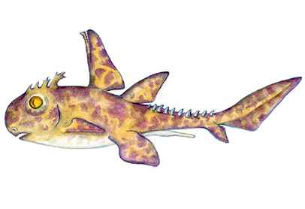
Rhinochimeridae
- scattered in temperate and tropic seas
- found in 200-2000m depth
- mildly toxic spine
www.discovery.com/exp/prehistoricsharks/gallery2.html
www.discovery.com/exp/prehistoricsharks/gallery13.html
Ischyodus: rat-fish Echinochimaera

Slide 4
Characteristics of Holocephali
relatives of modern spp. found from early Jurassic and distantly related spp. found in late Devonian
lack teeth and denticles in the skin
have simple gut without a stomach (http://orion1.paisley.ac.uk/courses/tatner/biomedia/sudunits/subcl97.htm)
lack spiracle and have a fleshy operculum that covers the gills
the upper jaw is fused to the cranium (holostylic)
loss of postorbital articular process for palatoquadrate
the anterior vertebrae are fused to dorsal spine and they lose the anteriorly concave spine shape

Slide 5
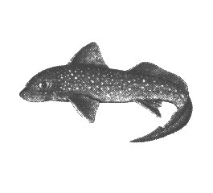
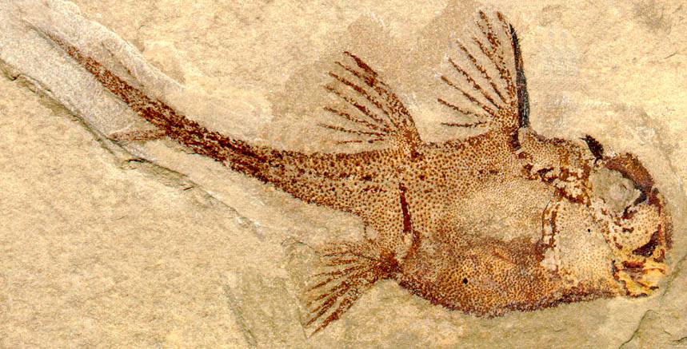
loss of expanded palatoquadrate otic process and otic articular fossa
(http://home.houston.rr.com/vnotes/unit1.5.html#Holocephali)
single nasal opening
head and pelvic claspers in males
(http://www-class.unl.edu/bios112/30-web.pdf)
(http://home.adelphi.edu/~lund/images/hi-res/echifem.jpg)

Slide 6
What Else Do We Know About Chimeras?
they prefer slow-moving, benthic habitats
prefer, but not restricted to, bottom-feeding
eat mollusks, fish, and crustaceans
many people believe that they may be the link between bony fish and Chondrichthyes based on their morphologies
some people also believe that they evolved separately from sharks
since chimeras are difficult to find and observe in their natural habitats little else is known about them

