Slide 1
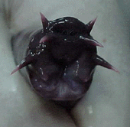
Hagfishes
By Linley Thomas
OceanLink: OceanInfo - The Hagfish Page

Slide 2
How to Spot a Hagfish.
-They look like eels or Lamprey, being long slender and pinkish gray in colour.
-They have no fins, except for a primitive tailfin .
-They have reduced eyes.
-They have short sensitive tentacles around their mouths.
-Large slime gland line the length of their bodies.
More than meets the eye…
They have four hearts, no stomach,no jaws and even with no true eyes, they have keen senses of touch and smell

Slide 3
Their Basic Story
Hagfish can be found in the chilly waters of the antitropical north and south.They tend to live on and in muddy sea floors in very dense groups (up to 15,000 in an area). Because females tend to produce large eggs in small numbers, their population sizes suggest a low death rate. http://oceanlink.island.net/oinfo/hagfish/hagfish.html
and locate their food by smelling and feeling as they swim. They prey on small invertebrates living in the mud, as well as scavenging dead and dying fish. They are noted for their unusual way of feeding—they slither into dead or dying fishes and eat them from the inside out, using their "rasping tongue" to carry food into their funnel-shaped mouth. http://www.mbayaq.org/efc/living_species/default.asp?hOri=1&inhab=198

Slide 4
Story Continued…
Scientists used to think the hagfish looked primitive as a result of the loss of characteristics often associated with being a parasite. Now common belief is that hagfish just haven't needed to change for the last couple of hundred million years. Now that's a successful body plan and lifestyle!OceanLink: OceanInfo - The Hagfish Page

Slide 5
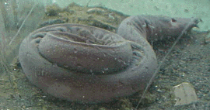
Hagfish Characteristics
There are several characteristics by which hagfishes differ from all other vertebrates, but these are either absences (lack of extrinsic eye muscles, lack of eye lens, lack of cardiac nerves, lack of radial muscles, etc.) or conditions which recalls that in
cephalochordates or tunicates (accessory venous hearts, disseminate pancreas, etc.). In both cases, these apparently unique hagfish features are likely to be primitive for all craniates.Hyperotreti

Slide 6
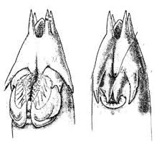
More Characteristics
Their “rasping tongue” consists of two pairs of rasps on top of a tongue. They pull meat into their mouths with the tongue, then tear it off the prey with the rasps.
Also, they have a very low metabolism. Once they eat, they may not have to again for up to seven months.
http://oceanlink.island.net/oinfo/hagfish/hagfish.html
Newly hatched hagfish look just like the adults and are hermaphrodites (having both male and female sex organs). When they mature, they will be either male or female, but have the ability to change from one to the other depending the gender structure of population.

Slide 7
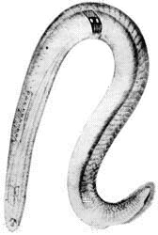
Characteristics Contd.
The skeleton of hagfishes is made up by a complex arrangements of cartilaginous bars. Cartilages also strengthen the tentacles, nasopharyngeal duct, and "tongue", there are also no branchial arches.
Hagfish do have a partial skull but no back bone, the only skeleton is the notochord. Olfactory organs are enclosed in cartilage capsules.
The caudal fin has cartilaginous ray for support.
OceanLink: OceanInfo - The Hagfish Page

Slide 8
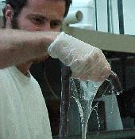
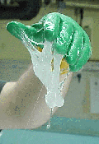
Claims to Fame
Hagfish have won fame through the massive amounts of slime they can ooze almost instantaneously as a defense tactic.
They can also sneeze to unclog their nostrils of their own slime. OceanLink: OceanInfo - The Hagfish Page
OceanLink: OceanInfo - The Hagfish Page

Slide 9
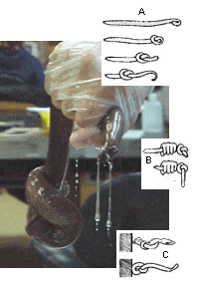
Famed Tricks
Hagfish have developed the ability to tie themselves in knots, and be able to slide in and out of this knot.(very useful tactic) This can be used to escape predators, to clean themselves of slime, and to work their way into a carcass.
OceanLink: OceanInfo - The Hagfish Page
This picture shows: A) knotting; this movement is used to clean slime off the body; B) escaping from capture using knotting, a very powerful motion; C) pulling on food by knotting. OceanLink: OceanInfo - The Hagfish Page

Slide 10
Hagfish Lineage in a Glance
Phylum Chordata
Class Agnatha
Order Myxiniformes
Family Myxinidae
There are about 20 species of hagfish divided into four genera (Myxine, Neomyxine, Paramyxine, and Eptatretus). The Myxine and Neomyxine are considered more advanced than the latter two for several reasons:
- They have a single pair of common external gill openings. The latter two have two minute separate gill openings (considered primitive). Paramyxine's openings are closer together than Eptatretus' so Paramyxine is considered more closely related to the first two. http://oceanlink.island.net/oinfo/hagfish/hagfish.html

Slide 11
The eyes in Myxine and Neomyxine are smaller than those of the other two, suggesting a less primitive condition by an adaptation to the dark environment favoured my hagfish.http://oceanlink.island.net/oinfo/hagfish/hagfish.html
- The only fossil hagfish is Myxinikela siroka, a Pennsylvanian find, preserved were the paired tentacles, internal organs, and detail of the head and jaws. The similarity to modern hagfishes is striking, and suggests that there has been little evolutionary change in this group over the last 300 million years.Introduction to the Myxini

Slide 12
Works Cited
Hyperotreti http://tolweb.org/tree/eukaryotes/animals/chordata/hyperotreti/hyperotreti.html
Introduction to the Myxini http://www.ucmp.berkeley.edu/vertebrates/basalfish/myxini.html
Monterey Bay Aquarium: Living Species List http://www.mbayaq.org/efc/living_species/default.asp?hOri=1&inhab=198
OceanLink: OceanInfo - The Hagfish Page http://oceanlink.island.net/oinfo/hagfish/hagfish.html

